Slide 1
Combined GPS and seismic monitoring of a 12-story structure in a region of induced seismicity in Oklahoma
Jennifer S. Haase, Scripps Institution of Oceanography, UC San Diego
Mohamed Soliman, Oklahoma State University,
Haejo Kim (SIO UCSD), Priyank Jaiswal (OSU), Jessie Saunders (SIO),
Frank L. Vernon (SIO), Weixing Zhang (GNSS Science Research Center, Wuhan University)
jhaase@ucsd.edu

Slide 2
Correlation of wastewater disposal and seismicity
Objective: Quantify ground motions and their effects on structures in this region of elevated seismic hazard due to induced seismicity.
Most of the building inventory in Oklahoma was constructed prior to the implementation of the Unified Building Code and prior to the onset of induced seismicity.
We installed a multi-parameter building earthquake monitoring system on a structure in a seismic zone of recent elevated seismicity levels.
Goal: Measure structural response and/or any permanent deformation or damage to buildings from any local seismic events, as injection rates change.
Color = saltwater injection volume
Langenbruch, Science, 2016

Slide 3
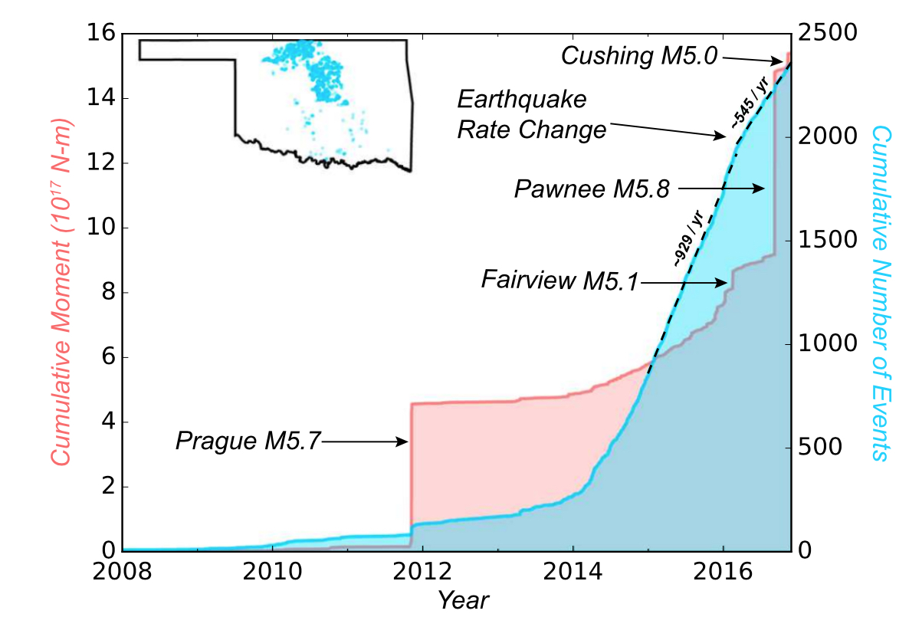
Timeline of seismicity and monitoring at OSU
4 earthquakes with Mw > 5 have occurred in Oklahoma since 2011, in a region of increased wastewater disposal related to oil and gas production.
March 25, 2015, July 17, 2015, Feb 16, 2016, directives for reduction in western OK from the Oklahoma Corporation Commission
March 7, 2016 directive for reduction in central OK from OCC
Sep 3, 2016 Mw 5.8 Pawnee earthquake, Governor declared a state of emergency
Cracks appeared in structures on Oklahoma State University Campus, where shakemap showed 0.12g to 0.15g
2016-2017 installation of 9 seismic stations near Pawnee (Keranen, Jaiswal, OSU, NSF Rapid grant)
M 5.0 6 Nov 2016 at Cushing Hub, largest commercial crude oil storage center in North America
Yeck et al., GRL, 2017.

Slide 4
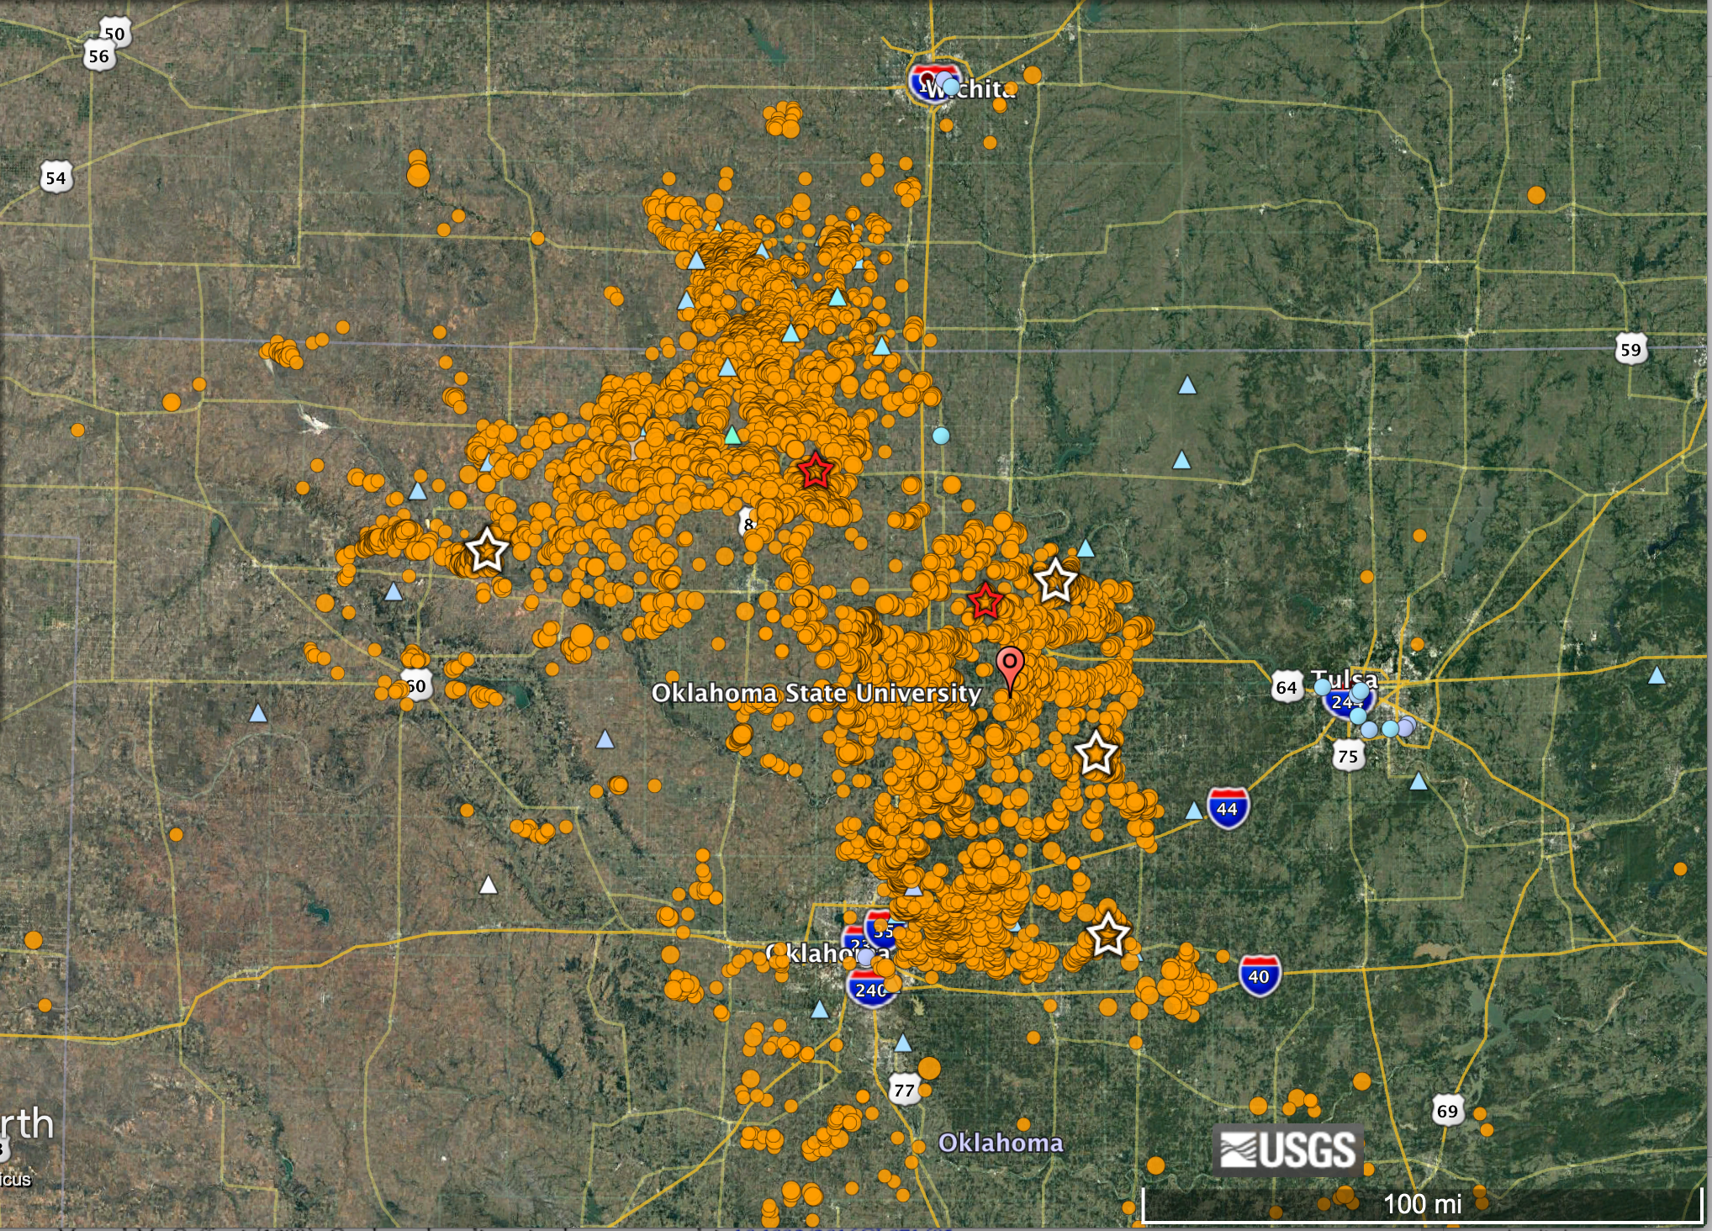
3 September 2016 Mw 5.8 Pawnee earthquake
M5.1 Fairview
M5.8 Pawnee
M5.0 Cushing
M 5.7 Prague
Earthquakes with M > 2.5 since 2001.
Map of aftershock seismicity and instrumentation deployed by associated NSF GEO RAPID investigations following the 2016 Mw 5.8 Pawnee earthquake.

Slide 5
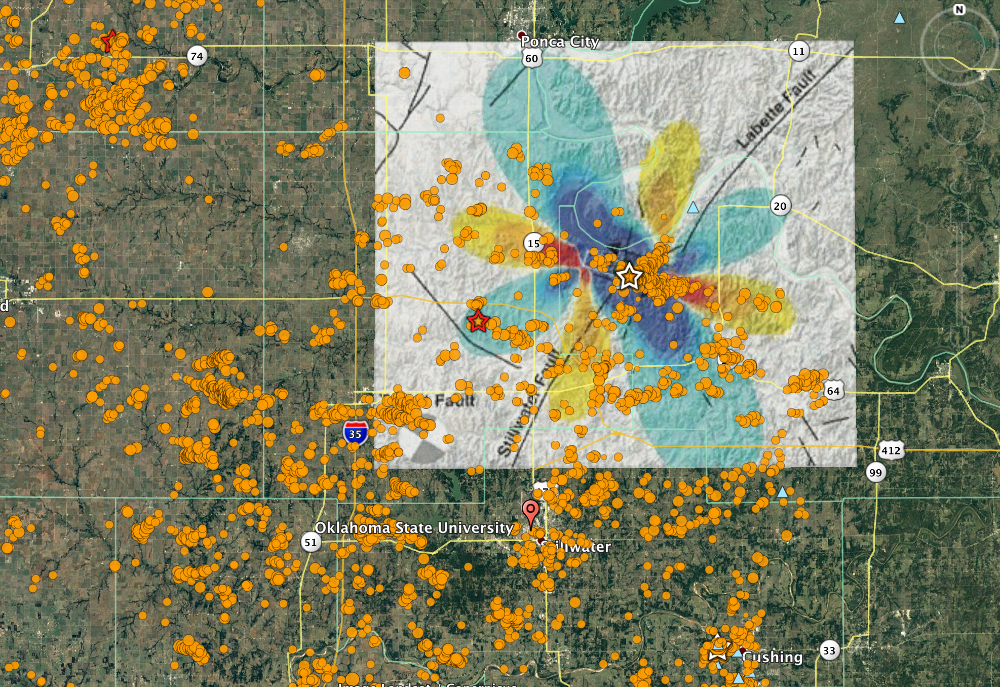
Faults near Stillwater, OK
Coulomb failure stress model from the Mw 5.8 Pawnee earthquake resolved at 5.6 km depth (Yeck et al., 2016).
Target faults (Holland, 2015) have strike/dip/rake like right lateral slip on Stillwater fault (32°/90°/180°).
Stillwater fault shows CFS change bringing the fault closer to failure.
Stillwater fault as shown is 28 km long
In theory a fault of that length could produce a Mw ~ 6.8 (Wells and Coppersmith, 1994)
OSU campus is 8 km from Stillwater fault.

Slide 6
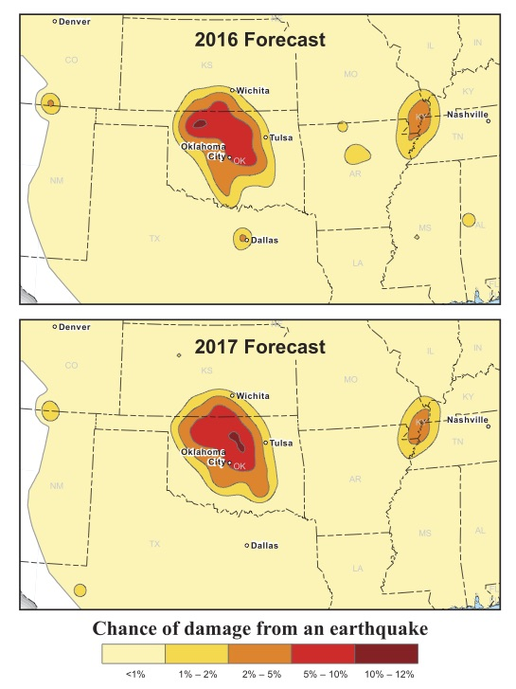
1-Year probabilistic hazard forecast
M 4.3 Sep 8, 2017
M 4.2 Dec 5, 2017
Two M > 4 events since project began
Petersen et al., SRL, 2017.

Slide 7
1-Year probabilistic hazard forecast
Two M > 4 events since project began
Petersen et al., SRL, 2017.

Slide 8
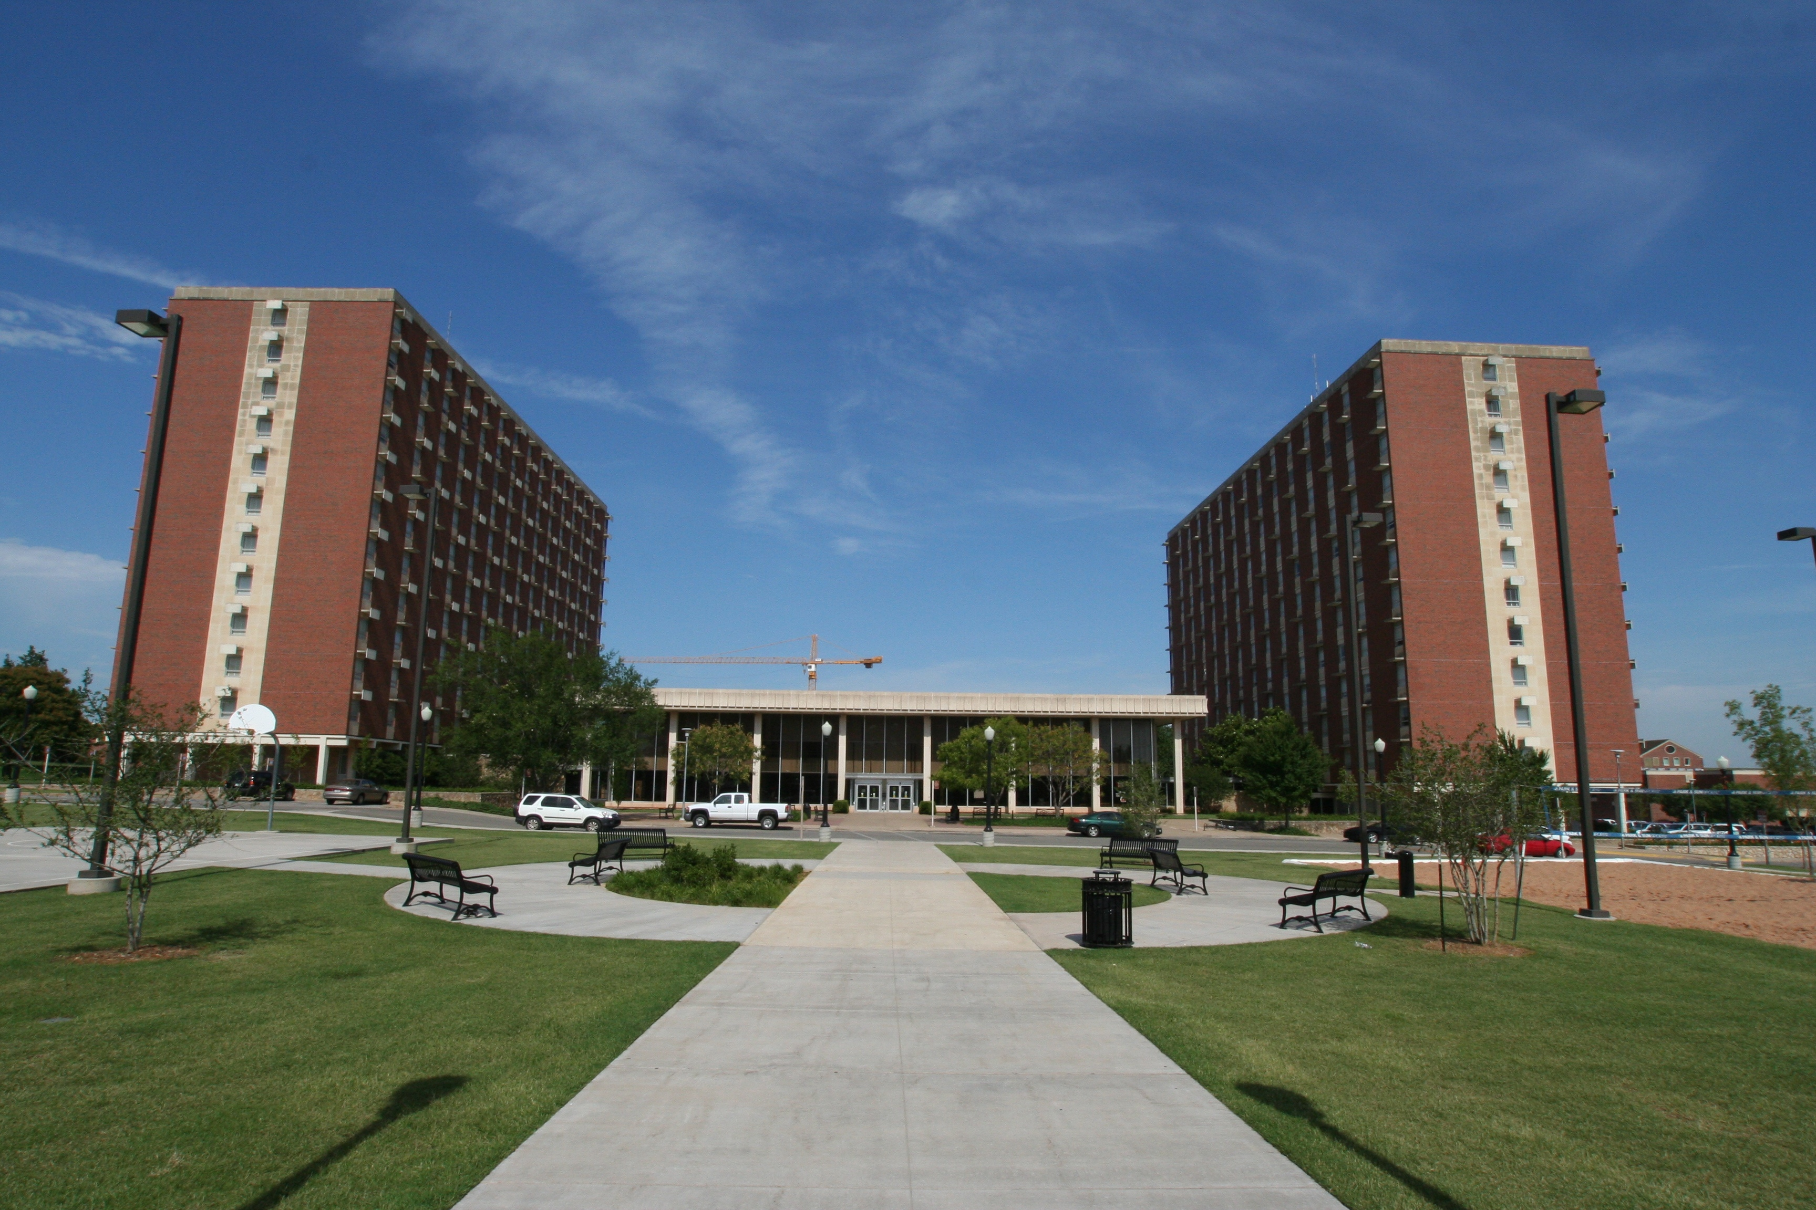
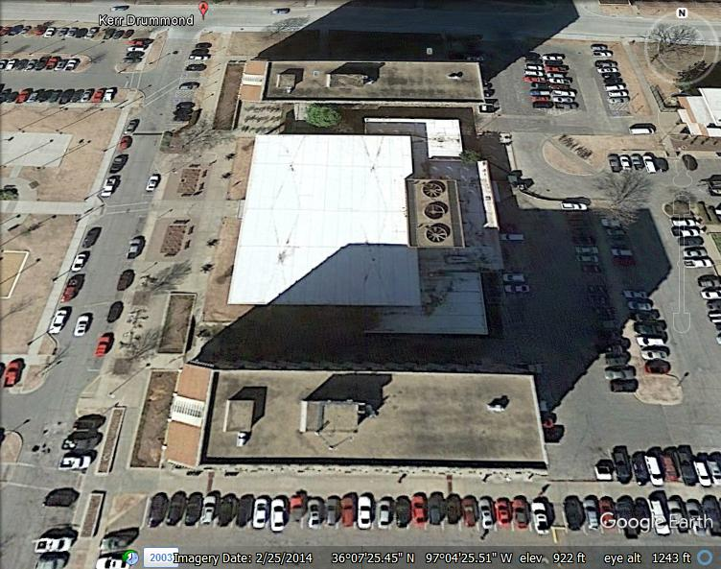
Oklahoma State Univ. Kerr-Drummond Hall
Designed prior to the earthquake design and detailing provisions for reinforced concrete structures in the 1970 version of the American Concrete Institute (ACI) design guidelines.
Reinforced Concrete (RC) columns and slabs in all stories.
The ground and first floors are conventional slab-beam construction.
All other floors are constructed as flat slabs, with light-weight partitioning, to maximize flexibility in floor usage.
Kerr-Drummond Hall pictured here on the campus of Oklahoma State University. Kerr Hall (left) has been closed because of aging infrastructure and Drummond Hall (right) is still in use for student dormitories. Constructed in the 1965, they are the tallest buildings on campus.
Notes:
Date for building was found on 2013 article (http://newsok.com/article/3870353) : “the 46-year-old Kerr Drummond”
Distance was found using Google Earth

Slide 9
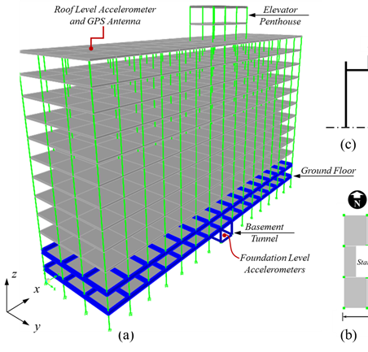
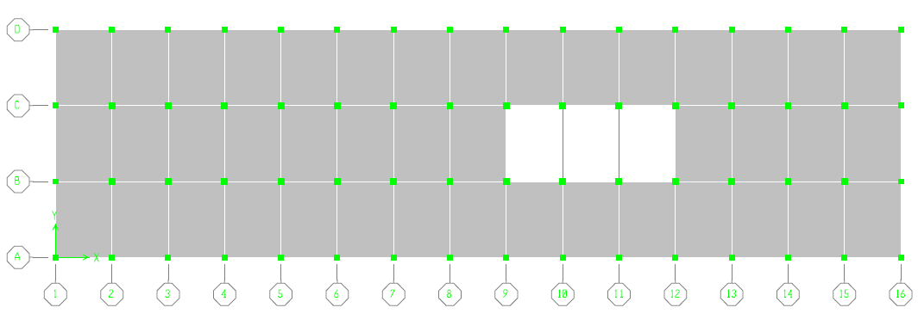
N
35 m
Stairs
Elevator Penthouse
17.8 m
Tri-axial Accelerometer
GPS Antenna
58 m
Plan was to install a GPS antenna and accelerometer on roof <5 m apart horizontally and vertically
12 story RC column and slab construction
Finite element (FE) simulation using commercial package SAP2000
http://docs.csiamerica.com/manuals/sap2000/CSiRefer.pdf.
The preliminary analysis included modal analysis and response spectrum analysis

Slide 10
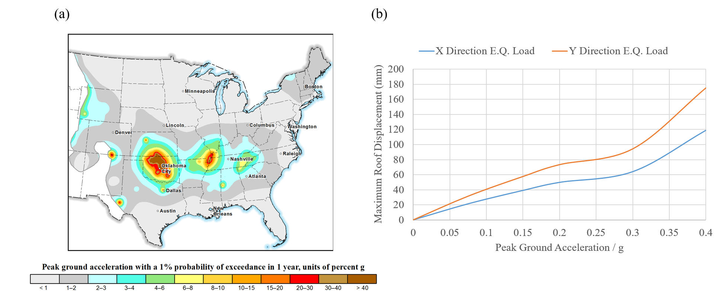
Simulated effects on 12 story structure
East North
Modal analysis:
First X-axis bending mode T = 2.2 s
First torsional mode T = 2.1 s
First Y-axis bending mode T = 1.8 s
The torsional behavior of the building is expected due to the asymmetry of the floor plan
0.12 to 0.15 g at OSU for Pawnee earthquake
The 2015 NEHRP Recommended Seismic Provisions for New Buildings (FEMA 2015) do not include the recent USGS seismic hazard data shown in Figure 6a.
The preliminary investigation included building rotations, member internal forces, story drift, and base shear
The earthquake analysis was conducted for several PGA values and the roof displacement was quantified.
Figure 6b shows the maximum roof displacement in X and Y directions resulting from earthquake loads with different PGA.

Slide 11
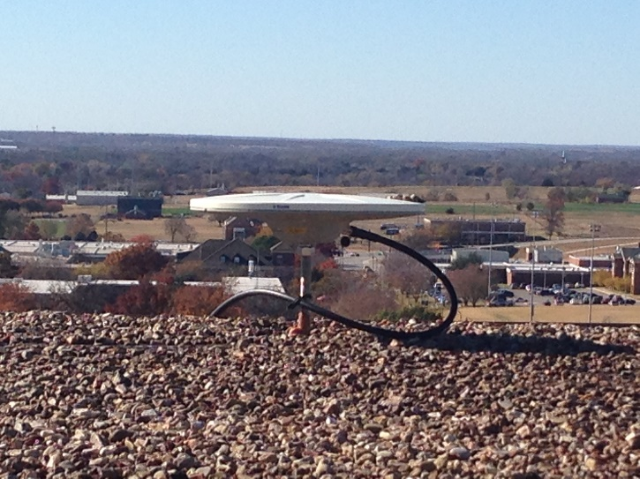
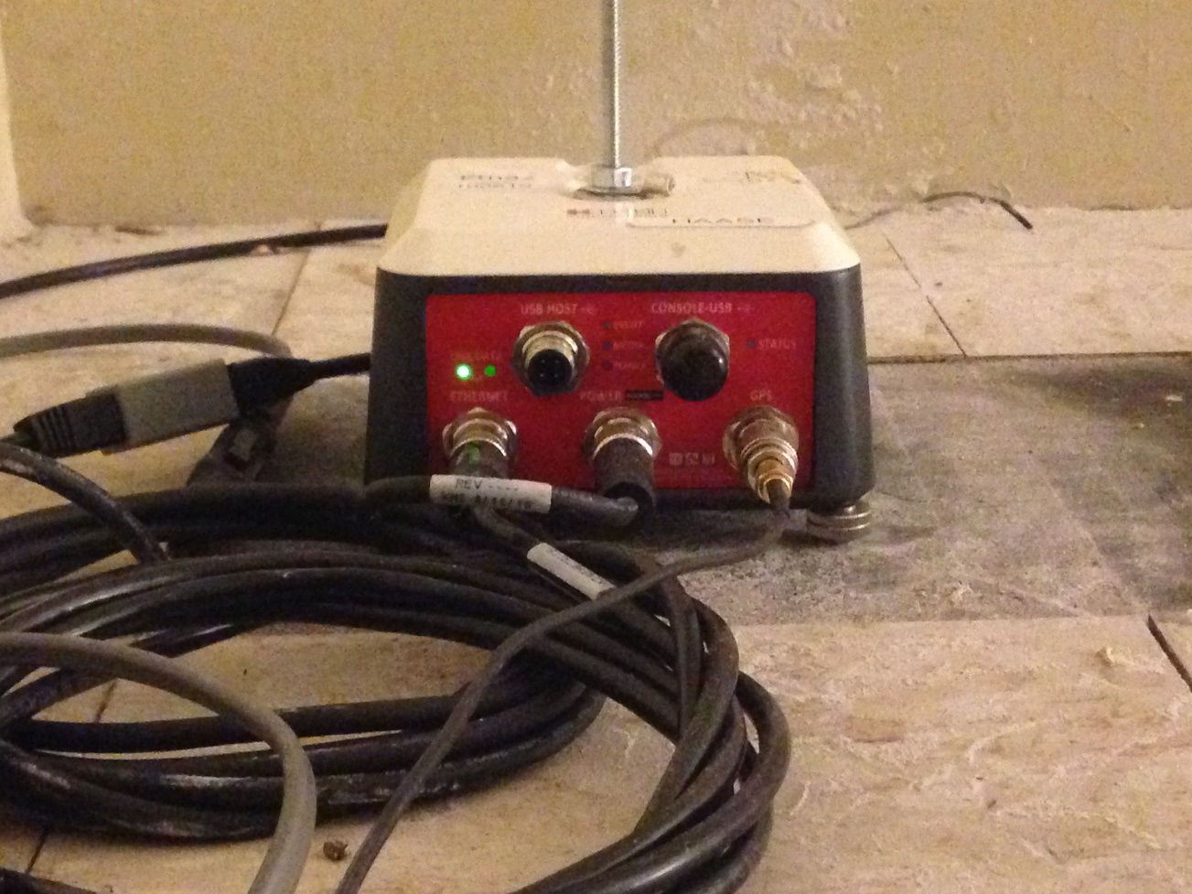
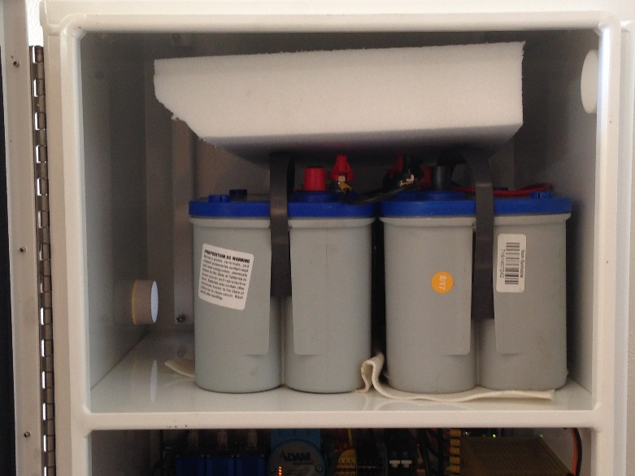
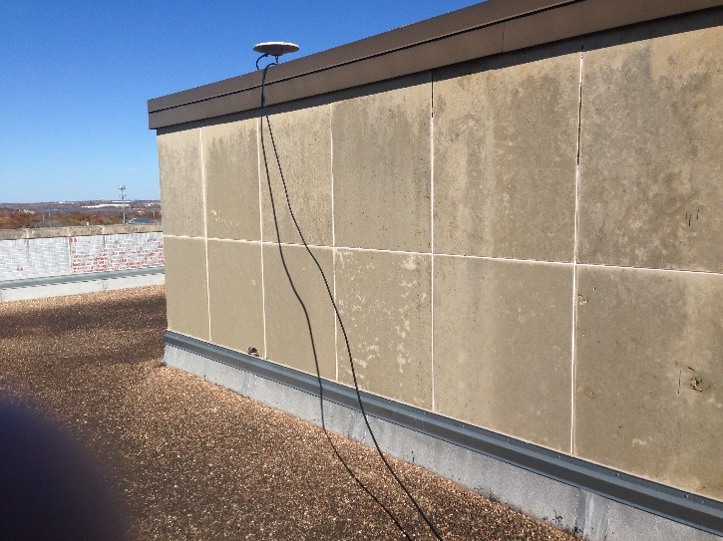
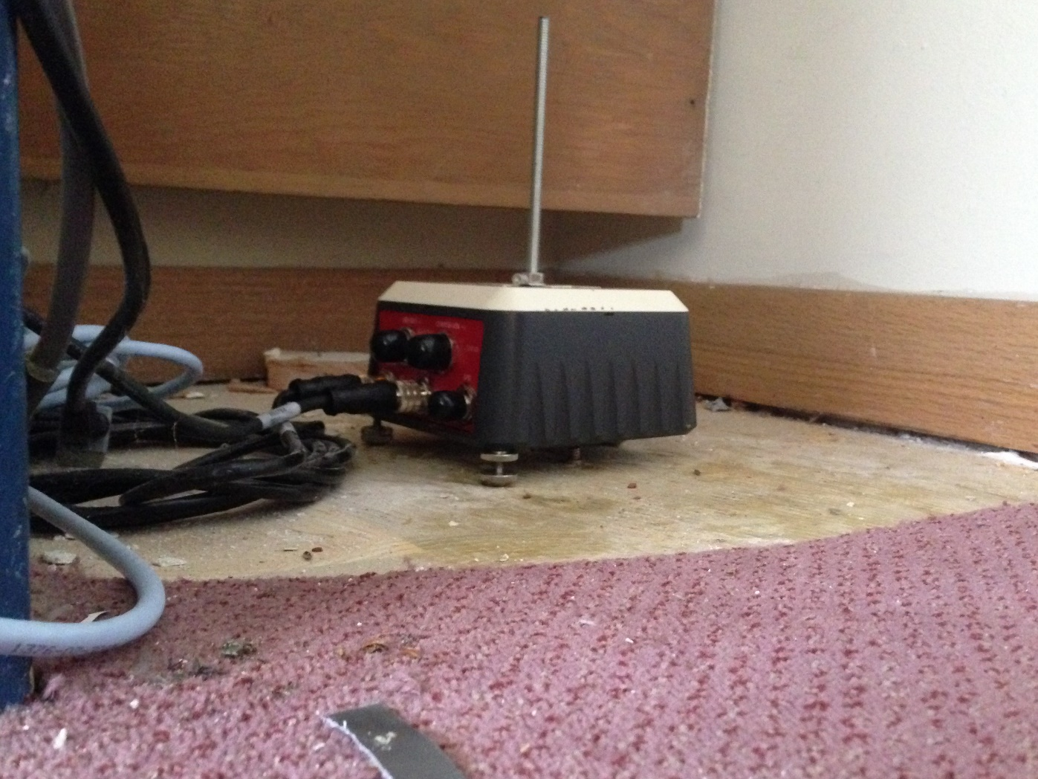
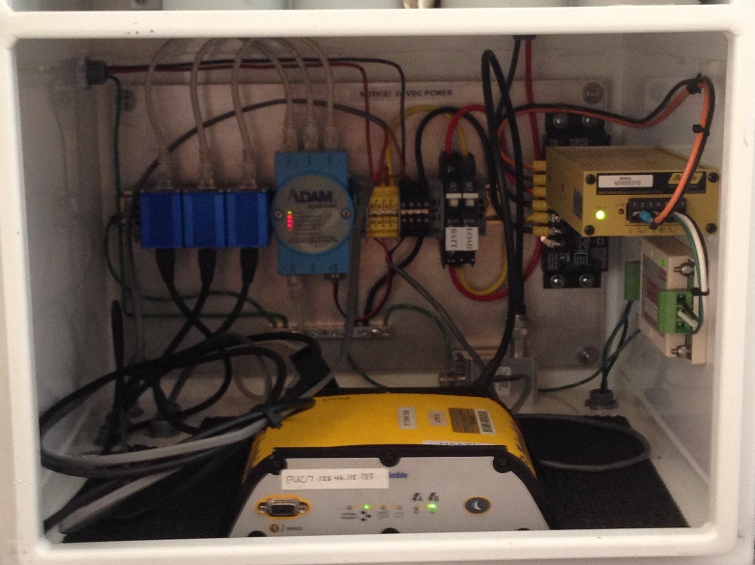
KERG rooftop GPS
KERR rooftop accelerometer
3 day battery on-site backup
KERF groundfloor accelerometer
Ethernet remote connectivity
Trimble Zephyr dual frequency GPS-only antenna
Kinemetrics ETNA2
100 sps 24bit 3 comp accelerograph
Trimble NetRS 5-Hz dual frequency GPS-only receiver

Slide 12
OKSSEN: Oklahoma Structural and Site Effects Network
KERR Etna2
soliman121-1.kdmezz.okstate.edu Port 6510
ANF: rtacq.ucsd.edu
Port 6510
Archiver program
Real-time data written to database
OSU
KERF Etna2
soliman1226-1.kdmezz.okstate.edu Port 6510
any RT
IRIS Facility
Student/Analyst users at UCSD
local.ucsd.edu
Antelope tools: nrt monitoring, dbpick
SIO
UNAVCO Facility
Field Site
SIO USARRAY
Network
Facility
To be completed
Field Site
kaibab.ucsd.edu
Archiver program
Daily ftp to database
Daily GPS data analysis
Kerg GPS
gps-receiver.kdmezz.okstate.edu
Structural
Monitoring
Site
GPS
MARMOT
Etna2
Q330
SIO broadband networks
Gyro
Bband
KERR roof
KERF foundation
Network code: OQ
KERG (GPS on roof)
Generalized Antelope ORB Communications Architecture

Slide 13
Mw 4.3 Dec 5, 2017 earthquake distance 28 km
KERR Roof North
KERF Roof East
KERR Roof Up
Displacement velocity acceleration
PGA east component 0.05 m/s^2
Maximum displacement east component 0.005 cm

Slide 14
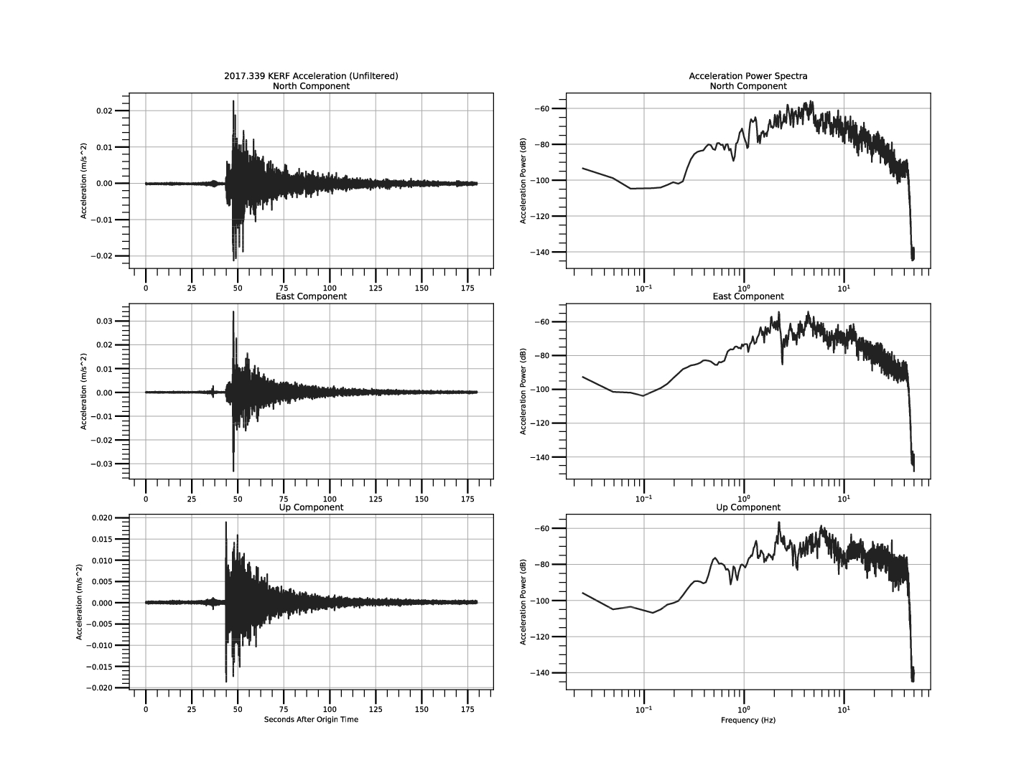
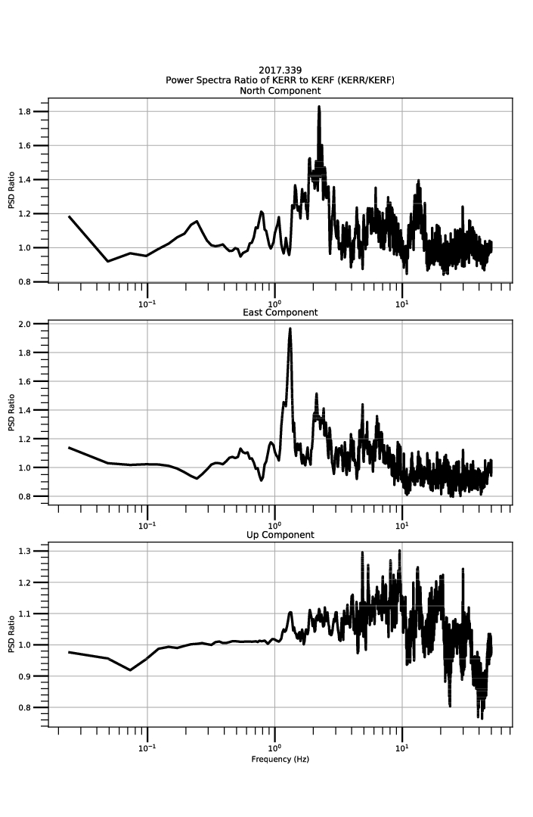
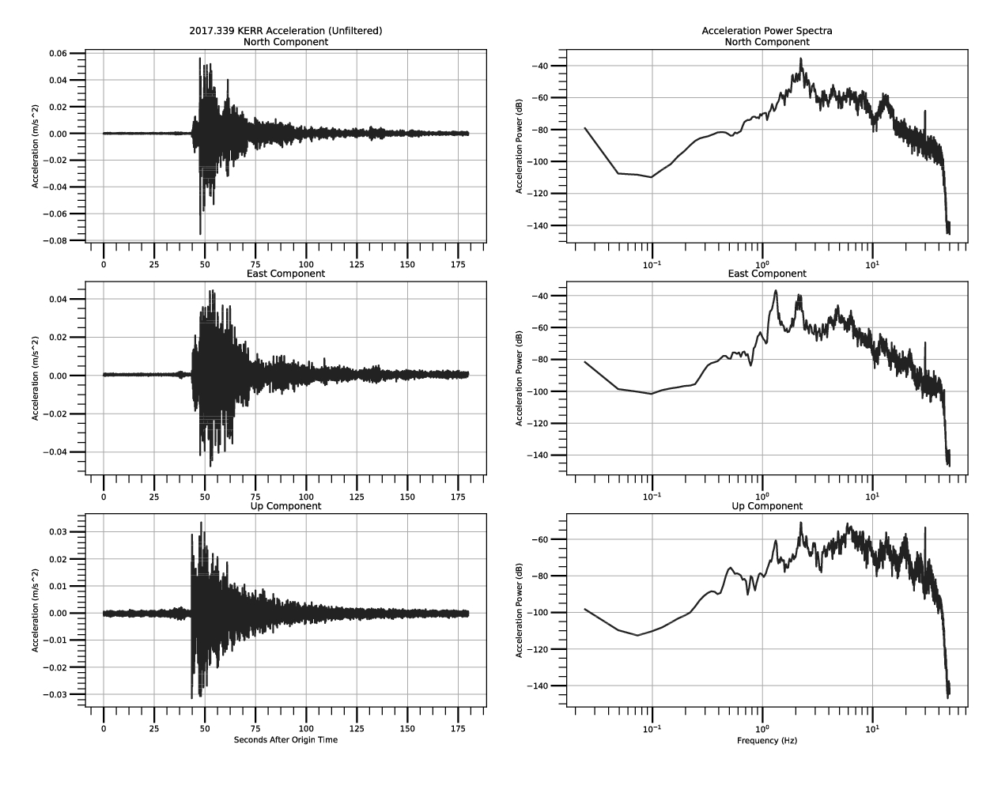
M 4.3 EQ acceleration power spectra
KERR Roof
KERF Foundation
KERR/KERF Ratio
~2.3 Hz
Up East North
~1.3 Hz

Slide 15
GPS displacement
PPPAR processing approach for 5 Hz data (Zhang and Haase, JGR, 2016) using PANDA (Position And Navigation Data Analyst) software from Wuhan University (Shi et al., 2008)
3 step solutions:
Solution for regional satellite clock corrections (Lou et al., 2014) using a North American reference network, CODE rapid orbits, and ionosphere free dual frequency observations.
Solution for carrier wave fractional cycle biases (Ge et al., 2008; Geng et al., 2010).
Kinematic precise point positioning with resolution of the integer number of cycle ambiguities in the interferometric carrier phase measurements.
Notes:
advanced methods to remove ionospheric and neutral atmospheric effects, satellite and receiver clock errors,

Slide 16
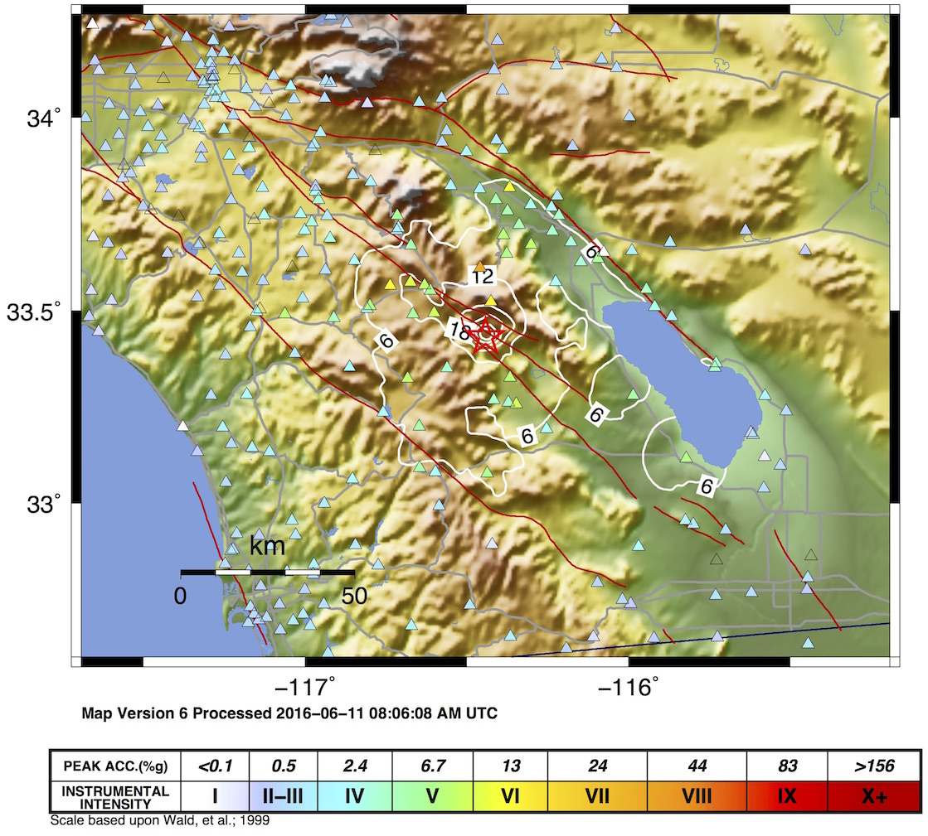
10 June 2016 Mw 5.2 Borrego Springs earthquake
~7% g
Typical acceleration at surrounding sites
Exceptionally high acceleration:
30% g !!
Near zero displacements indicate no large slip on fault
=>
NO damaging shaking expected outside the immediate source region
See Saunders et al., BSSA, 2016

Slide 17
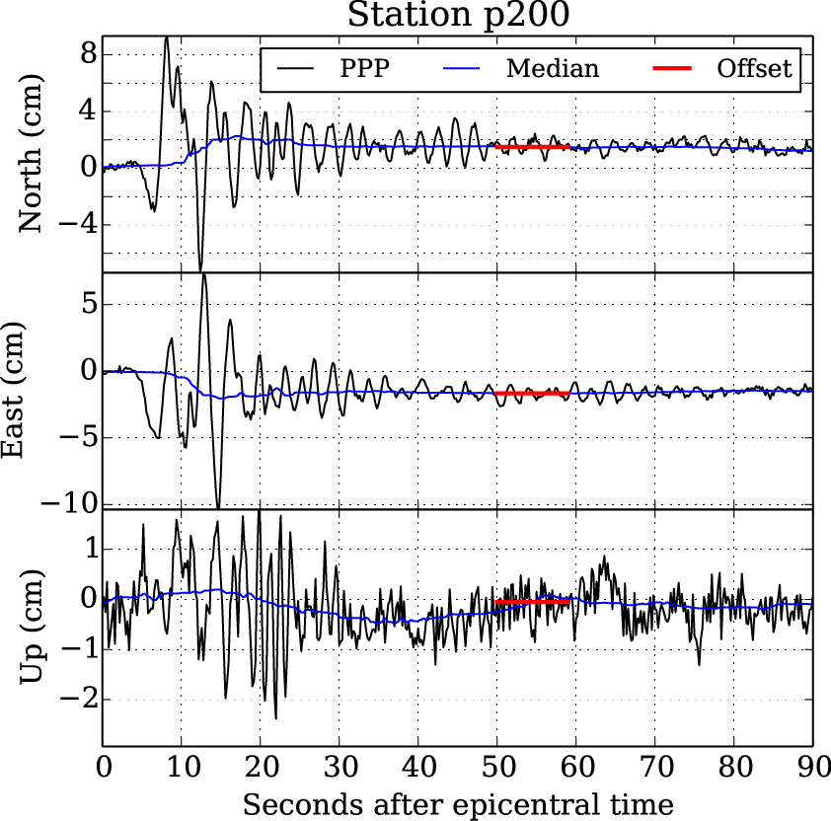
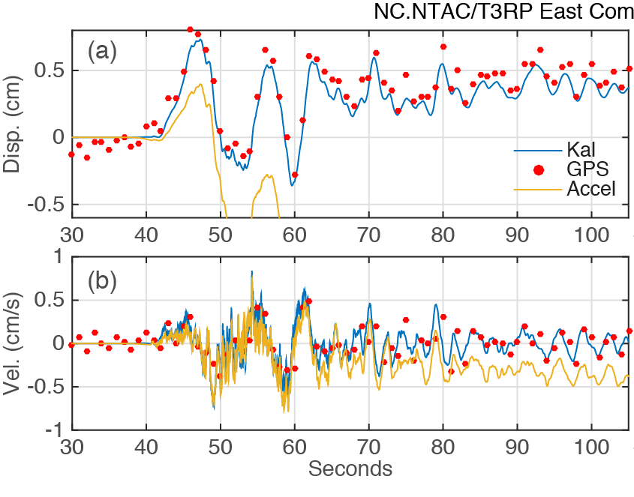
Examples: 24 August 2014 Mw 6.1 Napa Earthquake
5 Hz GPS
~15 cm displacement from site P200 18 km from epicenter
1 Hz GPS + accelerometer
~0.5 cm displacement from site NTAC 40 km from epicenter
Combined GPS + acceleration provide high rate displacement which includes static offset or permanent deformation
Melgar et al., 2015

Slide 18
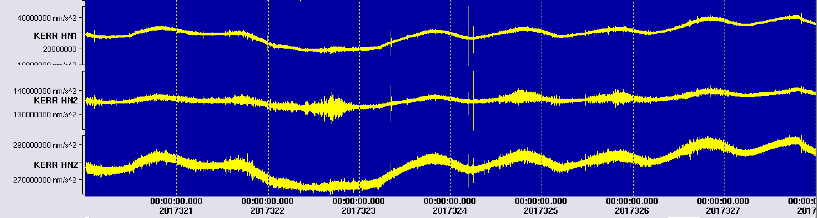
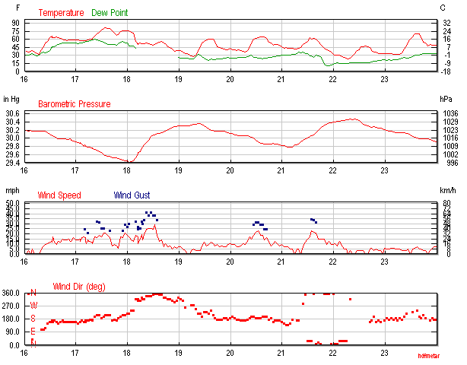
Wind forcing on building
N
November 18, 2017
40 mph northerly wind gusts associated with a cold front
30 mph wind gusts associated with warm (southerly) and cold (northerly) front passage
Diurnal temperature effects
Similar resonances are seen as with earthquakes
Wind: 0.6x10⁻² m/s² accelerations compared to M4.3 EQ: 5x10⁻² m/s²
E
U

Slide 19
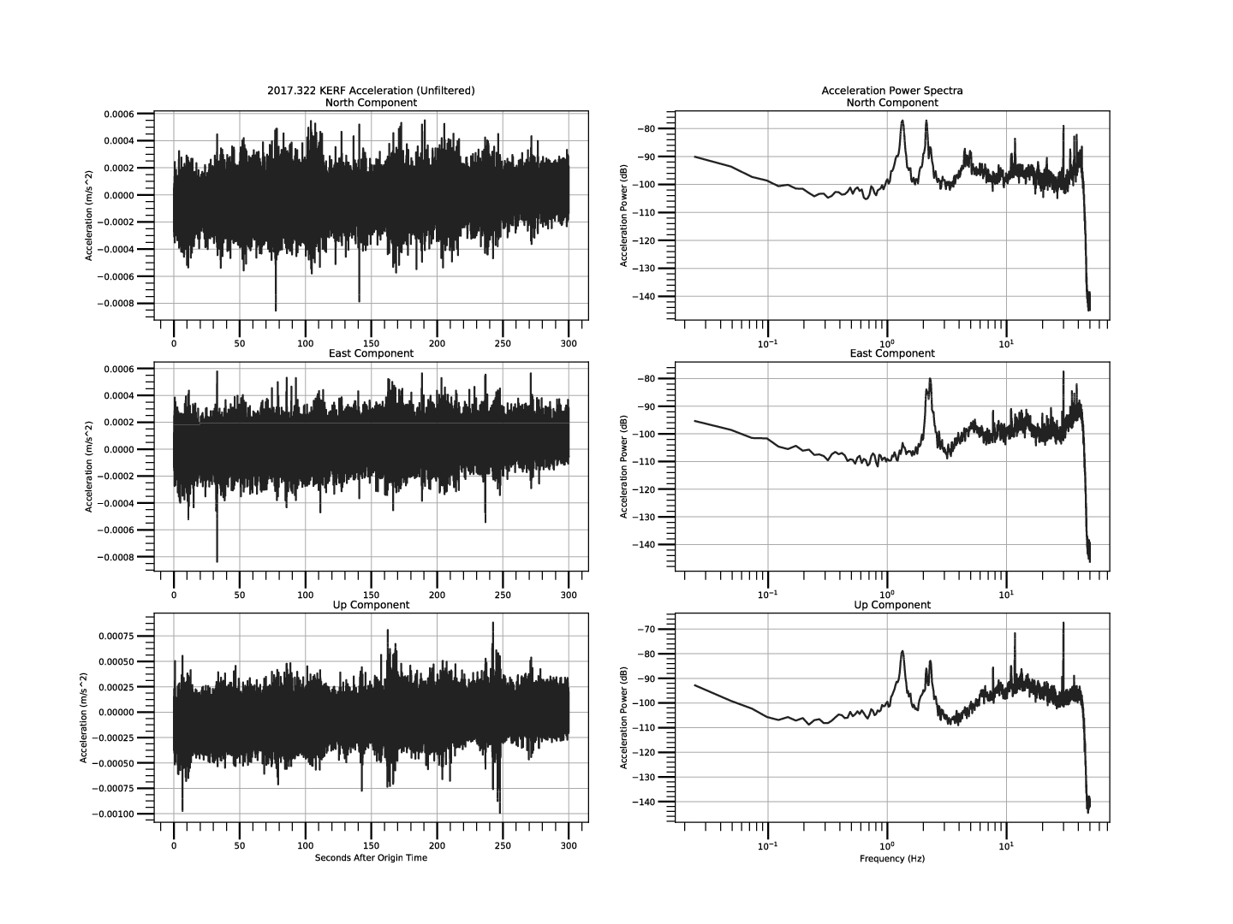
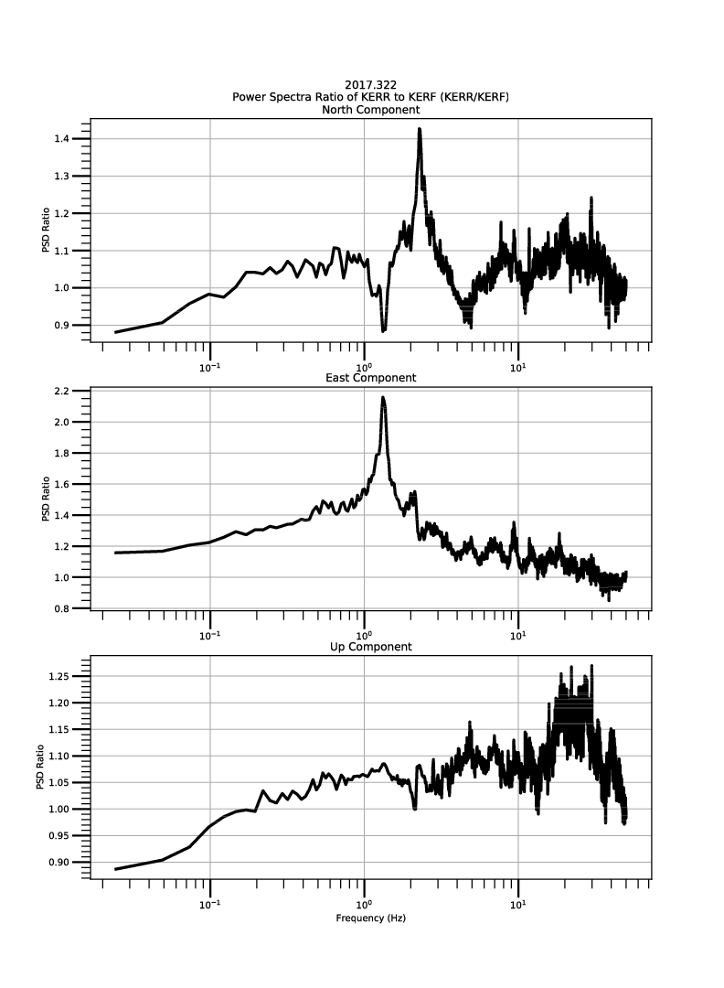
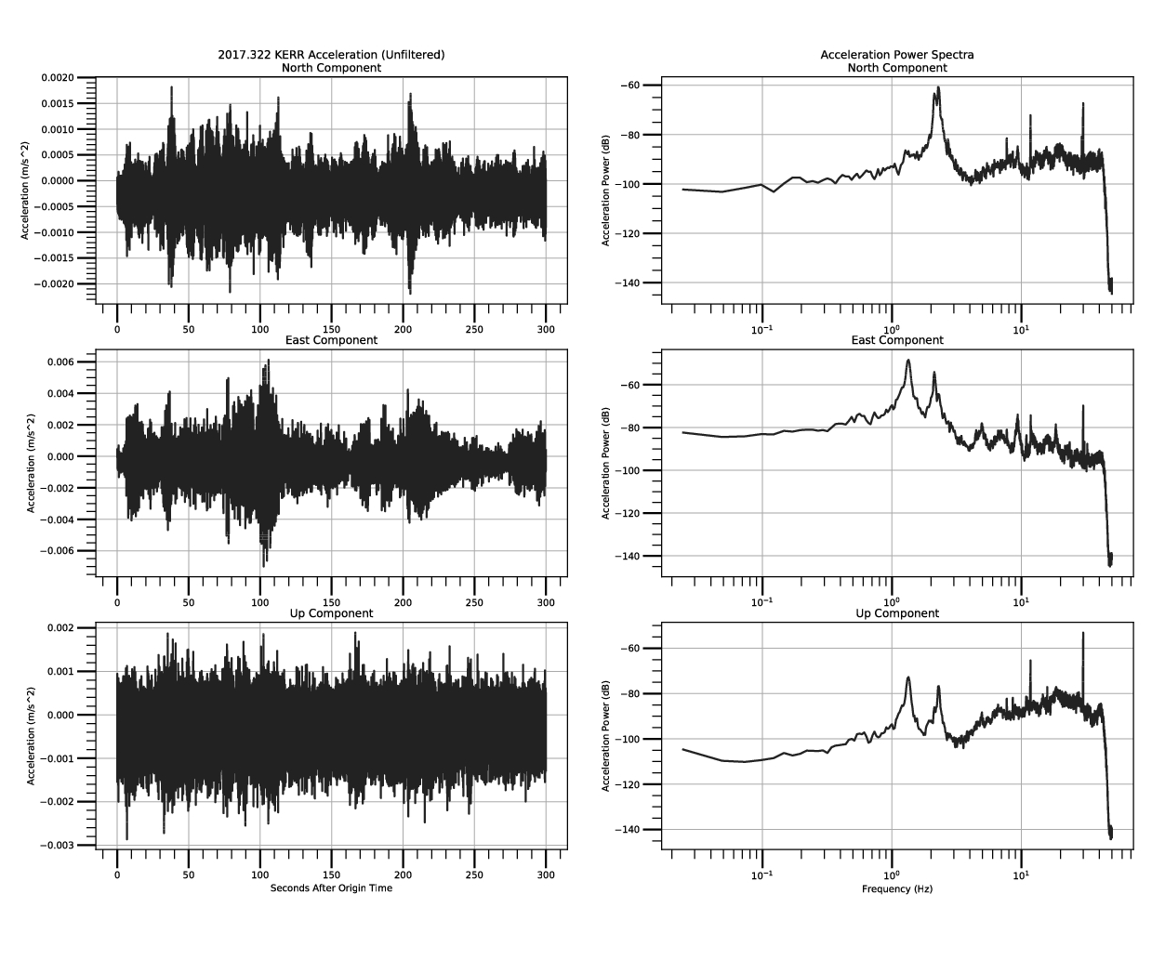
Wind acceleration spectra
KERR Roof
KERF Foundation
KERR/KERF Ratio
~2.3 Hz
~1.3 Hz

Slide 20
M3.3 2017-09-08
Many small events which have similar amplification

Slide 21
Conclusions
The OKSSEN Oklahoma Structural and Site Effect Network has been installed for monitoring a 12 story RC structure using ETNA2 24 bit accelerometers and 5 Hz GPS
Finite element structural modeling provided a reference for expected bending and torsional modes and expected rooftop displacements of 4-6 cm for 0.12-0.15 g
2017-12-05 M4.3 eq showed strong resonances at 1.3 and 2.3 Hz and a factor of 1.4 amplification at the roof
Displacements were too small to be observed by 5 Hz GPS, which has std of 0.9 cm horizontal and 1.4 cm vertical with a significant trend.
Wind events also excite similar resonances, but with simpler peaks, and provide an interesting supplemental dataset.

Slide 22
Acknowledgements
Instrumentation funded by UCSD Academic Senate Marine Research grant RQ235R-HAASE.
We thank D. Glen Offield (UCSD), Tim Sickbert, Brian Johnson, Chris Waite, and Joe Anthony (OSU) for assistance with instrumentation design and deployment.
We thank Juan Reyes, Geoff Davis, Jennifer Eakins, John Tytell, and Frankie Martinez with assistance with the Antelope System and implementing OKSSEN within the Array Network Facility at SIO.

