Slide 1


Augmenting Onshore GPS Displacements with Offshore Observations to Improve Slip Characterization for Cascadia Subduction Zone Earthquakes
Jessie K. Saunders & Jennifer S. Haase
Scripps Institution of Oceanography, UC San Diego
American Geophysical Union Fall Meeting 2017
Notes:
This work has been funded by NASA through the NASA Earth and Space Sciences Fellowship program

Slide 2
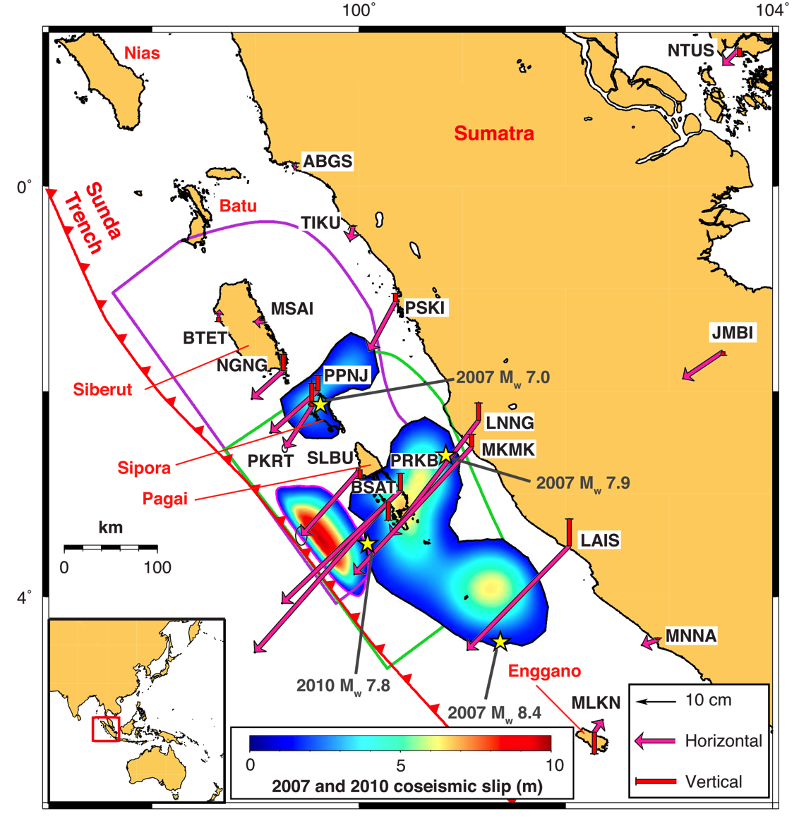
Introduction
Rupture location of a M_{w}~8 megathrust earthquake affects near-source tsunami impact
Cascadia subduction zone has experienced M_{w}~8 tsunamigenic earthquakes in the past
Because fault locking is unconstrained in the shallow megathrust, early warning systems need to be able to identify shallow ruptures
Dense, real-time GNSS network in Pacific Northwest
This project:
Improve static slip inversions of shallow ruptures by augmenting GNSS network with different offshore station configurations
2007 M_{w}8.4 Bengkulu earthquake
4 m tsunami run-up
2010 M_{w}7.8 Mentawai tsunami earthquake
12 m tsunami run-up
Tsang et al. 2016, GRL
Notes:
The rupture location of a Mw~8 megathrust earthquake can change the near-source tsunami impact, where a shallow earthquake near the trench can produce a disproportionally large tsunami for its magnitude. As an example, in 2007, a Mw8.4 earthquake offshore Sumatra produced a tsunami with 4 m run up, but this was dwarfed three years later by the Mw 7.8 Mentawai tsunami earthquake, which ruptured the shallow portion of the megathrust and generated a tsunami with 12 m run-up in this region.

Slide 3
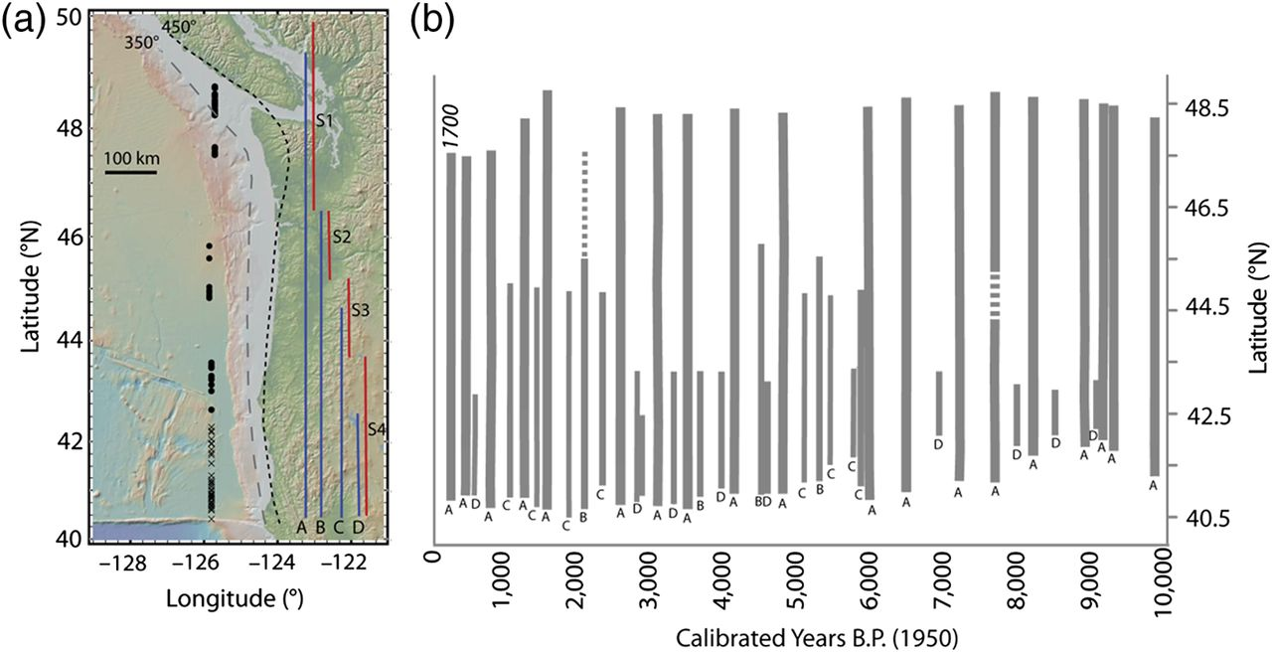
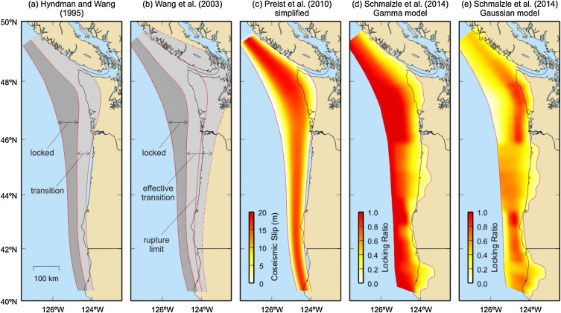
Introduction
Along-strike rupture extent and location with time
Rupture location of a M_{w}~8 megathrust earthquake affects near-source tsunami impact
Cascadia subduction zone has experienced M_{w}~8 tsunamigenic earthquakes in the past
Because fault locking is unconstrained in the shallow megathrust, early warning systems need to be able to identify shallow ruptures
Dense, real-time GNSS network in Pacific Northwest
This project:
Improve static slip inversions of shallow ruptures by augmenting GNSS network with different offshore station configurations
Cascadia Locking Models
Trehu 2016, BSSA; Wang & Trehu 2016, Journal of Geodynamics
Notes:
Everyone is preparing for “The Big One” – the next M9 megathrust earthquake in Cascadia, but there is evidence that the Cascadia subduction zone has also experienced tsunamigenic earthquakes of around M8 in the past, particularly in the southern portion of the subduction zone. Because models of fault locking for Cascadia are not well constrained in the shallow portion near the deformation zone, it is difficult to determine the potential for shallow rupture. Thus, early warning systems need to be able to identify a shallow rupture

Slide 4
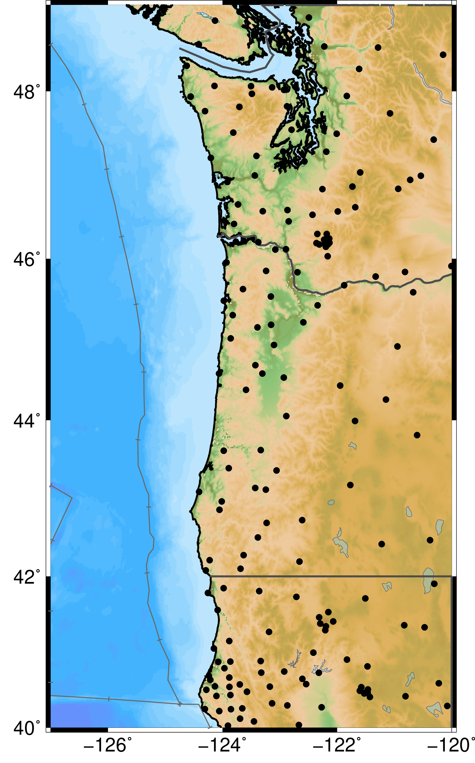
Introduction
Rupture location of a M_{w}~8 megathrust earthquake affects near-source tsunami impact
Cascadia subduction zone has experienced M_{w}~8 tsunamigenic earthquakes in the past
Because fault locking is unconstrained in the shallow megathrust, early warning systems need to be able to identify shallow ruptures
Dense, real-time GNSS network in Pacific Northwest
This project:
Improve static slip inversions of shallow ruptures by augmenting GNSS network with different offshore station configurations
Notes:
The Pacific Northwest has a dense, real-time GNSS network that is being incorporated into slip inversion-based early warning systems. Onshore GNSS displacements provide low frequency ground motions and coseismic offsets helpful for characterizing tsunamigenic earthquakes, however the one-sided distribution of data may not be able to uniquely determine the rupture region. To add further difficulty, in the case of a shallow rupture there might not be many onshore stations with measurable displacement above the noise level. These motivate our project. Our project aim is to examine how augmenting the current GNSS network with different offshore station configurations can improve static slip inversions for shallow M8 ruptures, and to find a preferred offshore network configuration for the Cascadia region.

Slide 5
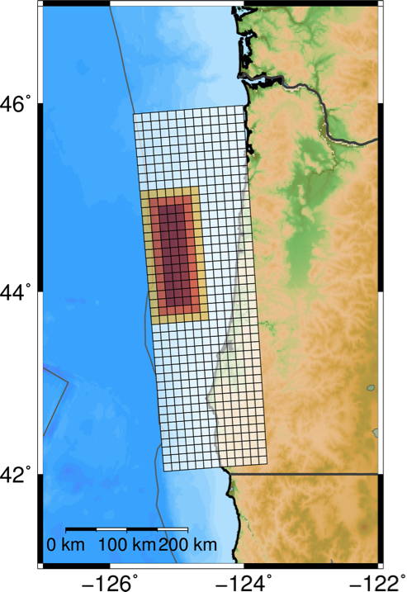
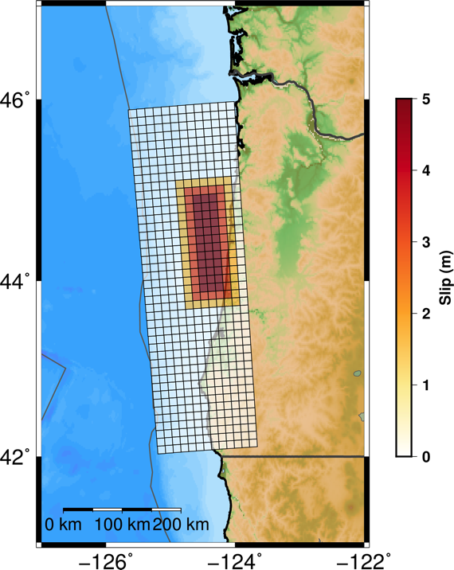
Input Rupture Models
Input Slip Models (M_{w}~8.0)
Coseismic Offset Profiles
Maximum Tsunami Amplitude at Coastline
Shallow Rupture
Deeper Rupture
Region where onshore GNSS stations are available
Deformation
Front
General Procedure:
Forward modeled coseismic offsets for both ruptures
Added noise
Onshore: ±1.5 cm horizontal
±5 cm vertical
Offshore: ±5 cm horizontal
±1.5 cm vertical
Performed static slip inversions using different station configurations and offshore data types
Compared slip inversion results with the input slip and tsunami models
Green’s functions: Zhu & Rivera 2002, GJI
MudPy slip inversion software: Melgar & Bock 2015, JGR
GeoClaw tsunami model software: LeVeque et al. 2011, Acta Numer.
Notes:
For our project we considered two simplistic rupture models offshore Oregon, a shallow rupture and a deeper rupture of M8.0. These have the same slip distribution, a uniform 5 m slip with linear slip taper around the edges. Our fault model is a regular grid approximation of the McCaffrey et al. 2012 model used in Slab1.0. The middle plot shows the coseismic offsets in the eastward and vertical directions for a transect profile across the middle of the ruptures. The purple region is where onshore GNSS data is available, and we can see that these will not measure much offset for the shallow rupture. The rightmost figure shows the maximum tsunami amplitude at the coastline for both ruptures. We use the GeoClaw software to generate the tsunami simulations.

Slide 6
Input Rupture Models
Input Slip Models (M_{w}~8.0)
Coseismic Offset Profiles
Maximum Tsunami Amplitude at Coastline
Shallow Rupture
Deeper Rupture
Region where onshore GNSS stations are available
Deformation
Front
General Procedure:
Forward modeled coseismic offsets for both ruptures
Added noise
Onshore: ±1.5 cm horizontal
±5 cm vertical
Offshore: ±5 cm horizontal
±1.5 cm vertical
Performed static slip inversions using different station configurations and offshore data types
Compared slip inversion results with the input slip and tsunami models
Green’s functions: Zhu & Rivera 2002, GJI
MudPy slip inversion software: Melgar & Bock 2015, JGR
GeoClaw tsunami model software: LeVeque et al. 2011, Acta Numer.
Notes:
The general procedure for our project is illustrated below. We forward modeled coseismic offsets for both ruptures using the frequency-wavenumber approach of Zhu and Rivera (2002) to compute the Green’s functions. We added Gaussian noise to the data. Onshore we had 1.5 cm in the horizontal and 5 cm in the vertical, and we did the opposite for offshore data. We performed static slip inversions on 15 iterations of noise for each rupture and using different stations configurations. We use the MudPy inversion software developed by Diego Melgar. Then, we compare the slip inversion results and their corresponding tsunami models to the input ruptures.

Slide 7
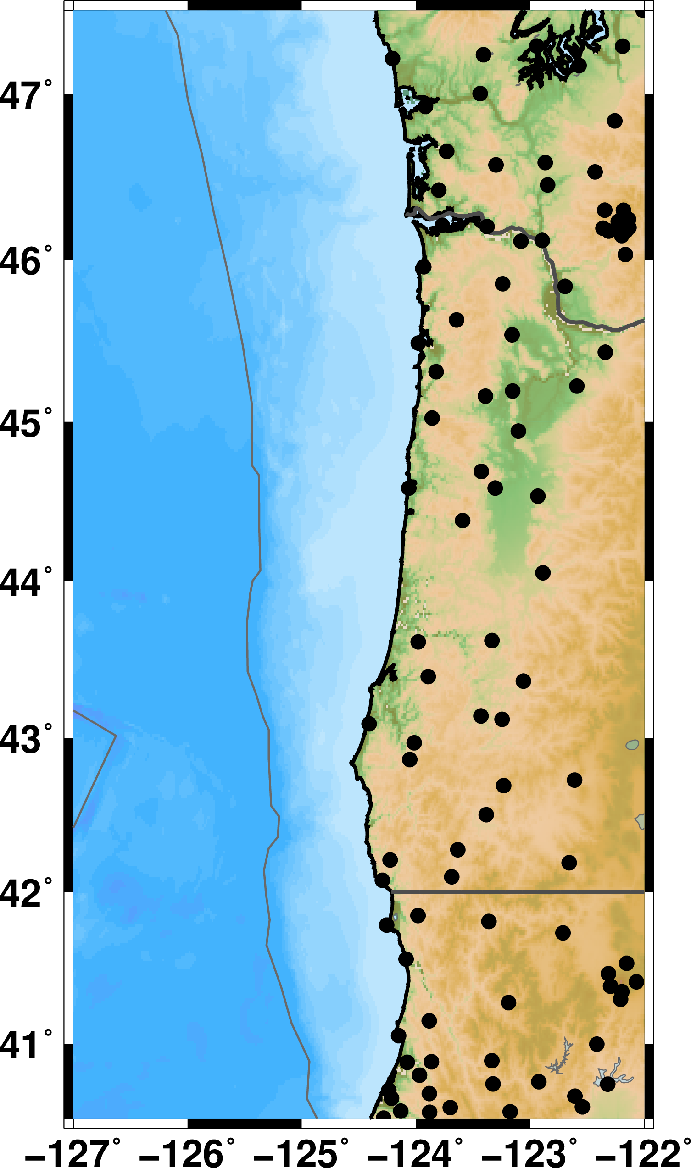
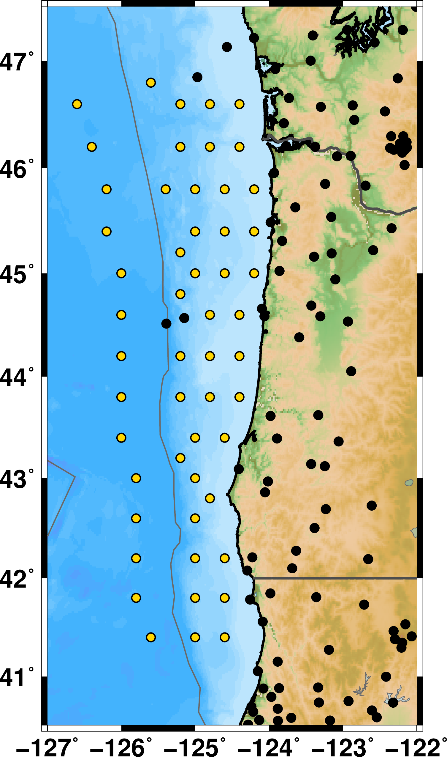



Station Configurations
GNSS Only
S-NET
Sparse Transect
Profiles
Dense Transect
Profiles
Trench Parallel Profile
Two types of offshore coseismic data tested: Vertical-Only & All-Component
Ocean Bottom Pressure Sensors
GPS-Acoustic
(Optimistic)
Notes:
Here are the station configurations we examined for this study. In these figures, the black dots are existing station locations and yellow are hypothetical locations. We test 5 configurations in this study: GNSS only, a configuration similar to the S-NET in Japan, transect profiles with 2 degree spacing, a denser set of transect profiles with 1 degree spacing, and a trench-parallel profile of stations. We examine two types of offshore coseismic data: vertical only, which can be obtained using ocean bottom pressure sensors; and a very optimistic three-component case, which would be if we added real-time GPS acoustic data to get the horizontal coseismic offsets.

Slide 8
Station Configurations
GNSS Only
S-NET
Sparse Transect
Profiles
Dense Transect
Profiles
Trench Parallel Profile
Two types of offshore coseismic data tested: Vertical-Only & All-Component
Ocean Bottom Pressure Sensors
GPS-Acoustic
(Optimistic)
Notes:
Here are the station configurations we examined for this study. In these figures, the black dots are existing station locations and yellow are hypothetical locations. We test 5 configurations in this study: GNSS only, a configuration similar to the S-NET in Japan, transect profiles with 2 degree spacing, a denser set of transect profiles with 1 degree spacing, and a trench-parallel profile of stations. We examine two types of offshore coseismic data: vertical only, which can be obtained using ocean bottom pressure sensors; and a very optimistic three-component case, which would be if we added real-time GPS acoustic data to get the horizontal coseismic offsets.

Slide 9
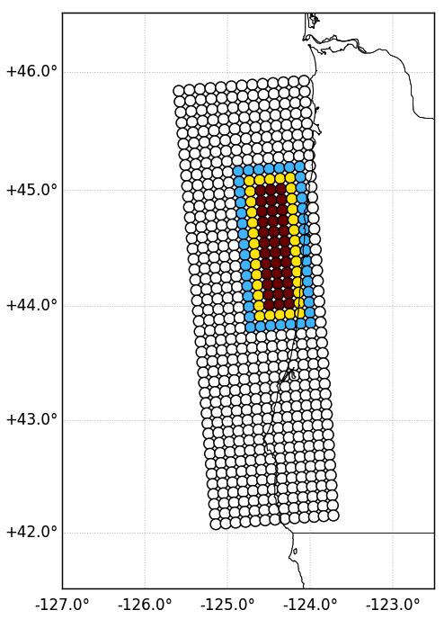
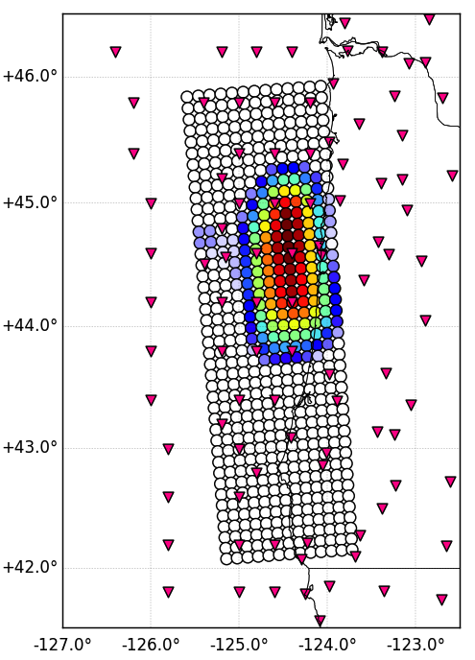
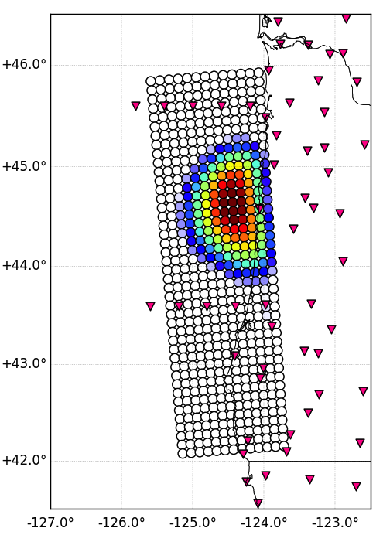
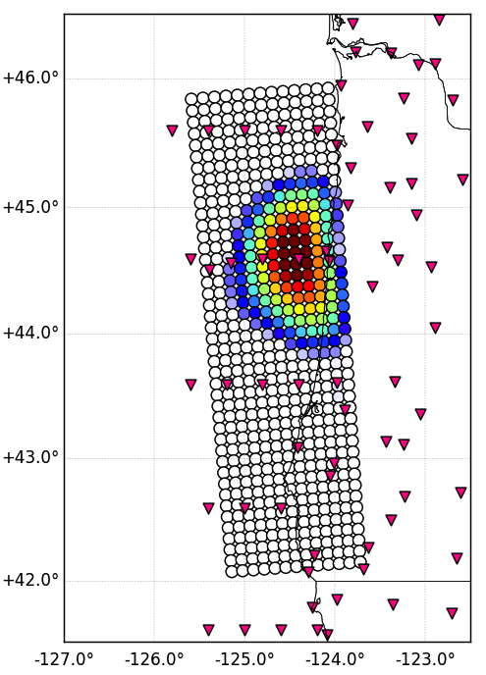
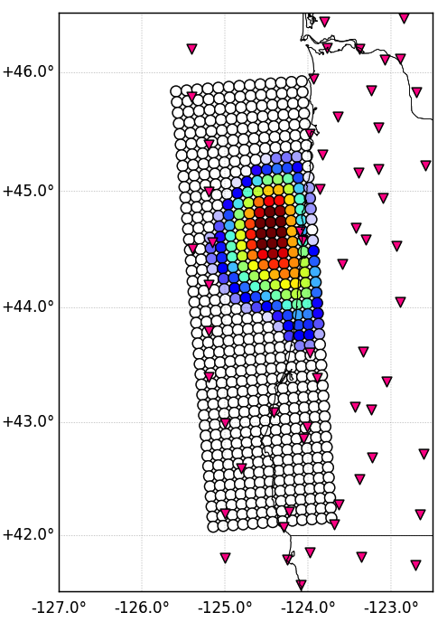
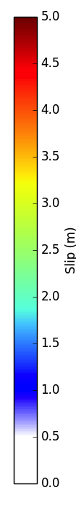
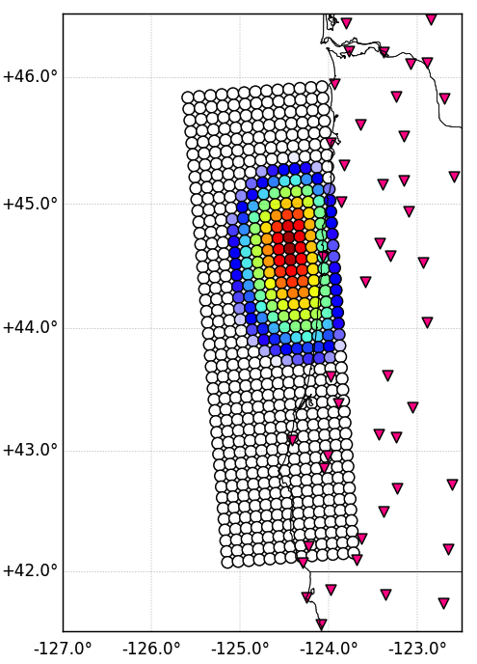
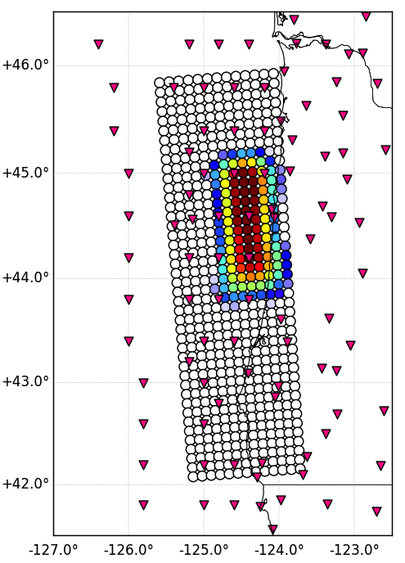
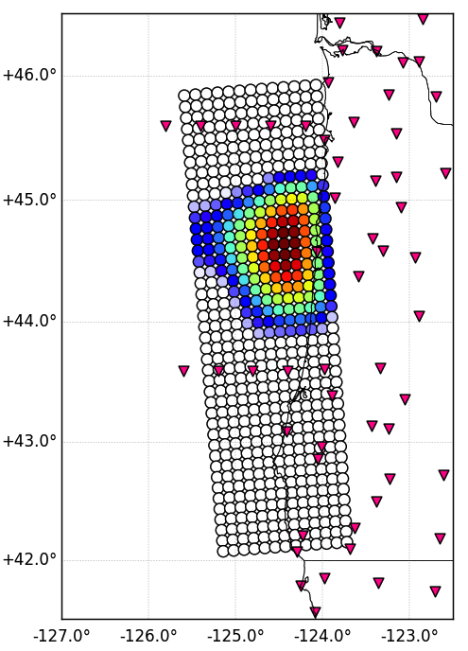
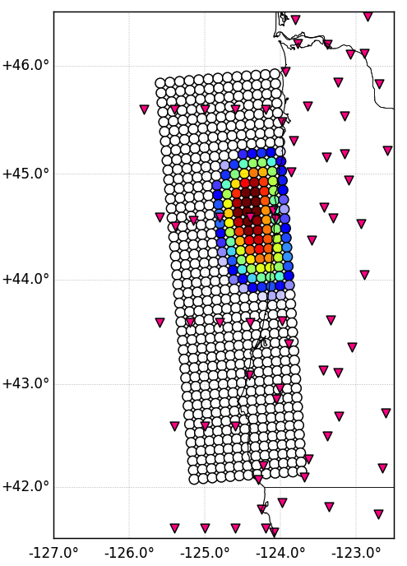
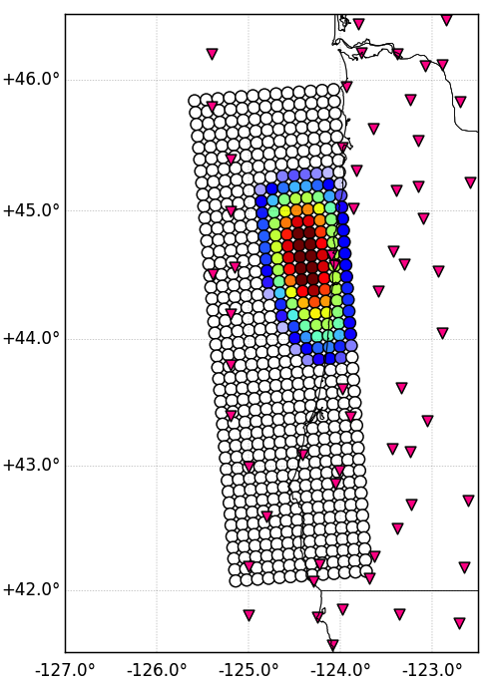
Static Slip Inversion Results (Deeper Rupture)
Input Rupture
S-NET
Sparse Transect Profiles
Dense Transect Profiles
Trench Parallel Profile
M_{w}8.09
M_{w}8.13
M_{w}8.10
M_{w}8.10
M_{w}8.10
Vertical-Only Offshore
GNSS Only
M_{w}8.10
M_{w}8.10
M_{w}8.10
M_{w}8.06
M_{w}8.07
All-Component Offshore
Notes:
Here are example static slip inversion results for the deeper rupture. The top left we have our input rupture model, and the rest are the different station configurations, with the top row showing inversion results using vertical-only offshore data and the bottom row used 3-component data offshore. As expected, the GNSS only inversion does a good job for this rupture, but it underestimates the amount of slip. Adding offshore stations improves the maximum slip for either type of data, while the up-dip rupture extent is improved by having three component data updip of the rupture.
Write the moment magnitude on these

Slide 10
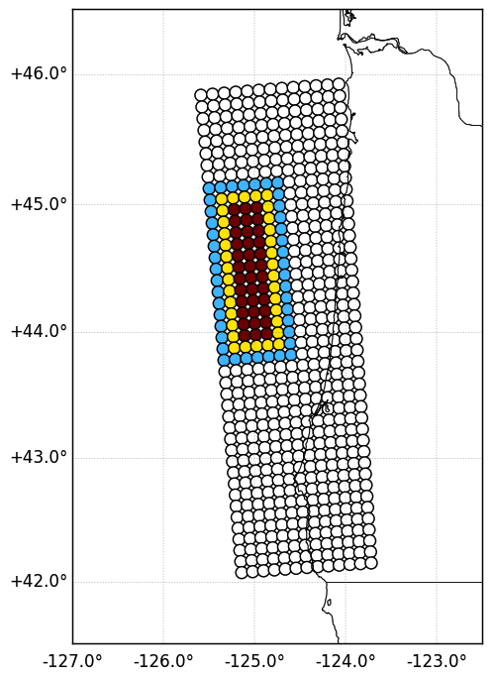
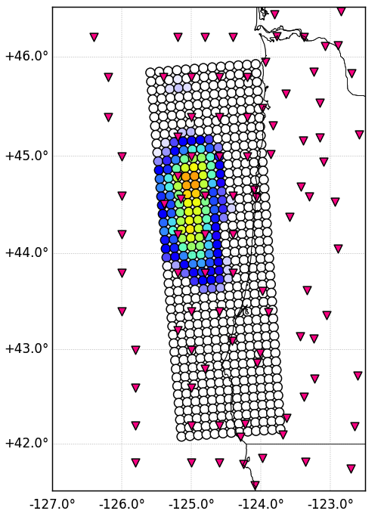
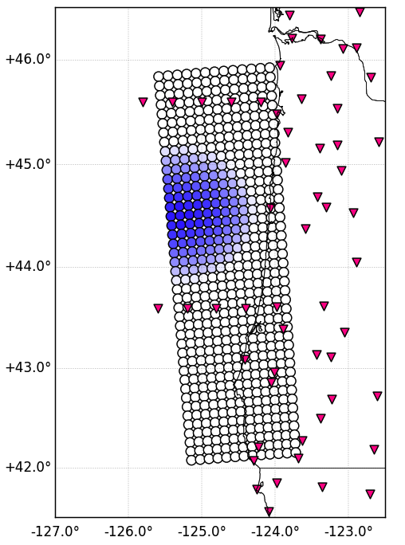
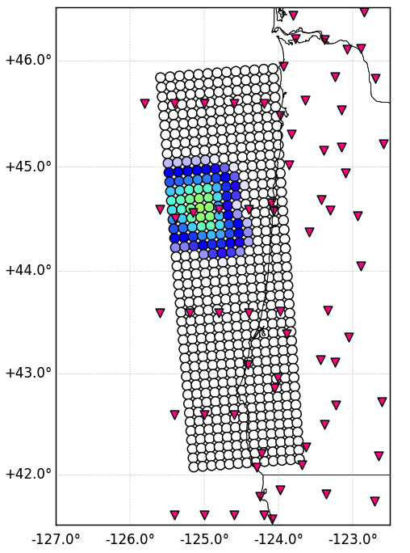
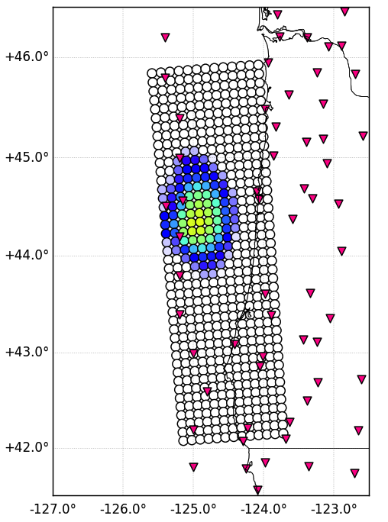
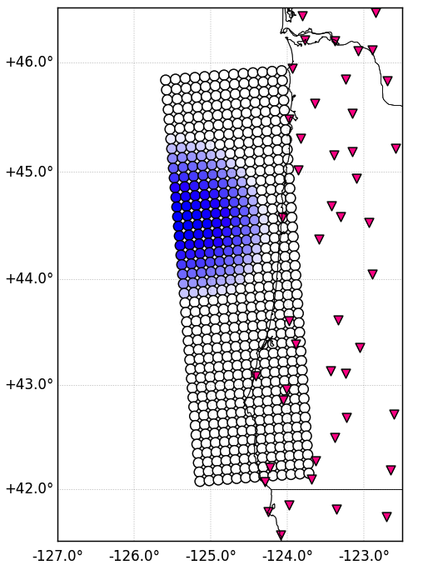
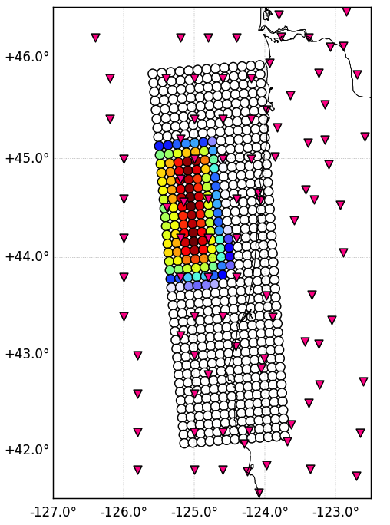
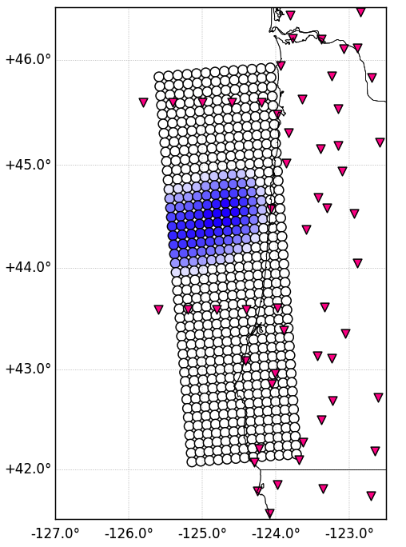
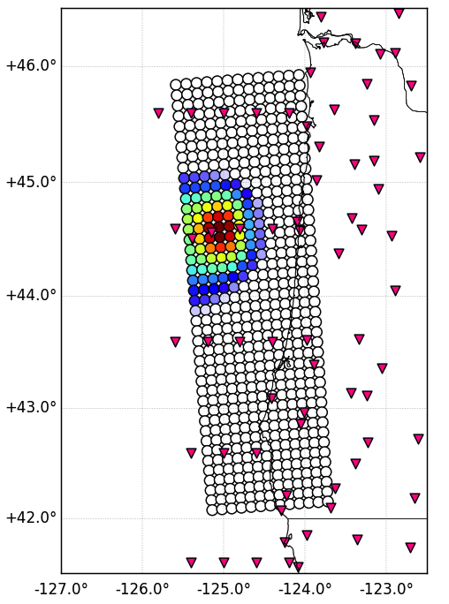
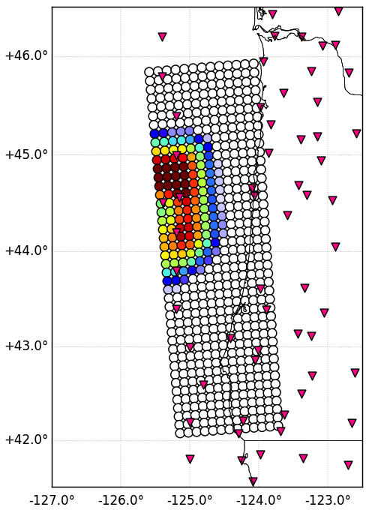
Static Slip Inversion Results (Shallow Rupture)
Input Rupture
S-NET
Sparse Transect Profiles
Dense Transect Profiles
Trench Parallel Profile
M_{w}8.02
M_{w}7.96
M_{w}7.80
M_{w}7.82
M_{w}7.88
Vertical-Only Offshore
GNSS Only
M_{w}7.82
M_{w}8.04
M_{w}7.76
M_{w}7.91
M_{w}8.03
All-Component Offshore
Notes:
Here are example slip inversion results for the deeper rupture. The GNSS only inversion correctly puts slip in the shallow portion of the fault, but significantly underestimates the amount of slip due to the lack of stations with appreciable coseismic offset. This is a similar case to the sparse transect profiles. When there are stations located directly above the rupture, the slip inversions show an improvement in the maximum slip. However, the slip appears to be consistently underestimated when using vertical-only offshore data compared to using all-component offshore data. And finally, the along-strike rupture extent is not properly recovered unless there are multiple offshore stations above the rupture in the along strike direction. This is really important for getting an accurate tsunami model, which we will show in the next slide.
Write the moment magnitude on these

Slide 11
Tsunami Model Comparison
GNSS Only
S-NET
Sparse Transect
Profiles
Dense Transect
Profiles
Trench Parallel Profile
Shallow Rupture
Deeper Rupture
--- Input Model
--- Vertical-Only Offshore
--- All-Component Offshore
Notes:
Here are the maximum tsunami wave amplitudes at the coastline. On each plot, the black line is the input model, dark blue is vertical-only, and light blue is all-component offshore coseismic data. The top row is the shallow rupture and the bottom is the deeper rupture, and they are separated by the different station configurations.
Consistent underestimation of shallow rupture by vertical-only, even with S-NET
Getting the along-strike rupture extent correct is important for determining the coastal extent of high amplitude waves, and also improves the estimation of the maximum wave height.

Slide 12
Static Slip Inversion Summary
Number of Additional Offshore Stations vs.
RMS Difference in Slip
Maximum Slip
Maximum Seafloor Deformation
Average Seafloor Deformation
Number of Offshore Stations
GNSS
Only
<
Sparse Transect Profiles
<
Trench Parallel Profile
<
Dense Transect Profiles
<
S-NET
Add some notes here?
Notes:
To summarize:
With the addition of offshore stations, unsurprisingly, the RMS difference in slip decreases

Slide 13
Static Slip Inversion Summary
Number of Additional Offshore Stations vs.
RMS Difference in Slip
Maximum Slip
Maximum Seafloor Deformation
Average Seafloor Deformation
Number of Offshore Stations
GNSS
Only
<
Sparse Transect Profiles
<
Trench Parallel Profile
<
Dense Transect Profiles
<
S-NET
Preferred Offshore Network Configuration:
Trench Parallel Profile
Notes:
To summarize:
With the addition of offshore stations, unsurprisingly, the RMS difference in slip decreases

Slide 14



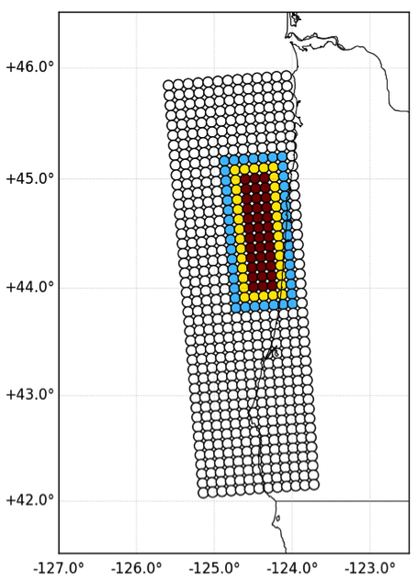
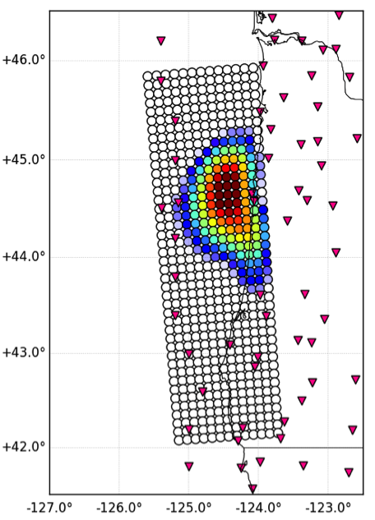

Preferred Offshore Network: Trench Parallel Profile
Slip Inversion Solutions
Input Slip Models
Tsunami Models
Vertical-Only
All-Component
Shallow Rupture
Deeper Rupture
Notes:
Might not include this slide
Add some text? Add legend for the
Fewer stations than S-NET
Produces comparable slip inversions and tsunami models to S-NET with three-component offshore data
Better estimates the along-strike rupture extent, which is helpful for estimating the coastal extent of high-amplitude wave impact (e.g., why it’s better than the transect profile configurations)
A set of stations on or near the deformation front will also be helpful for determining the pattern of shallow plate locking

Slide 15
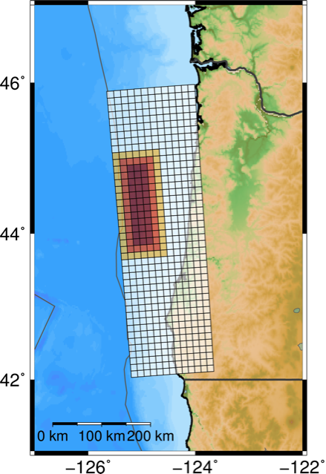

Examining the Kinematic Case
Notes:
Adjust figures to be in the same y-limits. Add station locations and labels to the map
PGD compared to permanent displacement
Slope of P-wave to PGD (move-out?)
Modeling the first few seconds (up to PGD?)
We also conduct sensitivity studies using kinematic models with varying rupture speeds and rise times as a proxy for expected rigidity changes with depth along the megathrust. We find distinguishing features in displacement waveforms that can be used to infer primary rupture region. We discuss how kinematic inversion methods that use these characteristics in high-rate GPS data could be applied to the Cascadia subduction zone.

Slide 16
Conclusions & Future Directions
Options for Improving Slip Inversions for Shallow Ruptures
Adding offshore stations improves maximum slip estimates compared to onshore-only static inversions for both rupture regions.
Three-component offshore data improve updip rupture extent estimates for deeper ruptures and are necessary for correctly estimating maximum slip for a shallow rupture.
Offshore stations that are not directly updip of the rupture or above the rupture do not improve static inversion.
Maximum slip and along-strike rupture extent are necessary for estimating tsunami impact.
Preferred offshore station configuration is a trench parallel line of stations.
Offshore Options
Depth-dependent slip scaling with vertical-only inversions (static)
Real-time GPS-Acoustic development for collocation at OBP sites (static)
Horizontal strong-motion data at OBP sites (kinematic)
Onshore Options
Preferentially fit first part of displacement waveforms (kinematic)
Include near-field strong-motion waveforms (kinematic)

Slide 17
References & Acknowledgements
LeVeque et al. 2011
Melgar & Bock 2015
Zhu & Rivera 2002
Blaser et al. 2010
Trehu 2016
Wang & Trehu 2016
Tsang et al. 2016
McCaffrey et al. 2012
Melgar et al. 2016
Graves & Pitarka 2010
This work has been funded by NASA grant NNX16AO32H through the 2016 NASA Earth and Space Science Fellowship.
We thank Diego Melgar for assistance in the use of MudPy, the GeoClaw tsunami propagation software, and especially with troubleshooting. We thank Junle Jiang for his helpful discussions and assistance in troubleshooting the tsunami modeling software. We appreciate the technical support of the IGPP Help Desk staff.

