Slide 1
Debugging Problem with Increments in WRF Setup for AR Recon 2018
MJ Murphy
17 May 2019

Slide 2
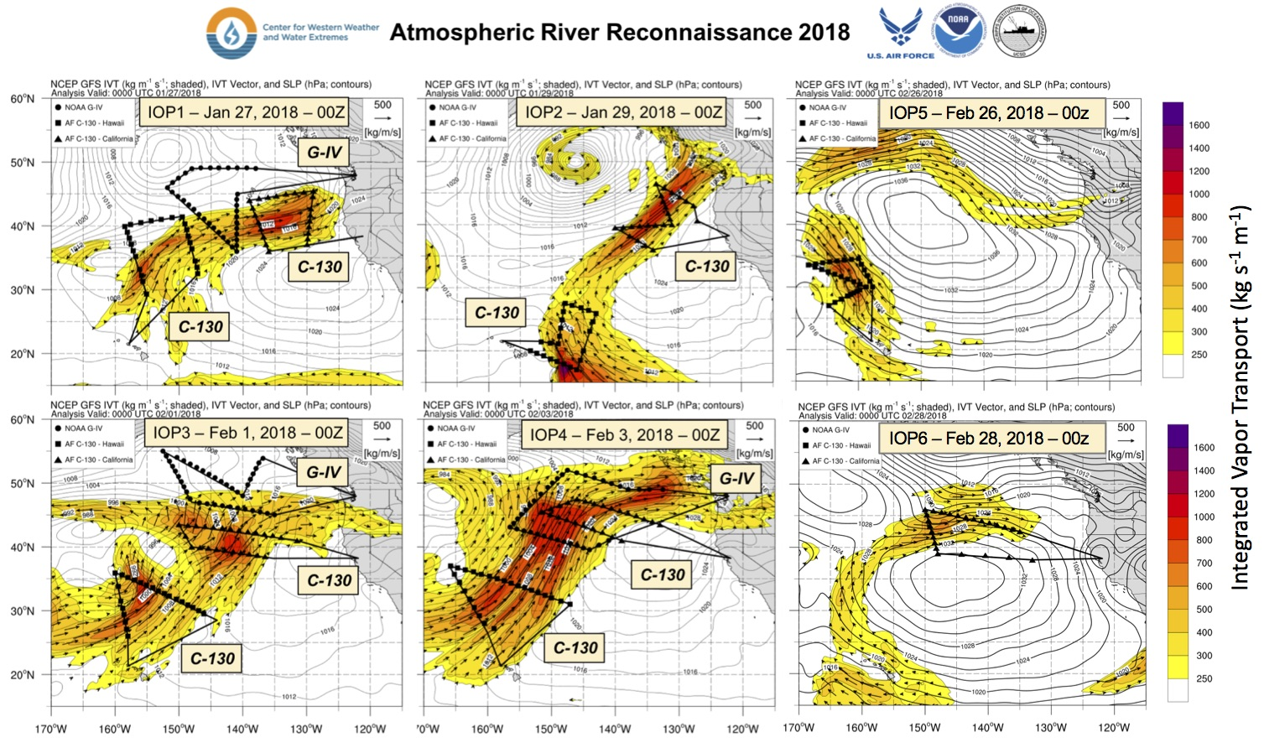

Slide 3
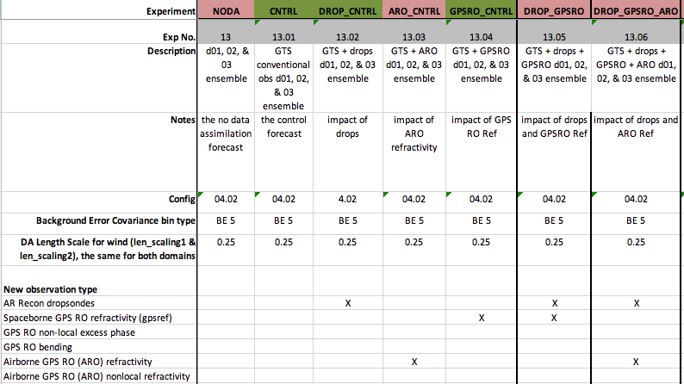
Experiments
Most important is to compare DROP+GPSRO to DROP+GPSRO+ARO
Long term we want to do both of these experiments with excess phase nonlocal operator

Slide 4
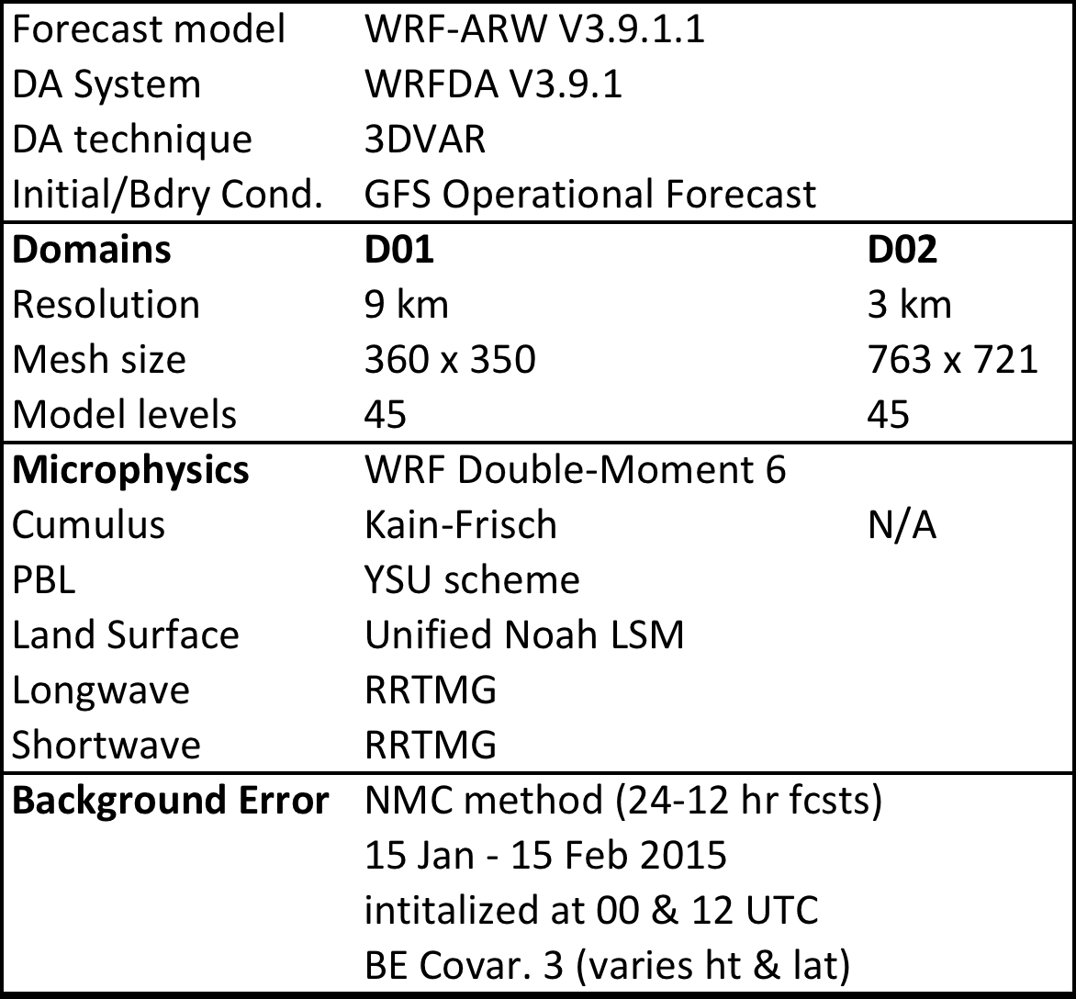
DA Experiments & Configuration
Model Configuration
Experiments:
For one individual type of data, where does it put the increment and how big is the increment and what fields have a significant increment (only do the analysis and do only a 6 hour forecast, no cycle, use all ARO)
Experiments :
Most important is to compare GTS+DROP+GPSRO to GTS+DROP+GPSRO+ARO (only in window)
(run forecast for 84 hours, no cycling?)
Conventional GTS observations include:
Aircraft, Ship, & buoy reports
Land-based surface stations
Ground based GPS PW
Satellite Atmospheric Motion Vectors (AMV)
Satellite Scatterometer Winds
Notes:
Describe the 4 numerical experiments:
No DA
Conventional observations
Spaceborne GPS RO refractivity
Field Campaign Dropsondes
Using WRFDA with 3DVAR.
These experiments all use the same microphysics scheme, later in the presentation I will vary the MP scheme for simulated polarmetric delays.
No satellite Radiance Assimilated
Why? Trying to understand the type of changes it makes to the model to use GPSRO & DROP?

Slide 5
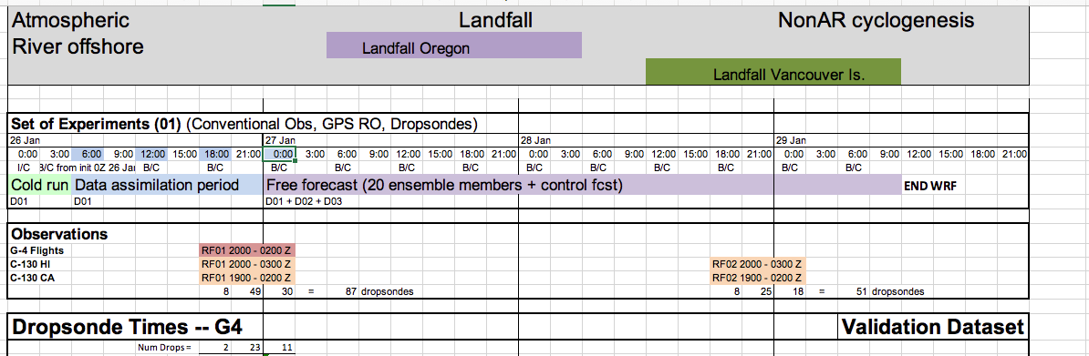

Slide 6
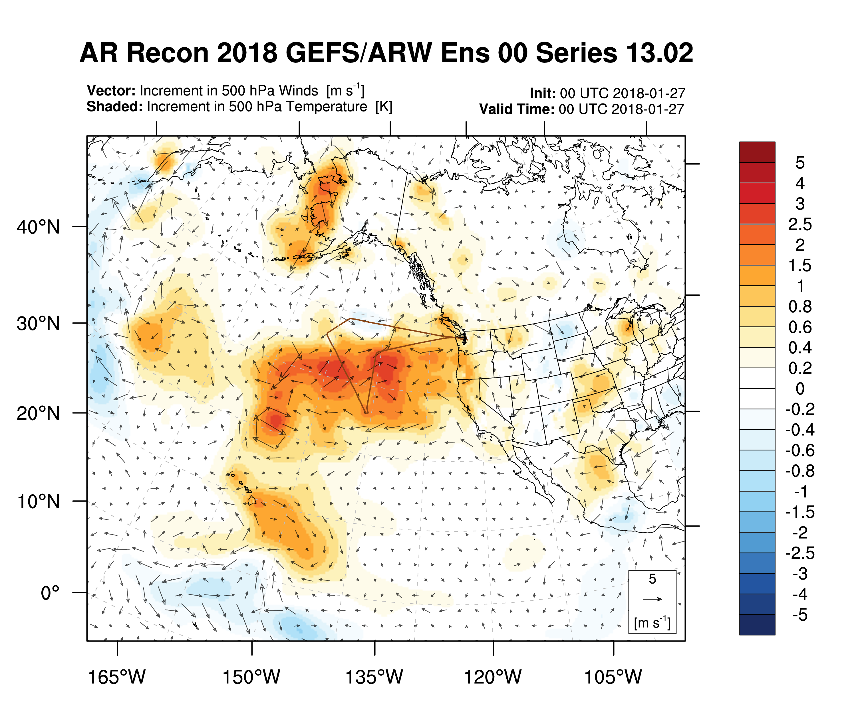
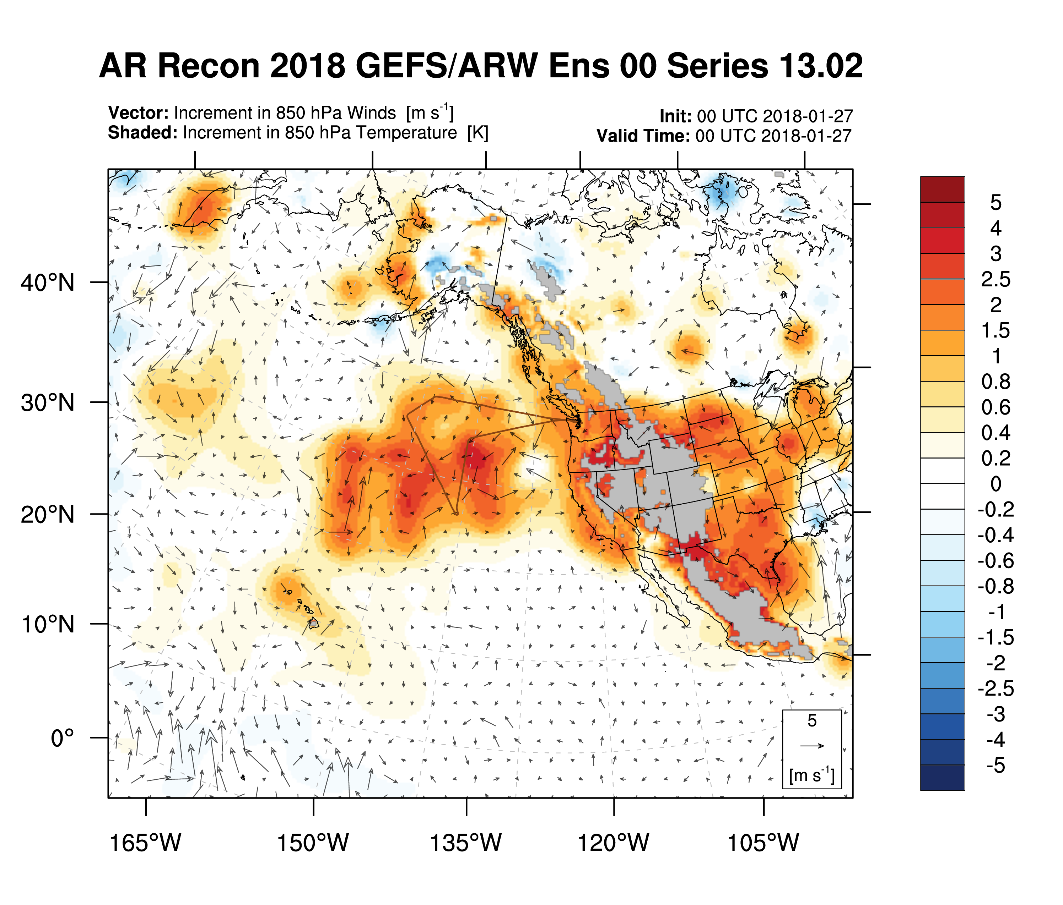
Problem:
Temperature Increments are Too Big

Slide 7
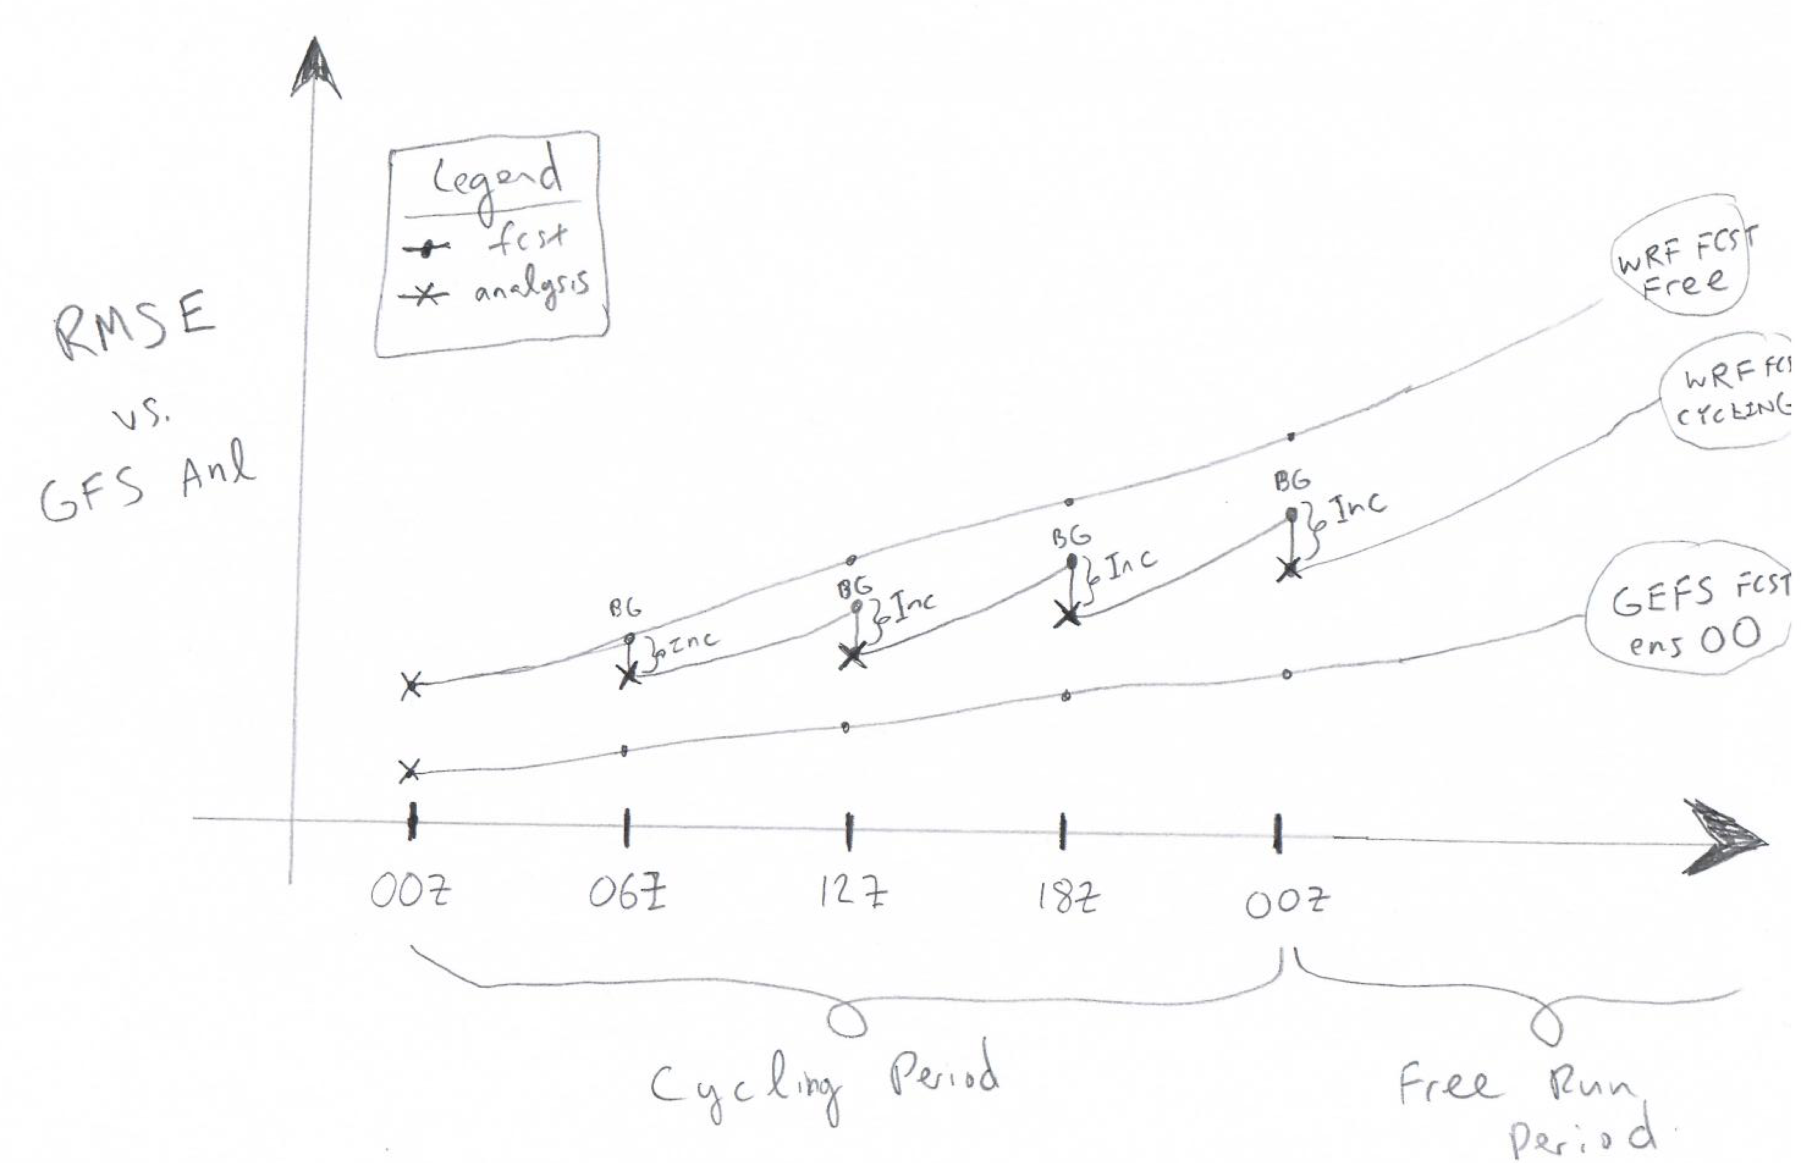
My WRF Setup for Cycling
One domain for cycling with nests init during free fcst.
IC/BC from GEFS control member (ens 00) fcst available every 6 hours.
“Truth” is GFS Analysis (FNL).
Note: GFS Analysis ≠ GEFS fcst initial conditions

Slide 8
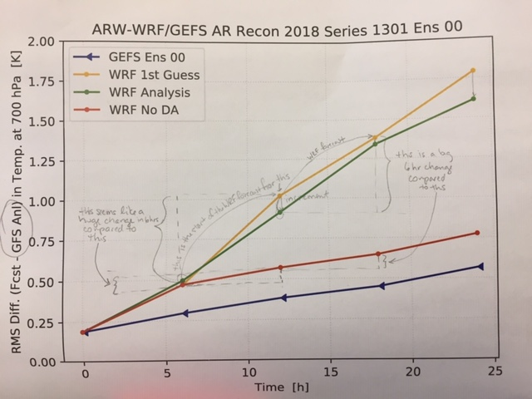

Slide 10
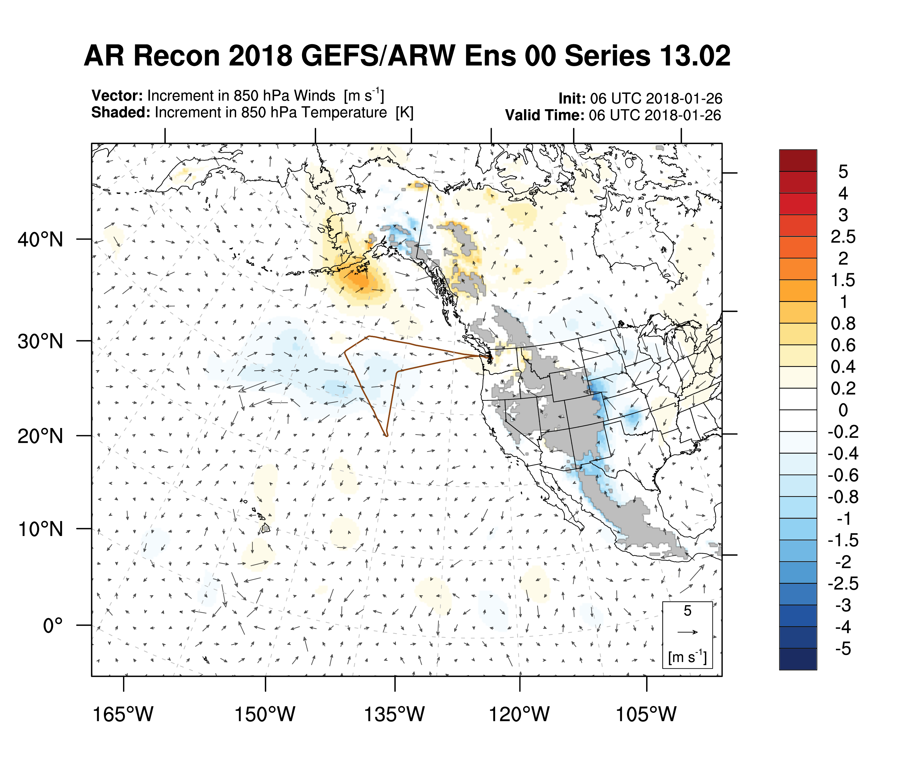
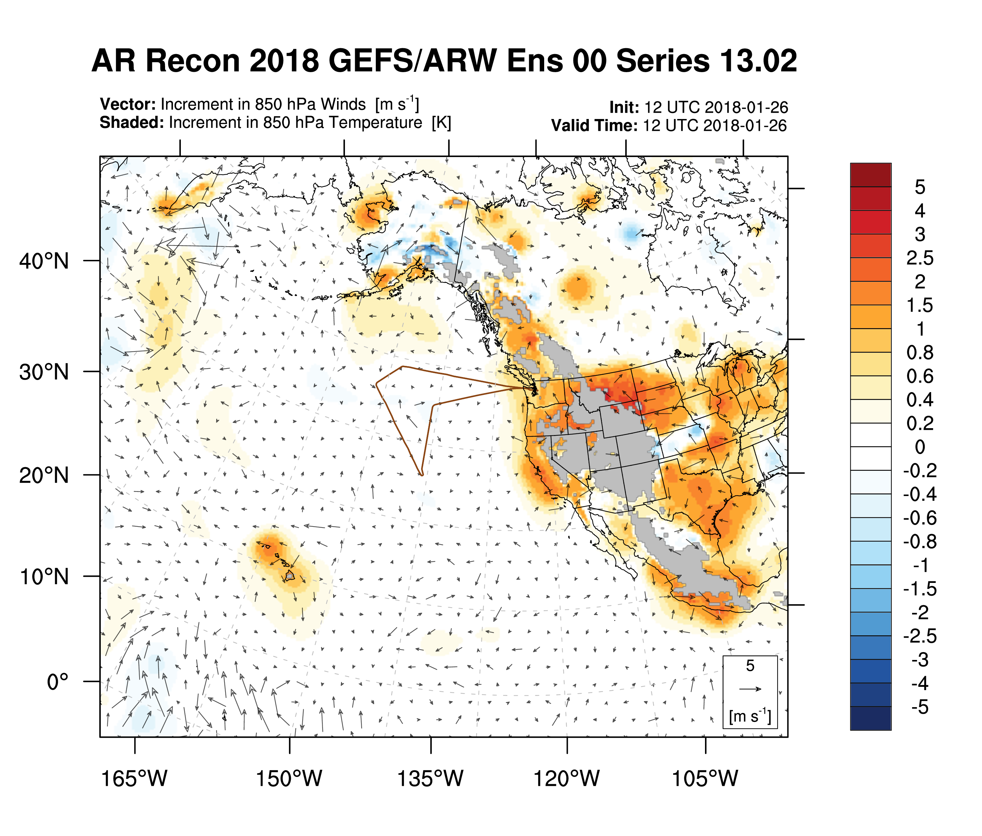
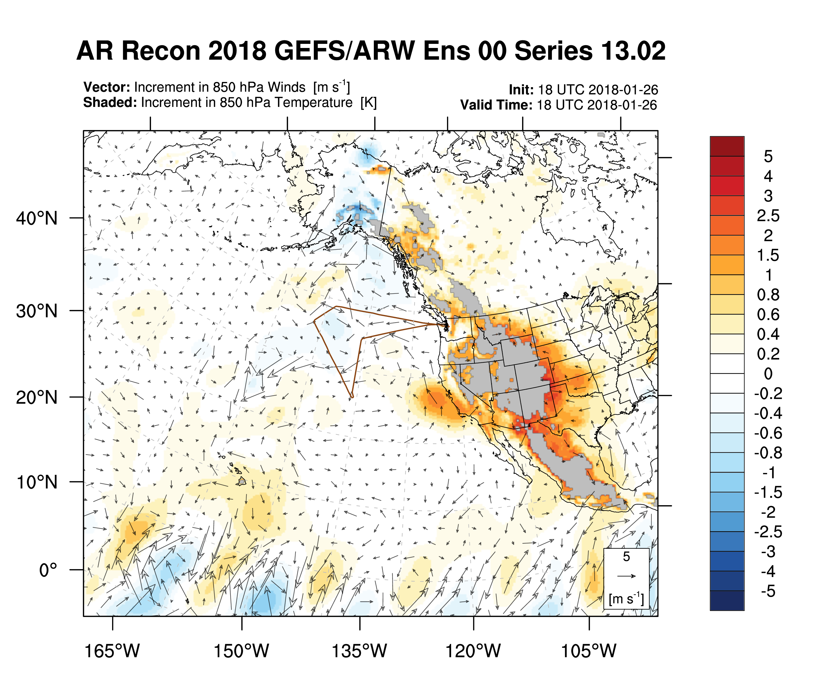
Increment in Temp @ 850 mb
Each cycle is shown
Dropsondes are in last cycle (00 UTC 2018-01-27)

Slide 11
Potential Reasons for Problem
Background Error (BE) is bad
  Single obs test looks reasonable
Obs themselves or Obs Error are bad
  Seems unlikely because they are read directly from prepbufr file
First Guess is bad
  Definitely using the right file (time, experiment, etc.). Perhaps WRF is giving us a bad forecast for some reason?
The DA is bad
  The results of the DA itself looks good but maybe issue with the updating with lower/lateral boundaries?
The BC from GEFS into WRF are bad
There is a huge shock to the WRF forecast at the initial DA time that takes more than 6 hours to spinup.

Slide 12
Plots are made of Netcdf wrf output of diagnostic information
Obs – Background and Obs – Analysis for radiosonde observations
Check there is actually no observation at the levels where there is a 5
Check if the obs_error for Lihue, Norman, Hilo in the diagnostic file is the same as the obs_error in the original prepbufr file?
Is there a bunch of obserror flags in the original prepbufr for the missing humidity data at Lihue that indicates prepbufr already knew the data was bad, or is it getting kicked out?
Check where /if the QC is kicking it out, at NCEP or in our WRF? By looking at prepbufr
What radiosonde data levels are in the original prepbufr file compared to the radiosonde data levels that are in the diagnostic output.
Is there a bad quality flag for the data in the original prepbufr file? What do those flags mean?
Lihue, Norman, Hilo why are there absolutely no humidity data below 750 at this radiosonde site. (u Wyoming and prepbufr )
Check why Obs-Analysis can be exactly zero in radiosonde comparison plot, is it because there is no value calculated because the observation is missing or blacklisted in the QC process?
(not critical because I’m pretty sure we just subtracted zero from zero to get zero)
Hypothesis that the first guess is a wrong file for some reason so the difference between a radiosonde obs and the first guess is huge and gets kicked out within the step that screens for outlier data.
Obs – background = innovation from an individual radiosonde.
Calculate directly from radiosonde data and a profile extracted from the model
Read prepbufr file for radiosonde data, extract correct point from model.
You plotted from diagnostic output
Hypothesis => the first guess model file that is used in the DA is the file that you can go get directly and look at it (checking the diagnostic output)
Check that the increment = analysis – background is smooth with height, calculate this directly from the wrf model files, not from the diagnostic output which might have put in a zero or a nan when you calculate increment = (o-b) – (o-a) = a-b from diagnostic output (after figuring out how to remove the exactly zero values) for example at a radiosonde location
Check visually for smoothness, and that the difference is reasonable realistic (not crazy)
Bruce wants a plot of innovations Obs – Analysis (from diagnostic output) over increment Analysis minus background (increment from your above model minus model, not from diagnostic output)
(this is lower priority for Jennifer, do the others first, I’ll take responsibility for walking into Bruce’s office)
So the same as above calculate analysis on pressure levels – background on pressure levels (not critical, unless you need it to do Bruce’s calculation above)
Produce a synthetic observation profile at Lihue by extracting the model profile at that location from first guess model and put it in an ascii little r file all by itself and run the da. The innovation and the increment should be zero numerically close.
Make plot for each layer, Model is zero and the land is not

Slide 13
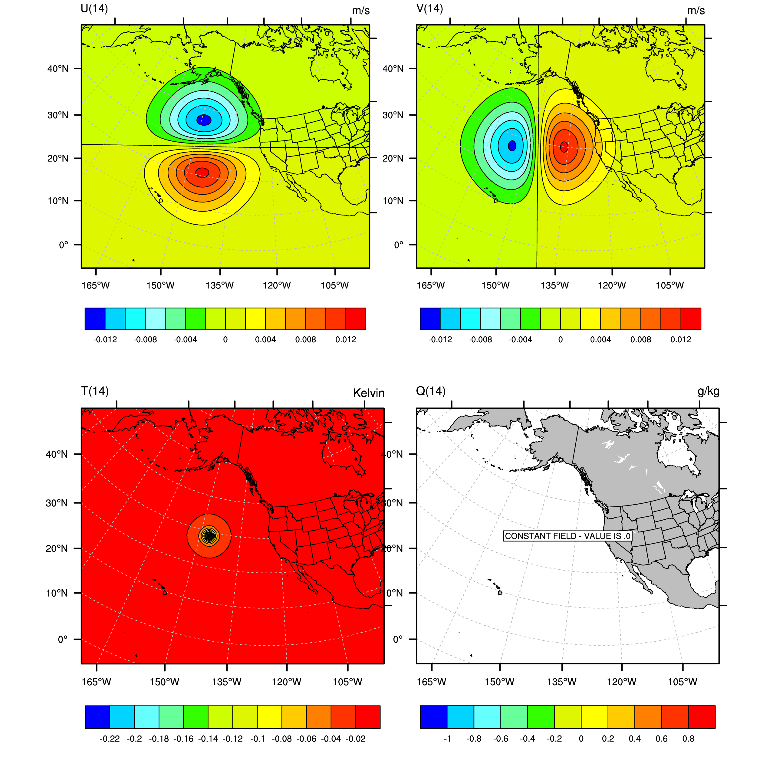
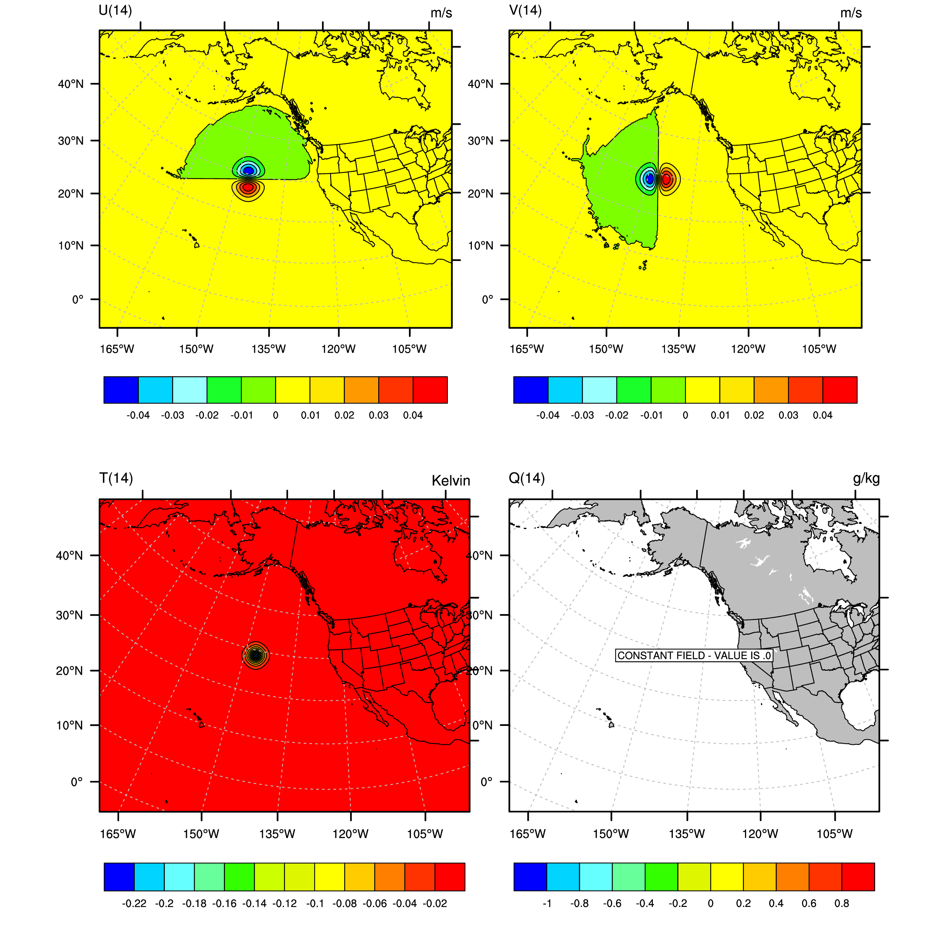
Single Observation Response to
Temperature Innovation (1 K @ ~ 700 mb)
No tuning used
Wind length scale tuning only

Slide 14
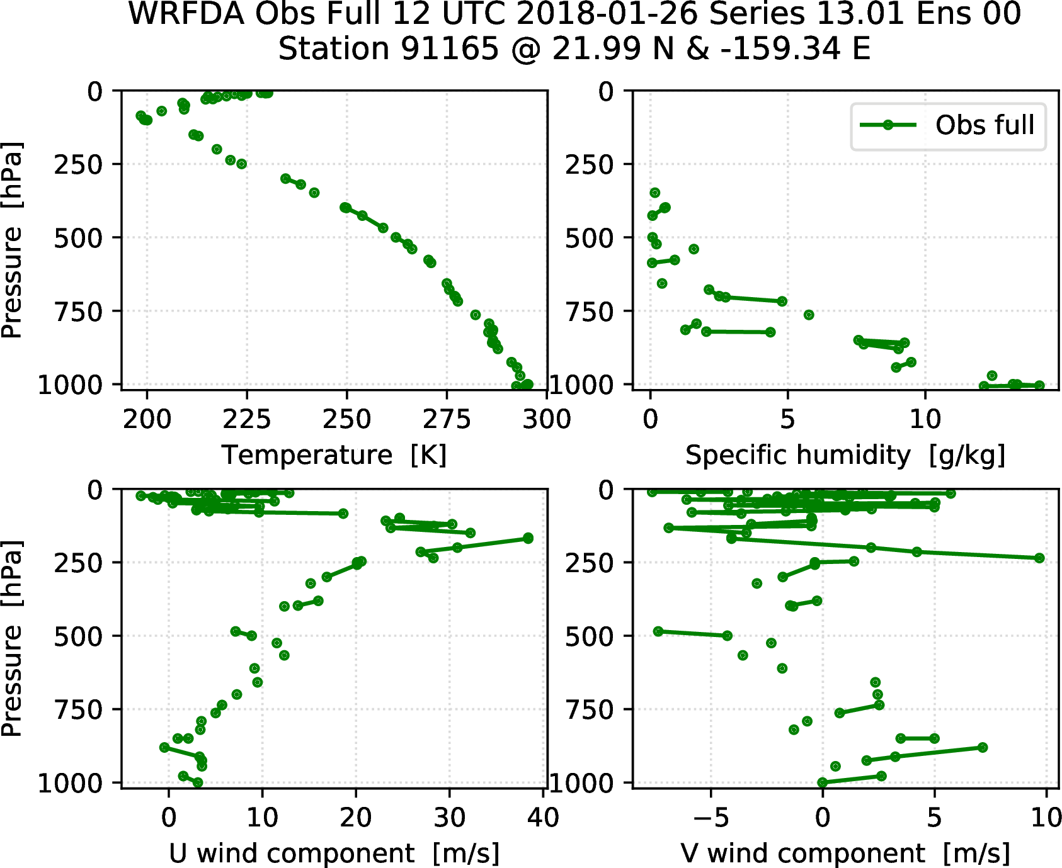
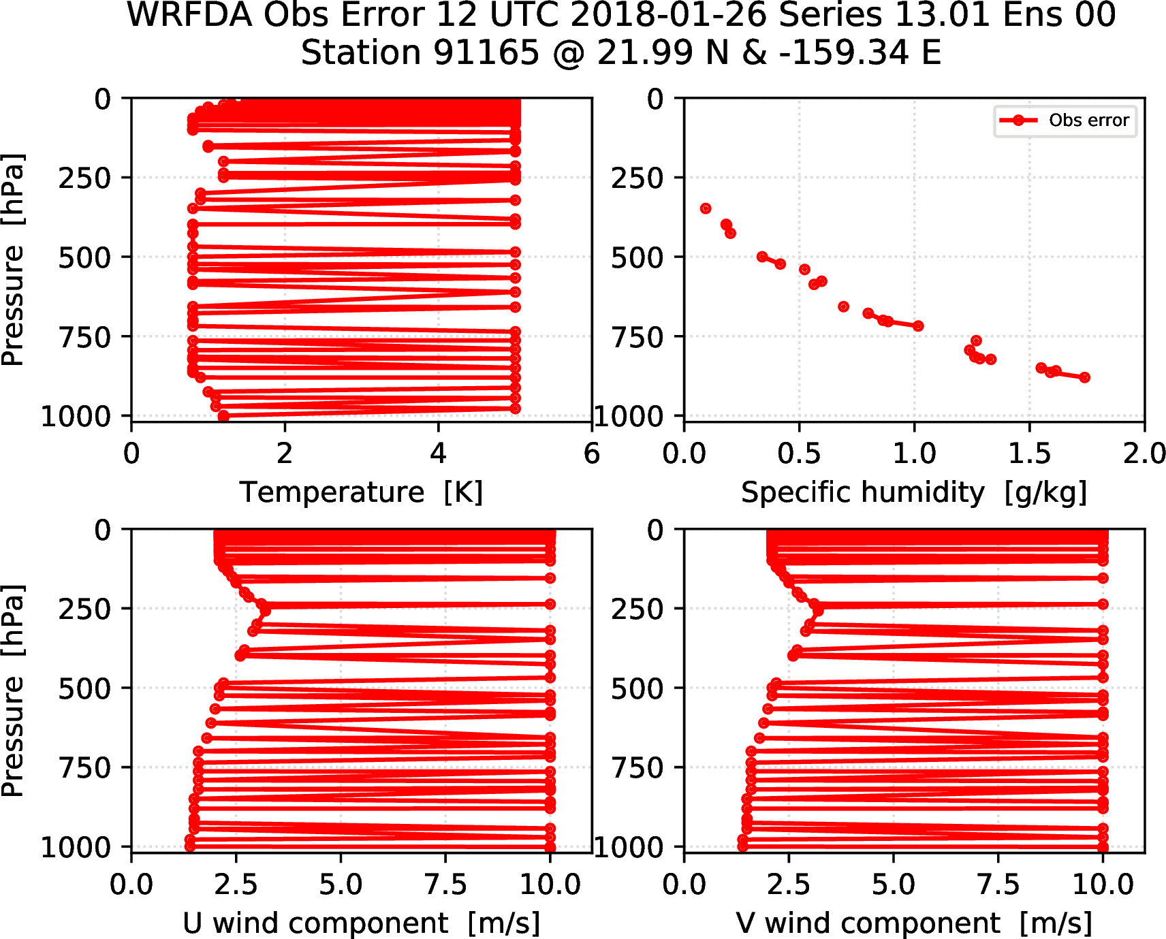
Obs used for DA (Lihue Radiosonde launch)

Slide 15
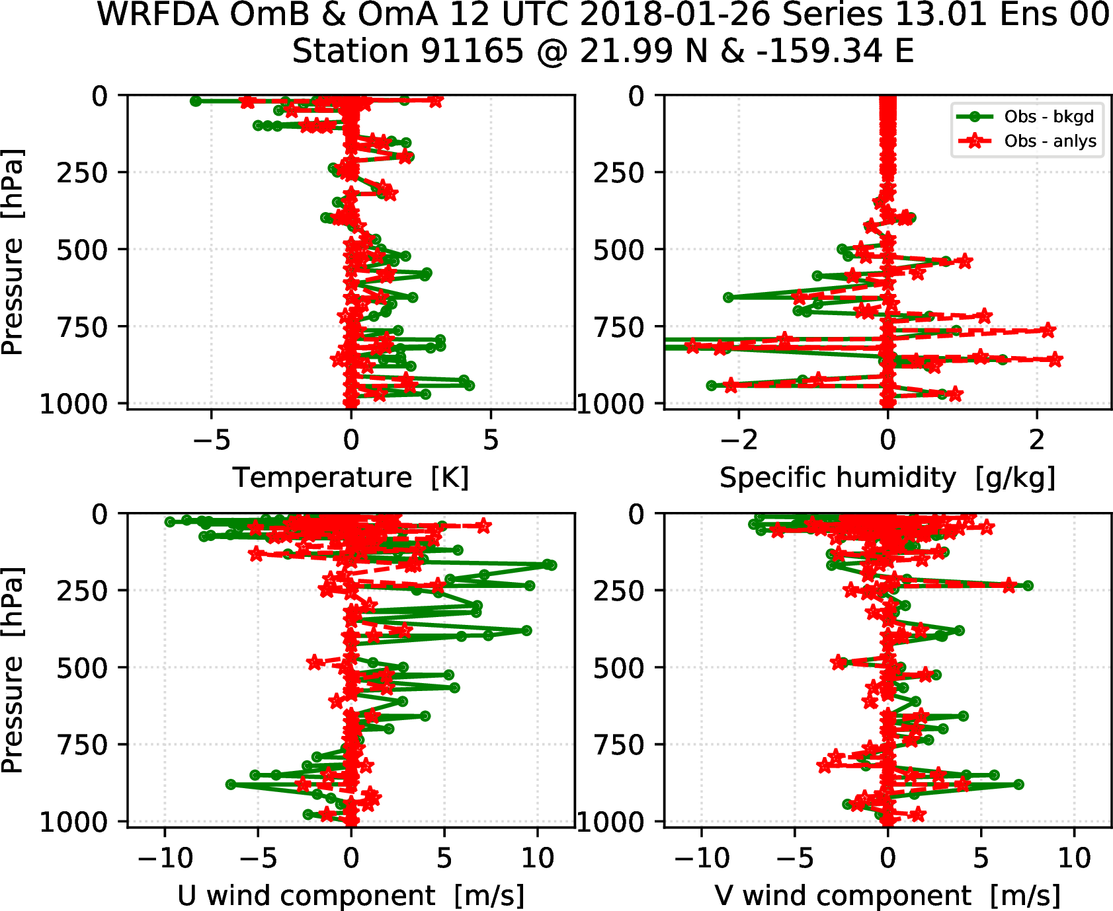
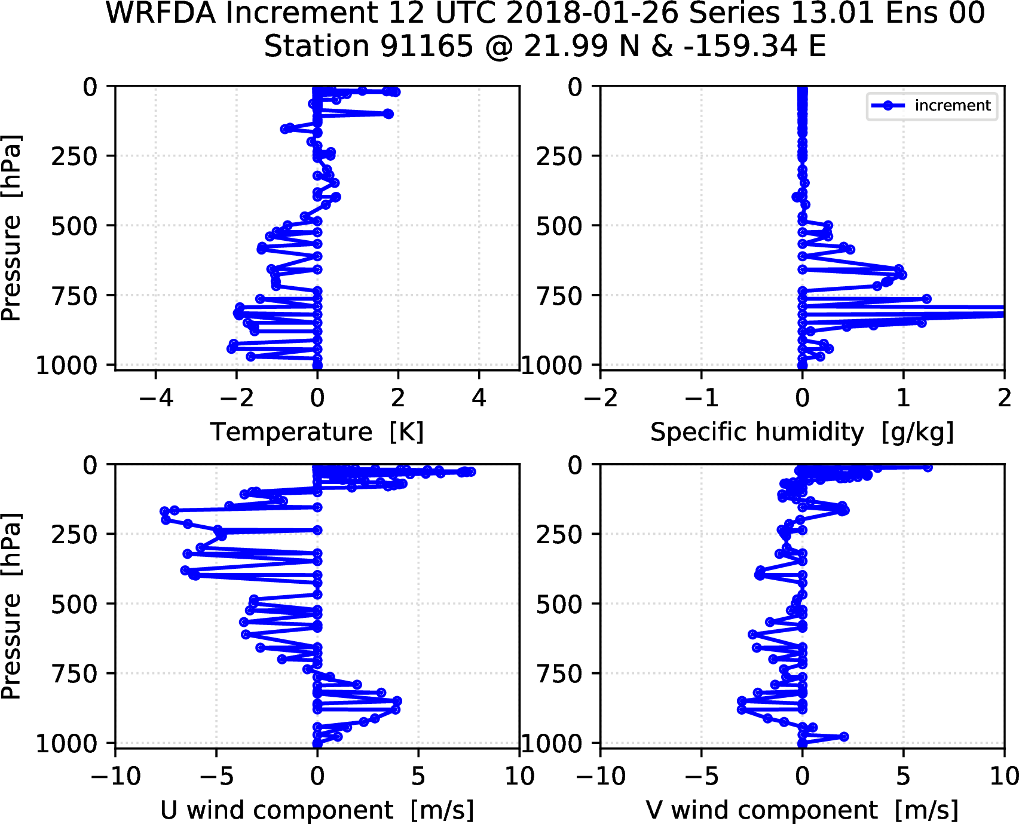
Obs used for DA (Lihue Radiosonde launch)

Slide 16
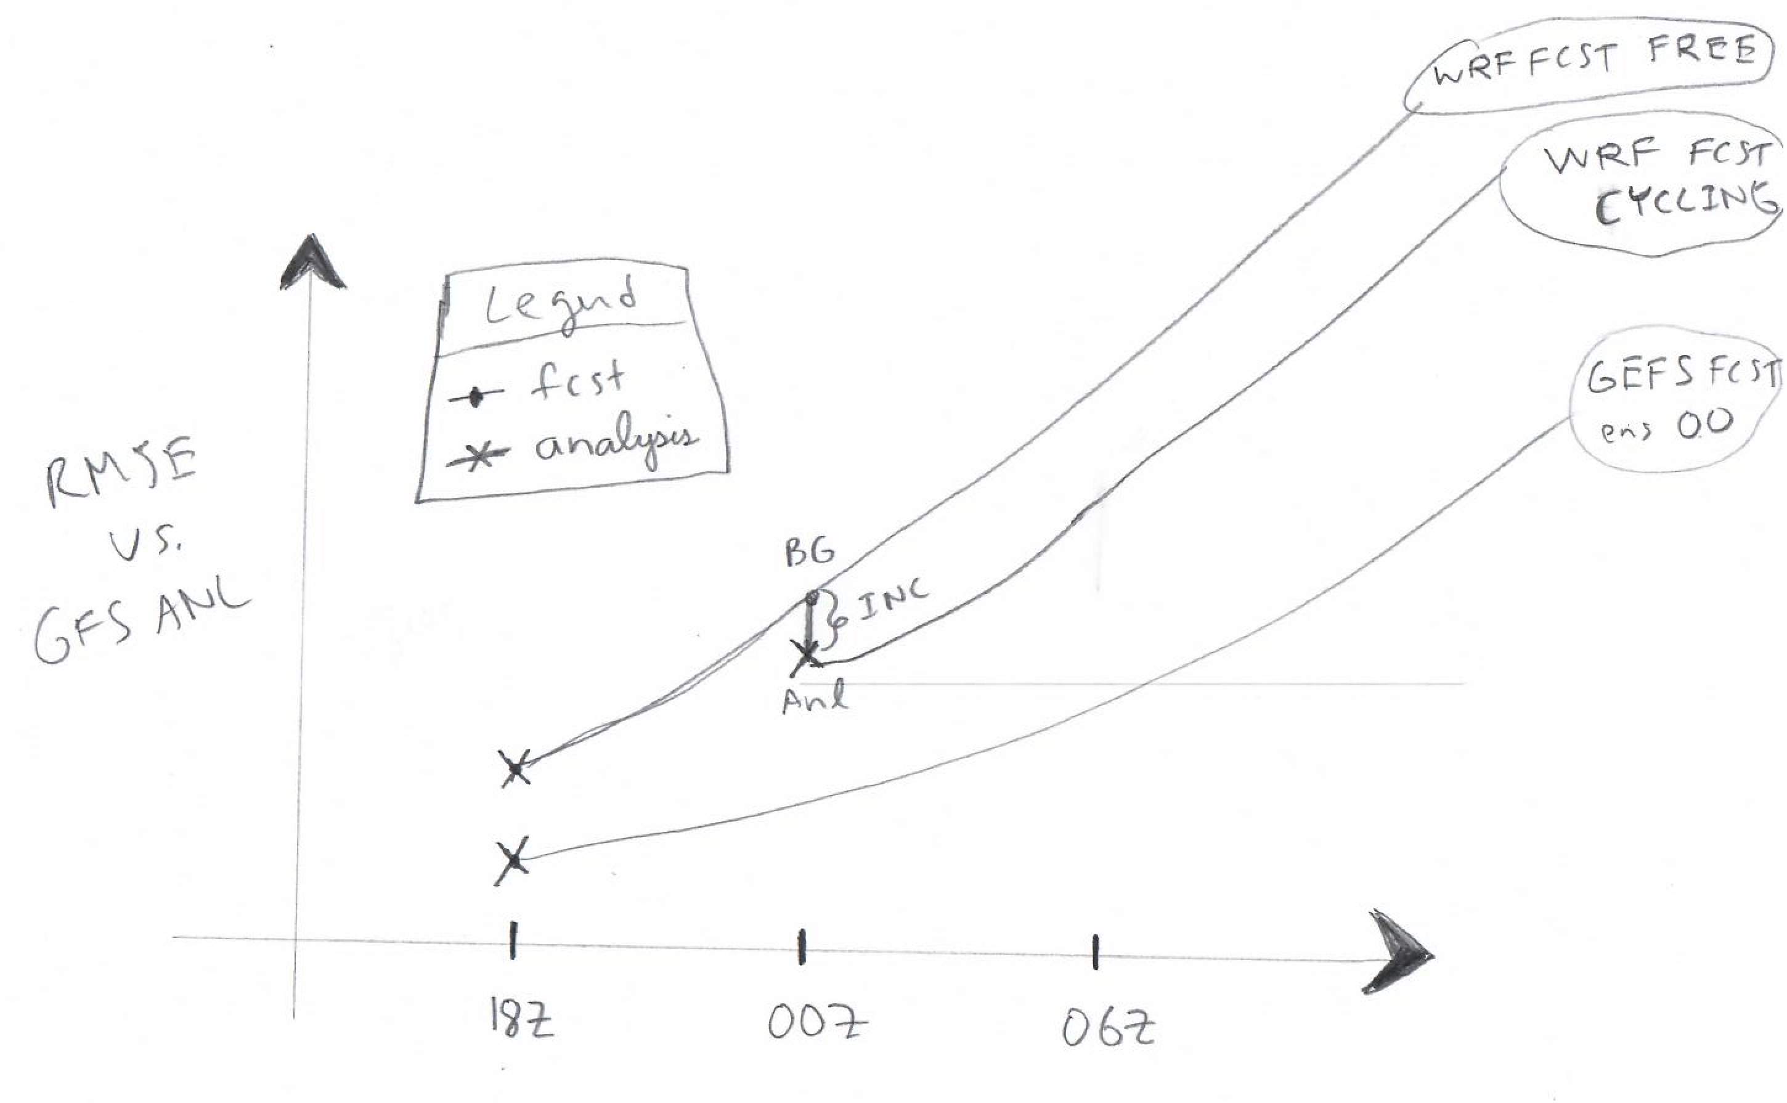
Mimicking MH’s WRF Setup for Cycling
Same as cycling setup described previously but with only one DA “cycle”

Slide 17
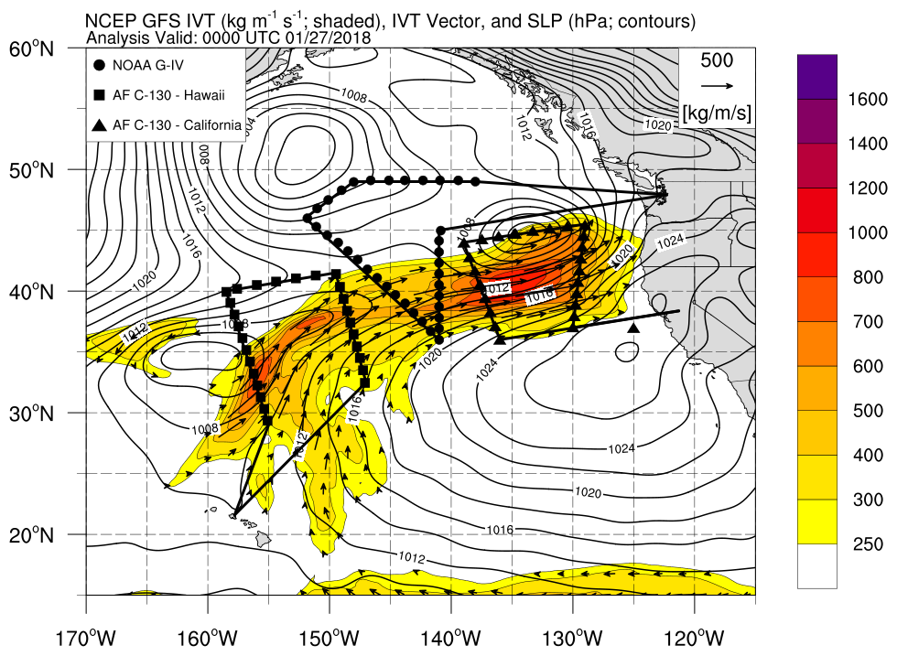
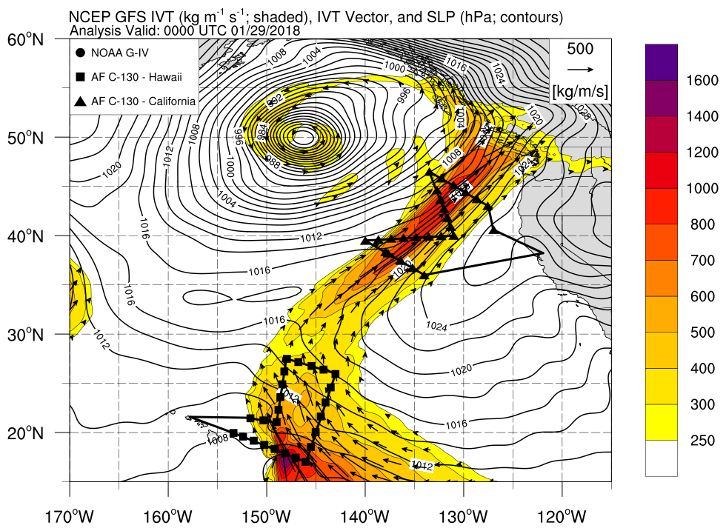
Dropsonde data assimilation experiments (Zheng)
ARO observations are available on 27 Jan 00Z to verify the analysis after dropsonde data assimilation
Preliminary dropsonde data denial experiments comparing 4DEnVar and 3DEnVar (Zheng et al., 2019, in prep.)

Slide 18
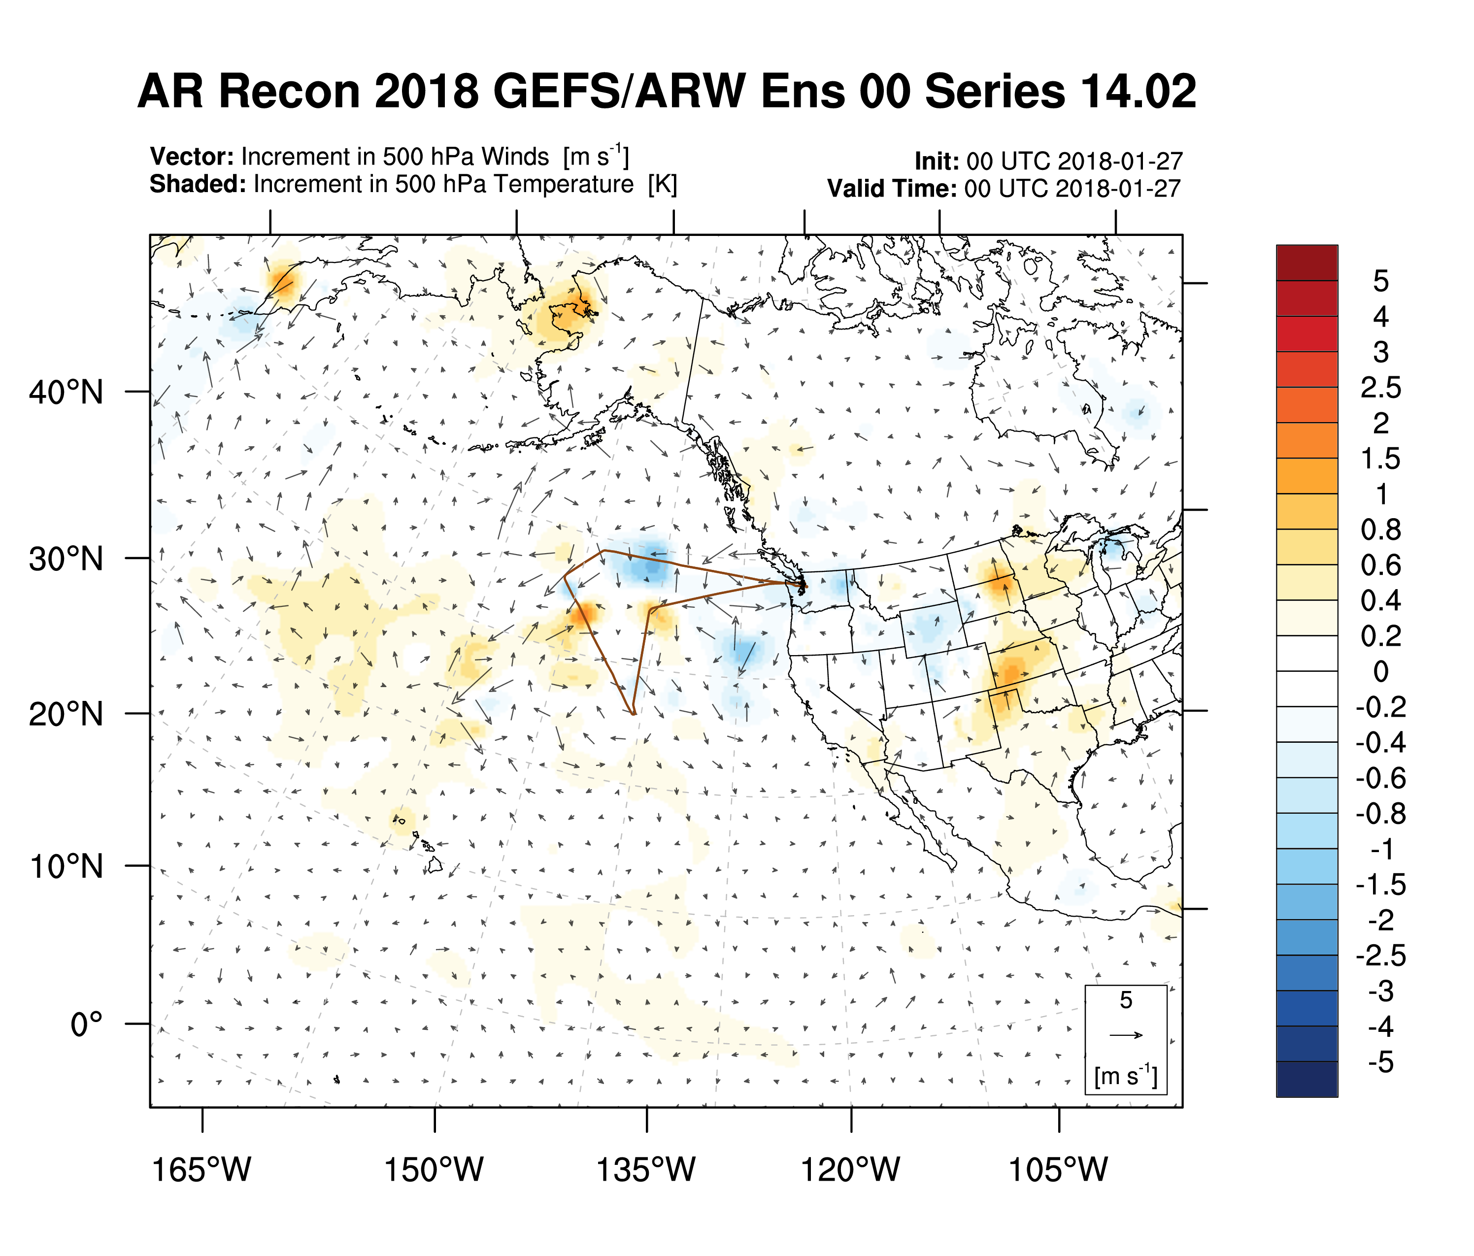
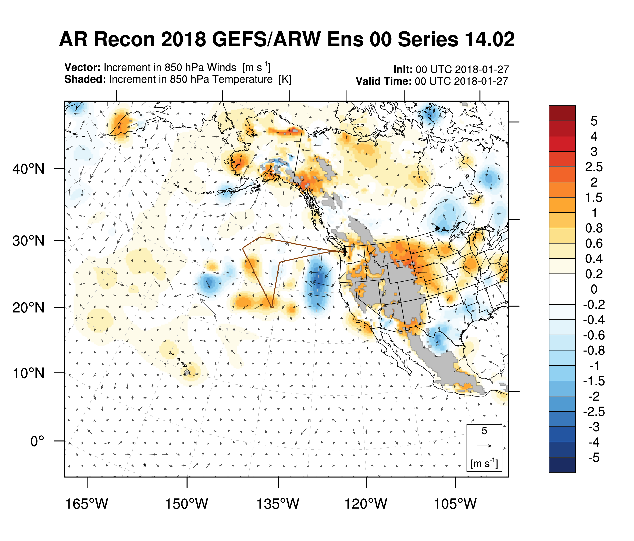
Increments in Temperature

Slide 19
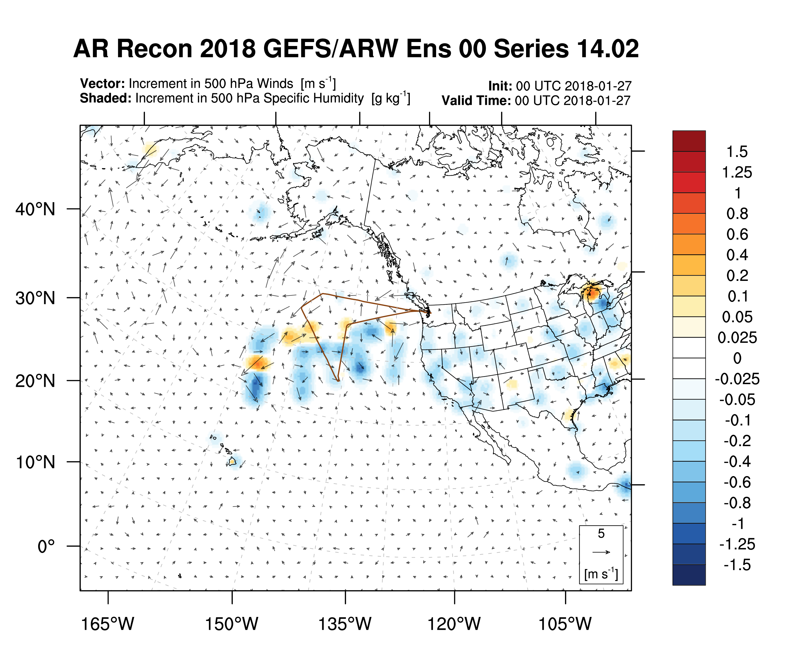
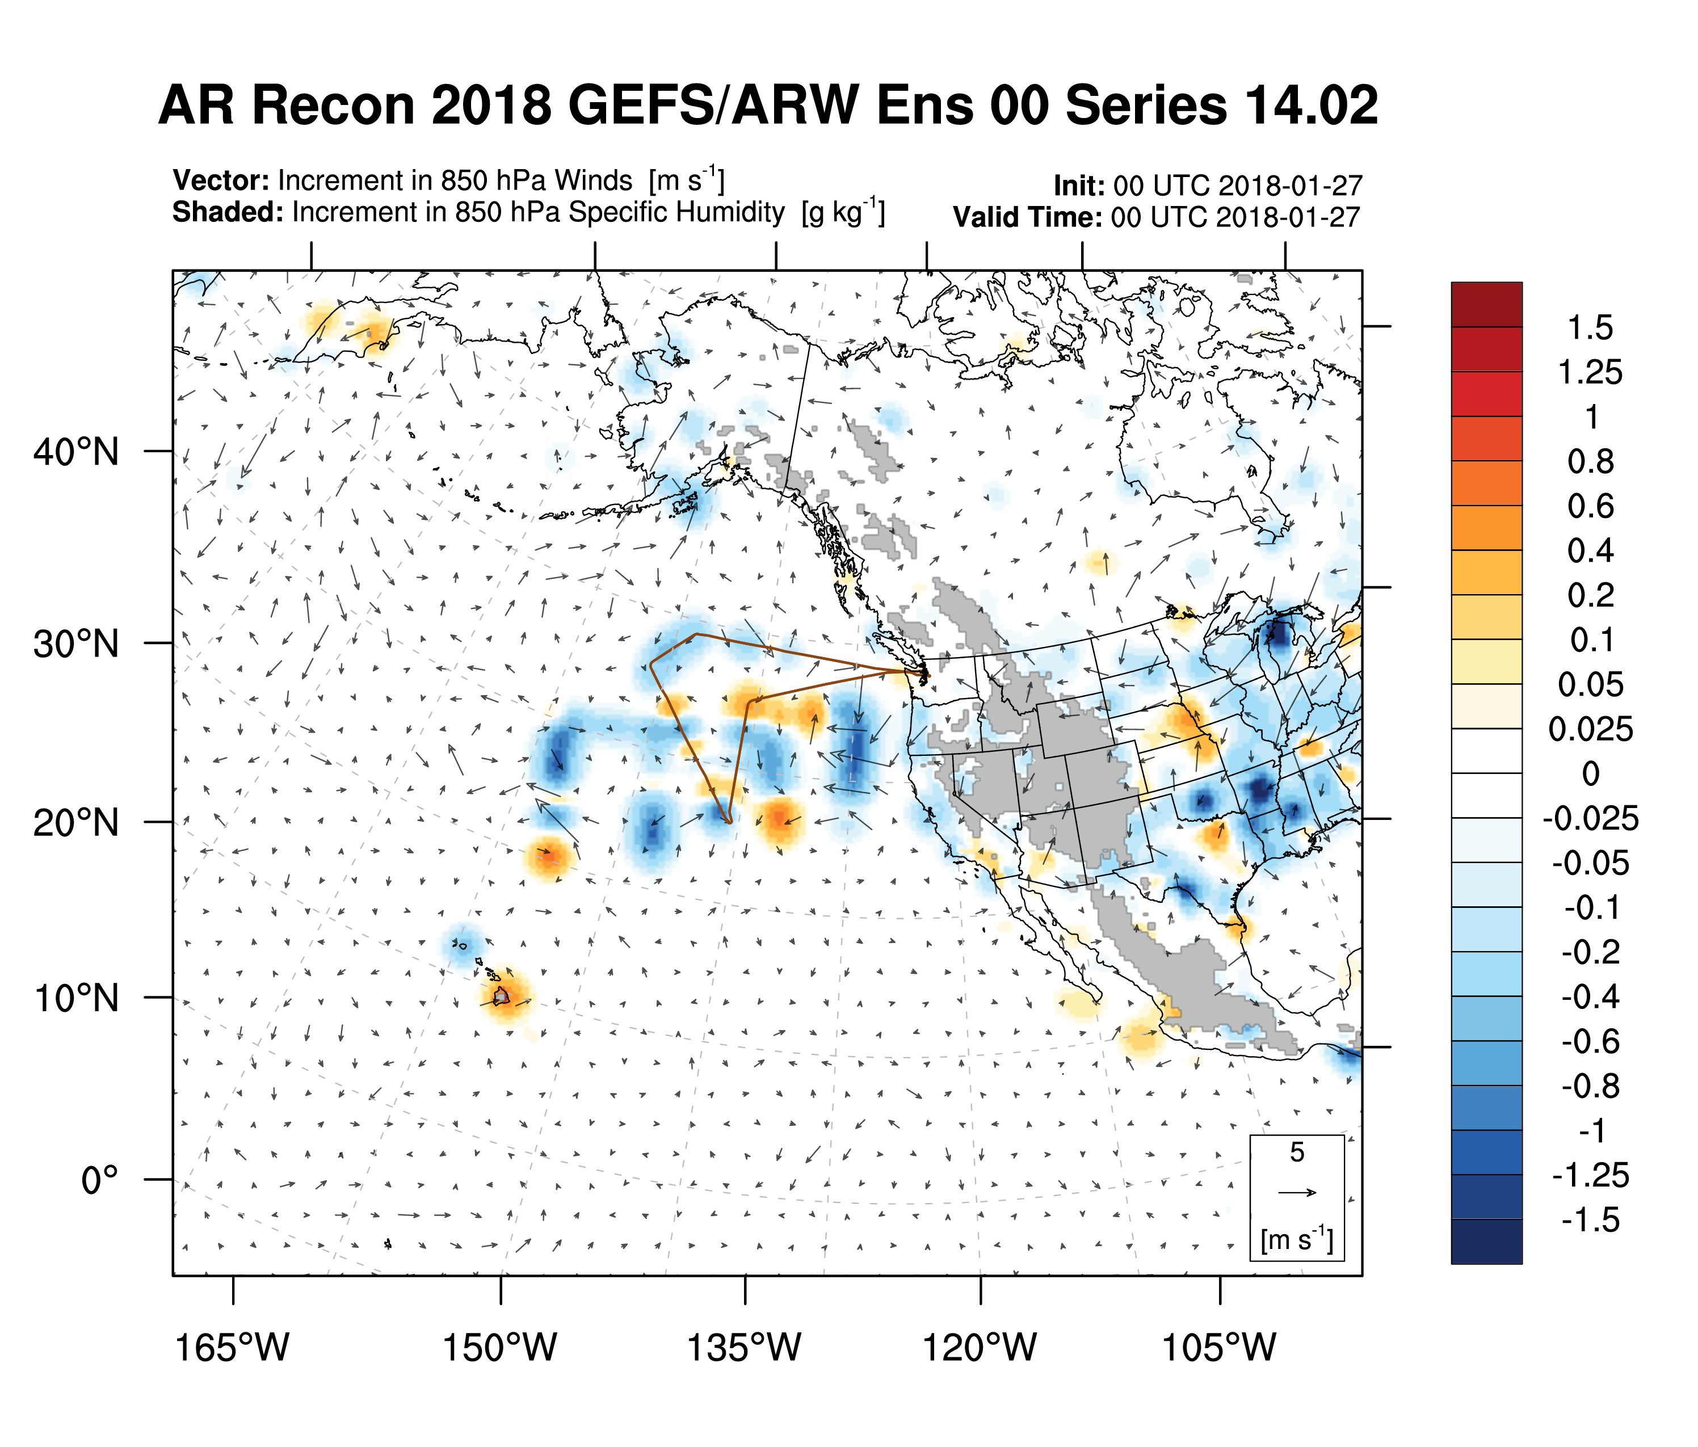
Increments in Moisture

Slide 20
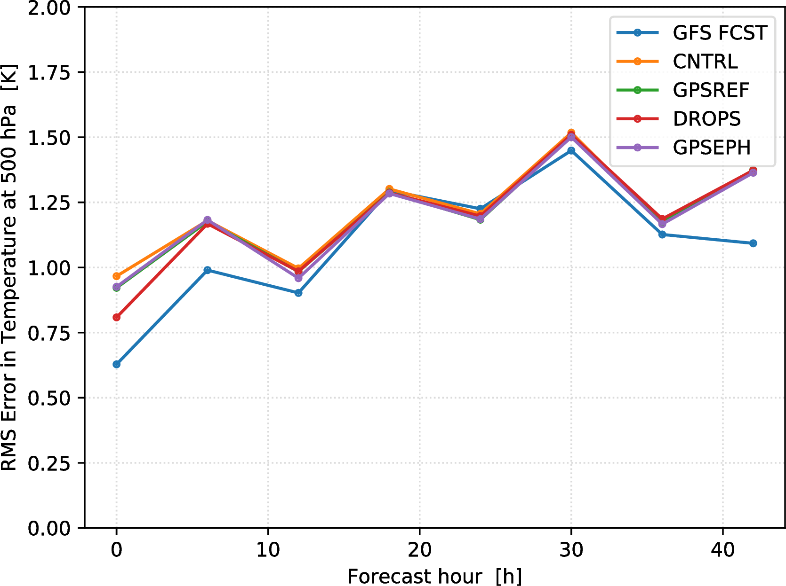
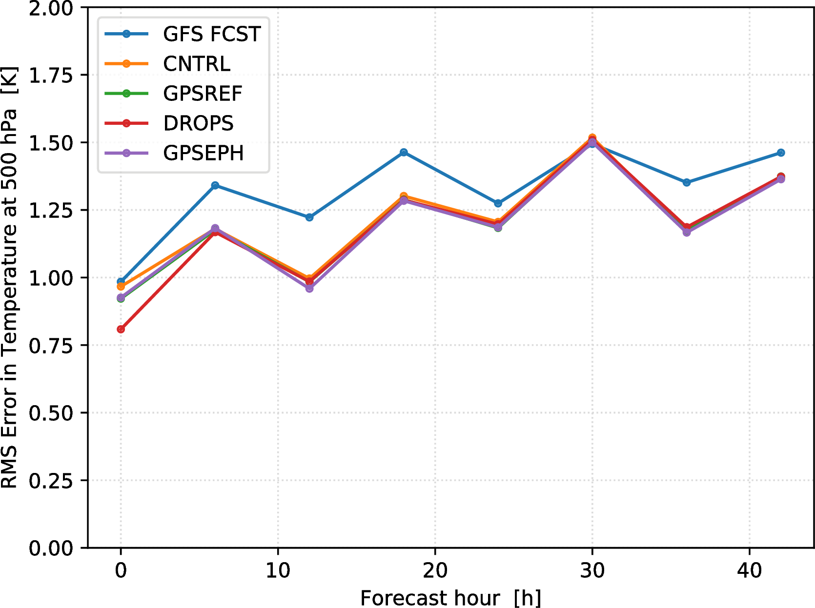
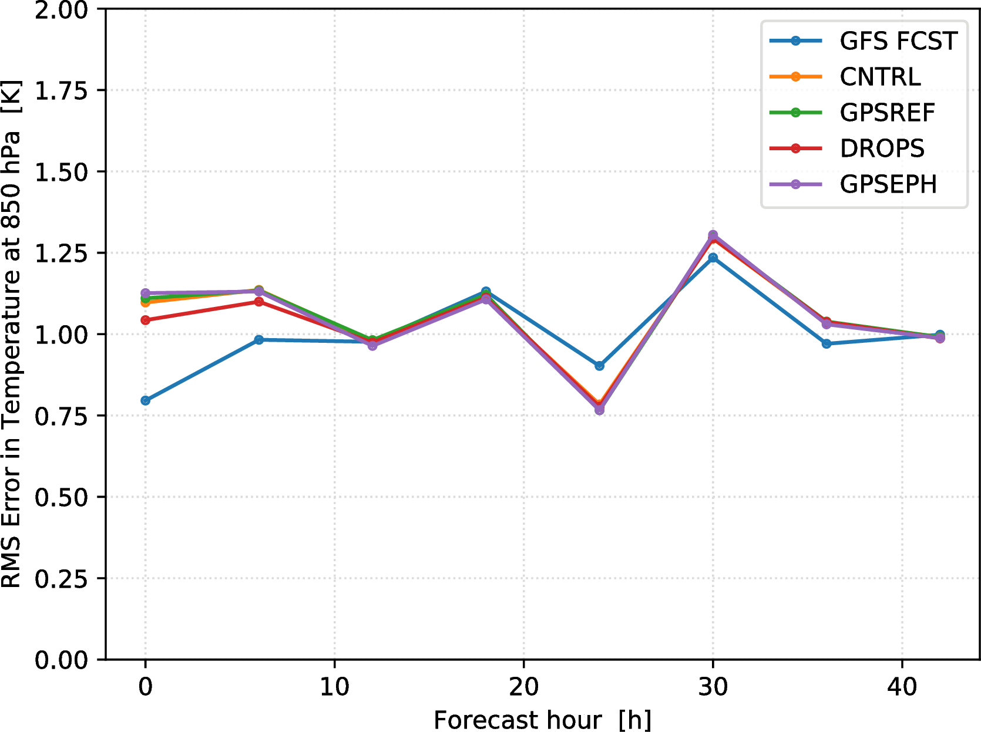
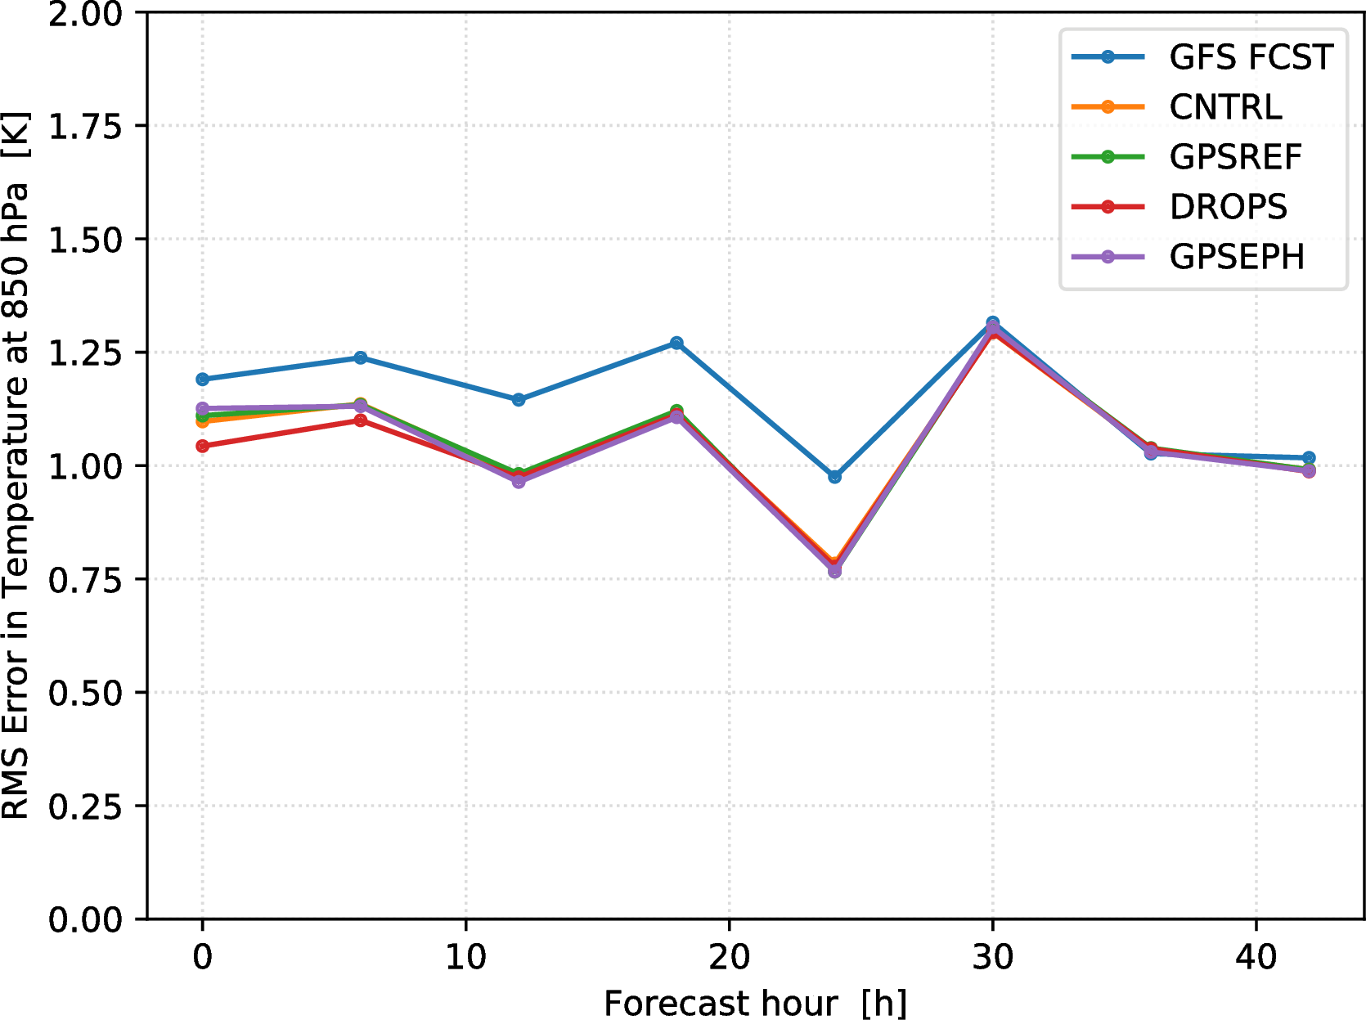
RMS (Experiment – ECMWF Anl) in Temp
BC:
GFS init 00UTC 05 Feb 2015
BC:
GFS init 00UTC 05 Feb 2015
GFS init 00UTC 06 Feb 2015
GFS init 00UTC 06 Feb 2015
Boundary Conditions for DA are GFS forecasts initialized at 00UTC 05 Feb 2015
DA (all experiments) brings temperature forecast closer to ECMWF analysis
Shown also for comparison are GFS forecasts initialized at 00UTC 06 Feb 2015
Notes:
PLACEHOLDER (but from series 11)
Need to switch from using ECMWF Operational Analysis to to GFS Analysis

Slide 21
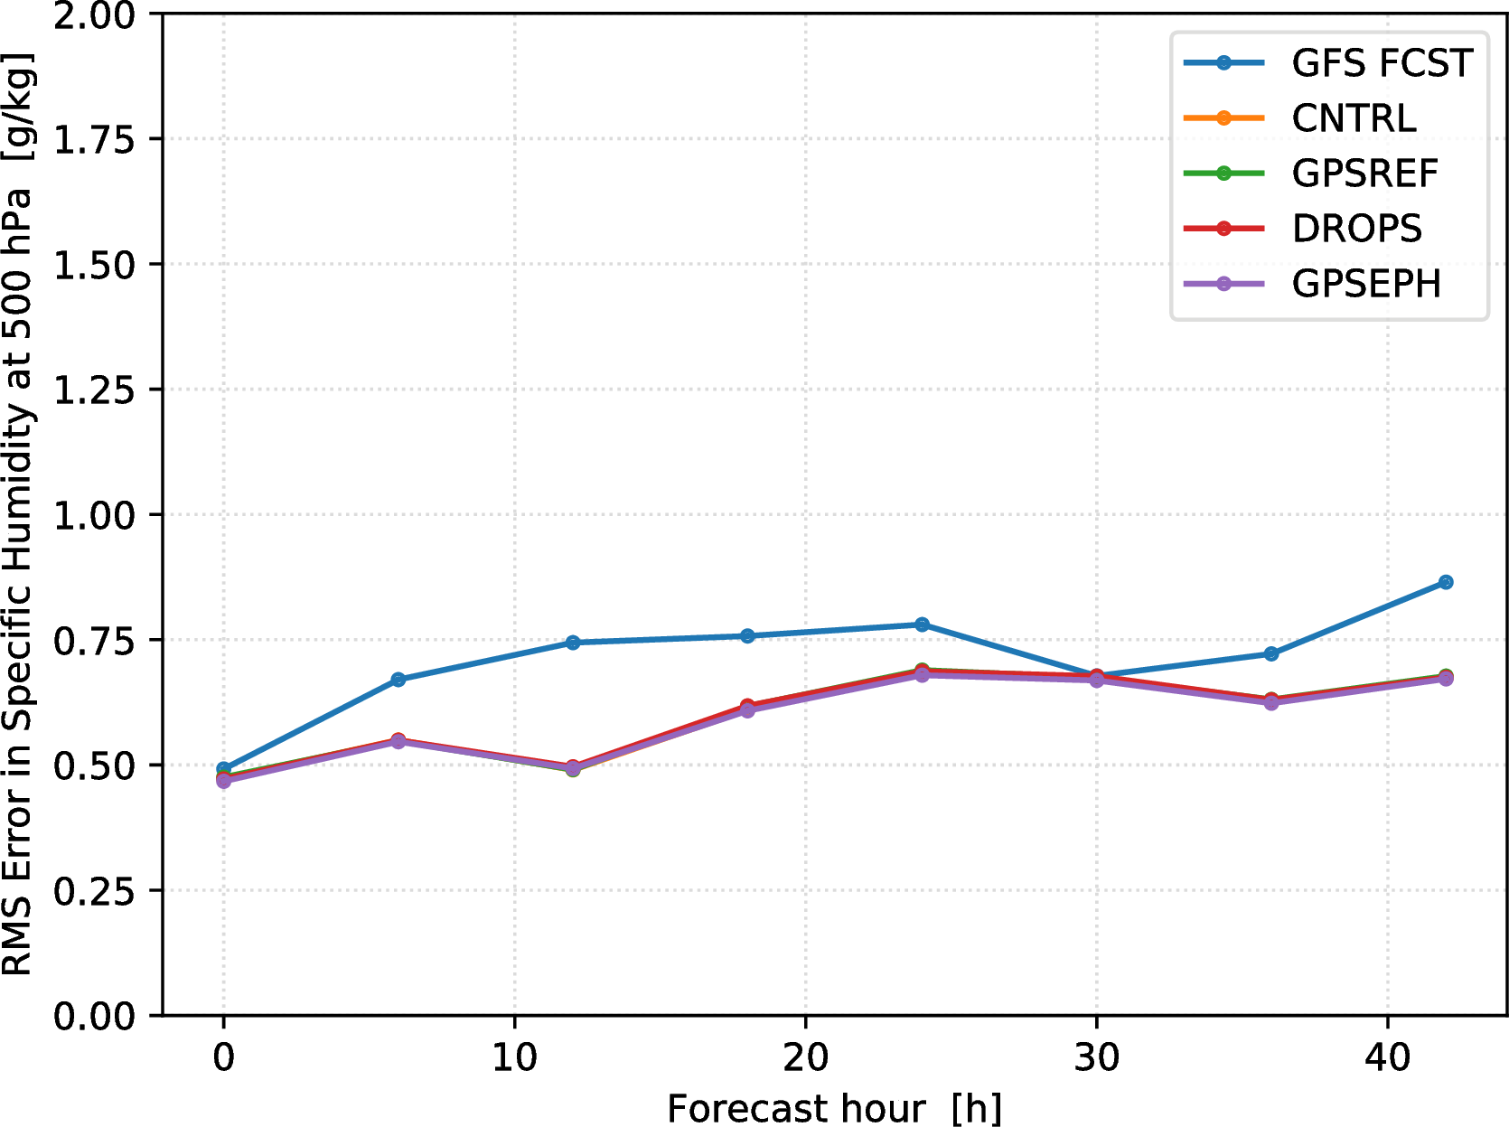
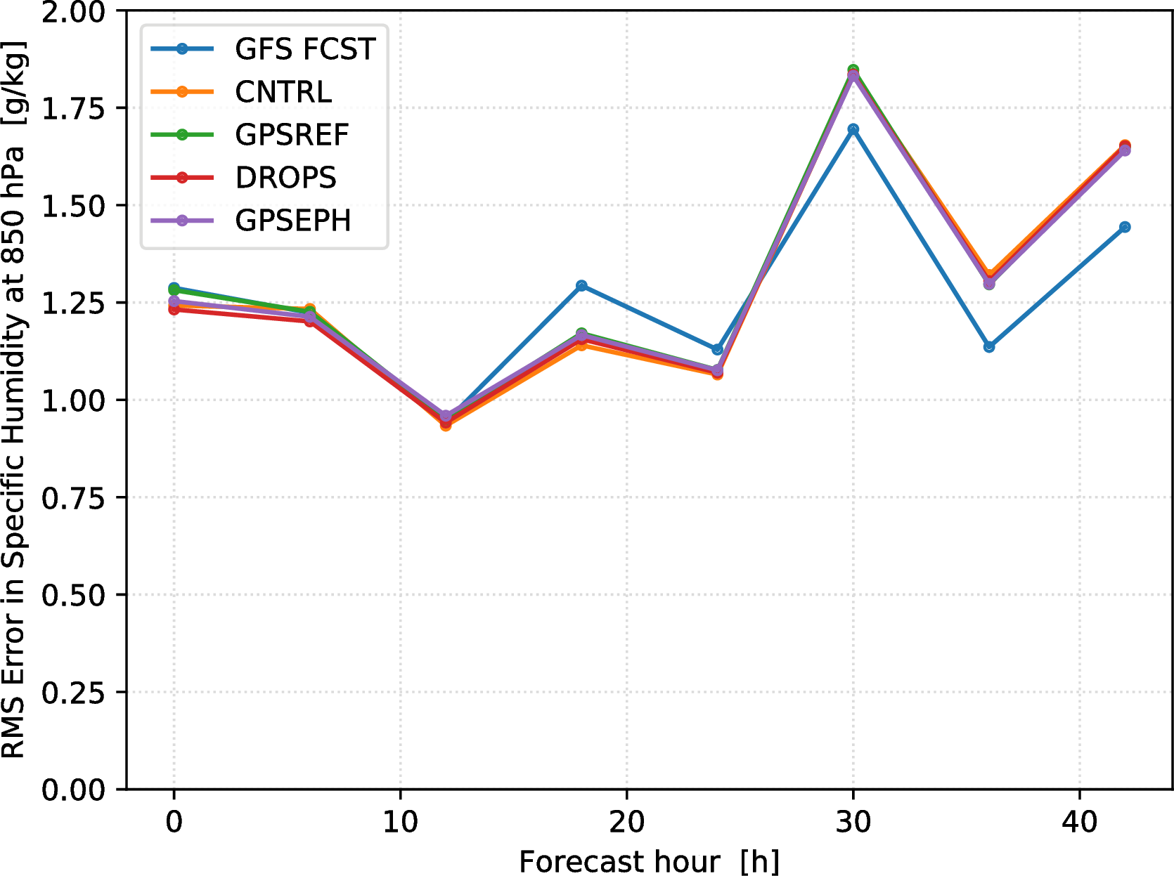
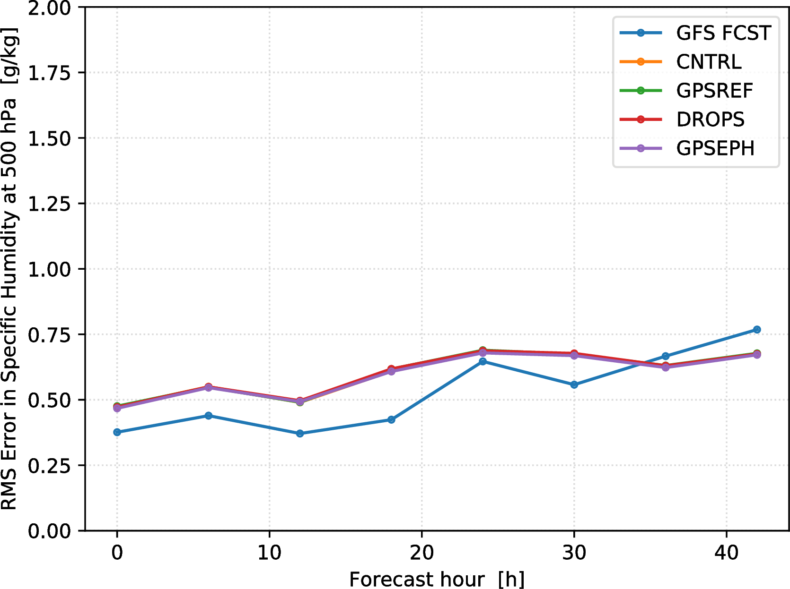
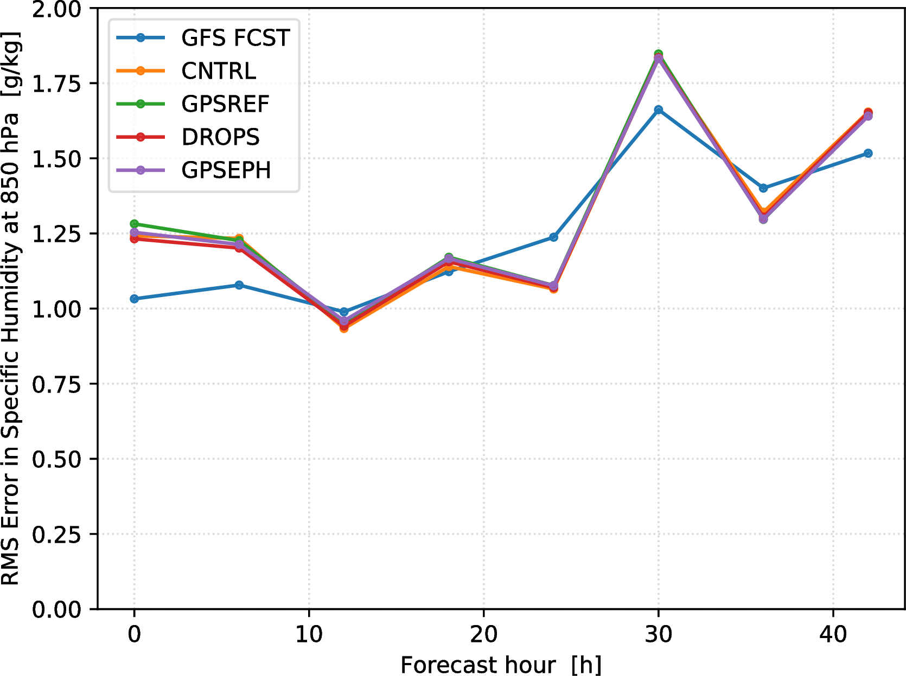
RMS (Experiment – ECMWF Anl) in q
BC: GFS init 00UTC 05 Feb 2015
500 hPa
BC: GFS init 00UTC 05 Feb 2015
GFS init 00UTC 06 Feb 2015
GFS init 00UTC 06 Feb 2015
850 hPa
Boundary Conditions for DA are GFS forecasts initialized at 00UTC 05 Feb 2015
DA (all experiments) brings 500 hPa moisture forecast closer to ECMWF analysis
Shown also for comparison are GFS forecasts initialized at 00UTC 06 Feb 2015
Notes:
Add map view of 500 mb of all exps & GFS Analysis & Fcst
PLACEHOLDER (but from series 11)
Need to switch from using ECMWF Operational Analysis to to GFS Analysis. Show curves for both the bias and the RMS in each plot.

Slide 22
End

Slide 23
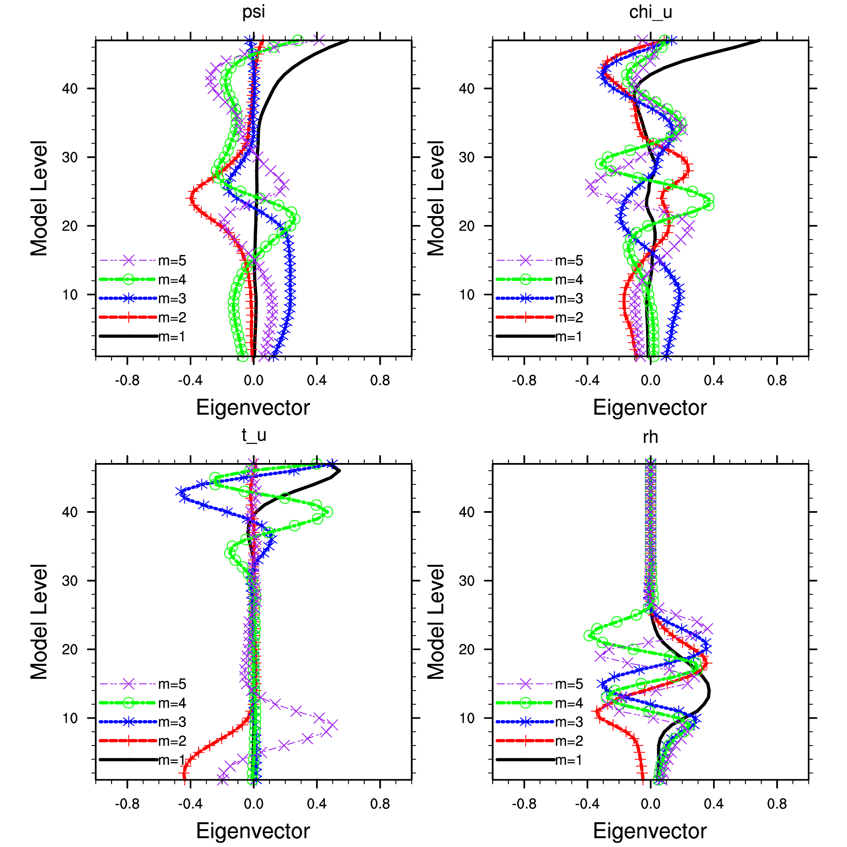
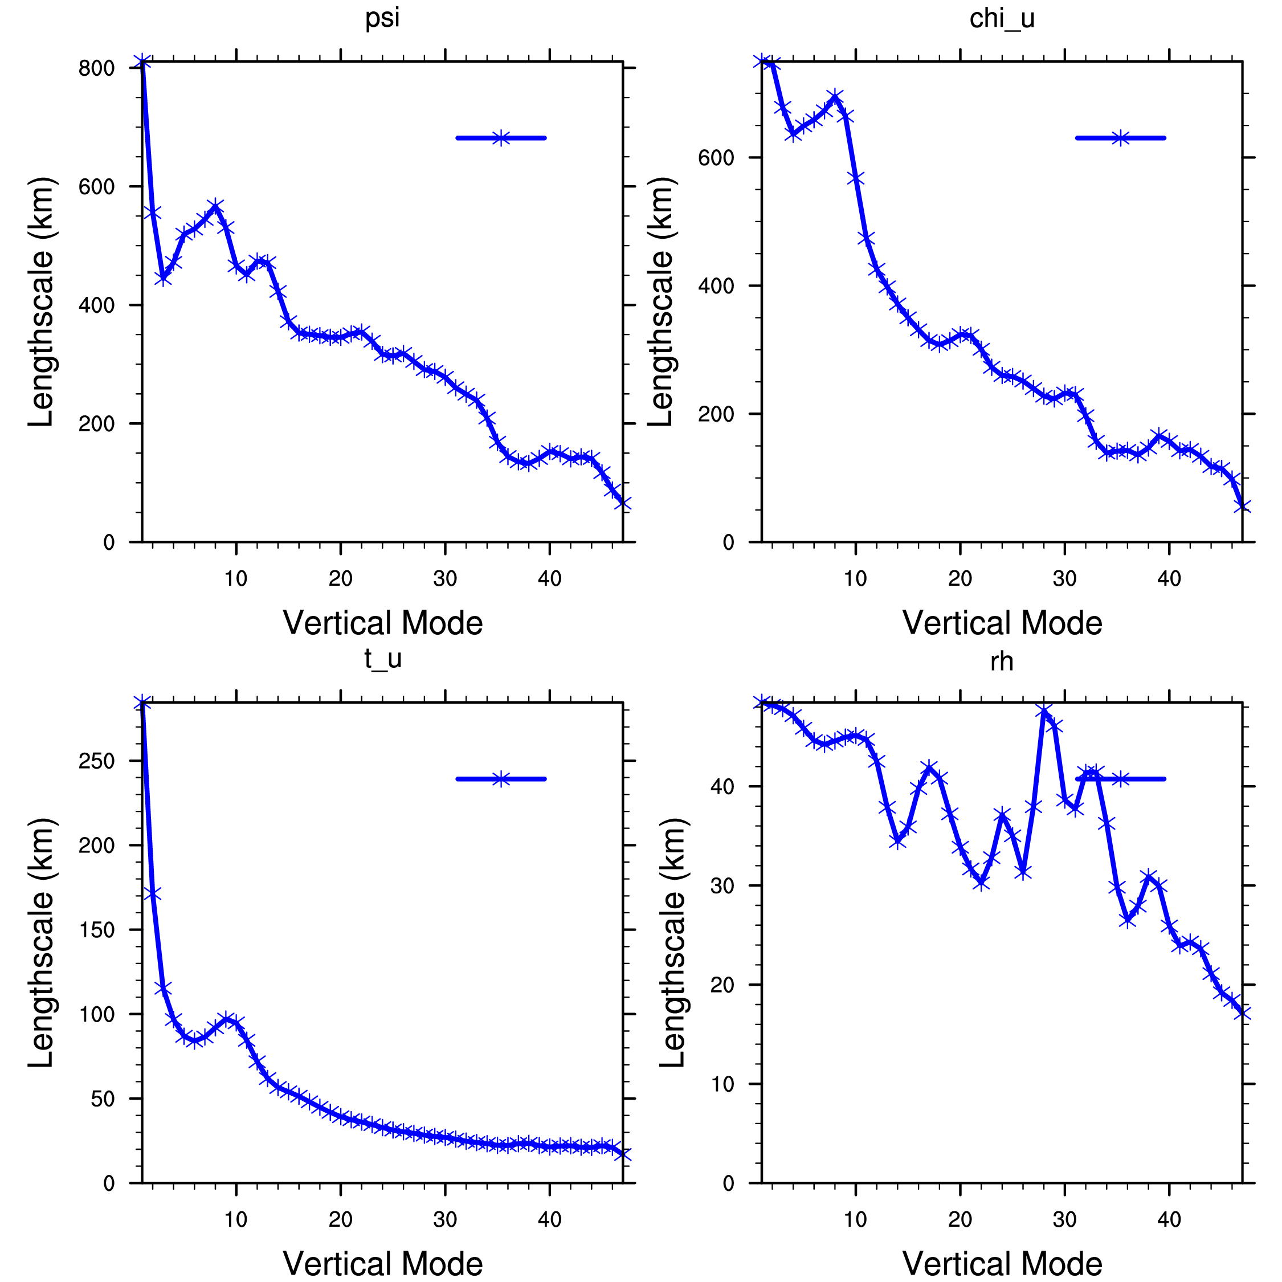
Investigate BE itself

Slide 24
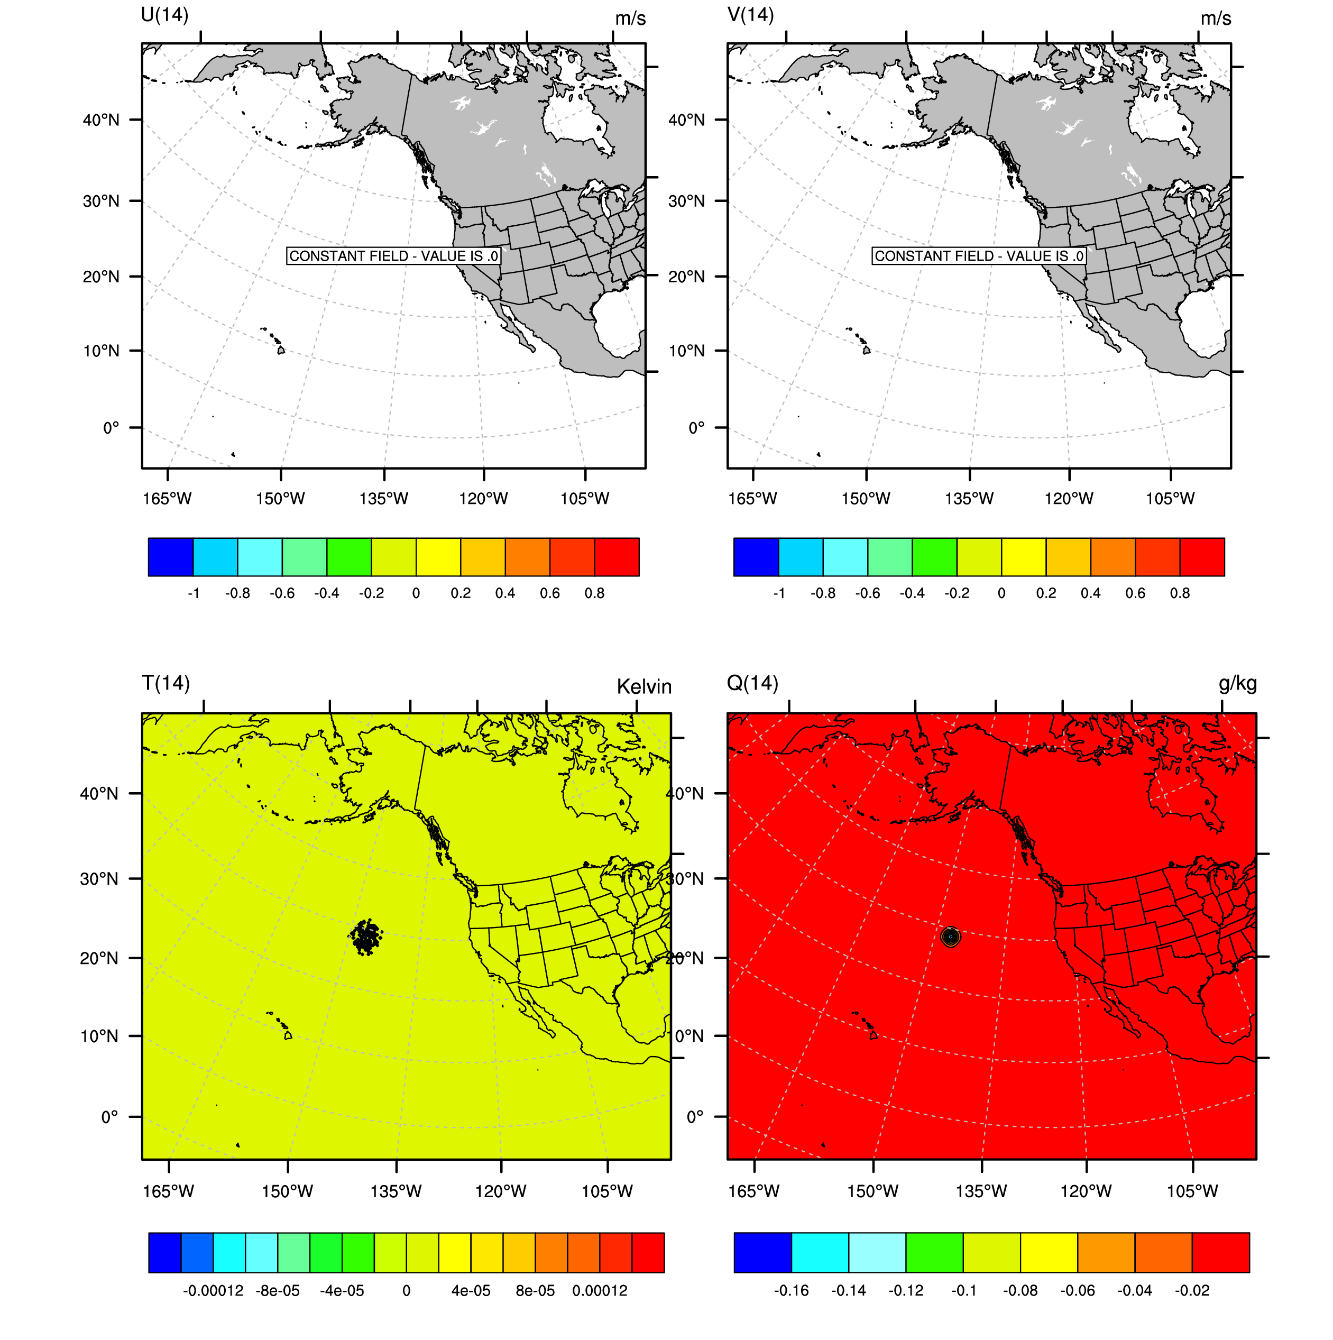
Single Observation Response to
Mixing Ratio Innovation (1 g/kg @ ~ 700 mb)
No tuning used
Wind length scale tuning only

Slide 25
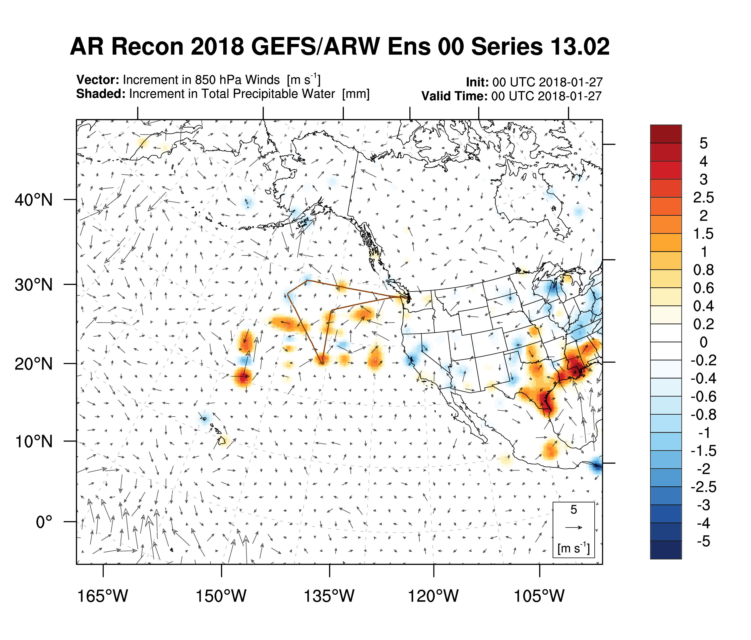
IWV Increments look Reasonable?

Slide 26
Potential Reasons for Problem
Background Error (BE) is bad
  BE itself or BE tuning parameters?
Obs themselves are bad
  Seems unlikely because they are read directly from prepbufr file
Obs Error is bad
  Seems unlikely because it should also be read directly from prepbufr file (BUFR format)
First Guess is bad
  Definitely using the right file (time, experiment, etc.). Perhaps WRF is giving us a bad forecast for some reason?

