Slide 1
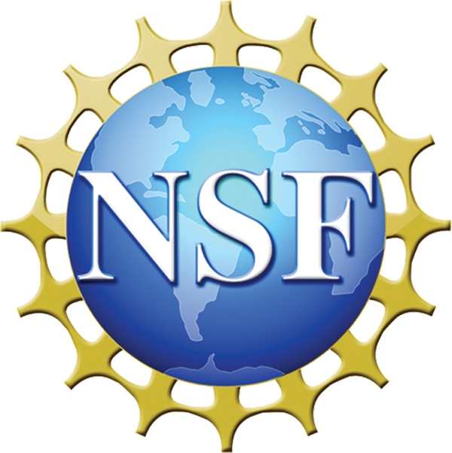
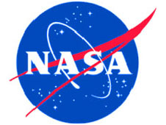
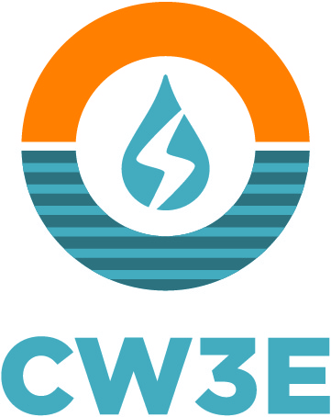
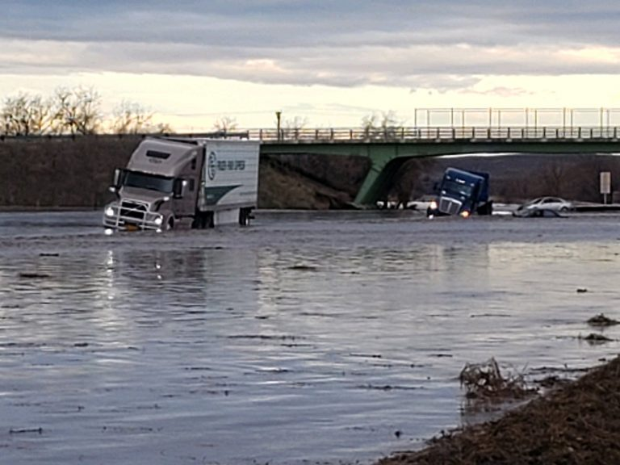
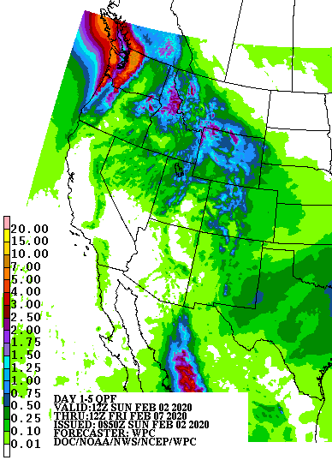
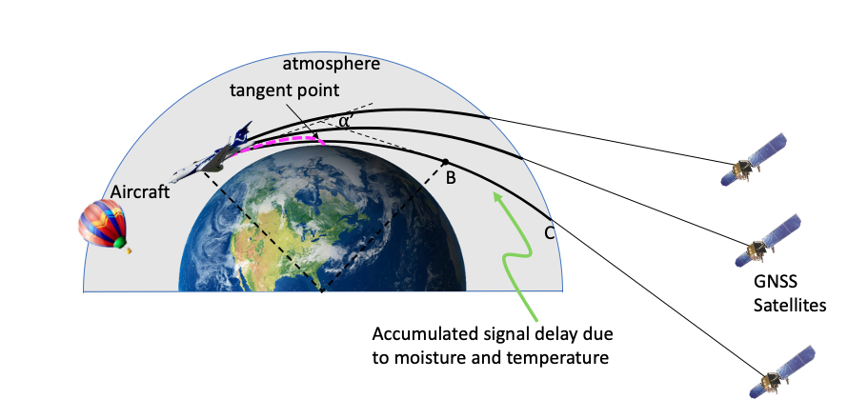
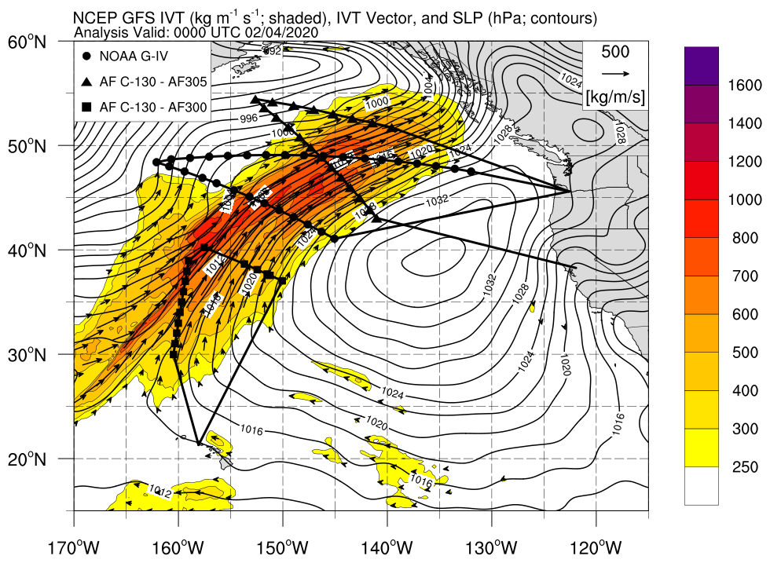
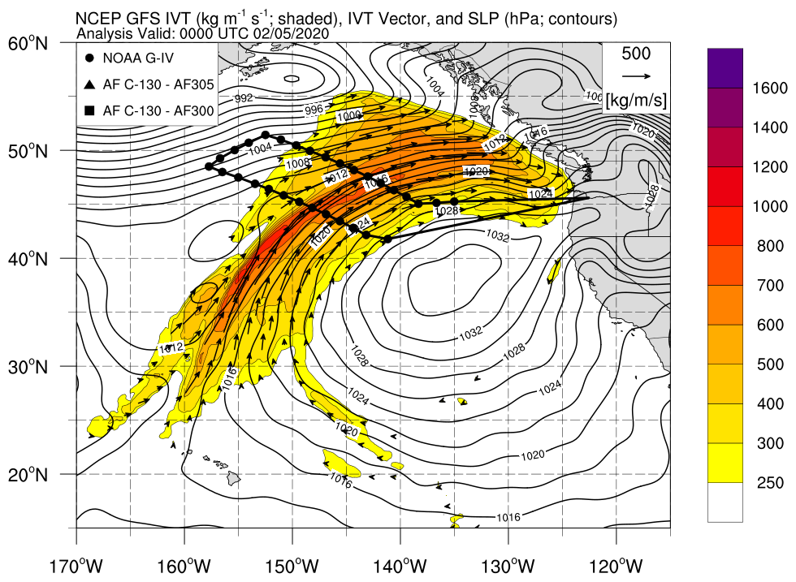
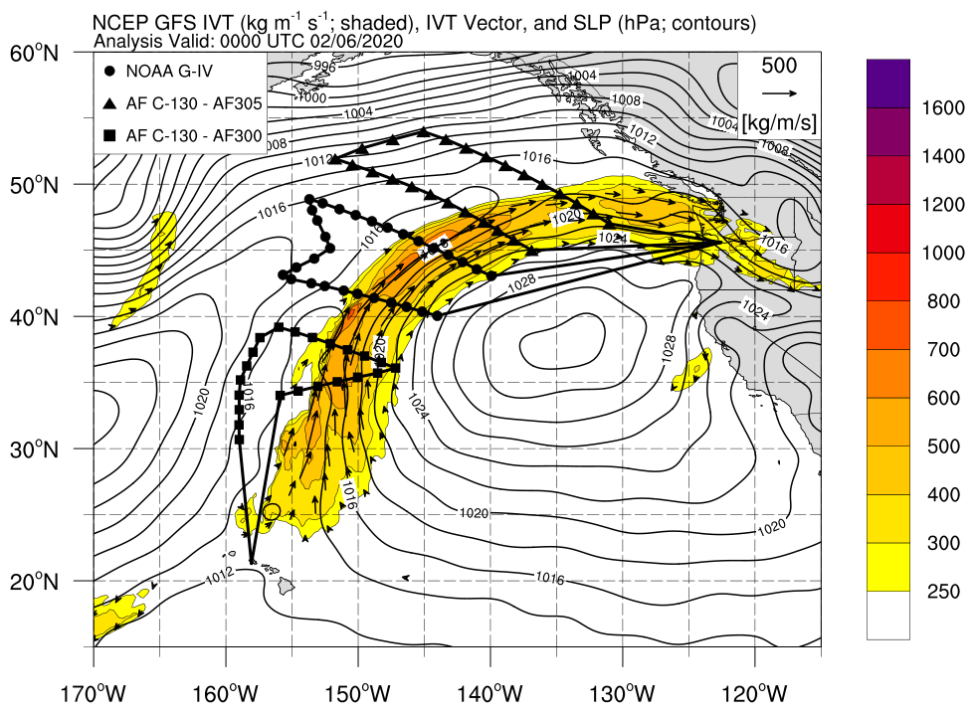
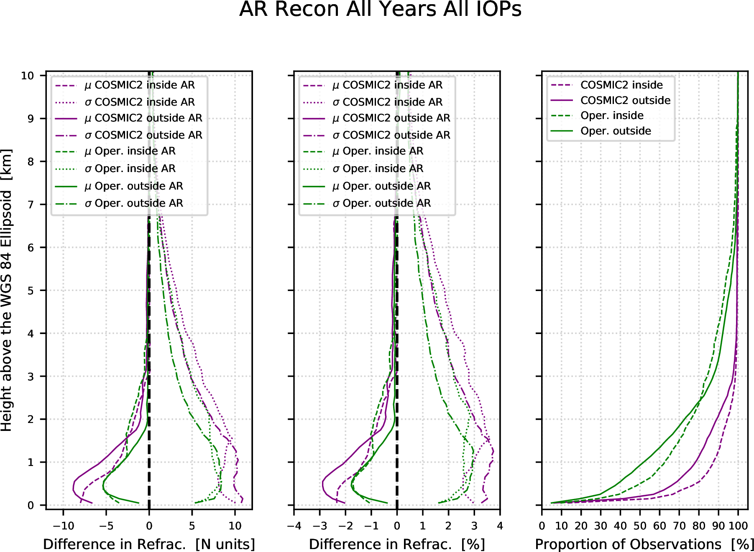
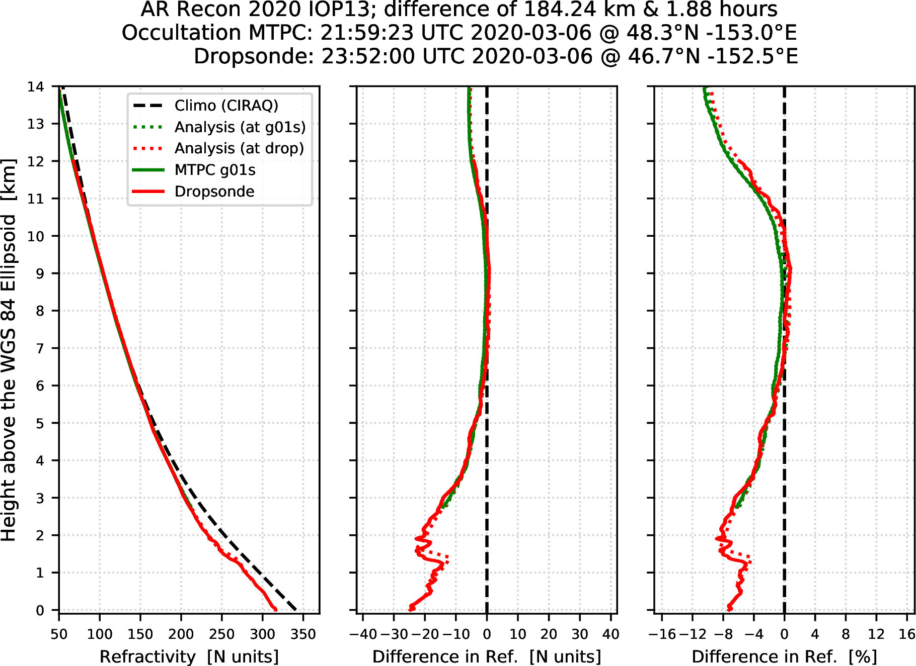
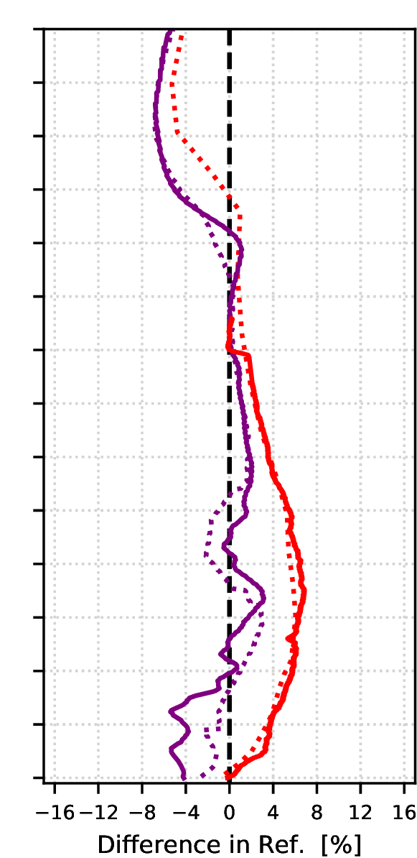
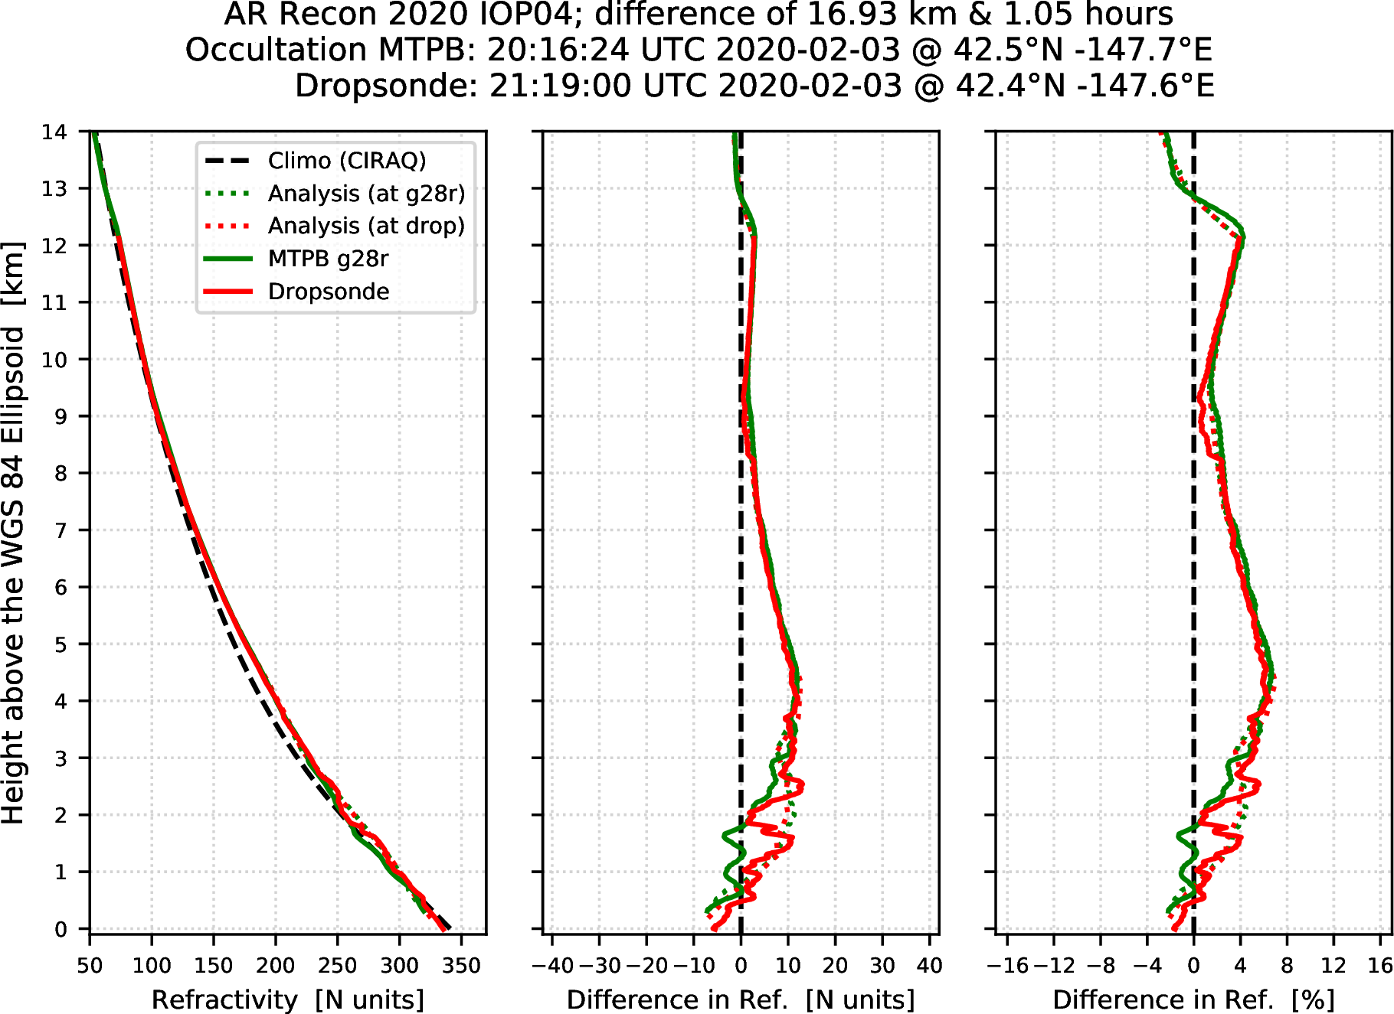
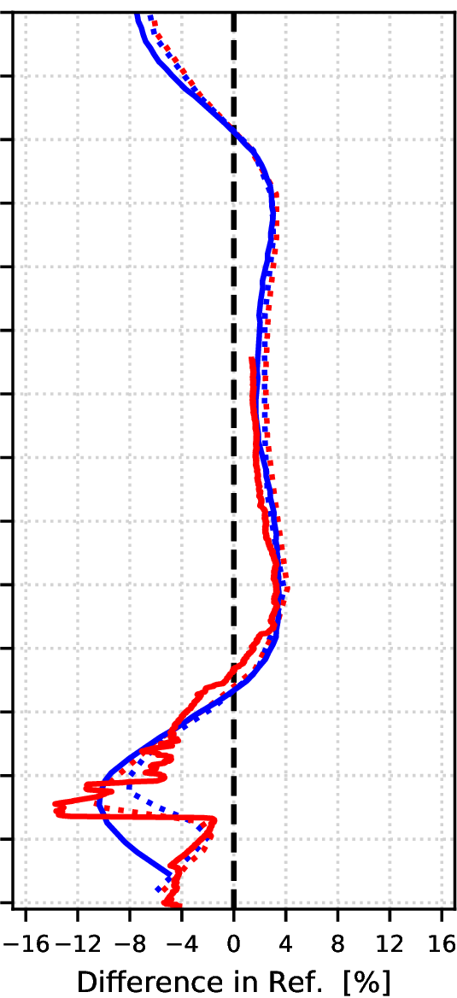
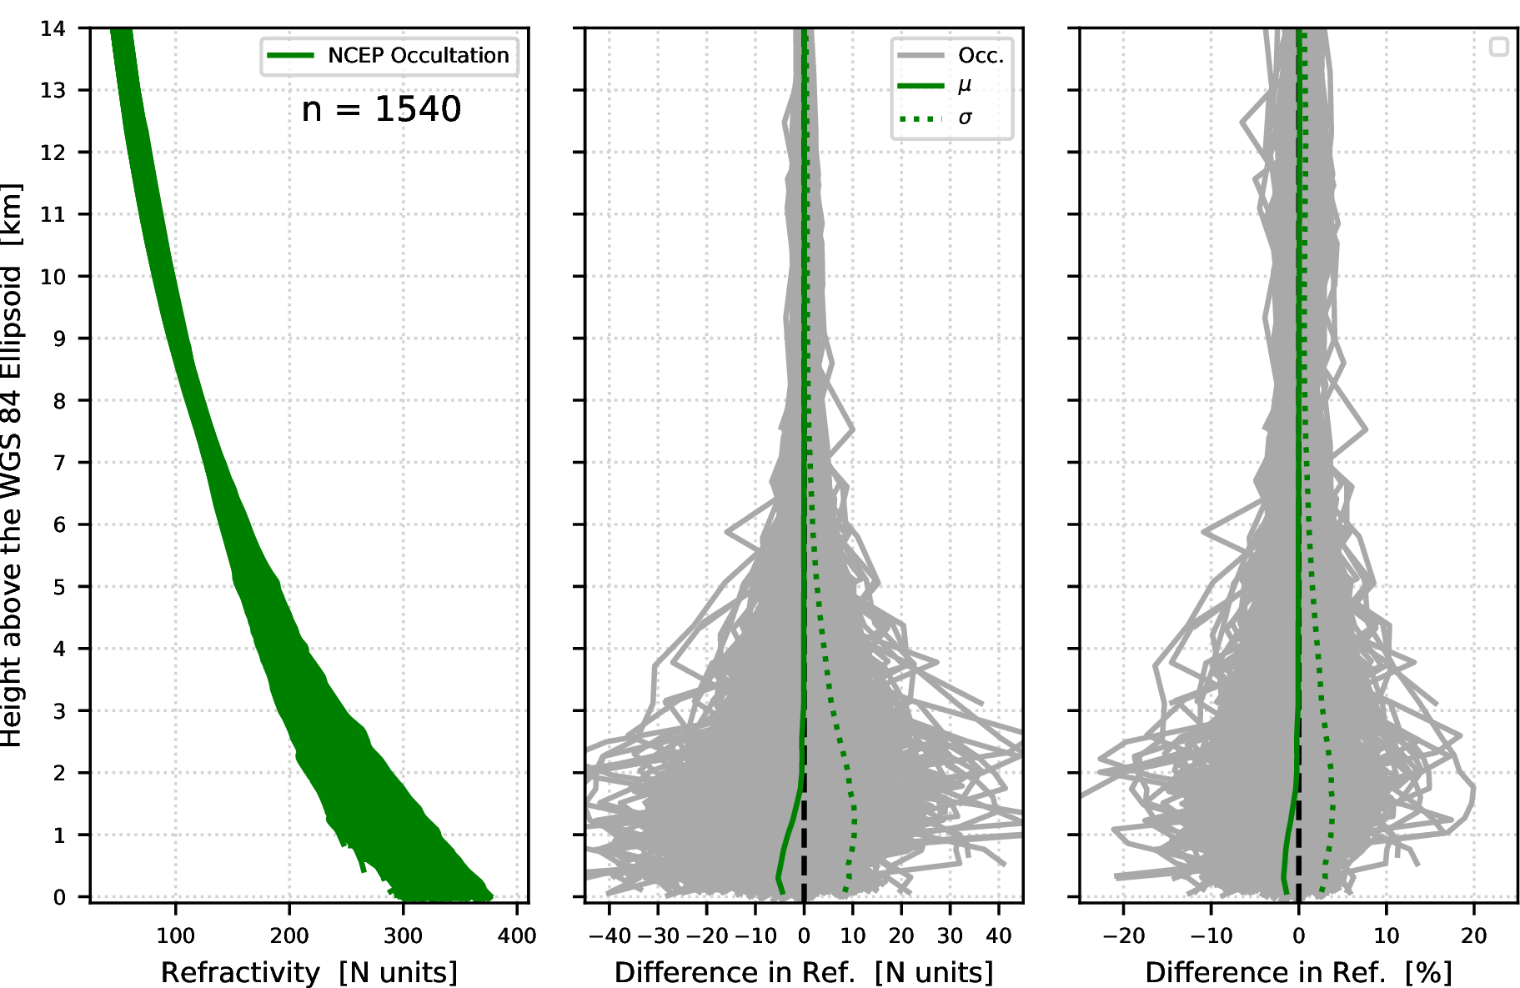
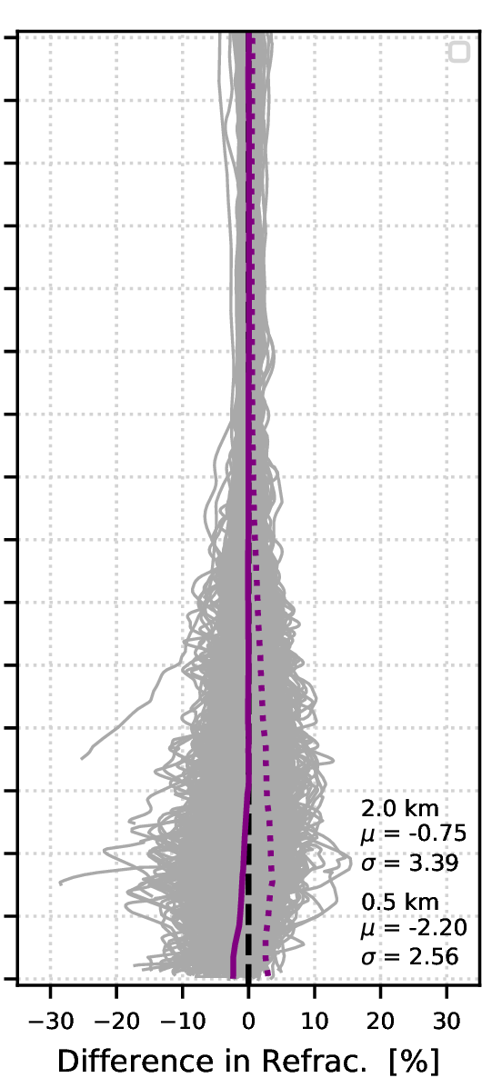
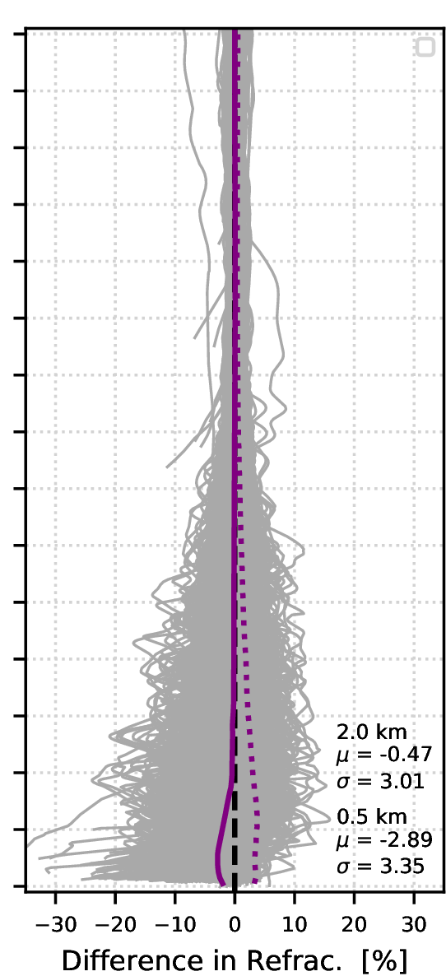
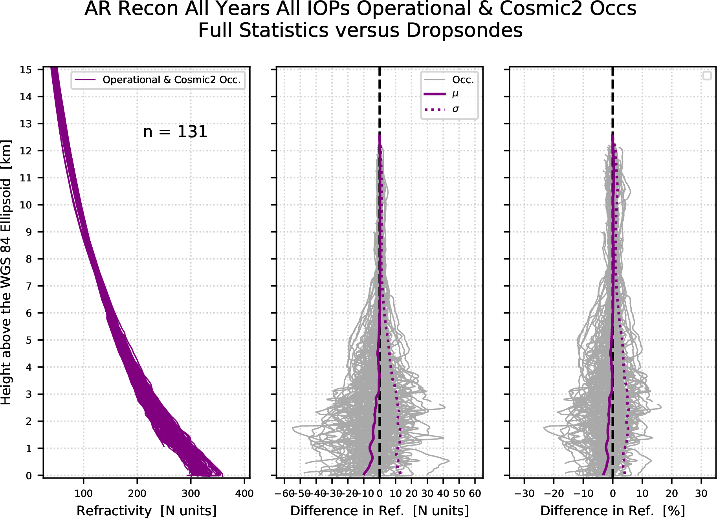
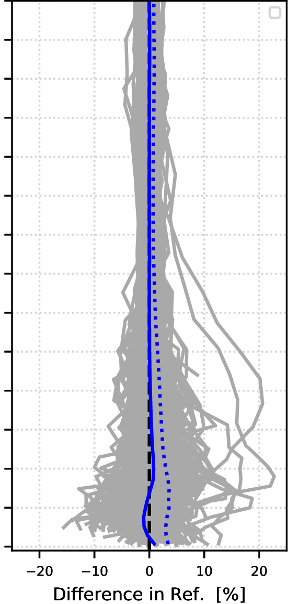
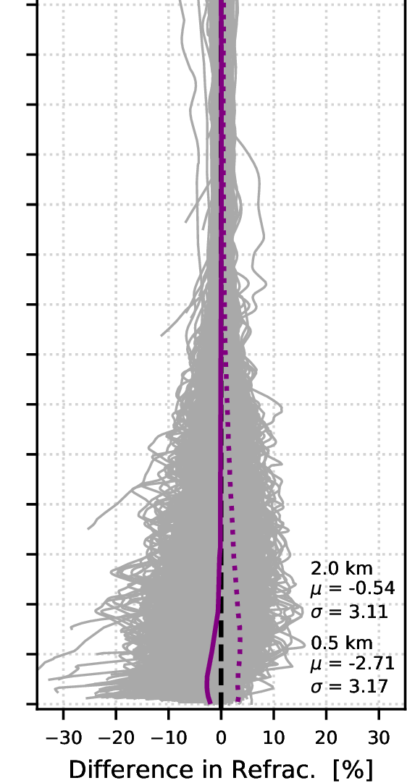
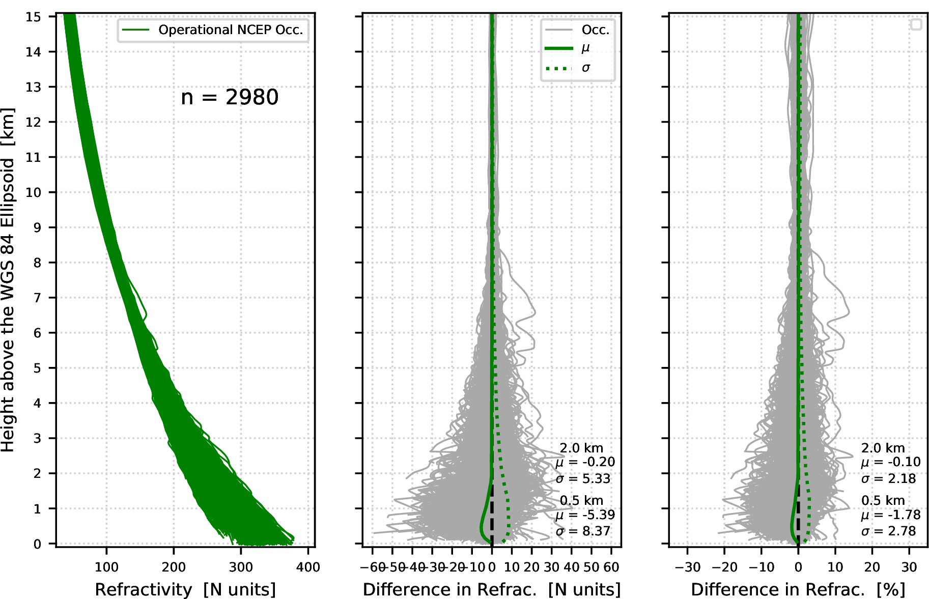
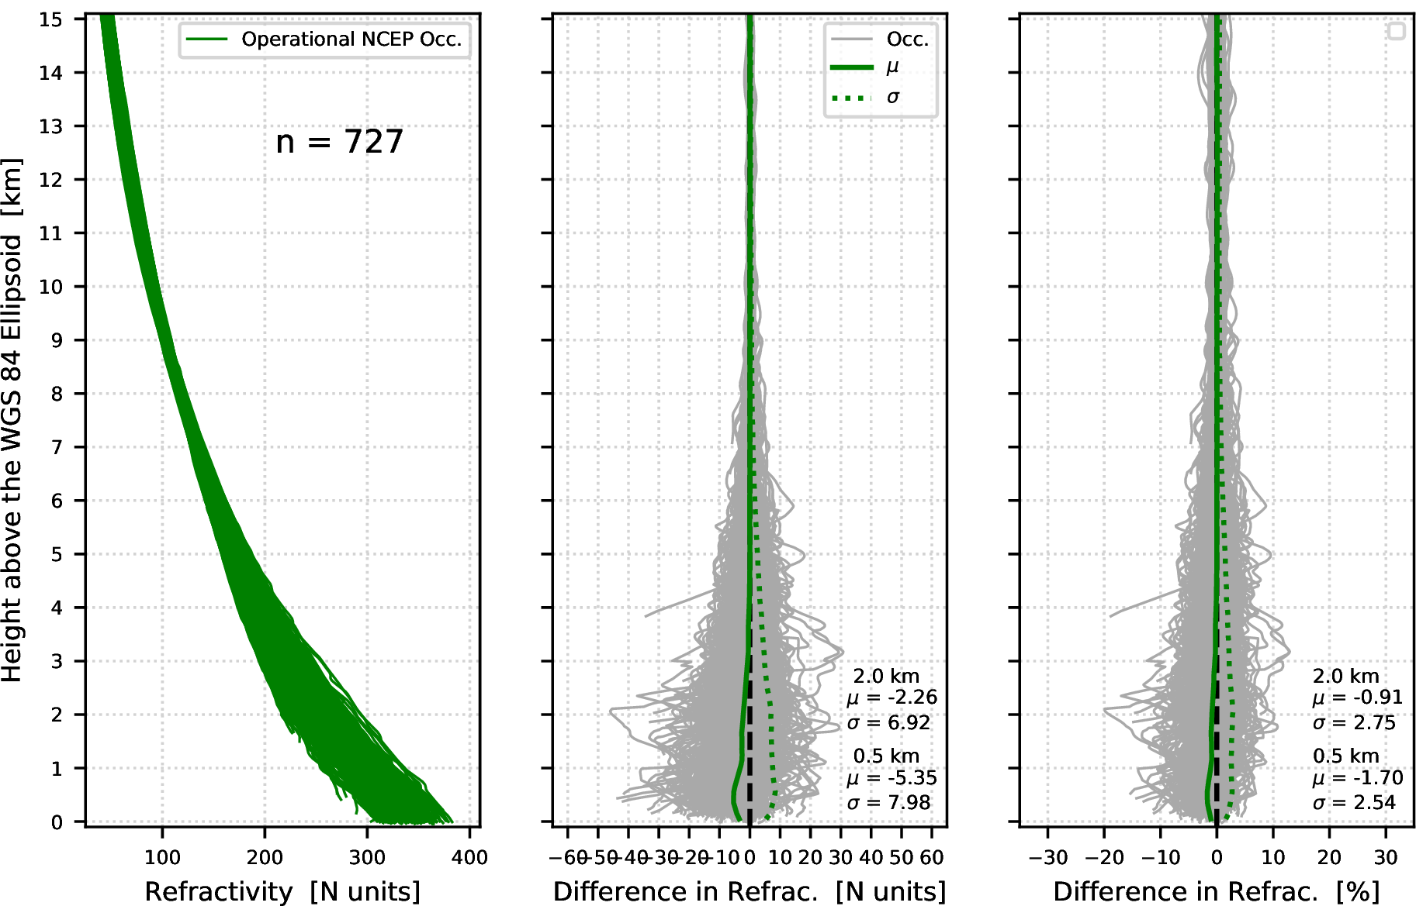
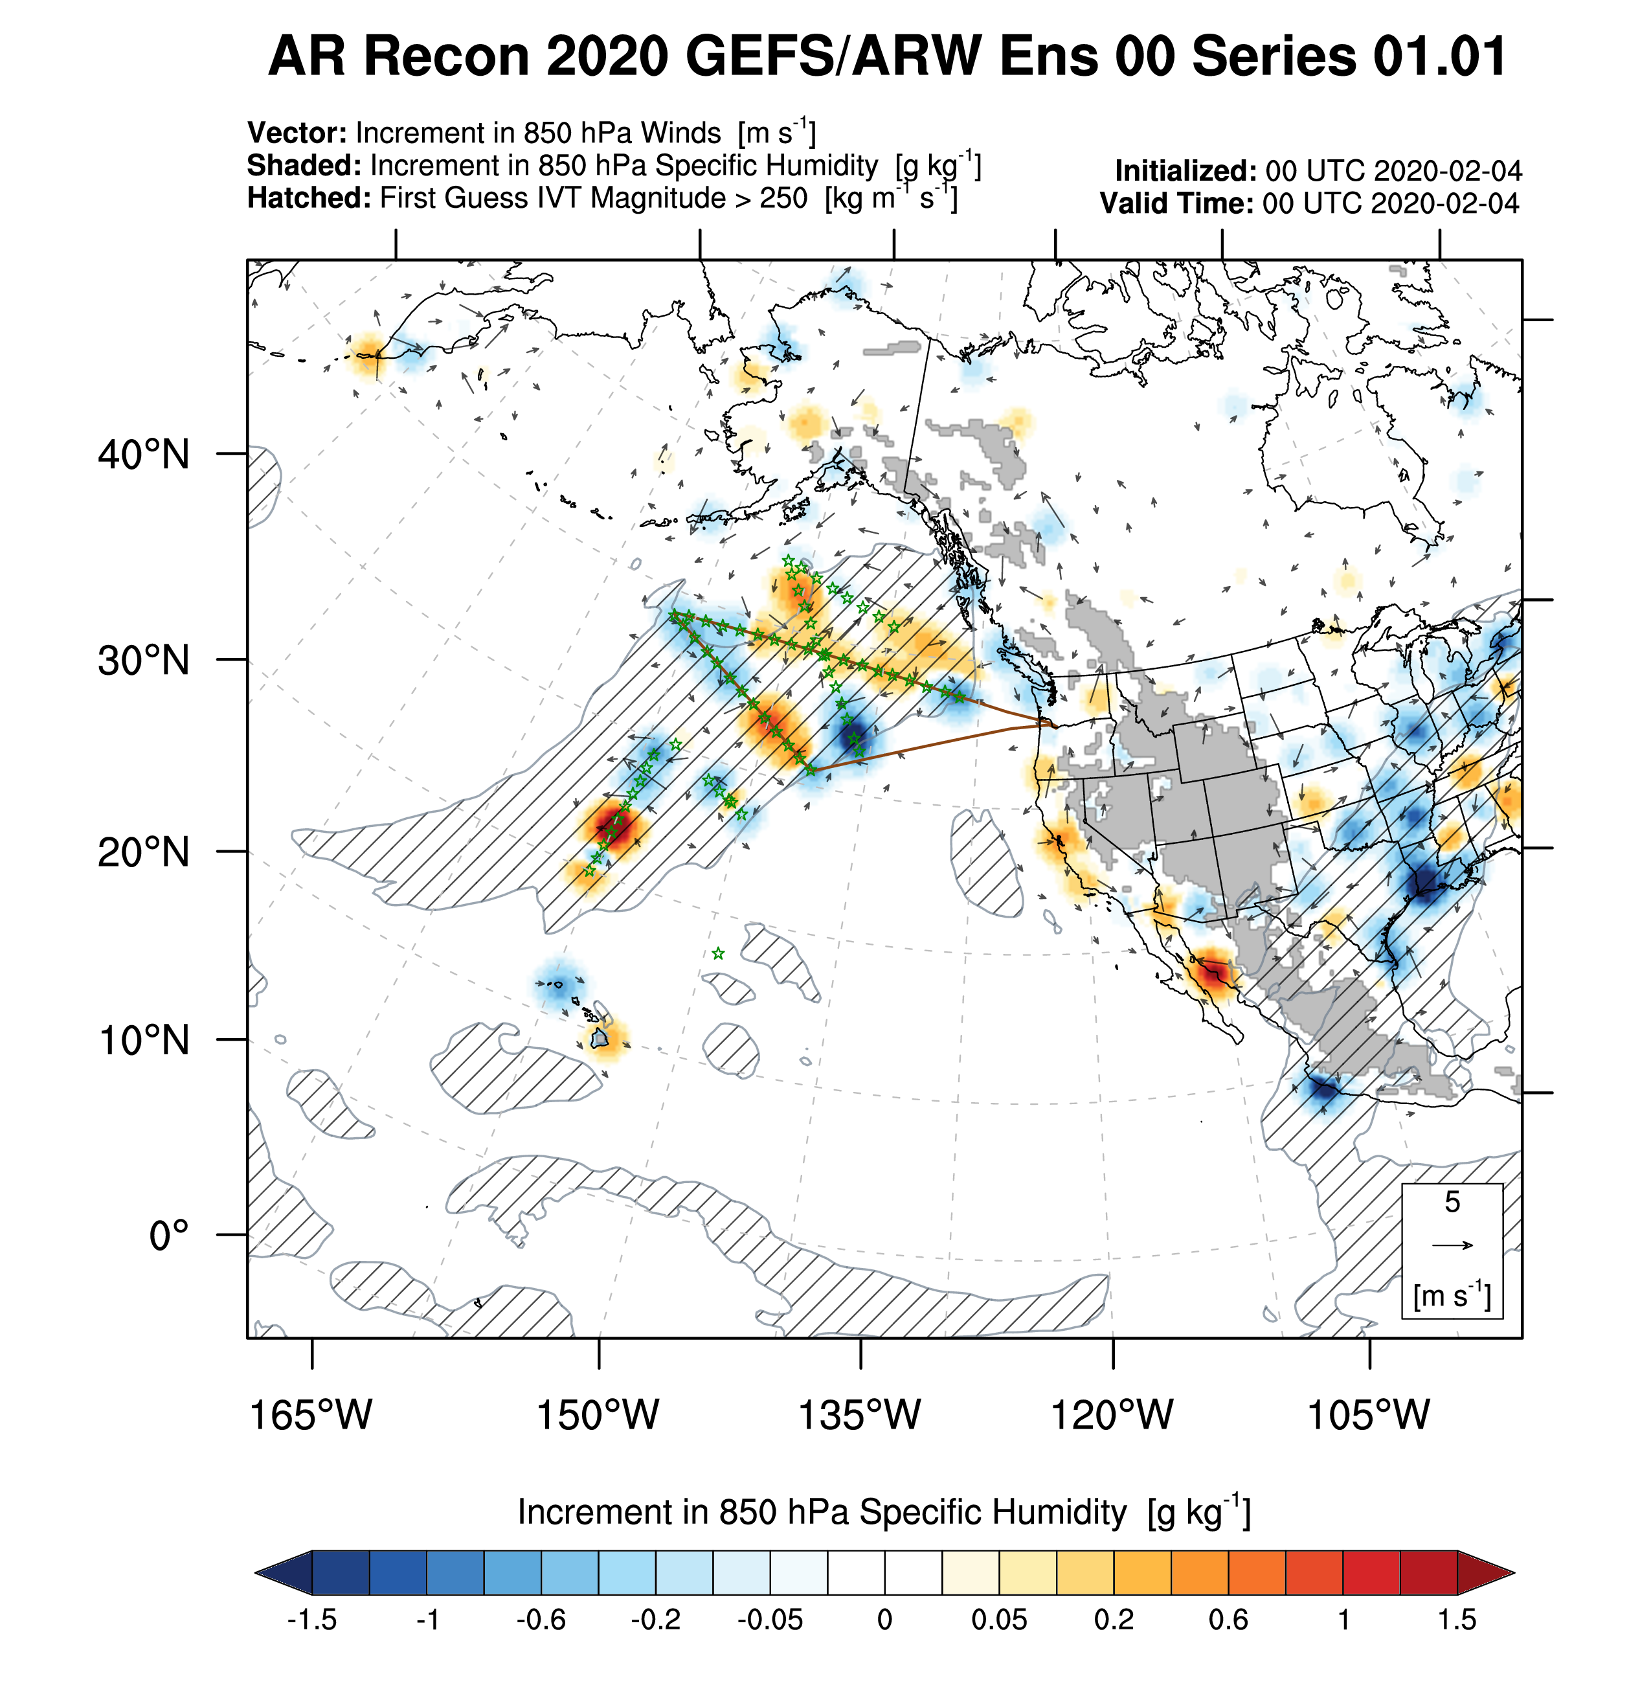
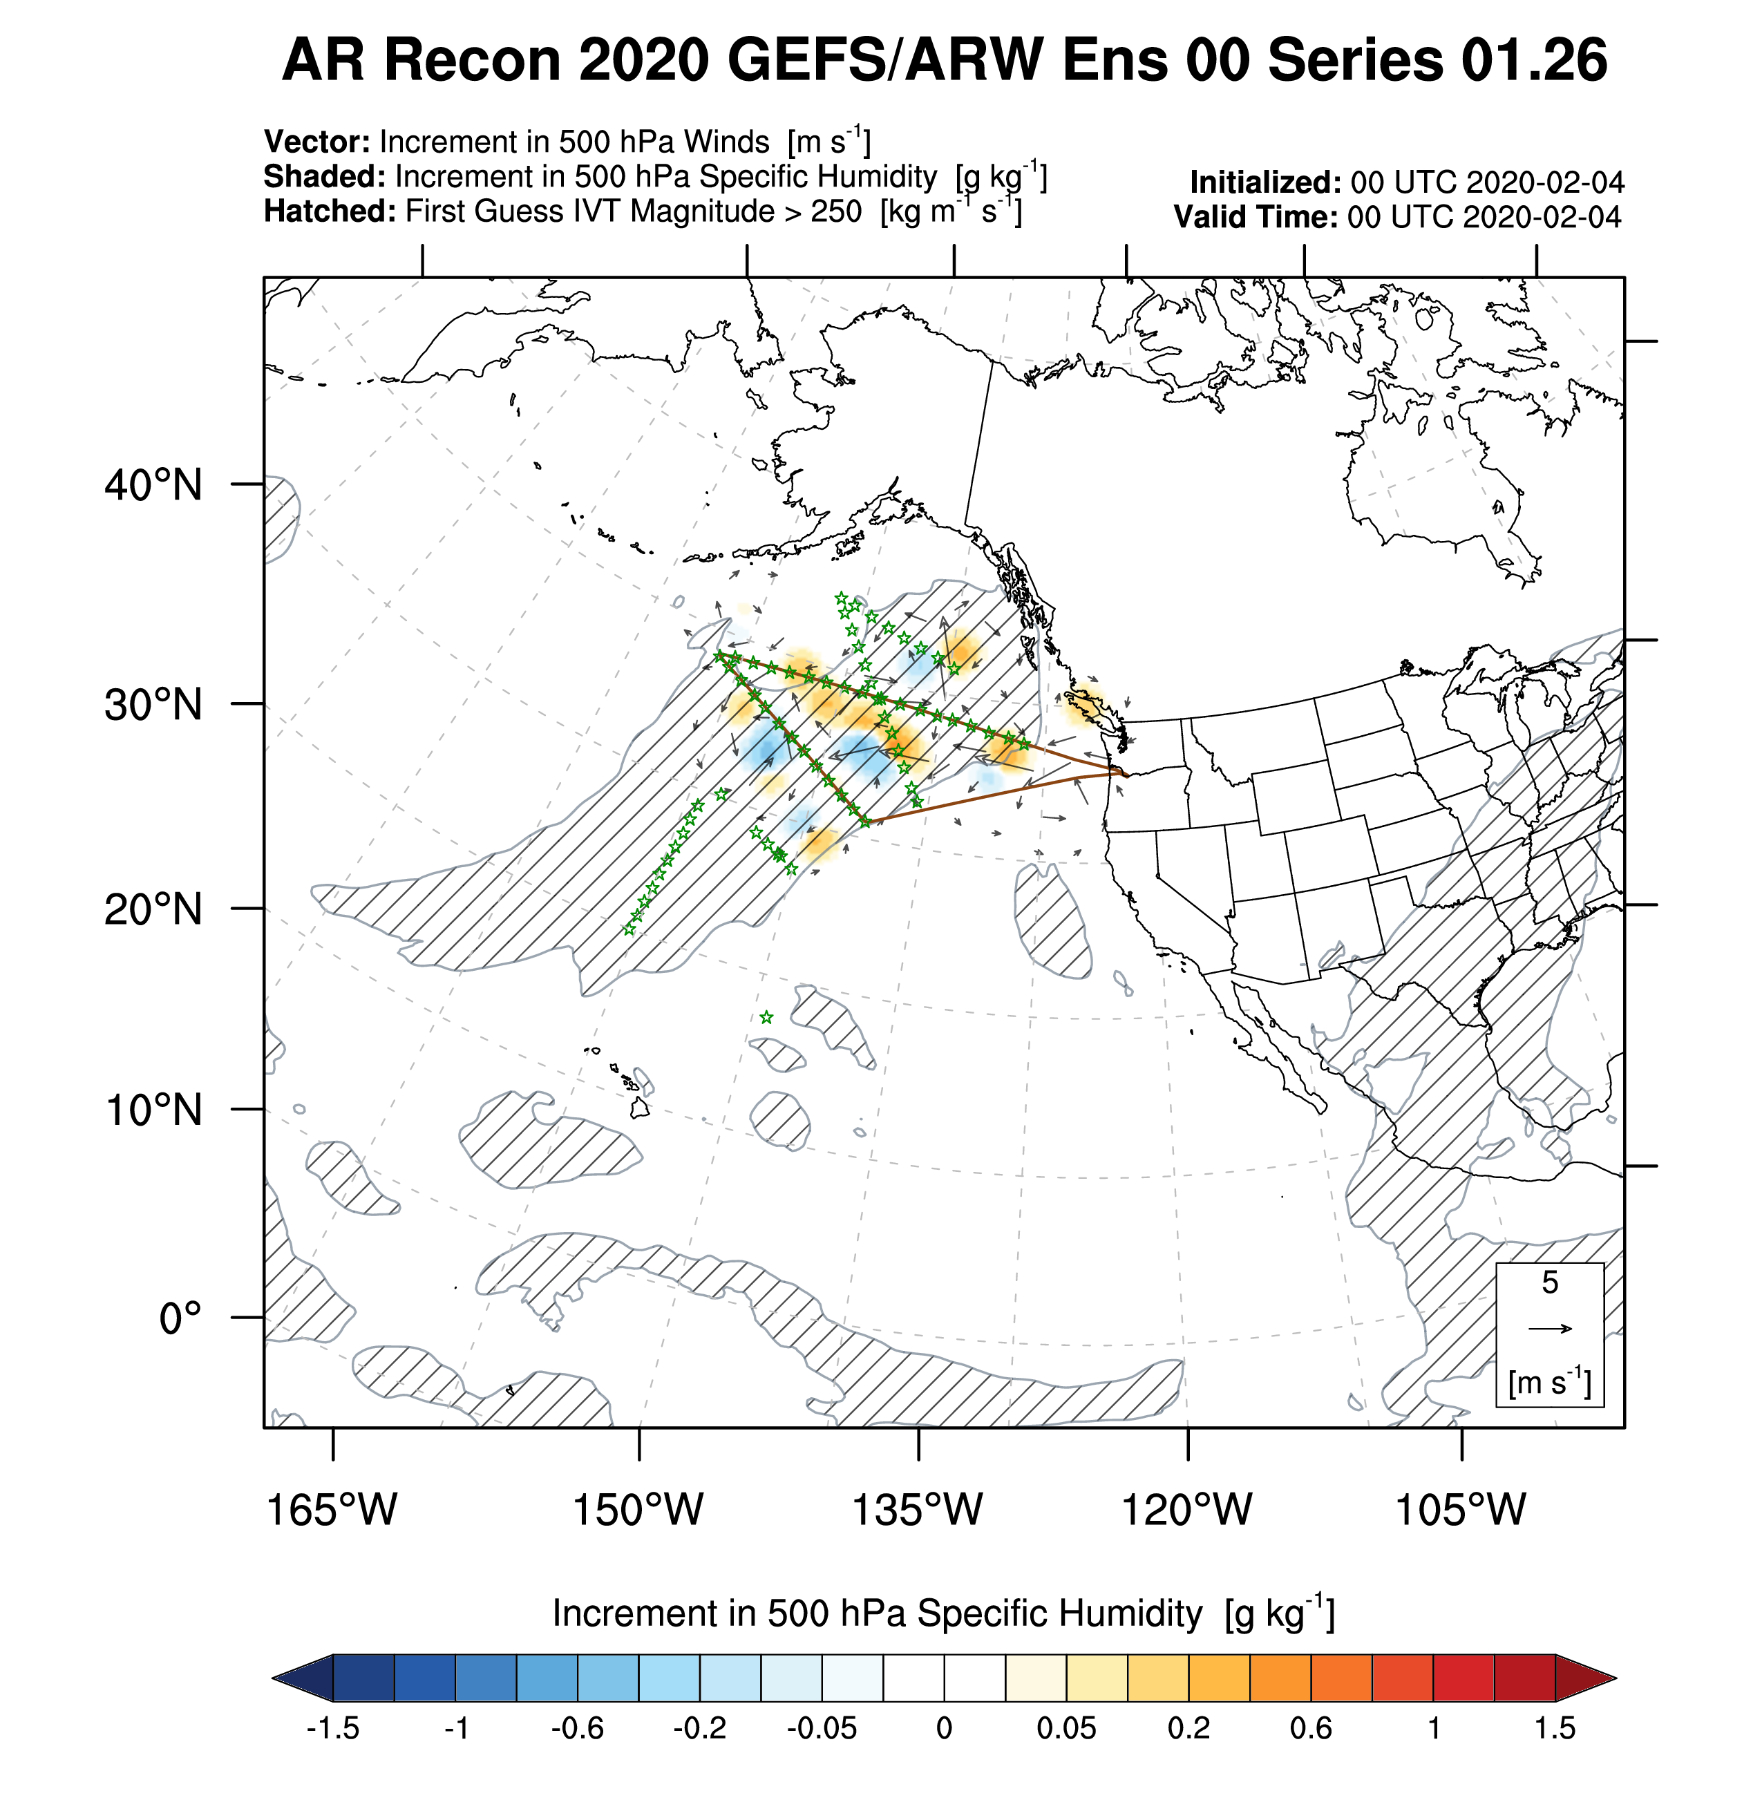
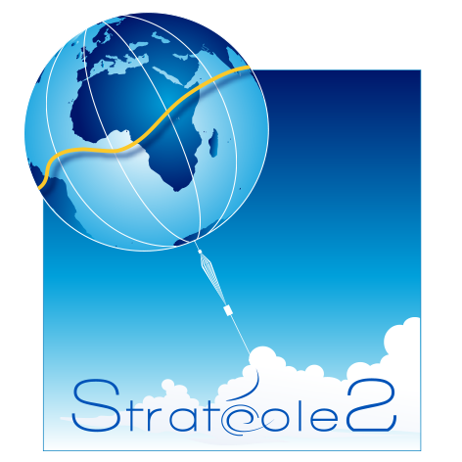
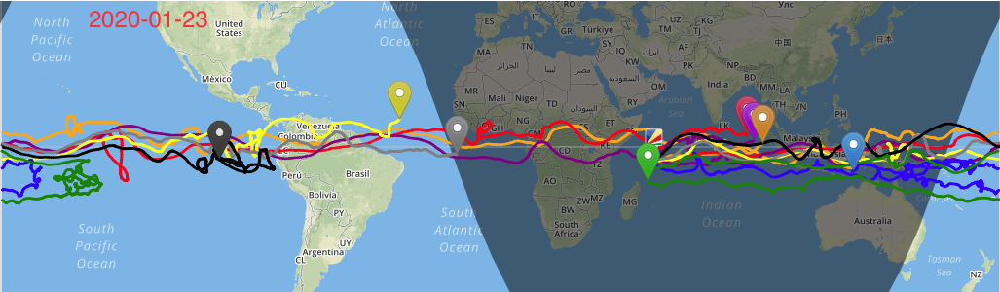
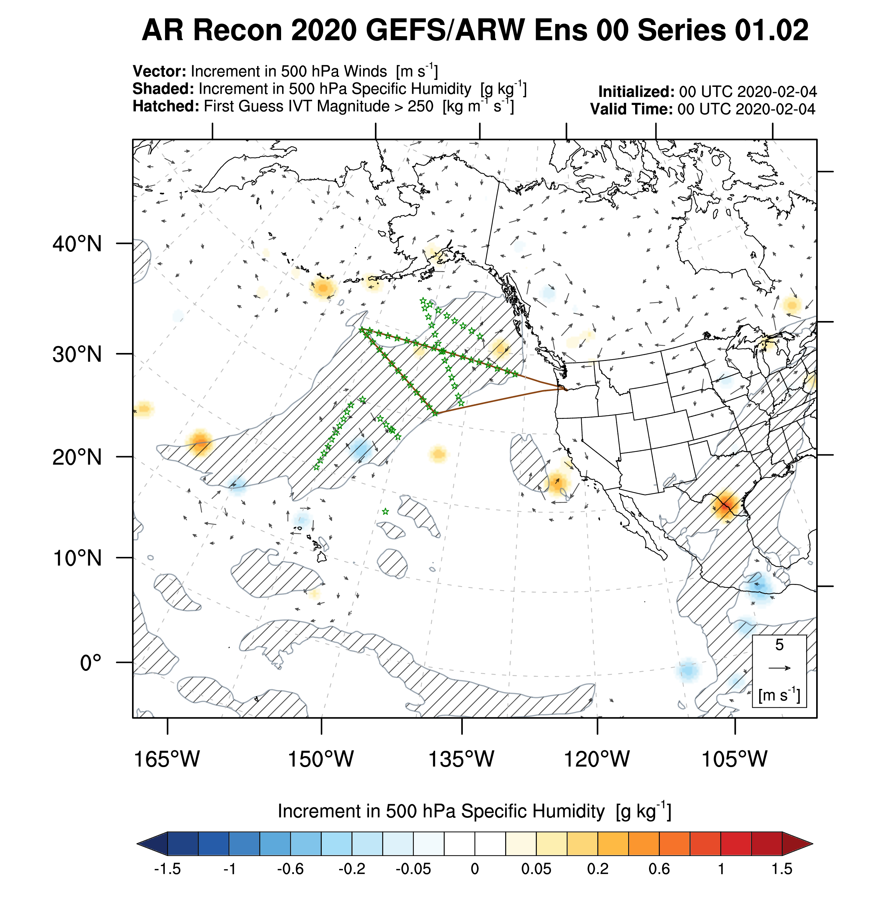
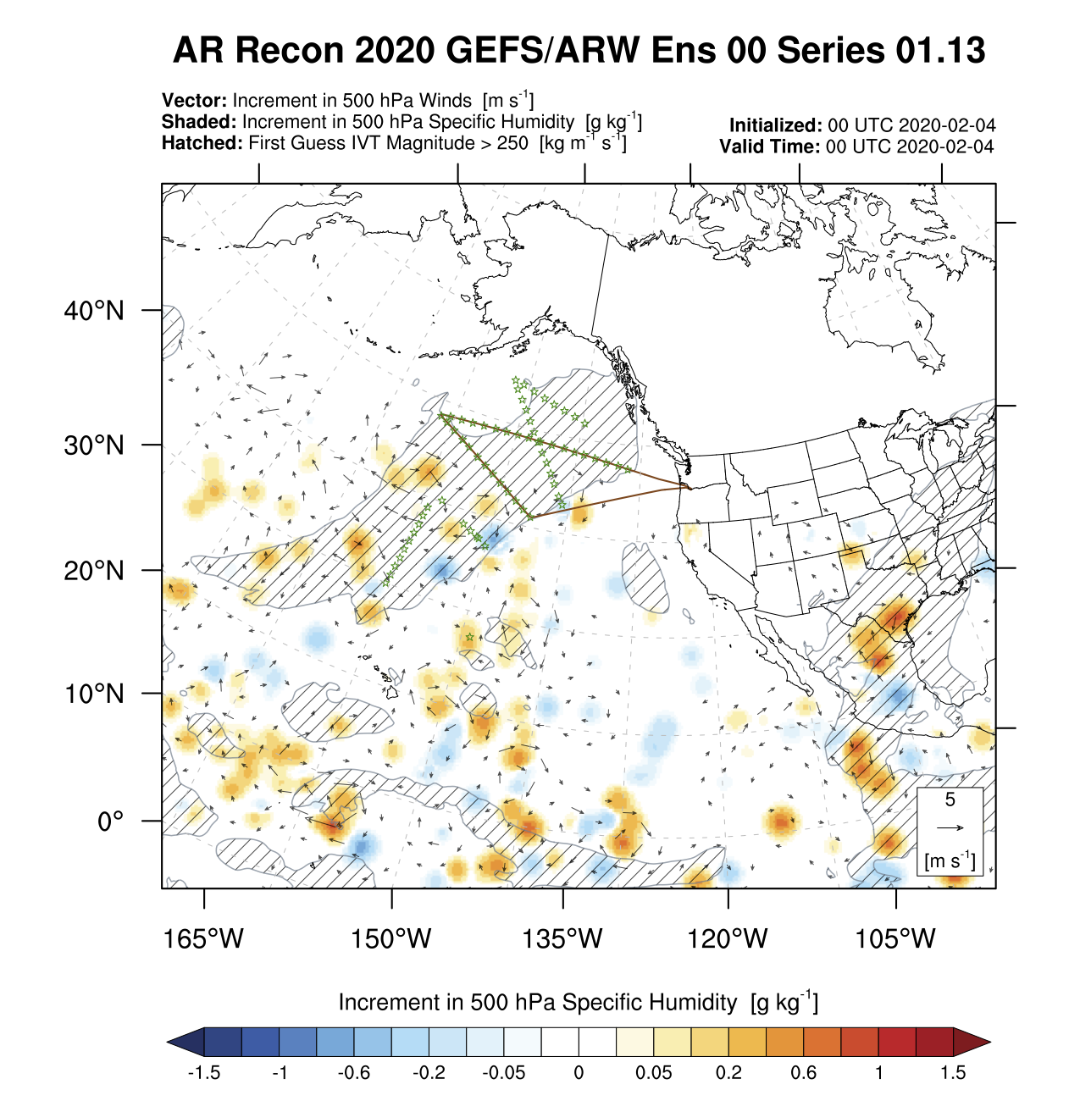
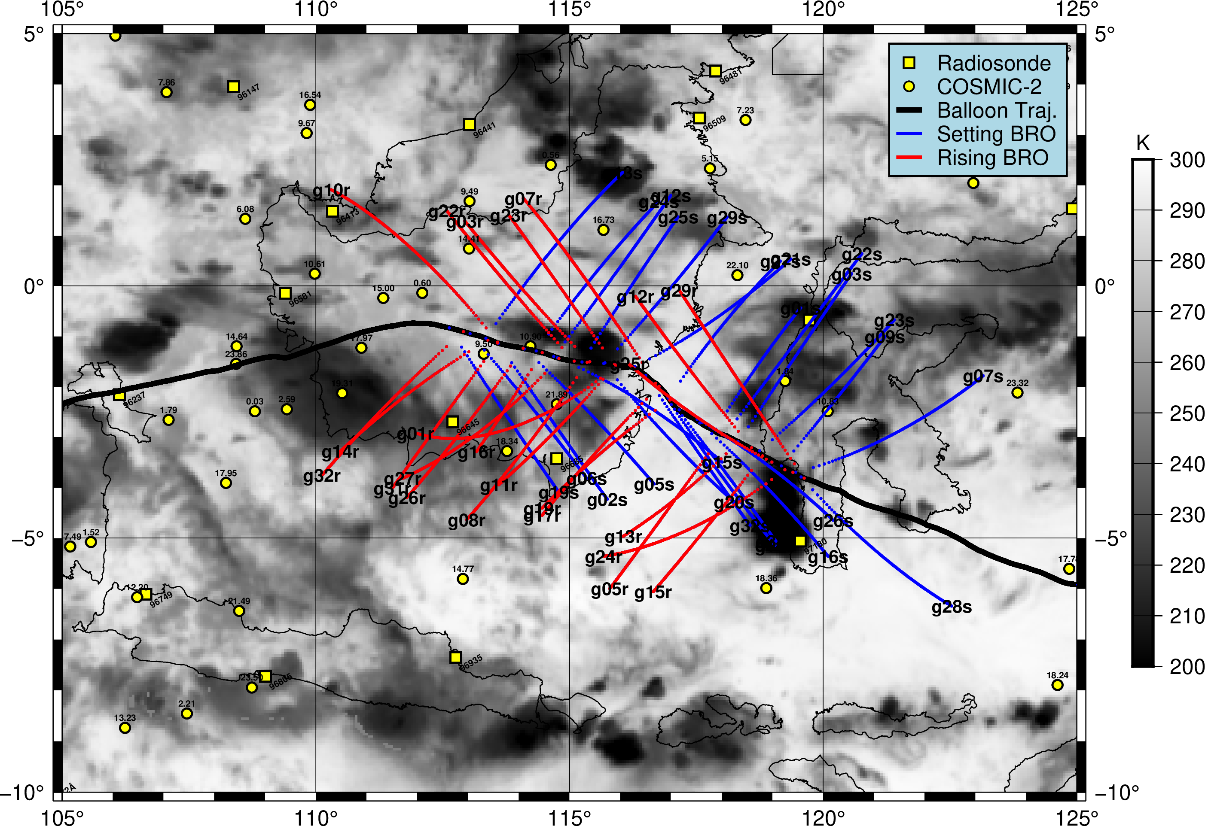
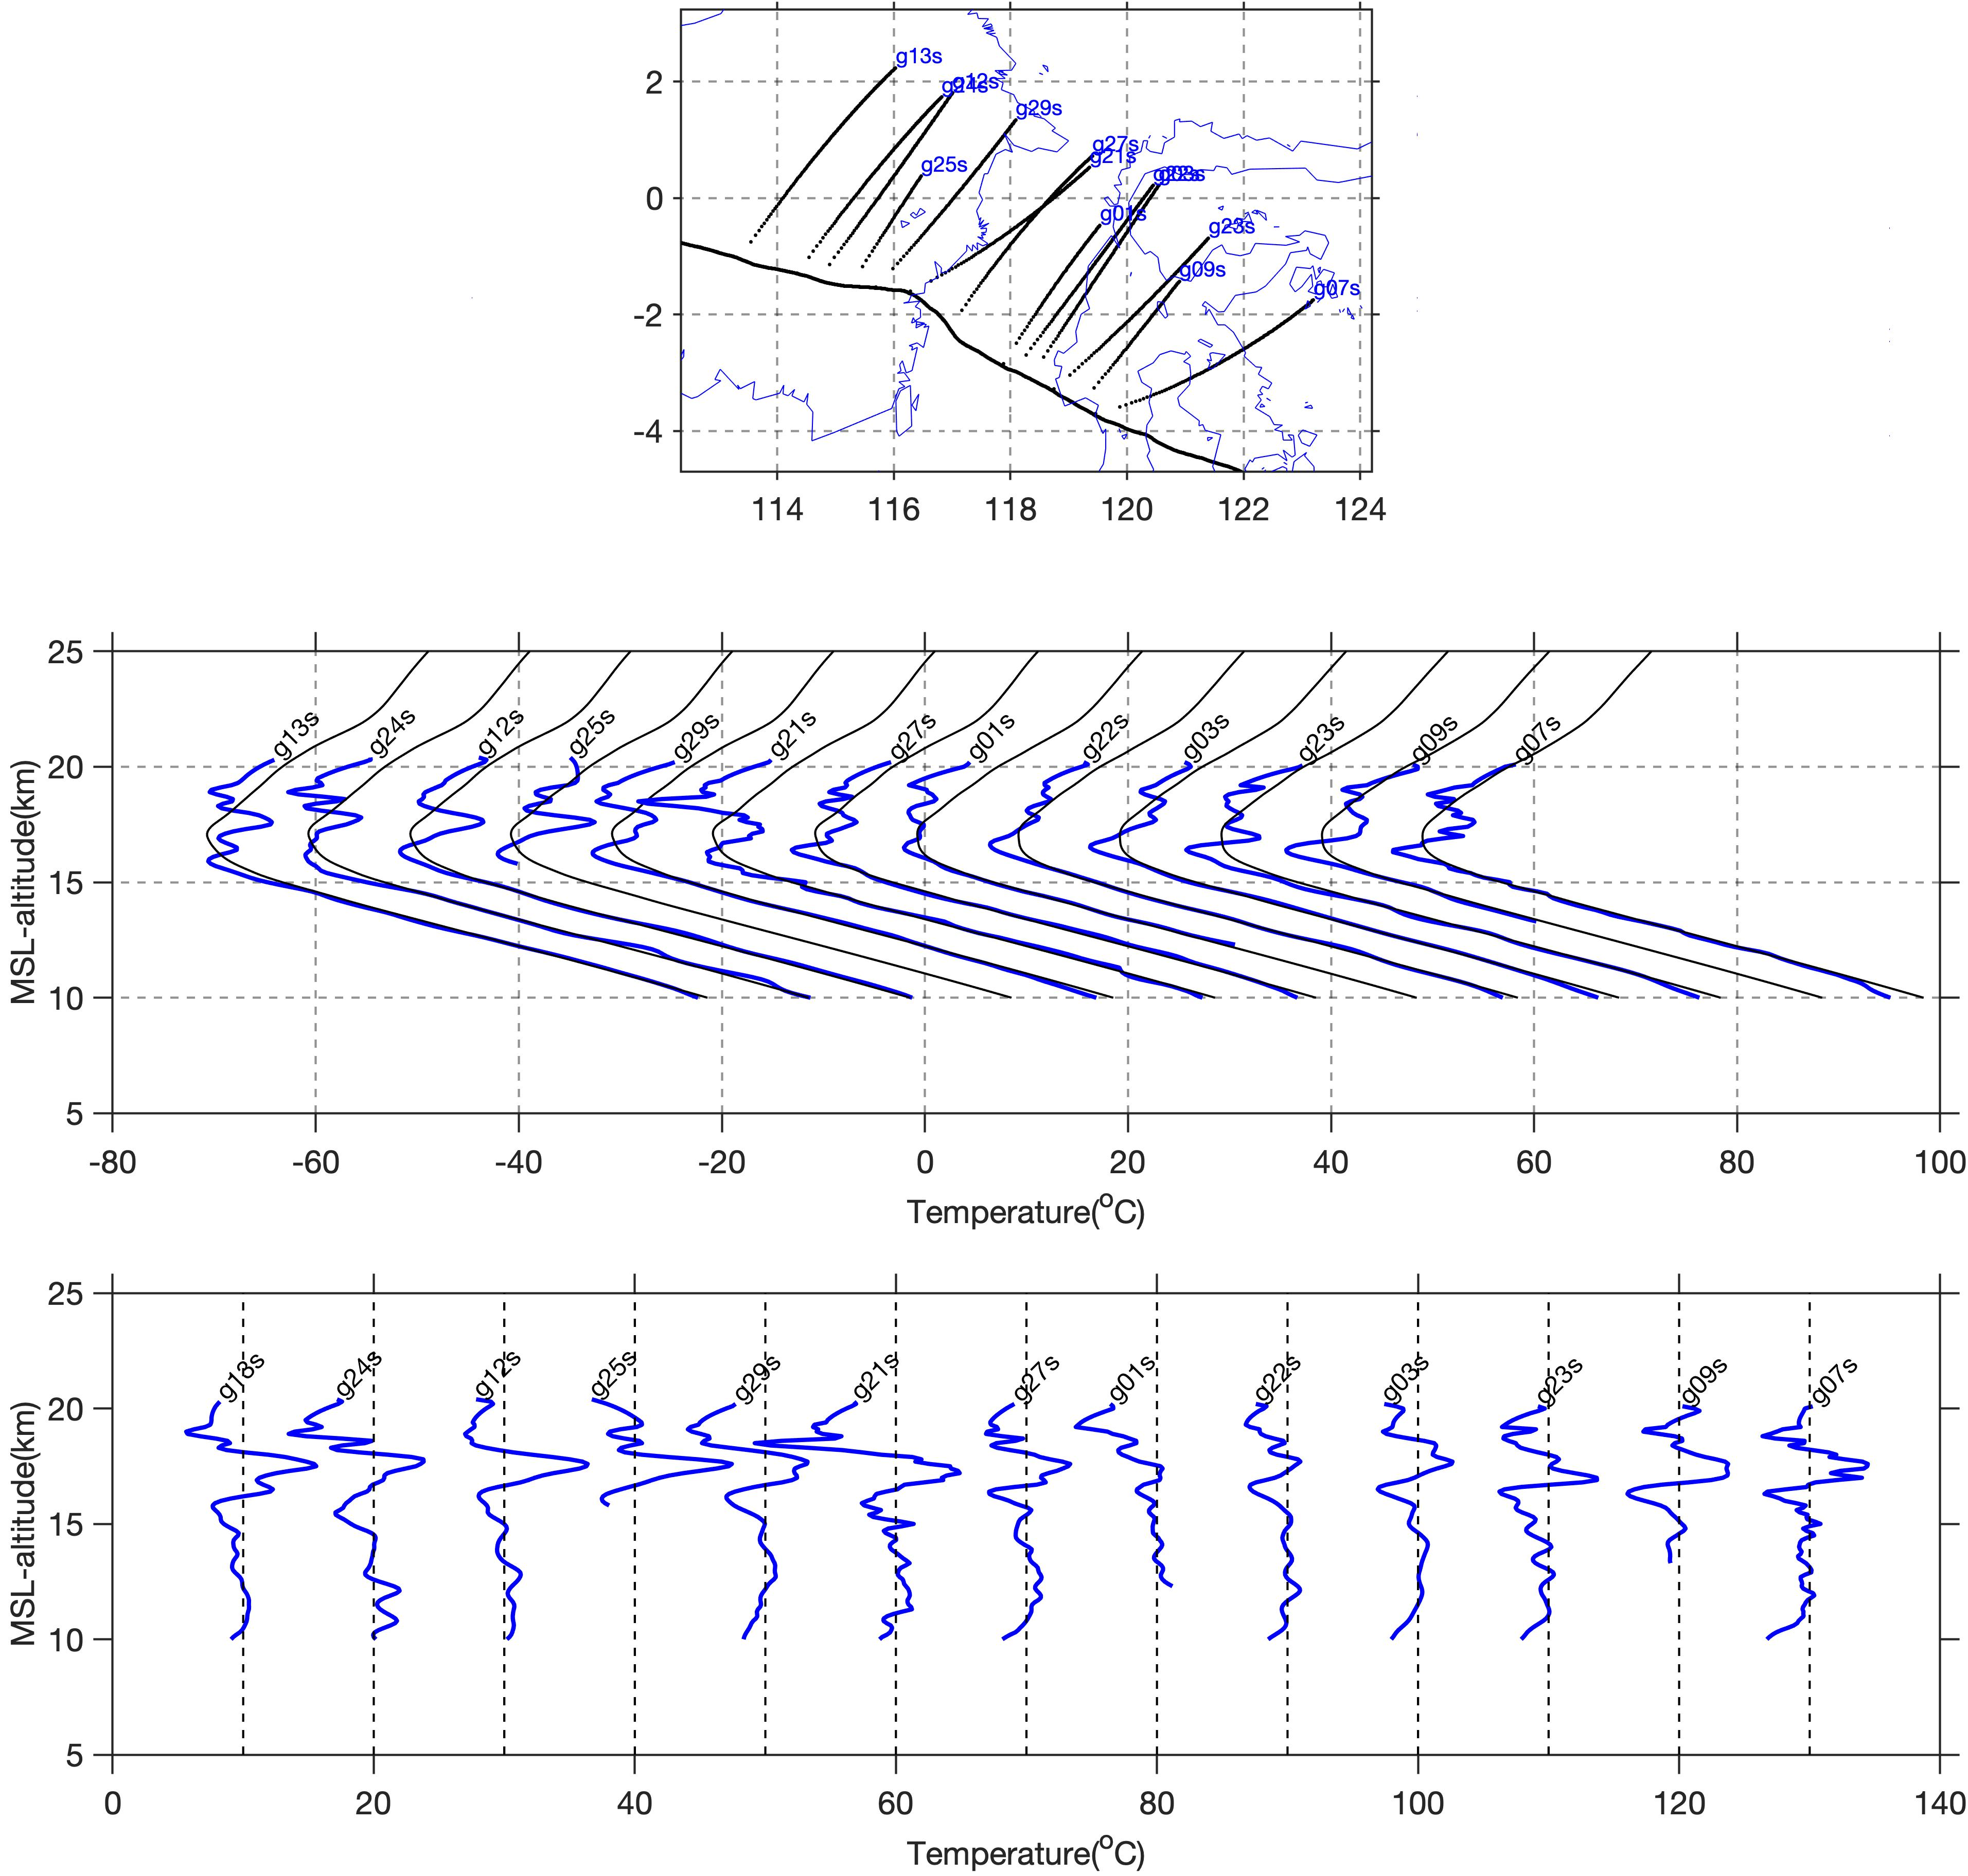
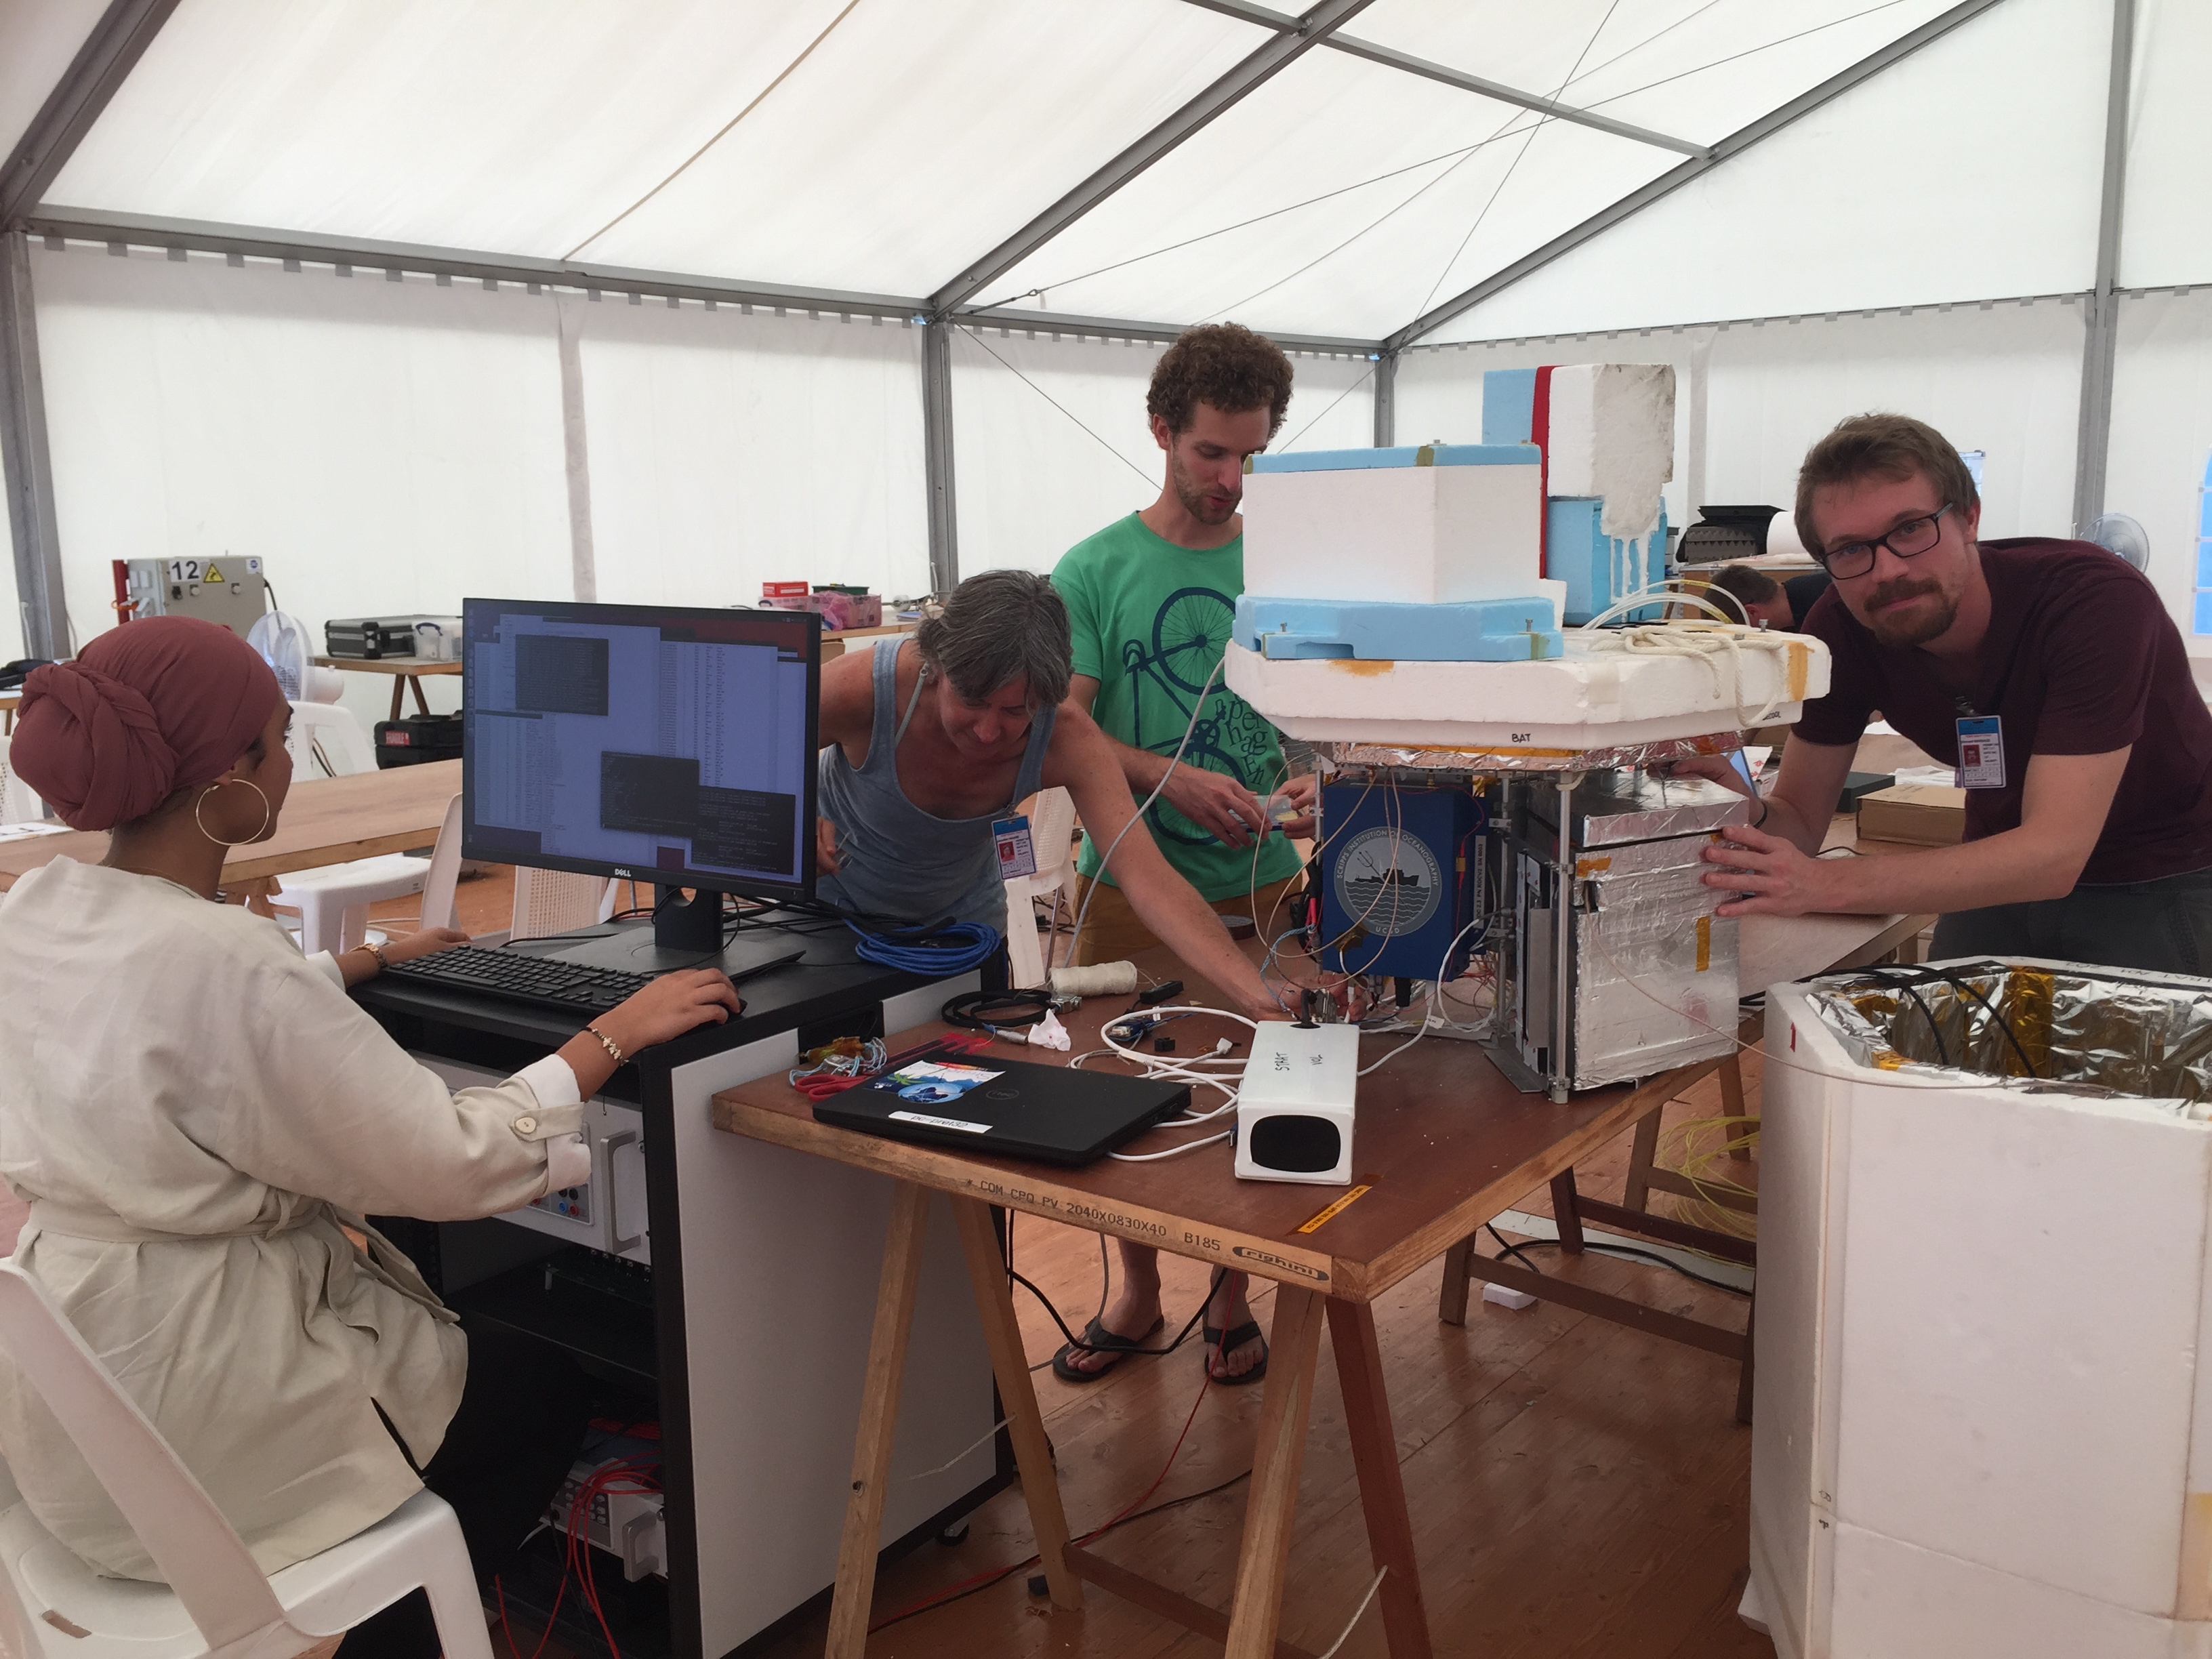
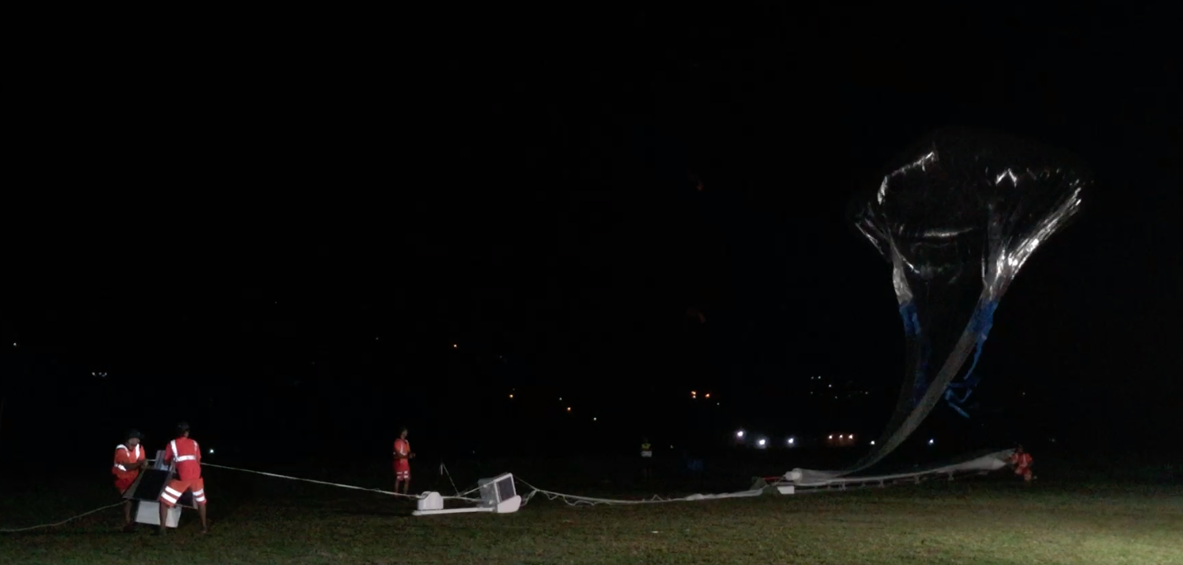

COSMIC-2 – providing a new framework for multi-scale analysis for airborne radio occultation
Jennifer S. Haase (jhaase@ucsd.edu)
Michael J. Murphy, Bing Cao
COSMIC-2 provides unprecedented coverage of the tropics with high resolution vertical profiles that provides a framework for the analysis of higher resolution datasets. Airborne radio occultation (ARO), on the other hand, whether from aircraft or balloons, provides the temporal and spatial continuity to investigate smaller scale processes. We present two examples of ongoing research that takes advantage of the complementary scales of measurements from COSMIC-2 and ARO.
COSMIC-2 Provides large scale lower troposphere environment for investigations of Atmospheric River events
High impact flooding event in the US Pacific Northwest
Targeted observations with dropsondes and Airborne Radio Occultation (ARO)
Evacuations were ordered due to releases from dams near Tacoma, WA.
Flooding closed major interstate highways in Oregon.
The 5-day accumulated precipitation was expected to be severe and long duration in the Pacific northwest.
Dynamical structure and model sensitivities are used to guide targeted observations with dropsondes and simultaneous ARO observations from the NOAA G-IV aircraft to reduce uncertainty in initial conditions.
Precipitation valid:
12Z 02 Feb to 12Z 07 Feb
Below is the sensitivity of the 24-hr accumulated precipitation in WA to model integrated vapor transport (e.g. Berman and Torn, 2019) on the day of the recon flight.
ARO Concept
Photo: Oregon State Police
IOP4
IOP5
IOP6
Measures GNSS signal propagation delay from satellites below the horizon
Refractivity at tangent point is a function of pressure, temperature, water vapor pressure
Vertical resolution of ~400m
Provides ~ 7 profiles per flight hour using all constellations: GPS, Galileo, GLONASS
Leverages the same aircraft used for dropsondes to expand the sampled regions to the sides of the flight path
High uncertainty in the 3-day forecast is related to whether the flow would make it around the high pressure and how steadily the integrated vapor transport would impact the coast. We examine the impact of IOP04.
Numerical data assimilation experiments
Quality of RO data inside Atmospheric Rivers in the lower troposphere
Impact of ARO observations on the forecast
Pairs of nearby AR Recon dropsondes & Radio Occultation (RO) profiles (within 2 h & 300 km) are used to determine that steep gradients, but non necessarily high moisture, are affecting the penetration depth and quality in the lowest troposphere.
The spatial impact of ARO on precipitation at landfall is similar to that of dropsondes, but dropsonde increment is stronger, probably because of wind observations. This indicates the data is of quality suitable for operational use.
Profiles Inside AR
Profiles Outside AR
10% more occultations get to 1 km within the AR compared to outside.
The WRF-ARW model was used with a 2-way nested grid spacing of 27 km and 9 km, and 48 vertical layers up to 10hPa, with BC from the GFS. The Grell-Freitas convection, NOAH land surface, Thompson 2-moment microphysics, YSU PBL and RRTMG radiation parameterizations were used. WRFDA 3DVAR (v4.1.1) was used to assimilate four different data types individually, with a static background error covariance calculated using the NMC method. The ARO and RO data use a refractivity observation operator.
Cosmic2
Occ
Oper.
Occ
Airborne
Occ
Small Sat
Occ
Oper.
Occ
Inside AR
Overly smooth
Bottom
of Occ
Inside AR
Outside AR
Relative to ERA5, profiles inside the AR have smaller μ & σ at 0.5 km than outside.
More profiles inside AR
2020 IOP04
2019 IOP04
2020 IOP13
Outside AR
(COSMIC-2&Other)
- Drops
Relative to ERA5, SmallSat have smallest μ & σ, presumably because they are artificially smooth.
COSMIC-2 – ERA5
Other GNSS RO – ERA5
Analysis increment for each dataset
SmallSat
COSMIC-2
Other GNSS RO
Inside AR Outside AR Inside AR Outside AR
DA experiments test the hypothesis that ARO provides comparable impact to dropsondes in the mid-levels. Result: The increments are comparable in amplitude and fill in gaps between flight legs. The spaceborne RO constellation without COSMIC-2 does not sample the area of interest. COSMIC-2 has the potential to provide very good sampling below 40º N, especially of the contribution from tropical moisture.
Dropsonde – no DA
ARO – no DA
COSMIC-2 Provides large scale UT/LS background for balloon investigations of equatorial waves
2019-2020 Strateole-2 campaign studies the tropical tropopause layer
The ROC2 instrument densely sampled the equatorial region over Indonesia using the ARO technique from stratospheric balloons in the Strateole-2 campaign.
We used gridded averaged COSMIC-2 profiles to remove the background tropopause structure from synoptic scale temperature variations in order to investigate smaller scale vertical variations due to equatorial waves.
The balloons recorded more than 48 ARO profiles in the course of the day and provided a detailed continuous view over 900 km of wave structures with 2-4 km vertical wavelength
Dropsondes + radiosondes
ARO
500 hPa moisture increment for each experiment
Tropical coverage of combined RO
Continuous temporal sampling
Operational GNSS RO
COSMIC-2 GNSS RO
ROC2 Flight Preparation
Balloon launch from the Seychelles
References
Berman, J. D., and R. D. Torn, 2019: The Impact of Initial Condition and Warm Conveyor Belt Forecast Uncertainty on Variability in the Downstream Waveguide in an ECWMF Case Study., Mon. Wea. Rev., 147, 4071–4089.
Haase, J. S., et al., (2018), Around the world in 84 days - Strateole-2 investigates the tropical atmosphere with long duration superpressure balloons, EOS, 99.
Haase, J. S., B. J. Murphy, P. Muradyan, F. Nievinski, K. M. Larson, J. L. Garrison, and K.-N. Wang (2014), First Results from an Airborne GPS Radio Occultation System for Atmospheric Profiling, GeoRL, 40.
Chen, X. M., S. H. Chen, J. S. Haase, et al. (2018), The Impact of Airborne Radio Occultation Observations on the Simulation of Hurricane Karl (2010), MWRv, 146, 329-350.
Lesne, O., J. Haase, G. Kirchengast, J. Ramsauer, and W. Poetzi (2002), Sensitivity analysis of GNSS radio occultation for airborne sounding of the troposphere, Phys. and Chem. of the Earth, 27, 291-299.
Wang, K. N., J. L. Garrison, J. S. Haase, and B. J. Murphy (2017), Improvements to GPS Airborne Radio Occultation in the Lower Troposphere Through Implementation of the Phase Matching Method, JGR: Atmospheres, 122,.
Acknowledgements
This work was supported by NSF GRANT 1642650, and NASA GRANT NNX15AU19G . We thank the CW3E AR Program and its sponsors, including the California Department of Water Resources, and the Army Corps of Engineers FIRO program. Flights on the NOAA G-IV aircraft was provided by the National Oceanic and Atmospheric Administration. We would like to acknowledge the assistance of the NOAA Aircraft Operations Center staff.

