Slide 1


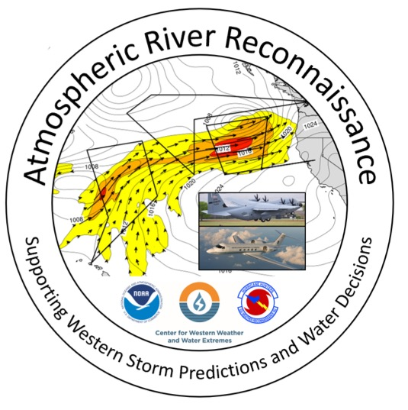
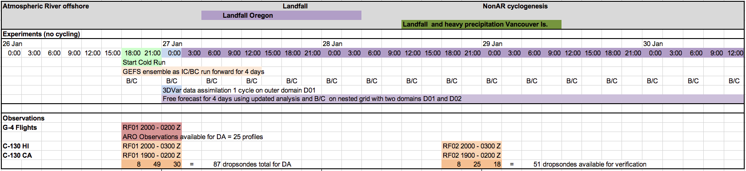

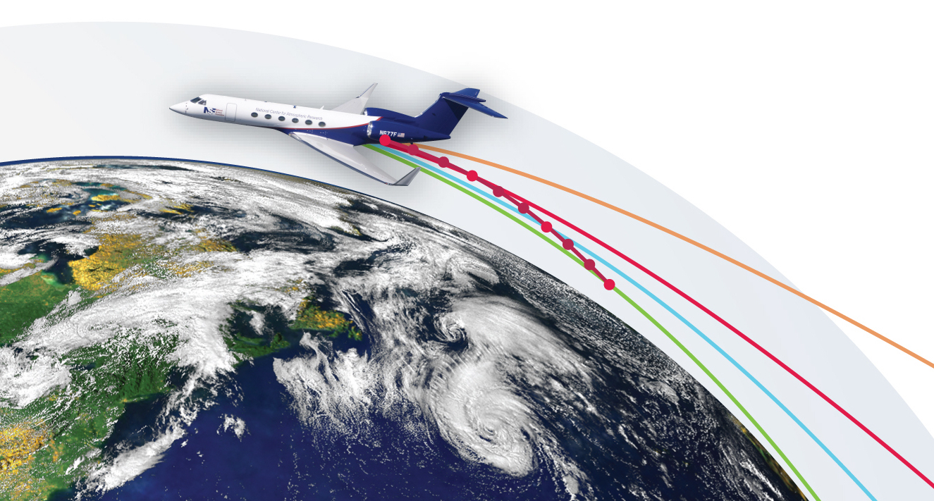
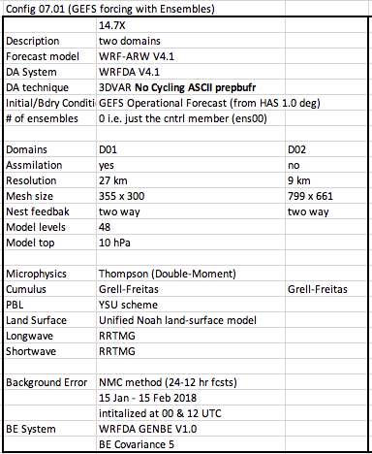
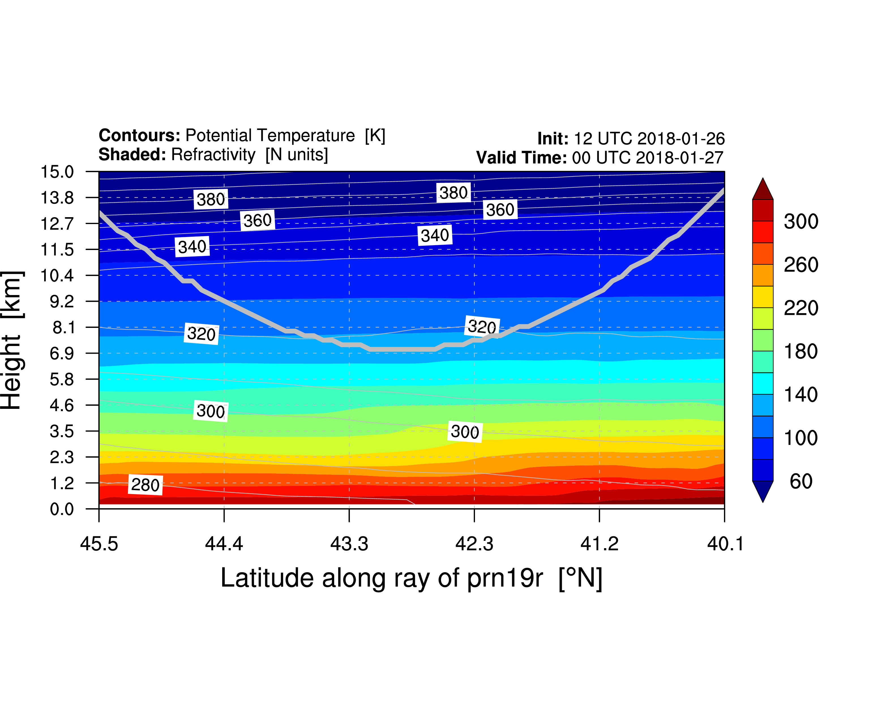
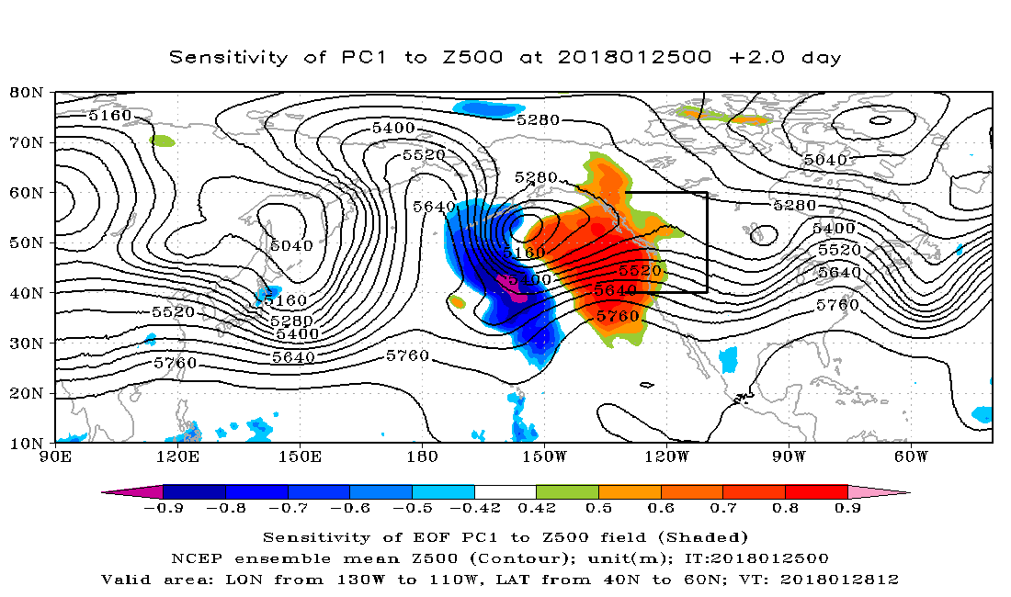
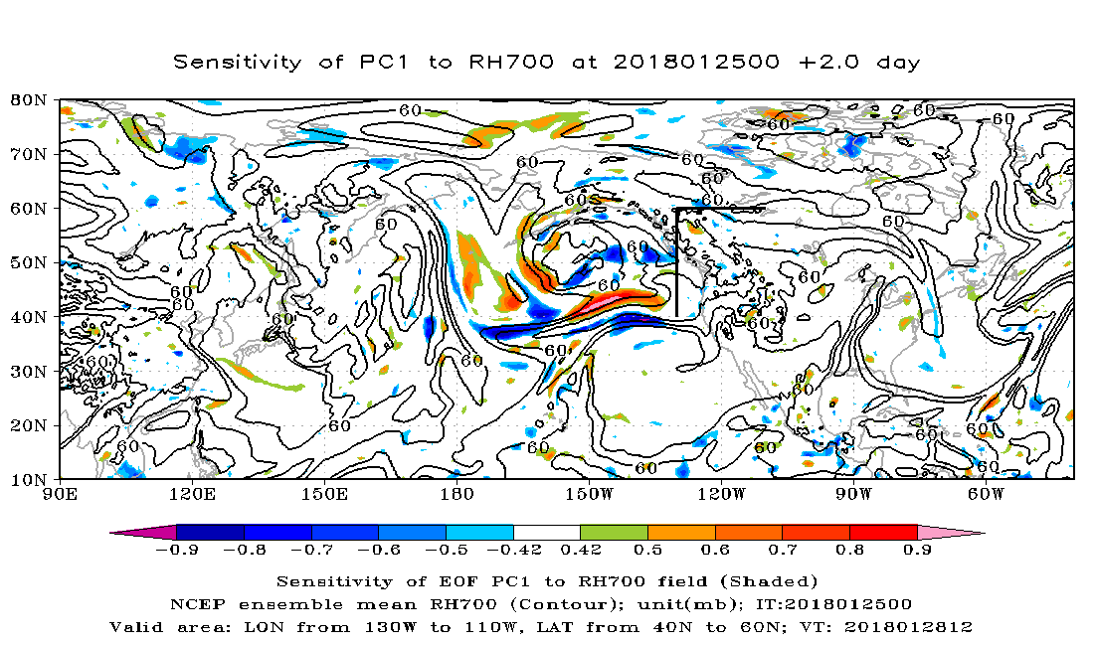
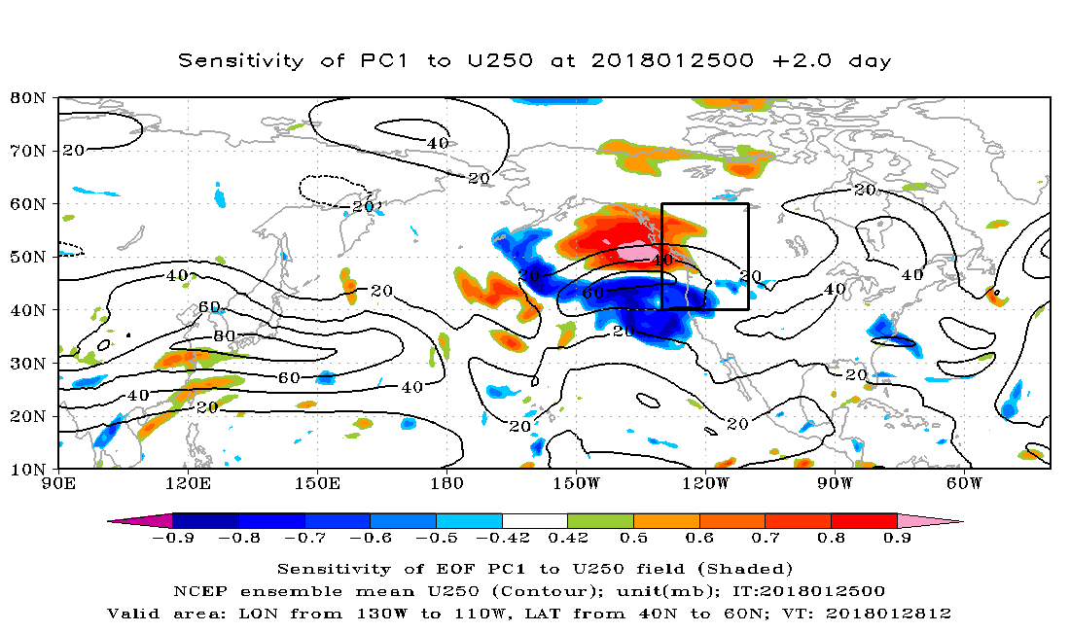
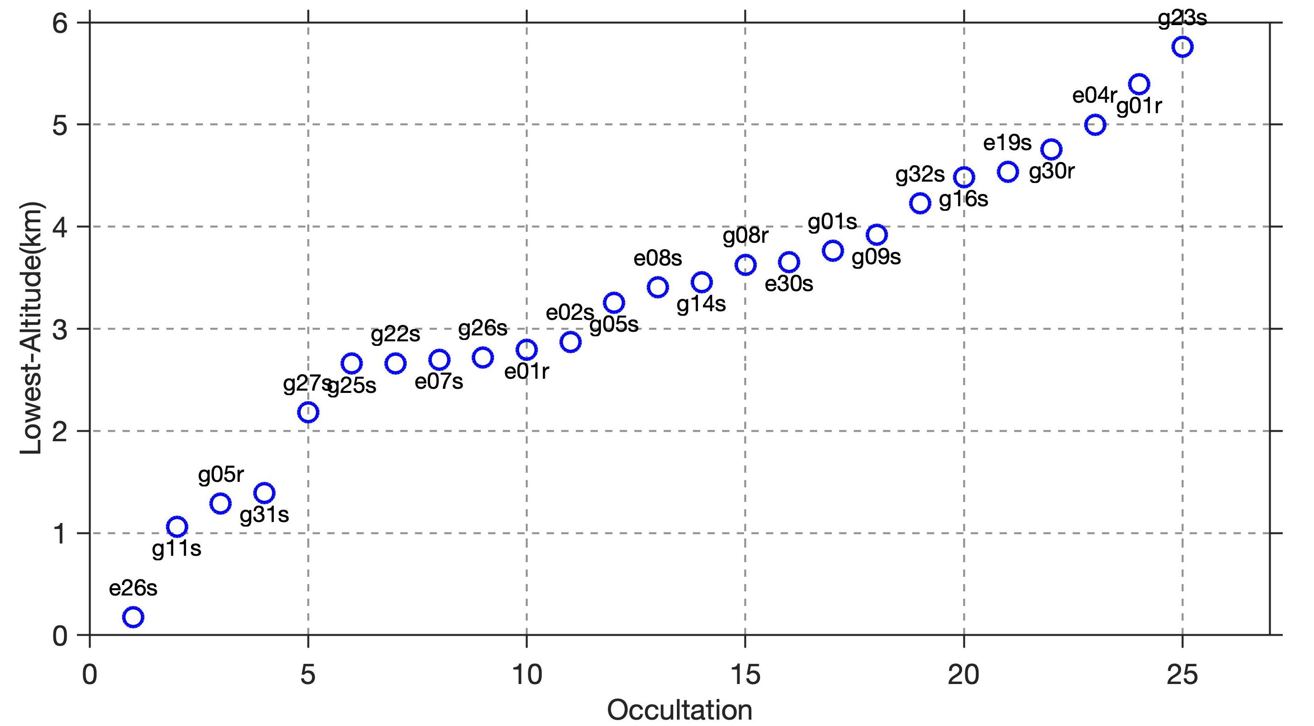
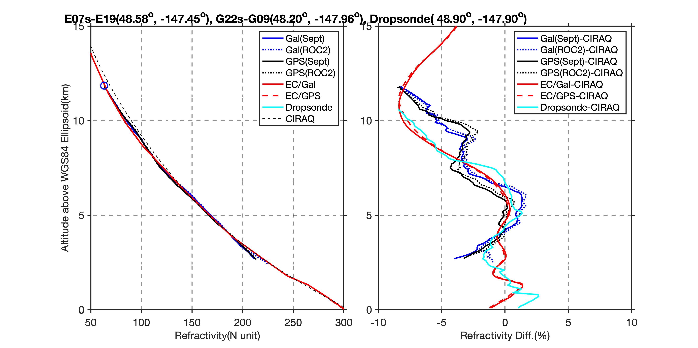
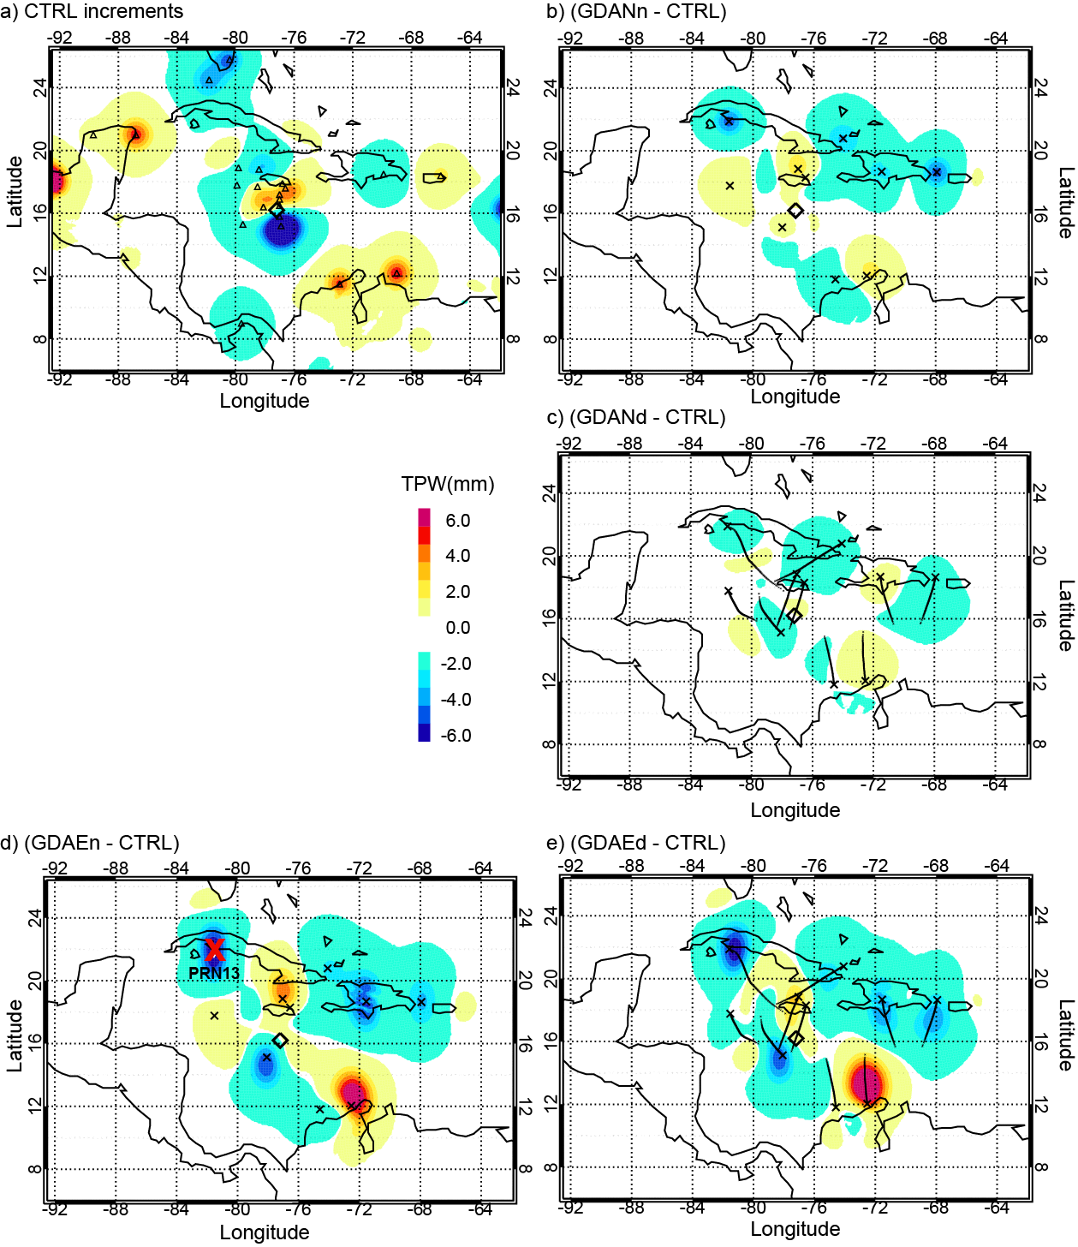
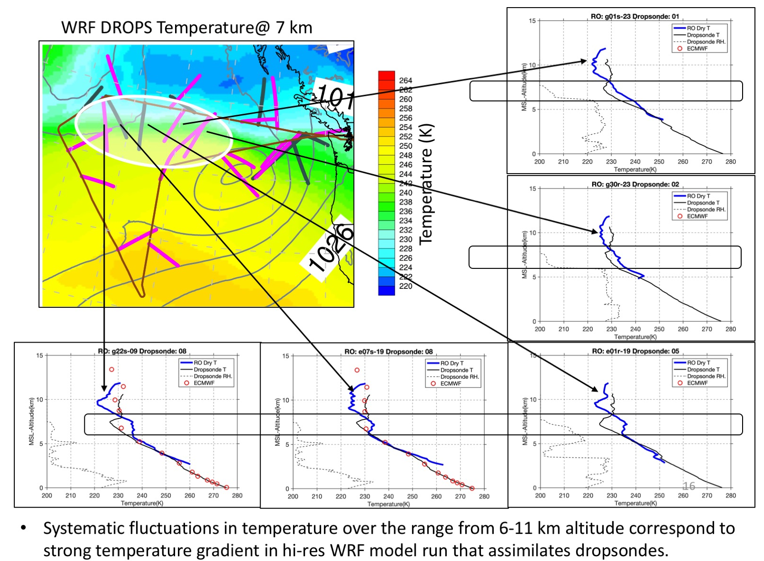
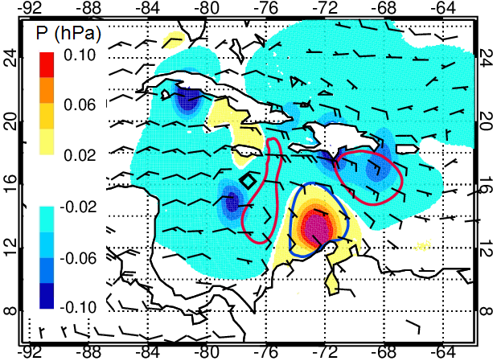
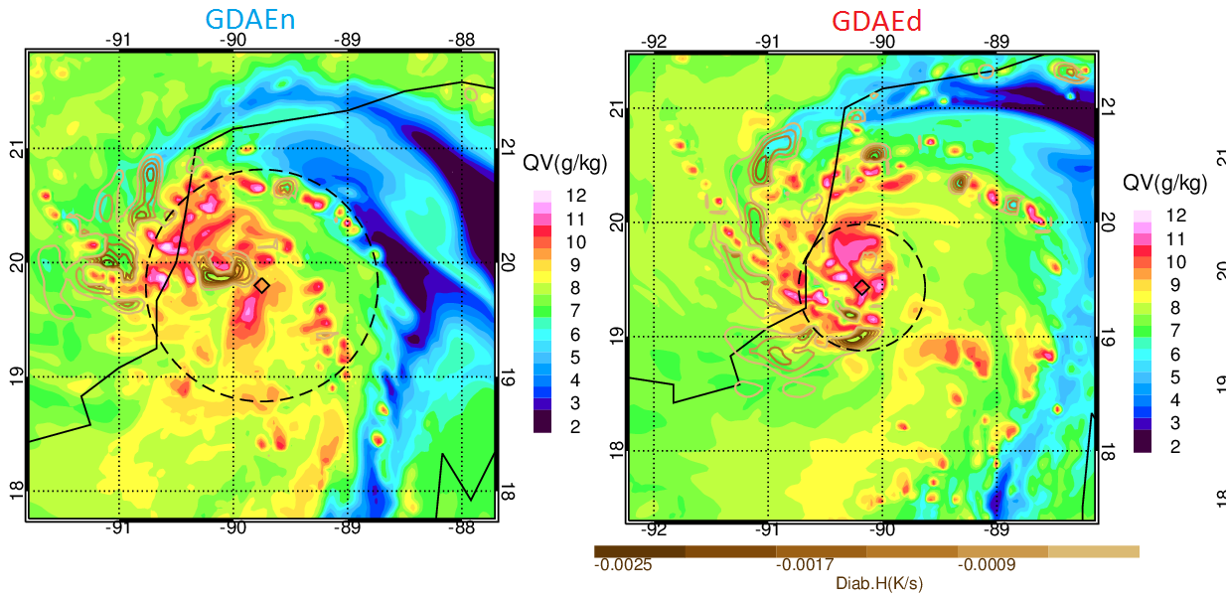
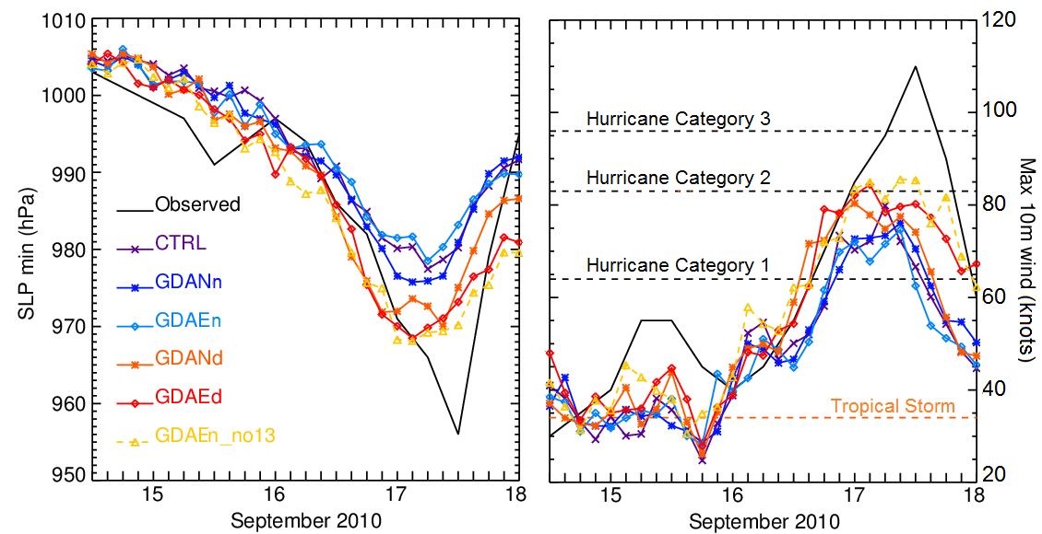
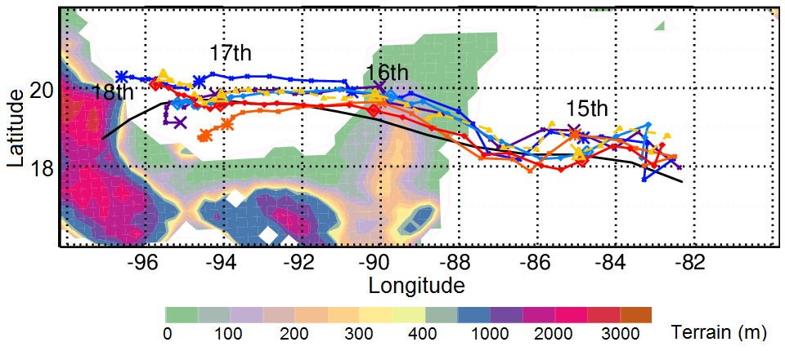
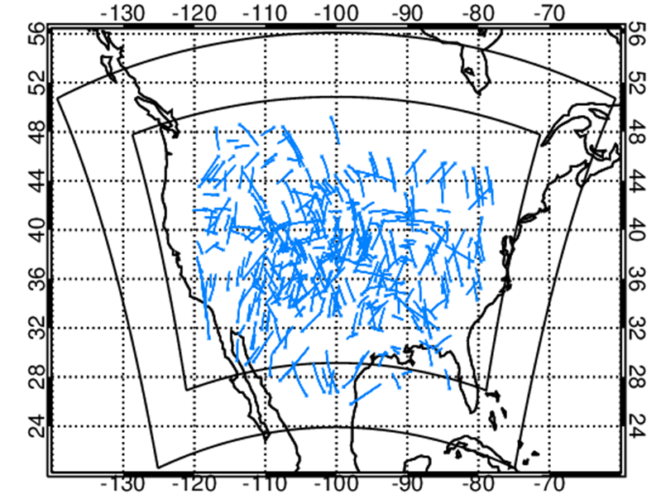
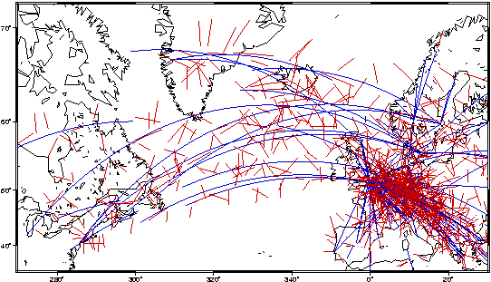
Potential Contributions of Airborne Radio Occultation Observations to Forecast Improvement of Hurricanes and Atmospheric Rivers
J.S. Haase¹, M.J. Murphy Jr. ¹, B. Cao¹, S.-H. Chen², M. Zheng³, F.M. Ralph³, B. J. Murphy⁴, X.-M. Chen², K.-N. Wang¹, S.-Y. Chen⁵, C. Y. Huang⁵, J.L. Garrison⁴
¹UC San Diego; ²UC Davis; ³CW3E UC San Diego; ⁴Purdue University; ⁵Central Taiwan University
Airborne Radio Occultation (ARO)
Measures GNSS signal propagation delay from satellites below the horizon
Refractivity at tangent point is a function of pressure, temperature, water vapor pressure
High vertical resolution
Complementary to dropsondes
Samples to the side of the flight track continuously, 25 per 7 hour flight
Data assimilation experiment
dropsonde
Data assimilation increment
ARO
AR Recon 2018 Field campaign IOP1 Targeted observations
Radiosondes + dropsondes
Spaceborne GPS RO
Impact on 12 hour forecast precipitation
tangent point
Difference in Spec. Hum.
Difference in precipitation
Airborne GPS RO
Airborne GPS + Galileo RO
Lowest tangent point of profile
ARO had an impact on the initial moisture fields that propagated downstream and affected precipitation at landfall.
In this case, the precipitation was minor so the overall impact was minor.
Perhaps sampling on 27 Jan at 18 Z upstream of the major precipitation at landfall on 28 Jan at 12 Z would show more impact.
We can investigate more ways to use the forecast timing of the precipitation.
The sensitivity of the PCA of precipitation to the observations may be a good predictor for this.
~7 hr flight.
17 GPS (14 Setting + 4 Rising).
8 Galileo (6 Setting +1 Rising).
One Galileo occultation penetrates to the surface.
Five rising occultations, one penetrates to 2 km.
EXCEPTIONALLY GOOD FOR SIMPLE CLOSED-LOOP RECEIVER HARDWARE.
11/25 occultations penetrate below 3 km
Dropsonde comparison for data quality evaluation
Sondes + GTS
Sondes + GTS + ARO
Negligible difference between two independent receivers.
1% difference between two constellations GPS and Galileo.
2-3% difference with ECMWF model and dropsonde.
Structural variations match very well.
Hurricane Karl 2010 example case study
Experiments | Observations assimilated
CTRL | GTS + dropsondes
GDANn | CNTL + airborne RO non-drifting refractivity
GDAEd | CNTL + airborne RO excess phase w/drifting tangent points
Importance of non-local DA operator
Spatial variations in temperature field sampled by ARO
Changes in the initial moisture, pressure, and vorticity fields
(GDAEd-CTRL) 3-km pressure and vorticity
1200 UTC 13 Sept. 2010
Distributed increment.
The vortex of the storm was more compact during early development, likely due to the increase in midlevel moisture and positive vorticity advection (right), compared to the CTRL experiment without ARO observations.
Positive vorticity advection
Impact on diabatic heating
Localized
increment.
(left) Water vapor mixing ratio (color shading) and diabatic heating (brown contours) at 650 hPa at 0000 UTC 16 September of GDAEn and GDAEd. Areas of diabatic cooling ahead of the storm likely impeded the storm development.
Black diamonds indicate the position of the surface minimum sea level pressure of the simulated storm. Dashed circles indicate the radius of maximum 10-m wind.
Potential for deployment on commercial aircraft
Impact on hurricane intensity and track
Flights in GTS database in one day
~3500 occultations over CONUS
11 Sept 2013 CO extreme flooding event
(Chen 2017; Gochis et al., 2015)
14 transatlantic AMDAR flights in one day
~250 occultations (GPS only)
(Lesne et al., 2002)
Central sea level pressure
Maximum 10-m wind
Tracks
References
Chen, X. M., S. H. Chen, J. S. Haase, et al. (2018), The Impact of Airborne Radio Occultation Observations on the Simulation of Hurricane Karl (2010), MWRv, 146, 329-350.
Chen, X. M. (2017), Airborne Radio Occultation Measurements and Their Impact on Severe Weather Prediction Using the Regional WRF Model, 132 pp, UC Davis, Davis, CA.
Haase, J. S., B. J. Murphy, P. Muradyan, F. Nievinski, K. M. Larson, J. L. Garrison, and K.-N. Wang (2014), First Results from an Airborne GPS Radio Occultation System for Atmospheric Profiling, GeoRL, 40.
Lesne, O., J. Haase, G. Kirchengast, J. Ramsauer, and W. Poetzi (2002), Sensitivity analysis of GNSS radio occultation for airborne sounding of the troposphere, Phys. and Chem. of the Earth, 27, 291-299.
Murphy, B. J., J. S. Haase, P. Muradyan, J. L. Garrison, and K.-N. Wang (2015), Airborne GPS radio occultation refractivity profiles observed in tropical storm environments, JGR, 120, 1690-1790.
Wang, K. N., J. L. Garrison, J. S. Haase, and B. J. Murphy (2017), Improvements to GPS Airborne Radio Occultation in the Lower Troposphere Through Implementation of the Phase Matching Method, JGR: Atmospheres, 122, 2017JD026568.
Acknowledgements
This work was supported by NSF GRANT 1642650, and NASA GRANT NNX15AU19G , NSF grants 100602-200912528, AGS 1015904, and AGS 1301835. We thank the CW3E AR Program and its sponsors, including the California Department of Water Resources, and the Army Corps of Engineers FIRO program. We thank NSF & the NCAR EOL facility for the loan of the Applanix navigation system, Adrian Borsa for the GNSS equipment loan, and Dave Jabson for his assistance with the ROC equipment. Flight time on the NOAA G-IV aircraft was provided by the National Oceanic and Atmospheric Administration. We would like to acknowledge the assistance of the NOAA Aircraft Operations Center staff, and in particular Gabriel DeFao and Jack Parrish.

