Slide 1
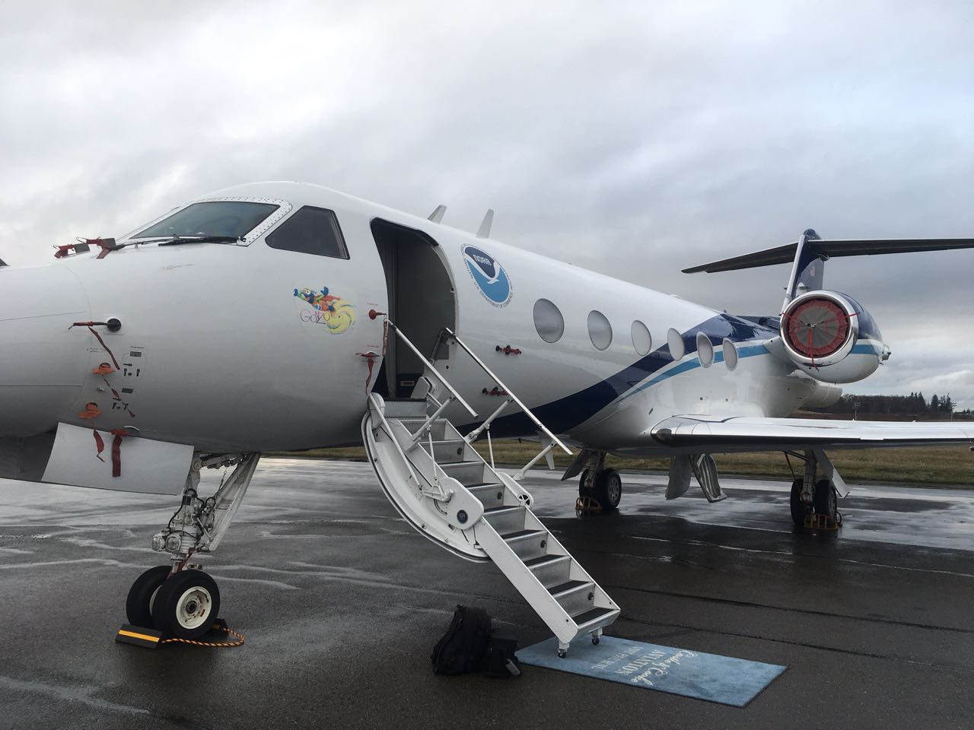



Assessing the accuracy and value of airborne radio occultation (ARO) observations using complementary dropsonde data from the
AR-Recon 2018 flight campaign
Jennifer S. Haase, Bing Cao, Michael J. Murphy,
Minghua Zheng, and Eric. K. Wang

Slide 2
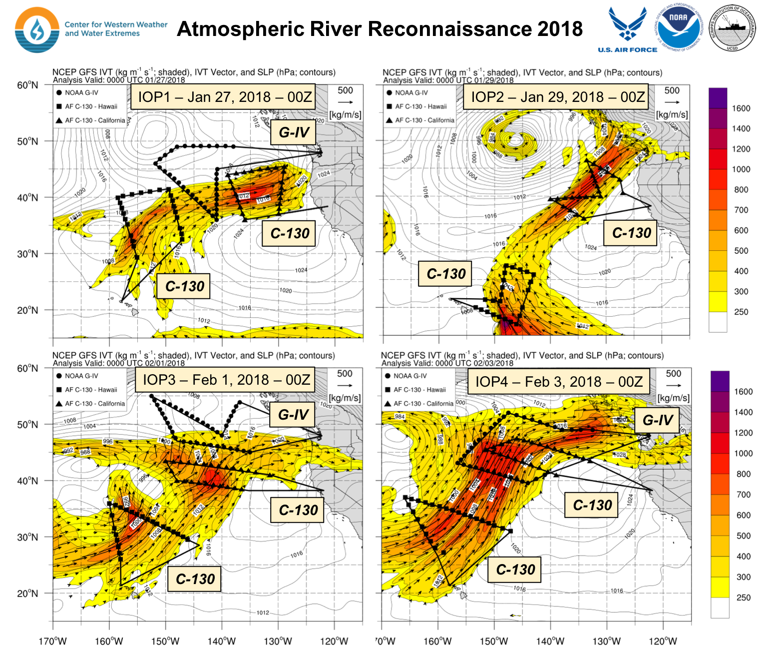
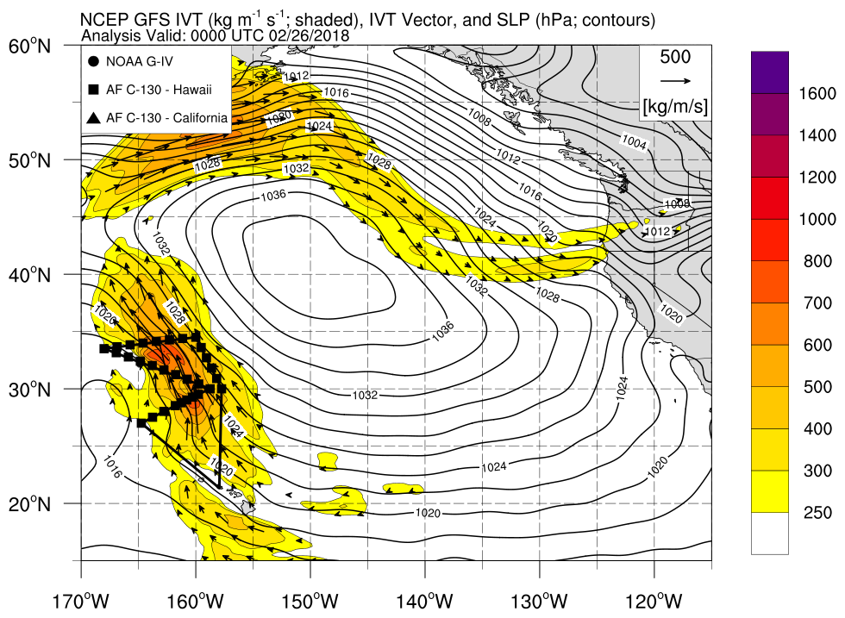
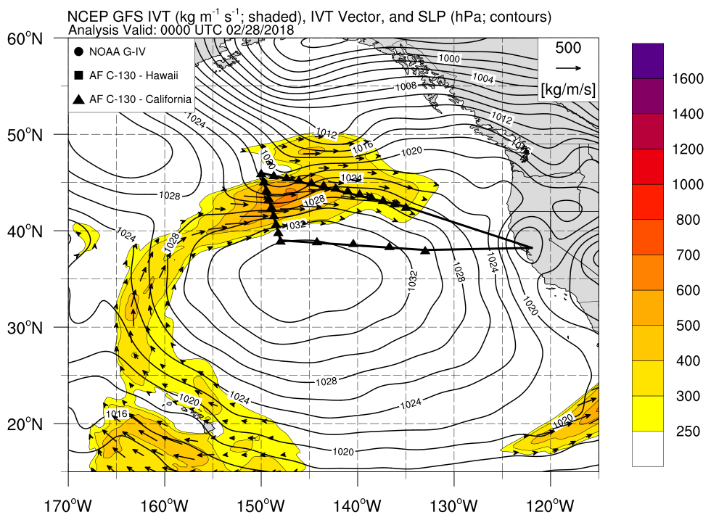
IOP5 – Feb 26, 2018 – 00z
NOAA G-IV@43,000 ft
2 AF WC-130@20,000 ft.
ROC2 on board the NOAA G-IV
3 Flights
Integrated Vapor Transport (kg s⁻¹ m⁻¹)
IOP6 – Feb 28, 2018 – 00z

Slide 3
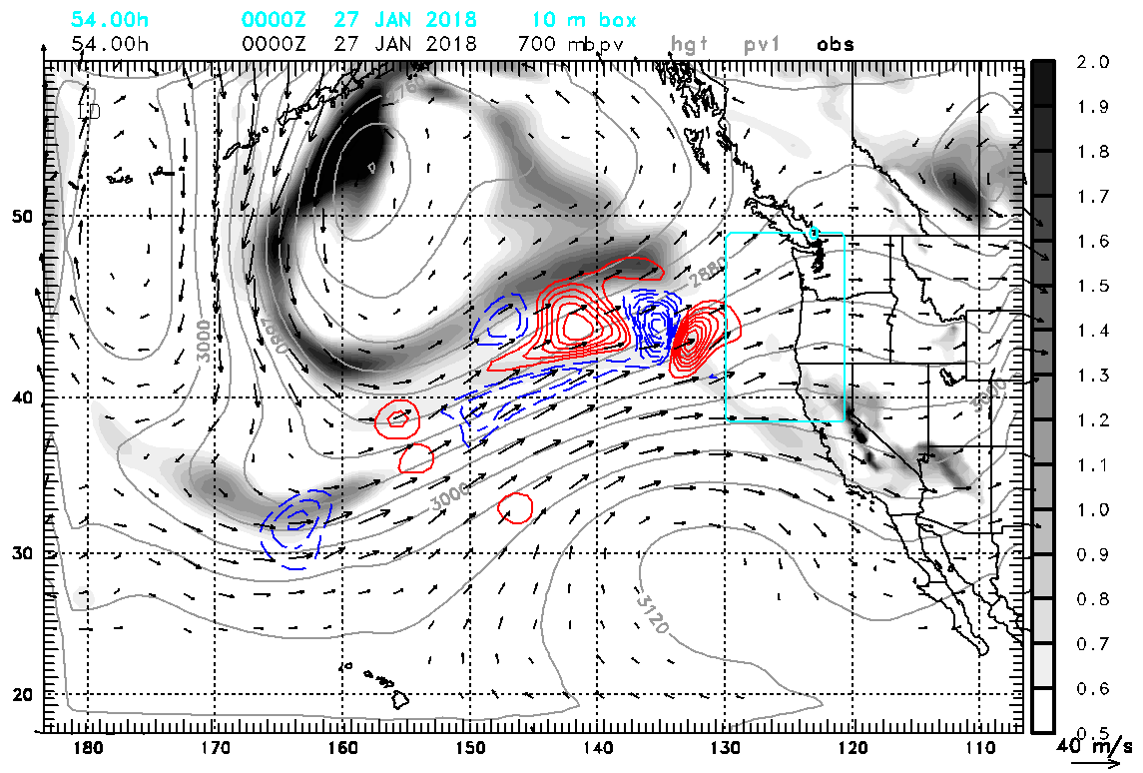
G-IV flights target sensitivity to potential vorticity on cold side of atmospheric river
400 hPa Potential Vorticity
COAMPS Adjoint Sensitivity Valid at 00Z 27 January (54h)
700 hPa PV (gray)
700 hPa Heights (gray contour) and Winds (vectors)
700 hPa PV Sensitivity (blue/red)
The sensitivity of the forecast 12h accumulated precipitation in the rectangle 24-36h after flight time (in this case, 00Z to 12Z 28 January) to PV at 700 hPa at flight time 00Z 27 Jan based on a forecast initialized at 06Z 23 Jan.
Notes:
A positive change in PV at the location of ARO observation 05r will produce a negative change in precipitation at 00Z to 12Z 28 February.

Slide 4
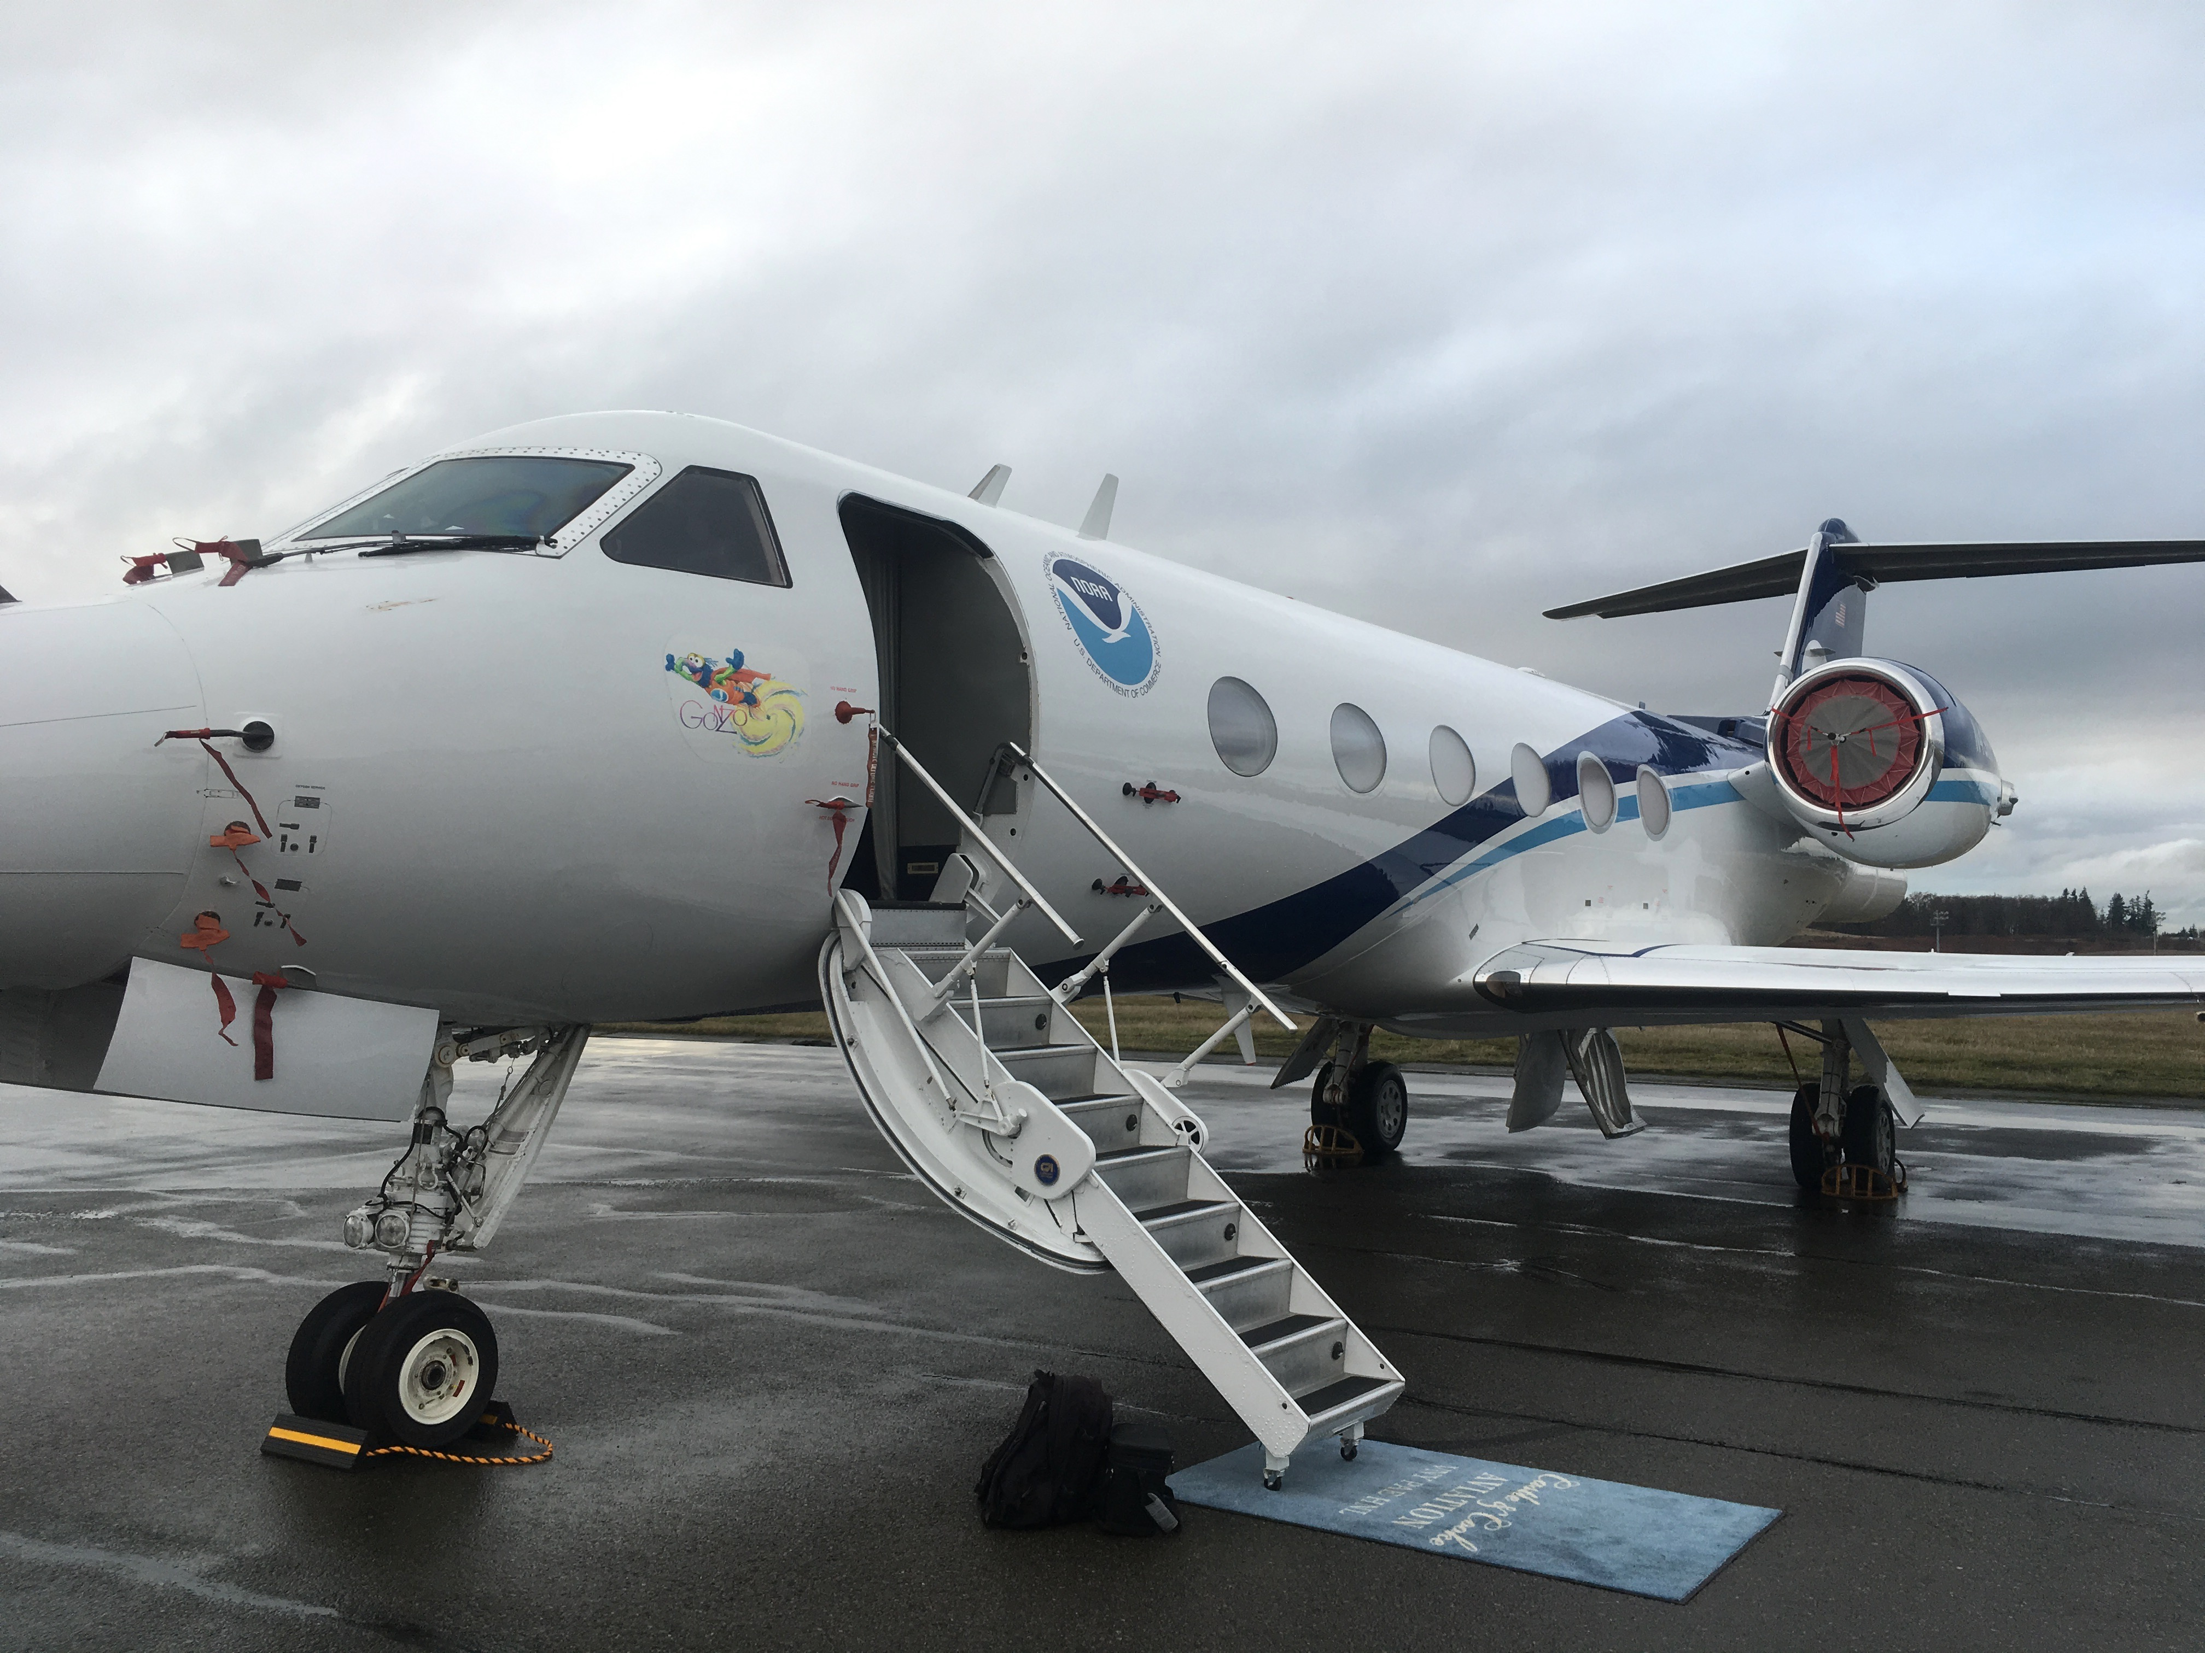
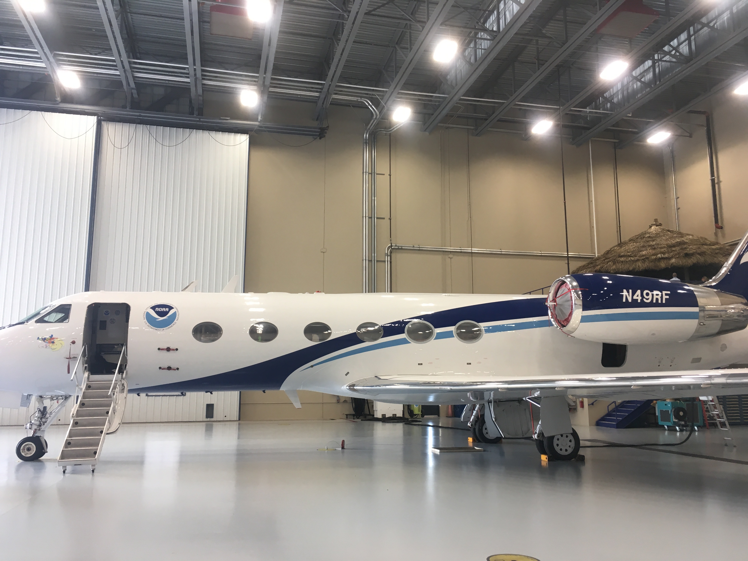
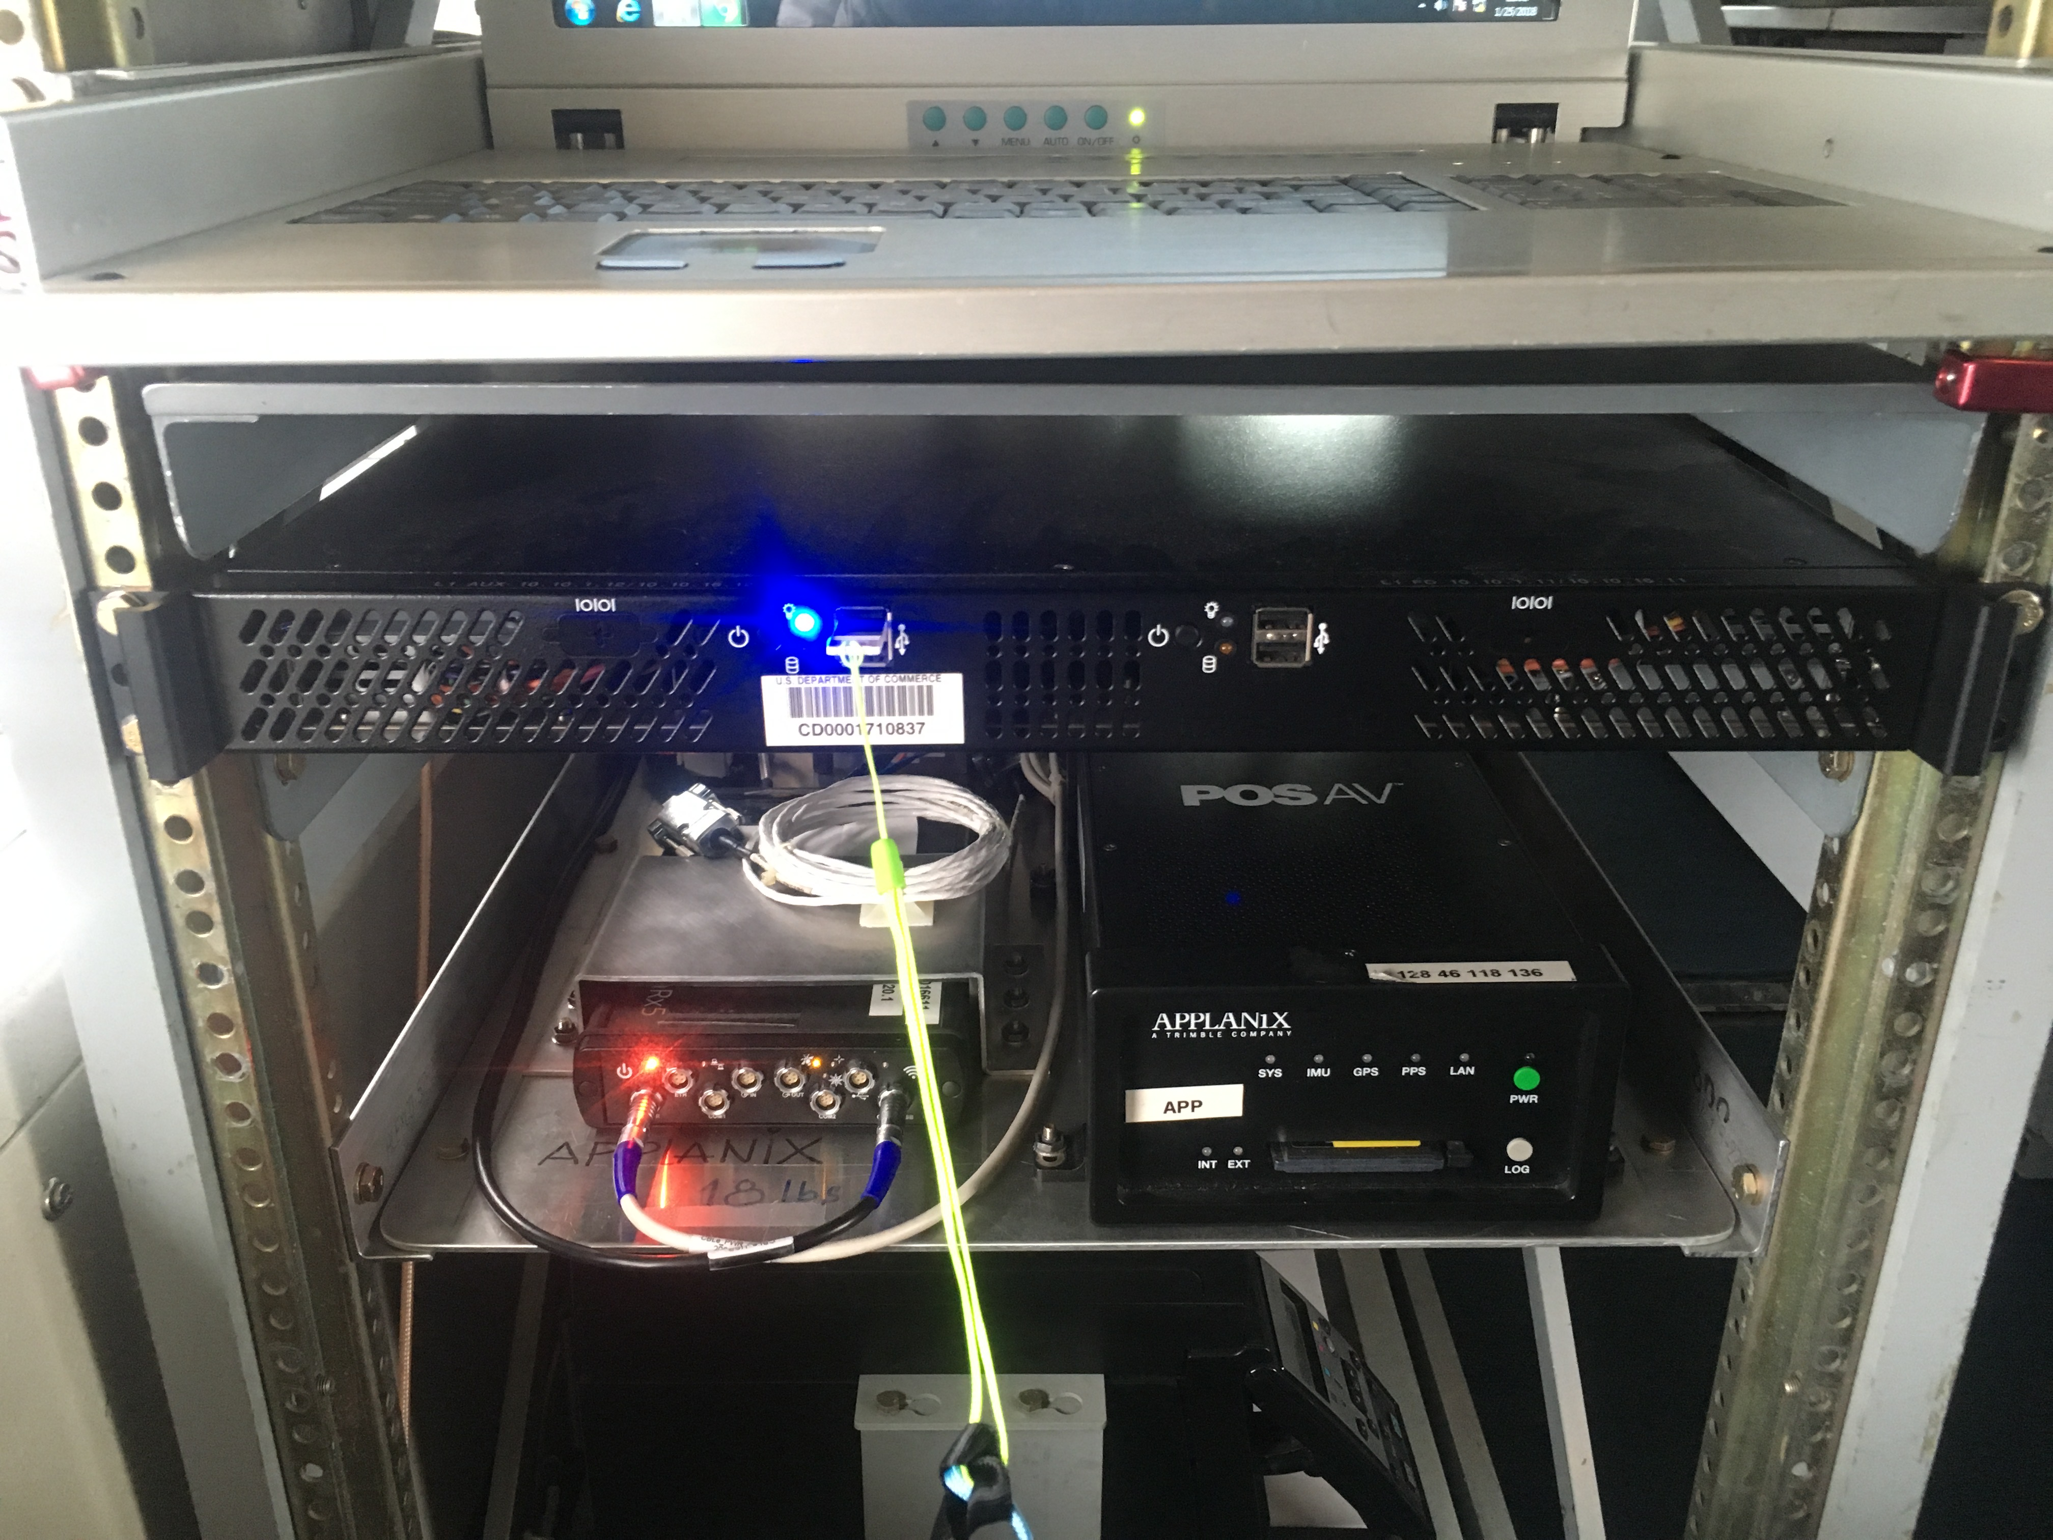
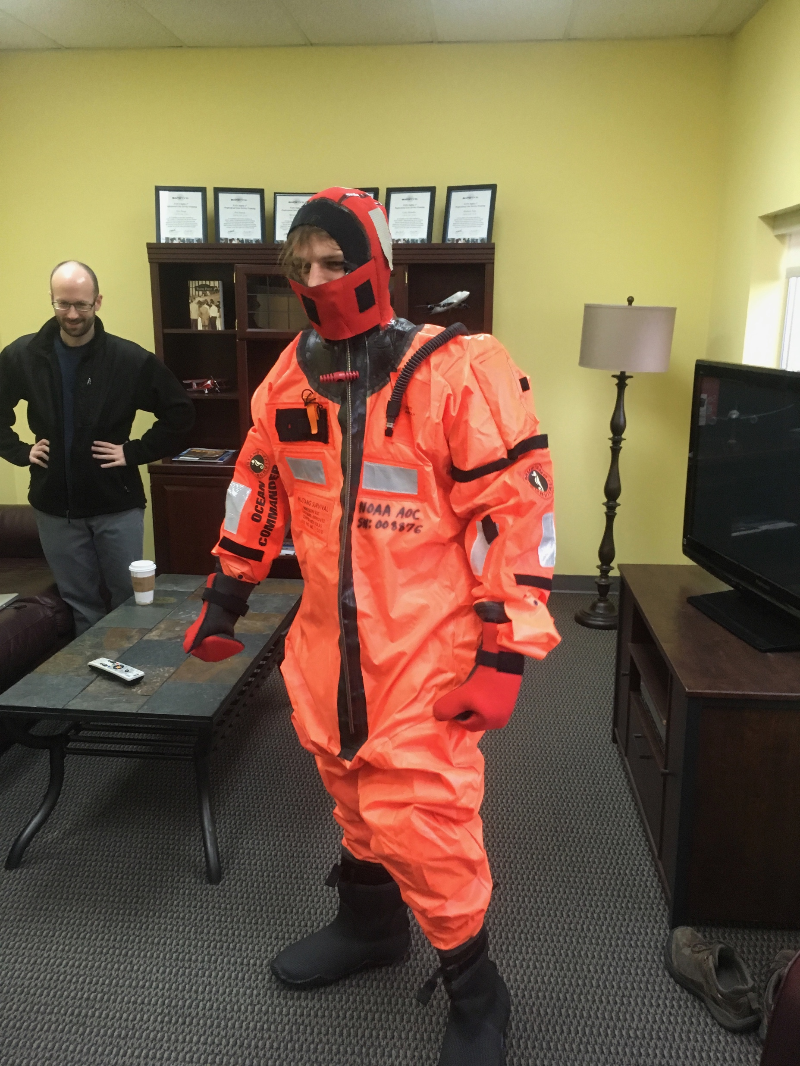
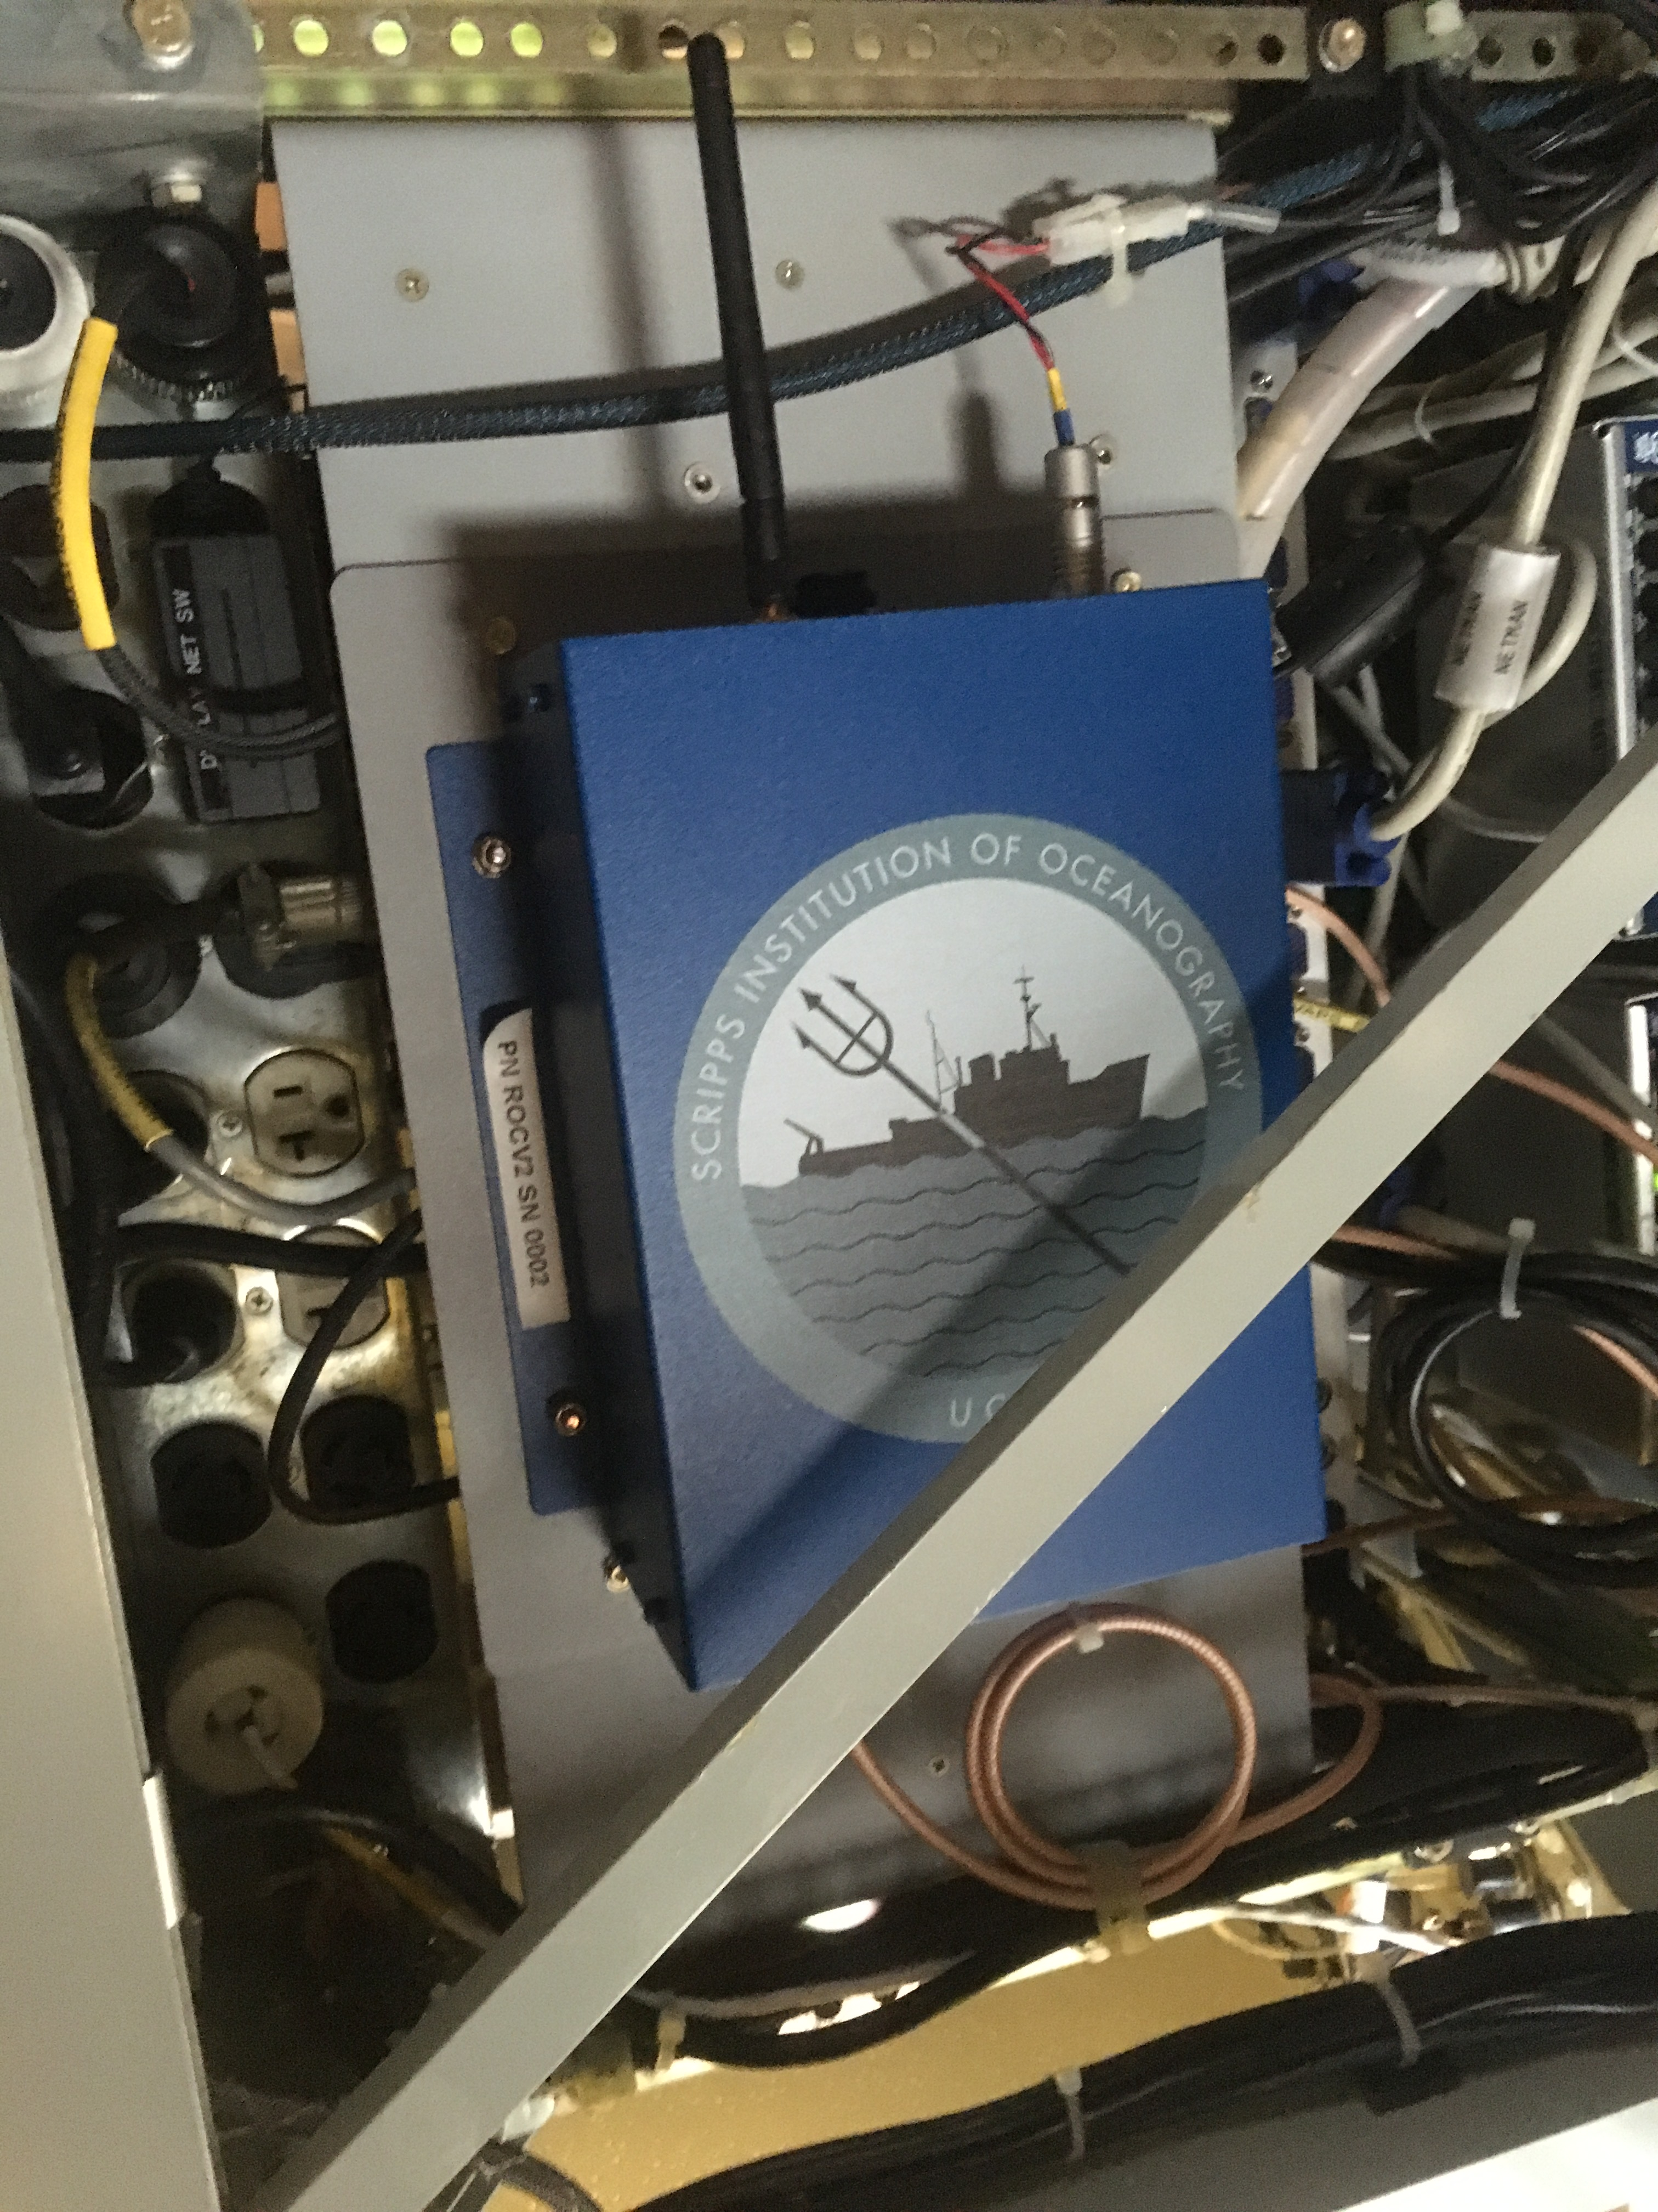
AR-2018: ROC2 receiver onboard the NOAA G-IV
Flight altitude:
41,000 – 45,000 ft.
True airspeeds:
440-460 kts.
2015 campaign GNSS open-loop tracking – tracks to surface
2018, 2019 campaign simplified GNSS receiver – tracks to ~5 km
Redundant recordings with two different GNSS receivers.
Standard GPS antenna captures Galileo signals in the same frequency band.
Acknowledgements: NOAA AOC
GPS Antenna
Septentrio PolaRx5
Applanix AV GPS/INS System
Anti-exposure suit in case of ditching in water
ROC2

Slide 5
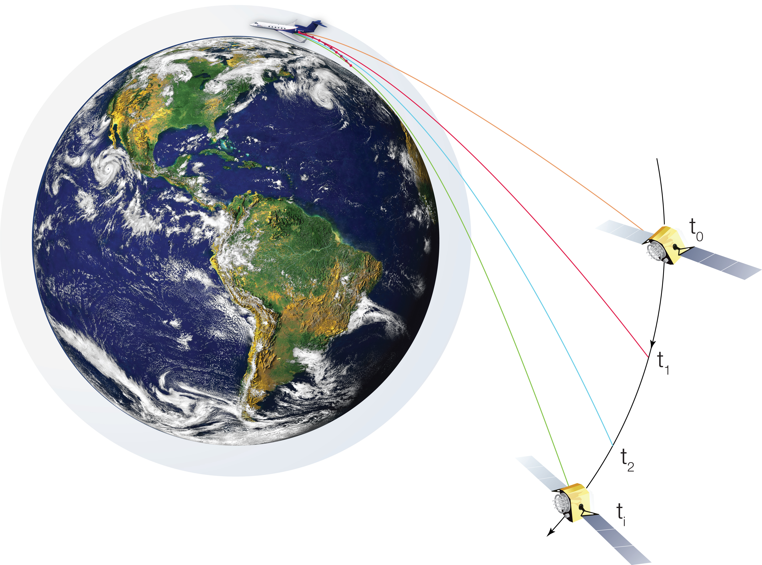
Complementary nature of soundings
Airborne Radio Occultation (ARO) samples to the side of aircraft, nearly horizontally, at different levels of the atmosphere
The delay of the GPS signal from a setting GPS satellite is observed through a Doppler shift in the carrier phase and refractive bending of the ray path.
ARO provides a limb-sounding profile of refractivity, N, using the same technique as COSMIC satellites.

Slide 6
Complementary nature of soundings
Dropsondes sample directly beneath the flight track (+ wind drift of sonde)
Airborne Radio Occultation (ARO) samples to the side of aircraft, geometry is unaffected by winds
The delay of the GPS signal from a setting GPS satellite is observed through a Doppler shift in the carrier phase and refractive bending of the ray path.
ARO provides a limb-sounding profile of refractivity, N, using the same technique as COSMIC satellites.
aro
dropsonde

Slide 7
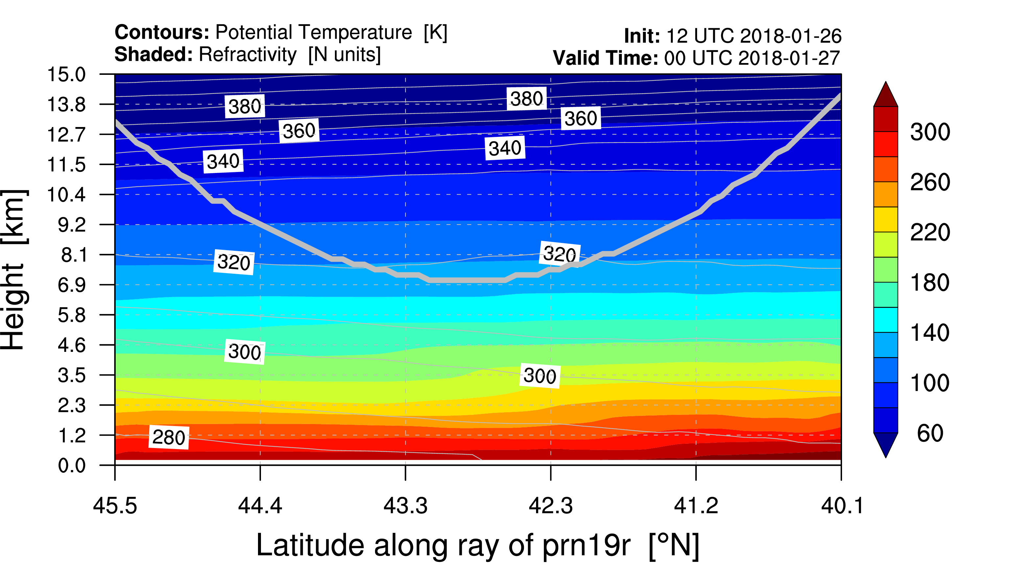
Sampling of the atmosphere by the GPS ray path
N
tangent point
Observations are most sensitive to N at the tangent point.
The effect of refractivity in upper layers is removed in the retrieval process assuming horizontally constant values.
Error in removing upper levels is due to the difference between the upper level N from a horizontally constant value.
Notes:
COAMPS refractivity model

Slide 8
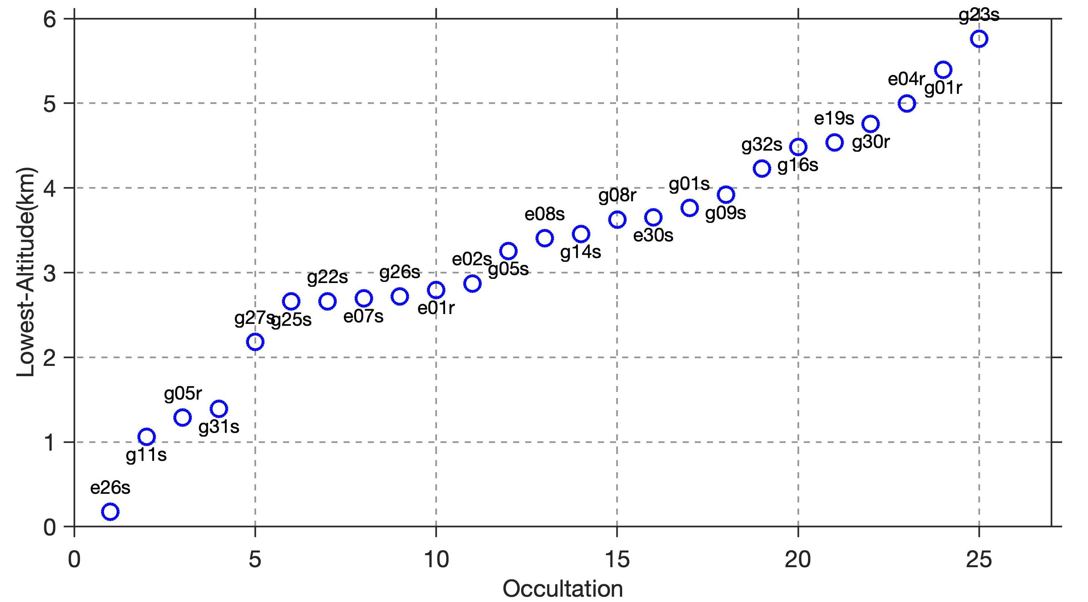
Vertical extent of ARO profiles
Galileo Occ.
Rising Occ.
~8 hr flight.
17 GPS (14 Setting + 4 Rising).
8 Galileo (6 Setting +1 Rising).
11/25 occultations penetrate below 3 km.
18/25 occultations penetrate below 4 km.
One Galileo occultation penetrates to the surface.
Five rising occultations, one which penetrates to 2 km.
EXCEPTIONALLY GOOD FOR SIMPLE CLOSED-LOOP RECEIVER HARDWARE.

Slide 9
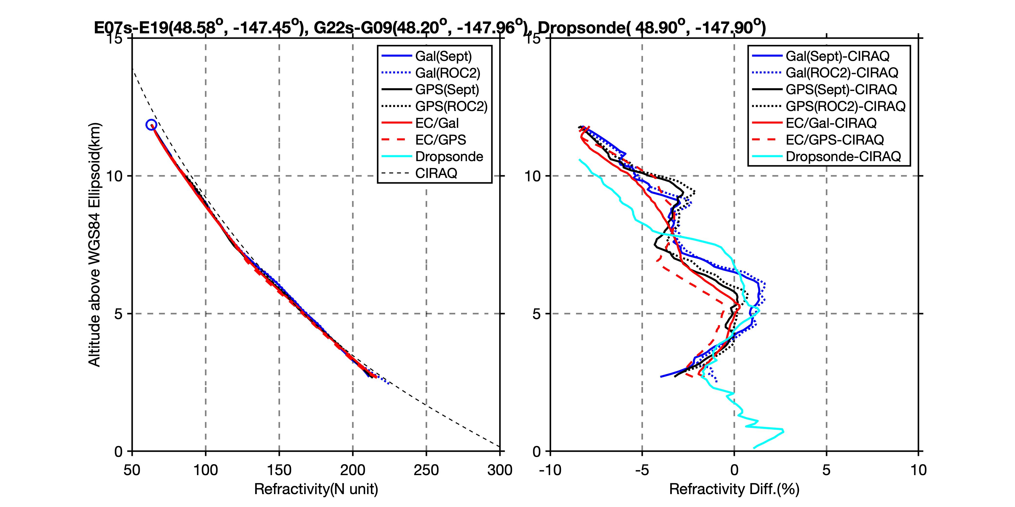
ARO quality evaluation - summary
Negligible difference between two receivers.
1% difference between two constellations GPS and Galileo.
2-3% difference with ECMWF model and dropsonde.
Structural variations match very well.

Slide 10
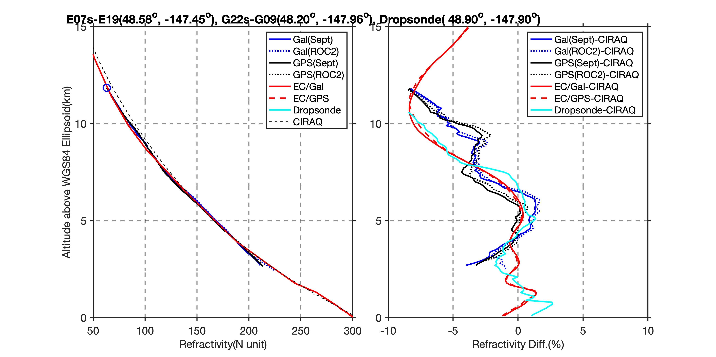
ARO quality evaluation - summary
The EC model profiles are shown for the two dropsondes nearest the GPS and Galileo ARO data
EC model (assimilates dropsondes) and matches dropsondes
EC model is significantly different at tangent point locations where it matches ARO better than dropsondes
Therefore these differences between dropsonde and ARO are realistic atmospheric variations.

Slide 11
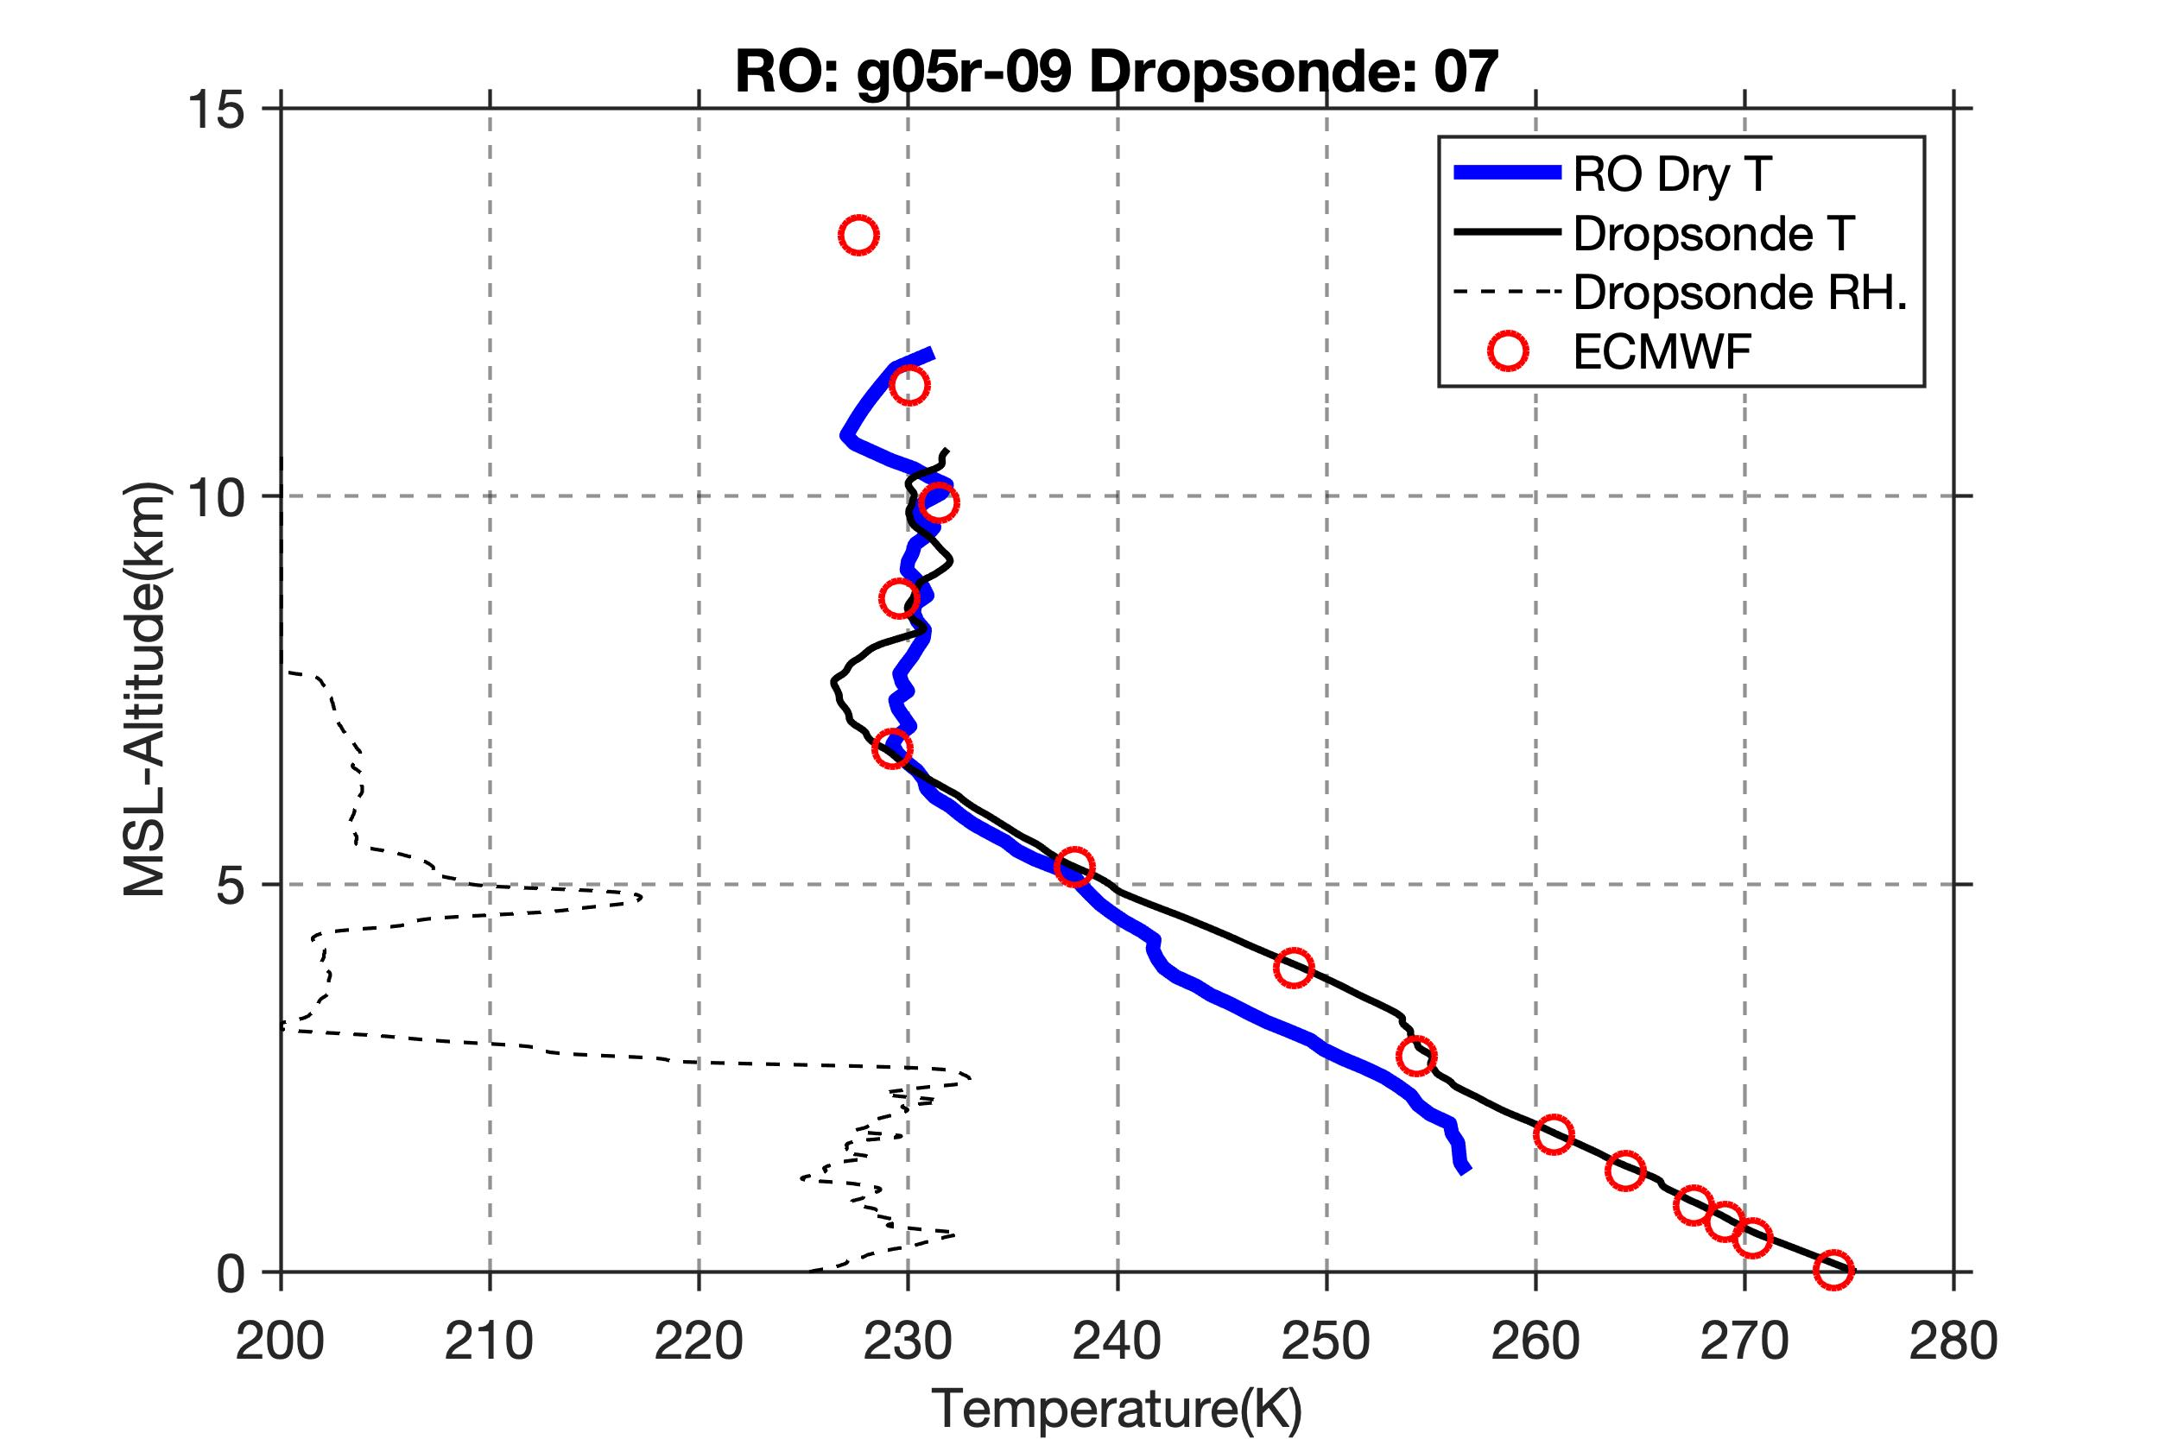
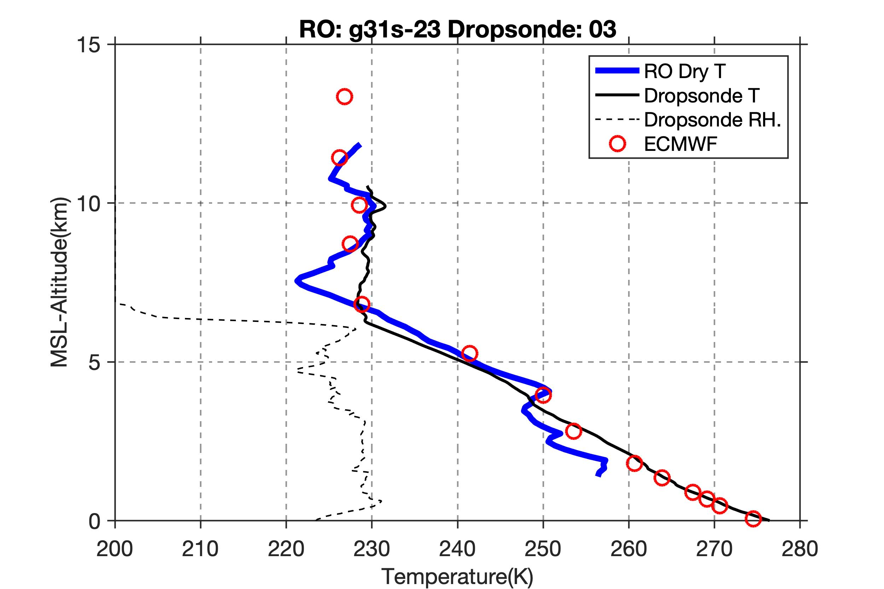
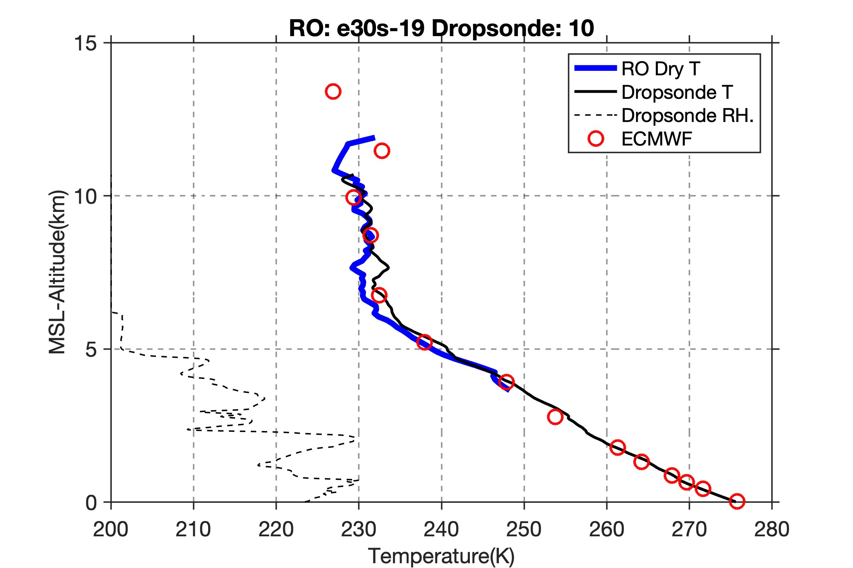
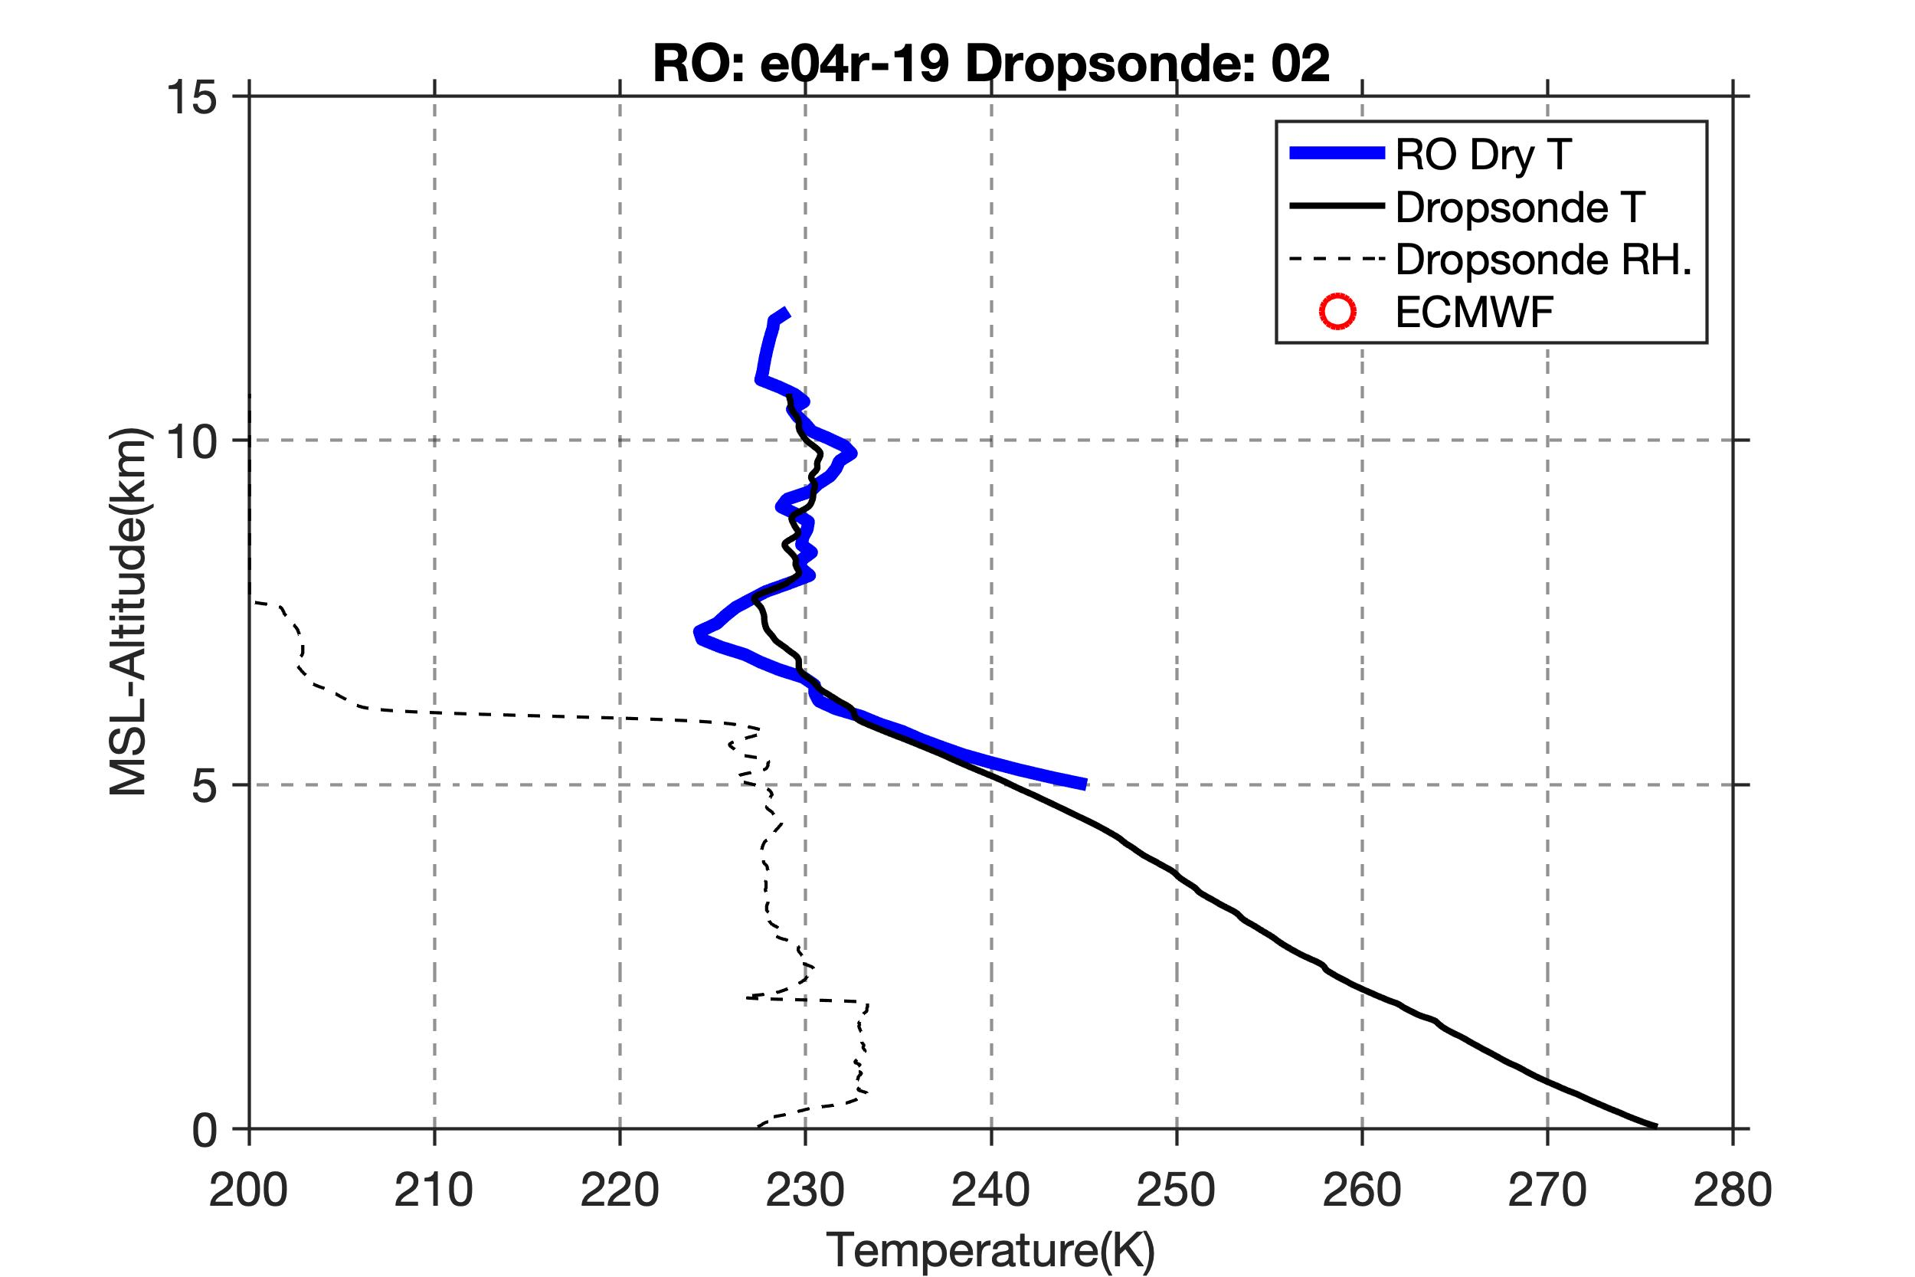
Hydrostatic dry temperature on cold side
North of cold front, upper level temperature is nearly constant. ARO detects a colder temperature inversion at 7 km.
GPS
ECMWF analysis assimilates the dropsonde data, so agrees well.
Galileo

Slide 12
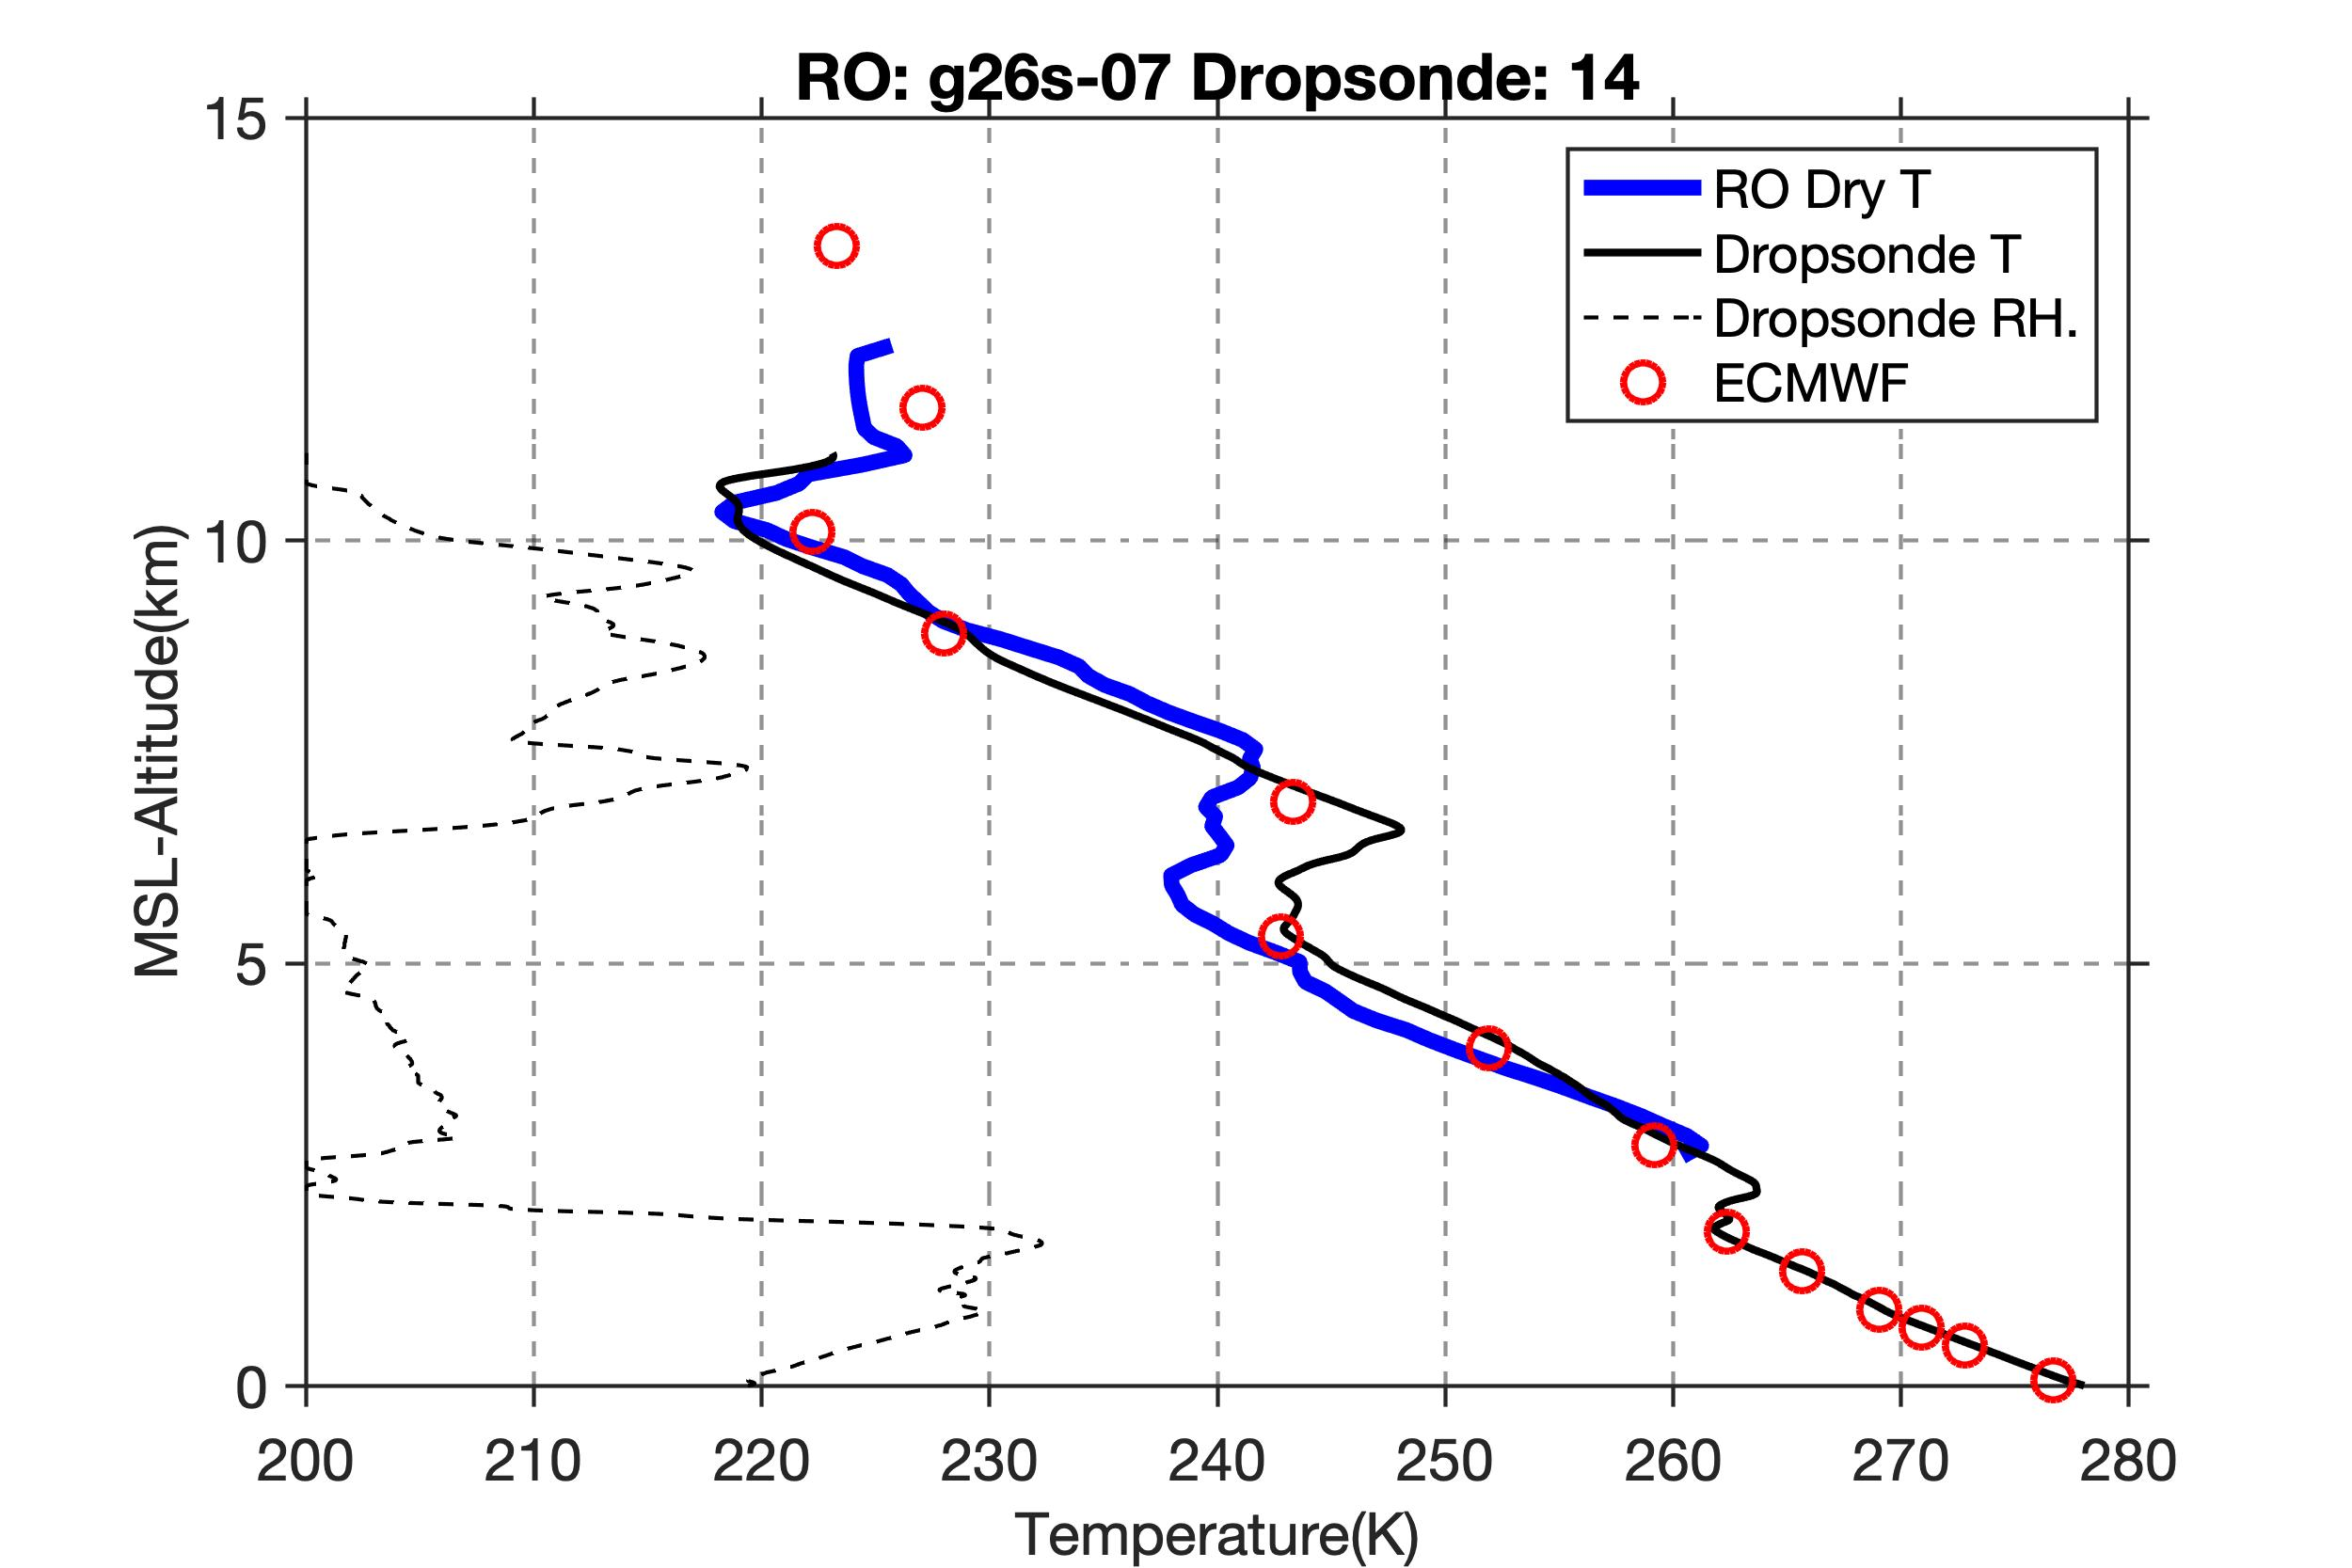
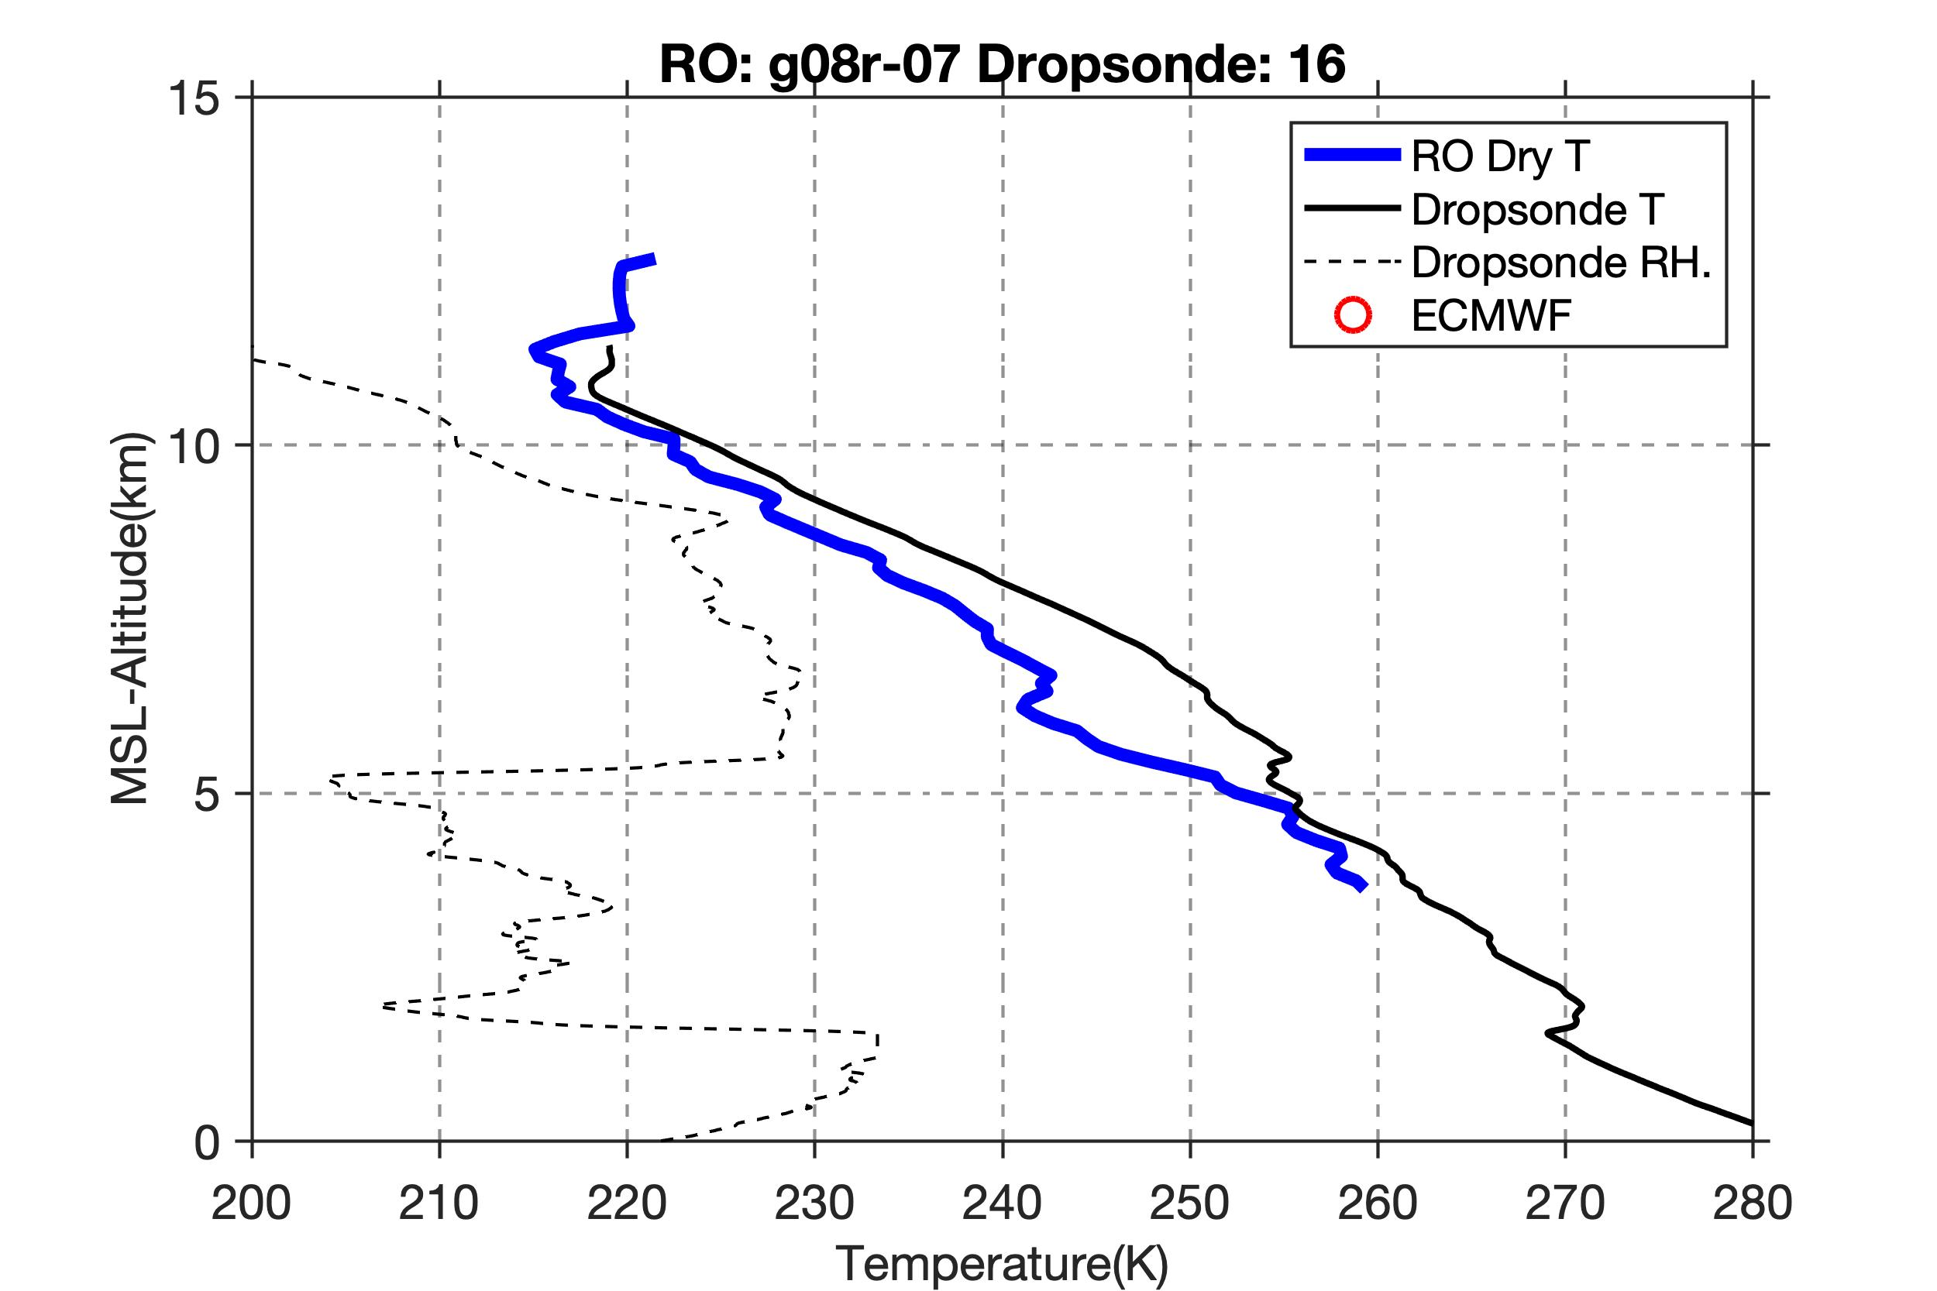
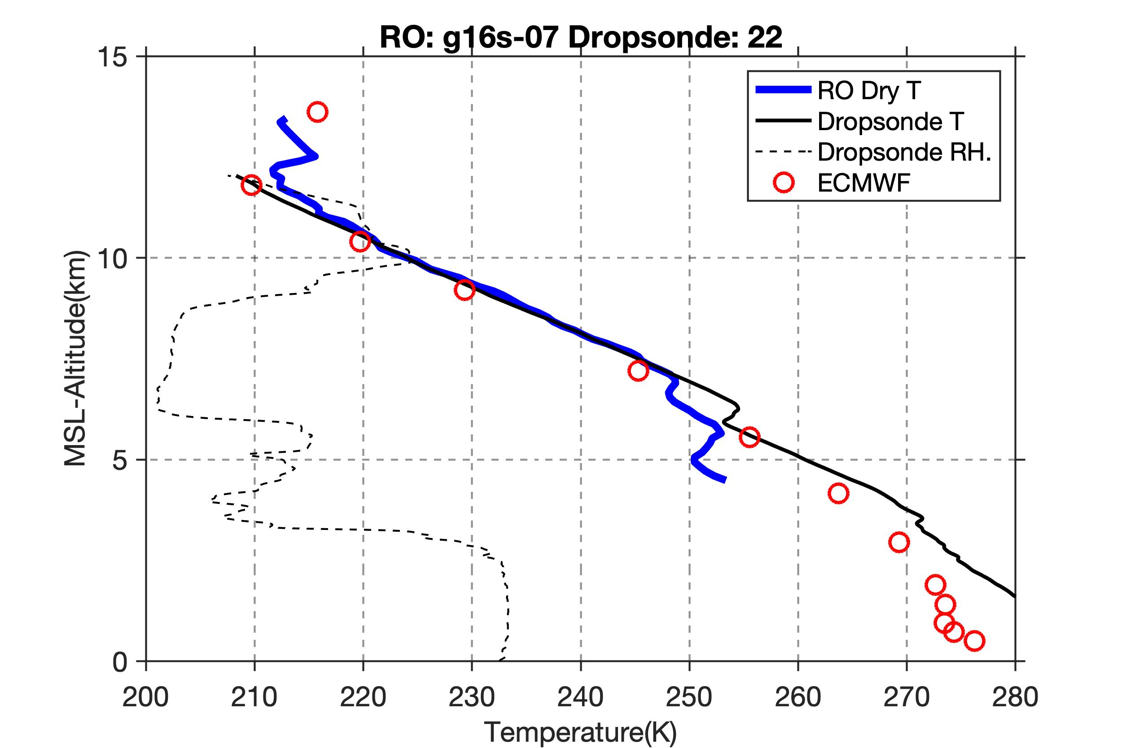
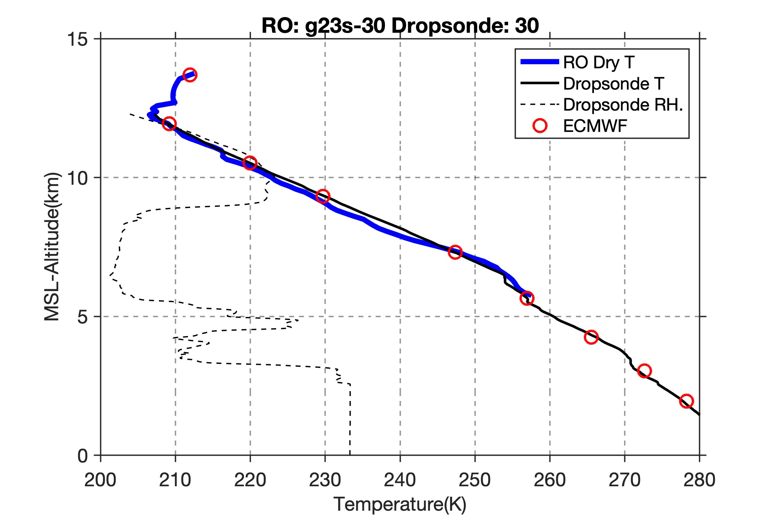
South of cold front, steep upper level temperature gradient.
Fewer profiles on warm side, as expected for closed loop receivers, due to multipath.

Slide 13
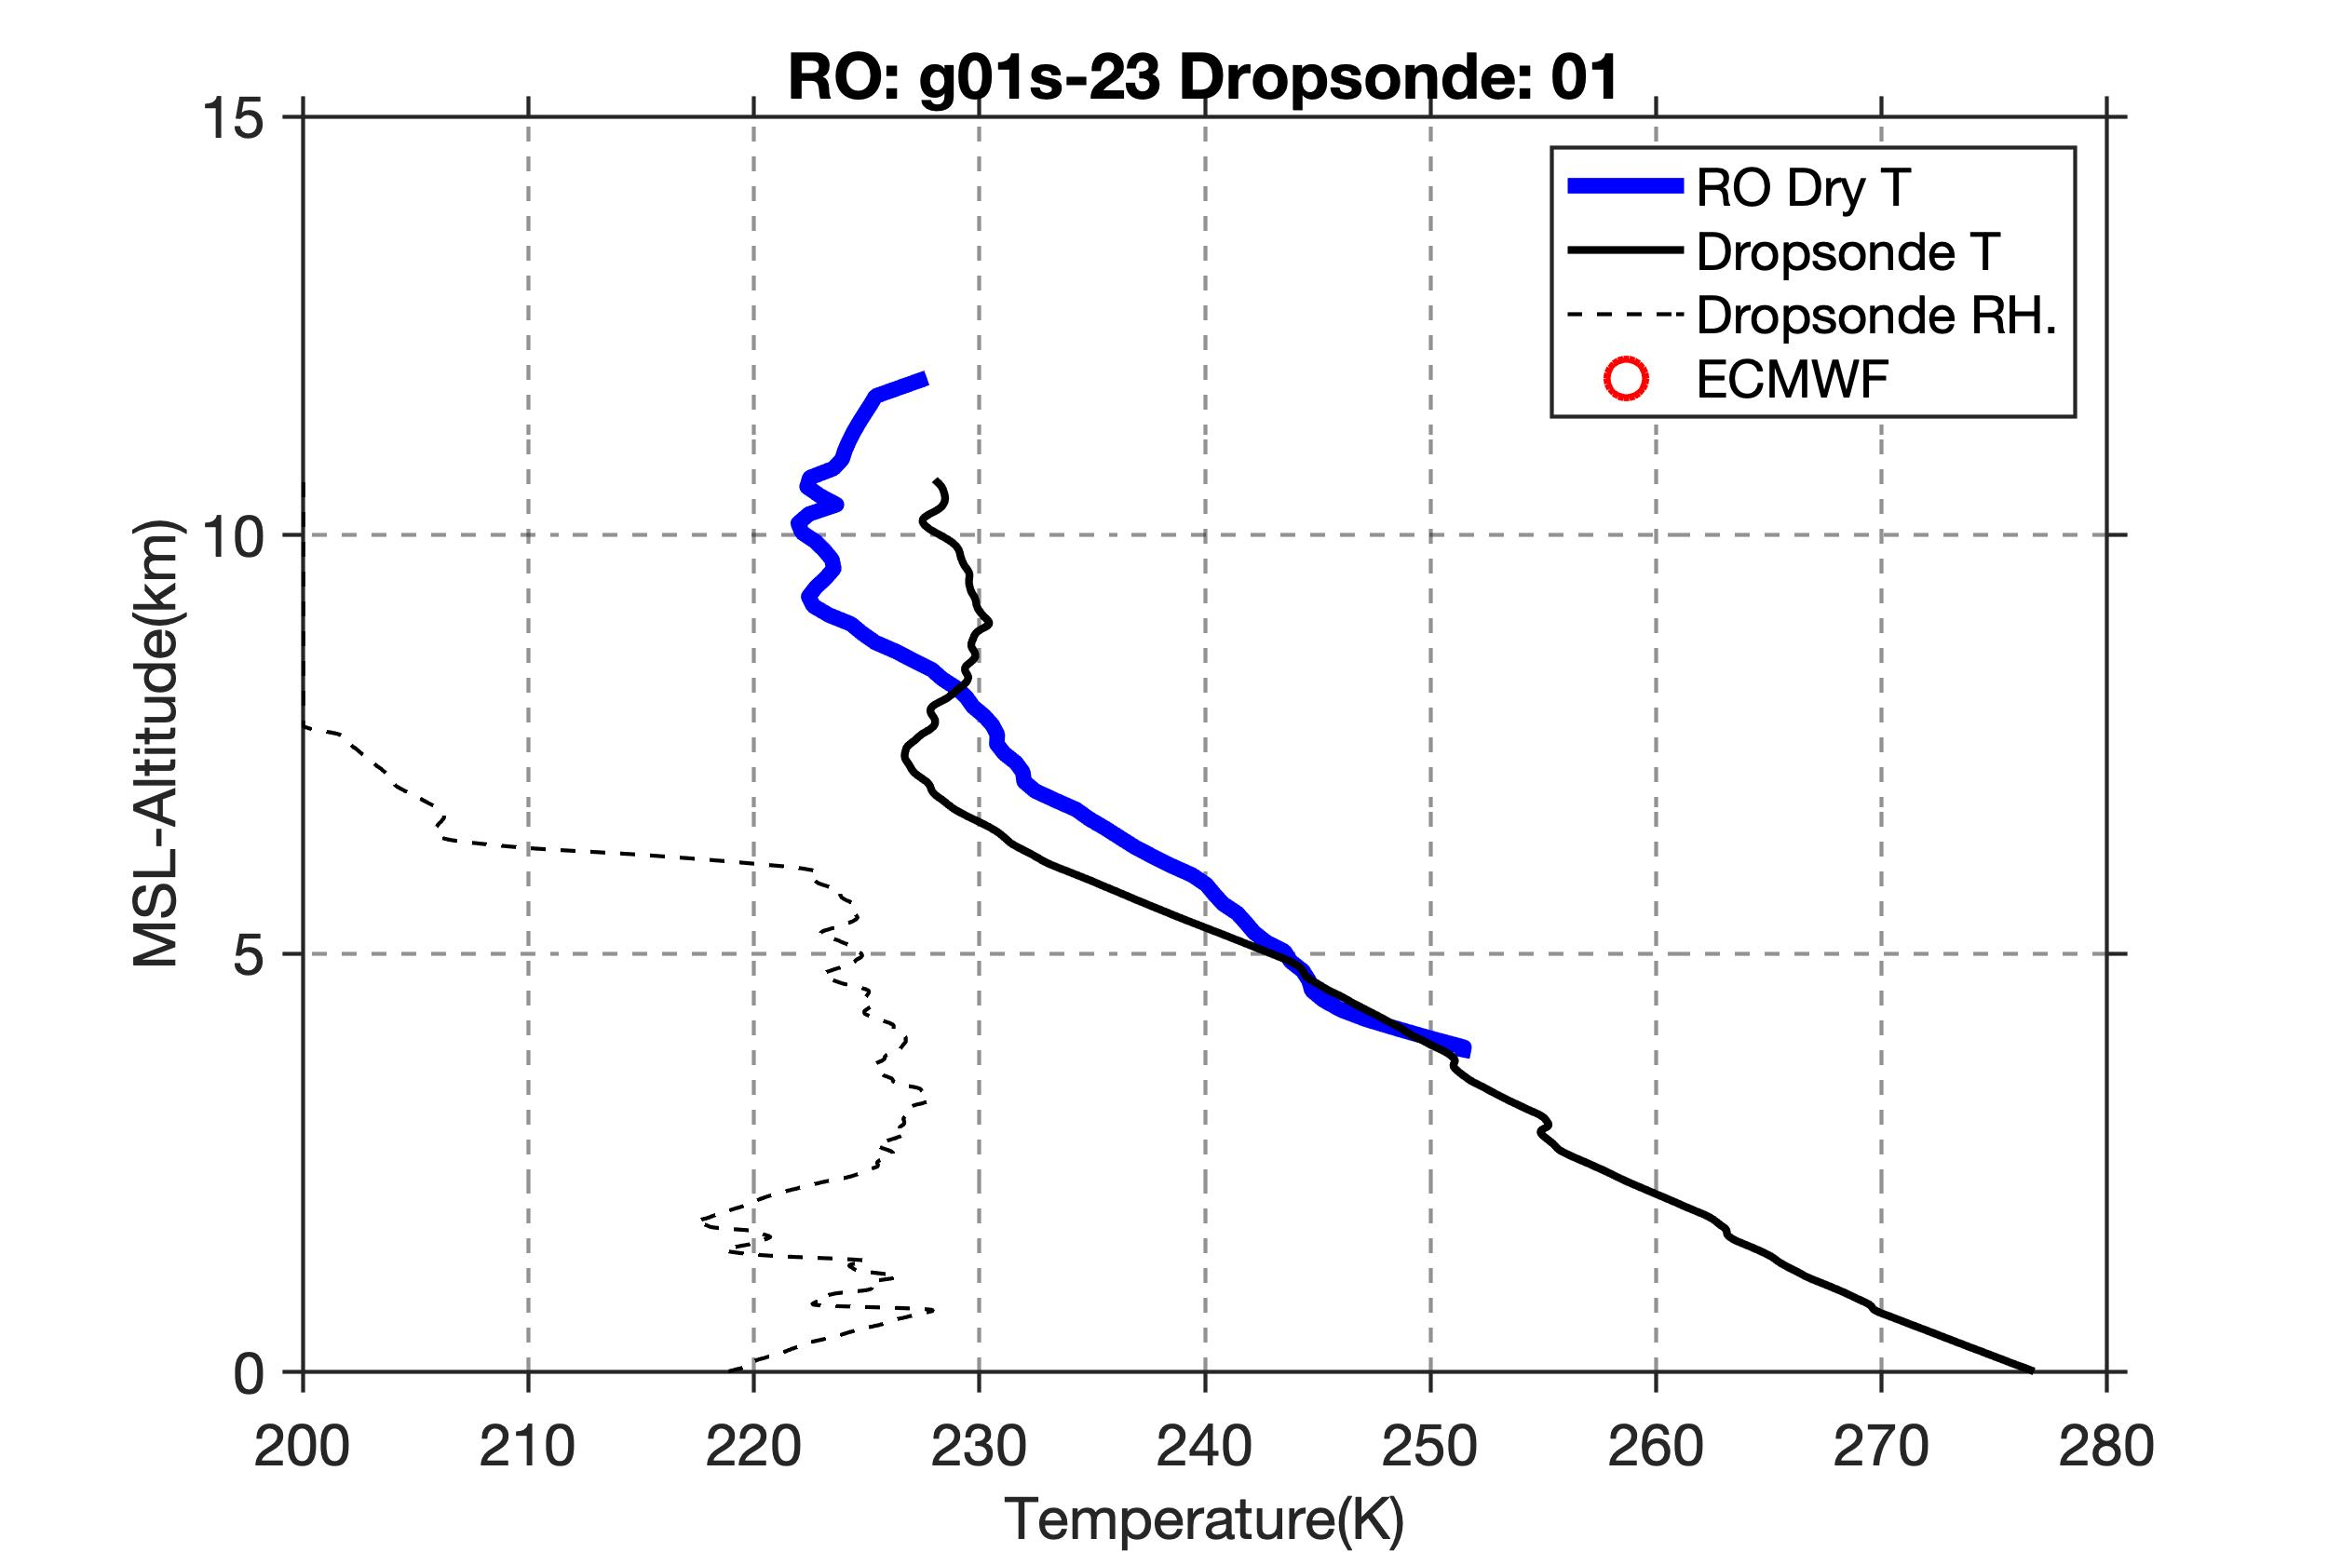
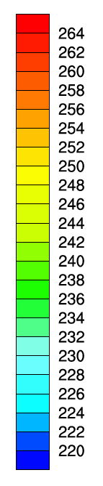
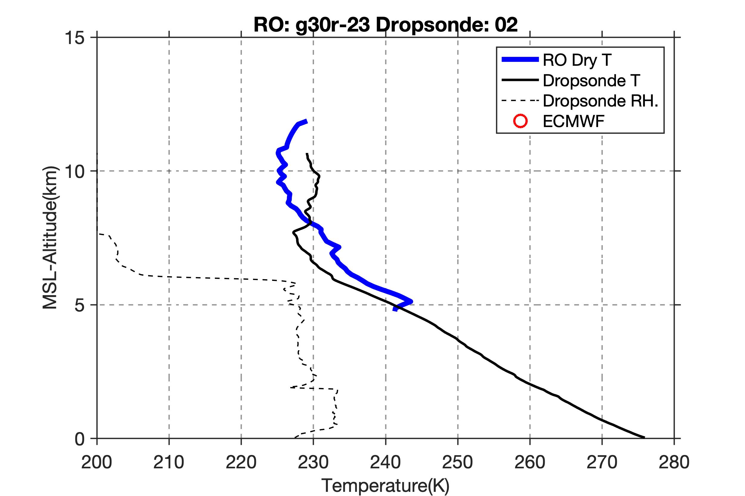
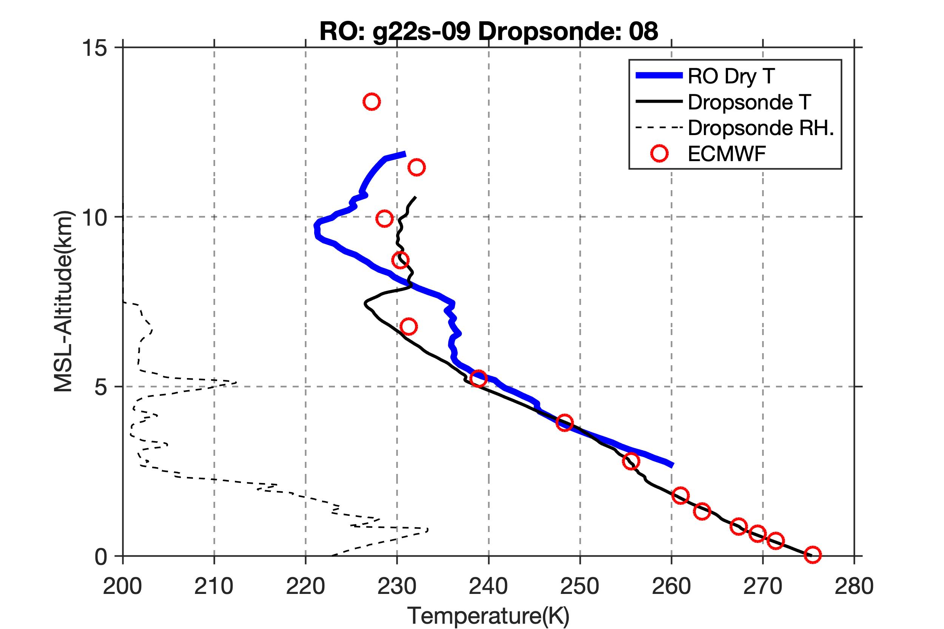
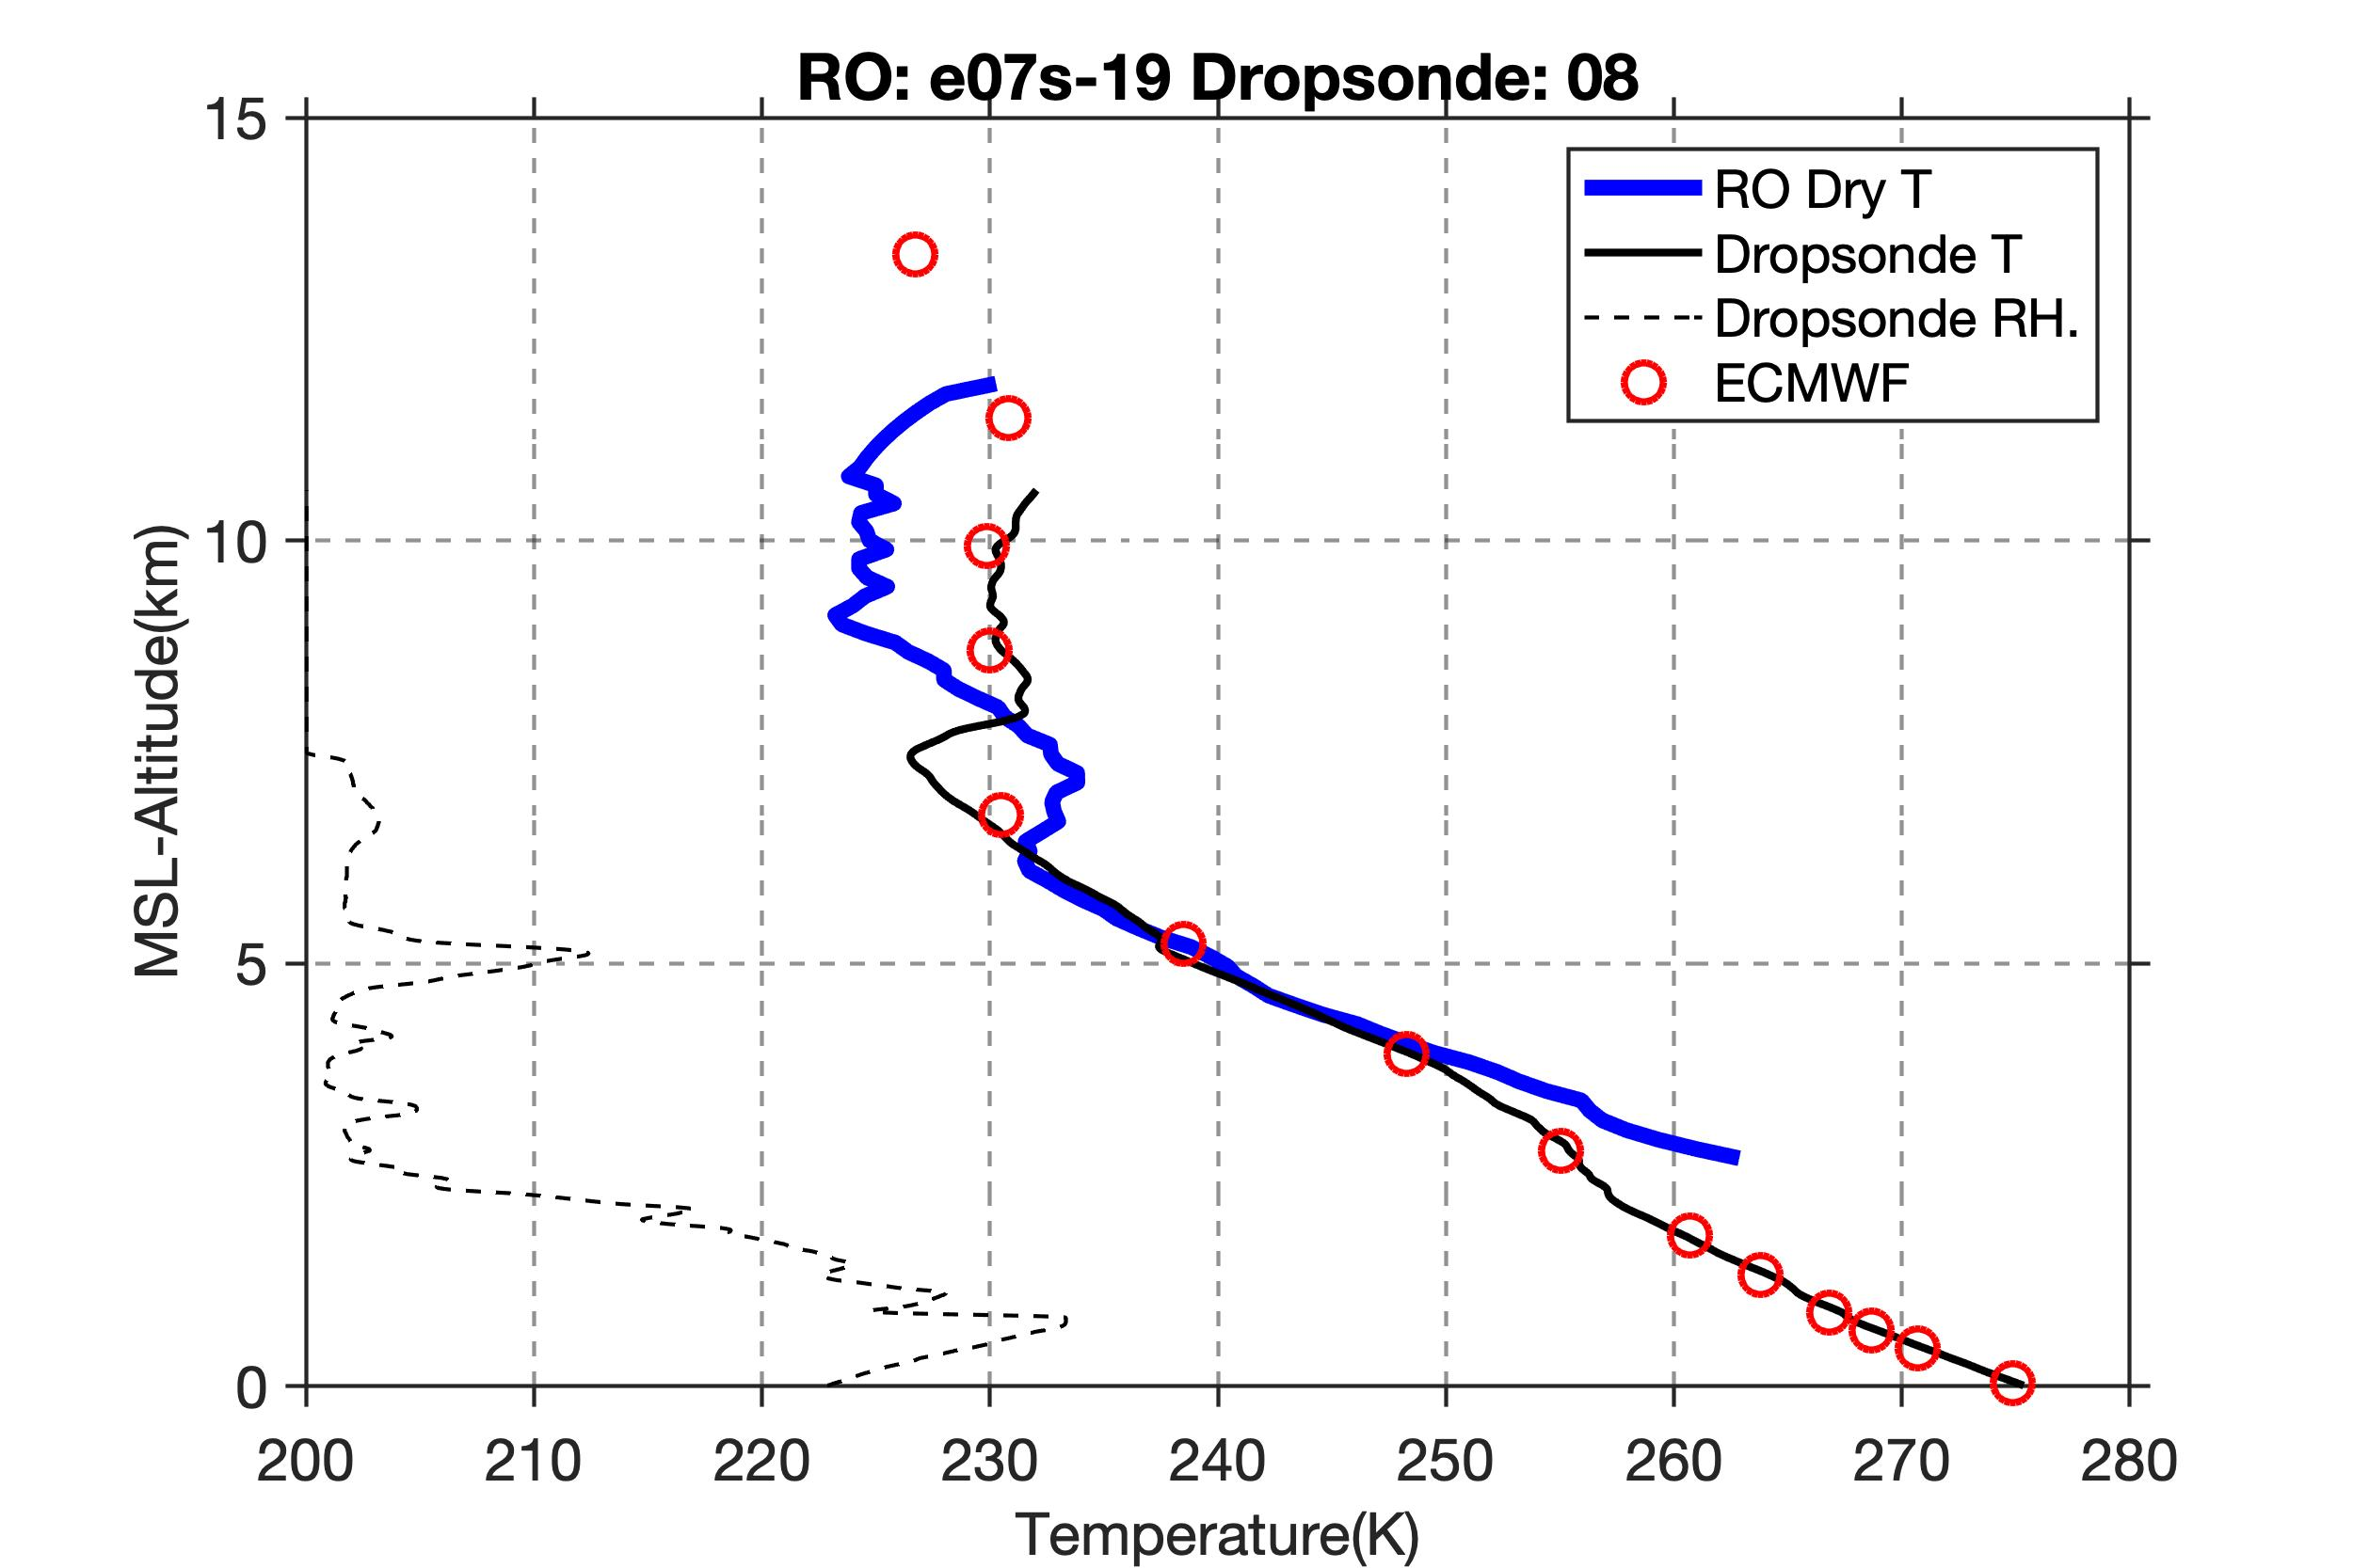
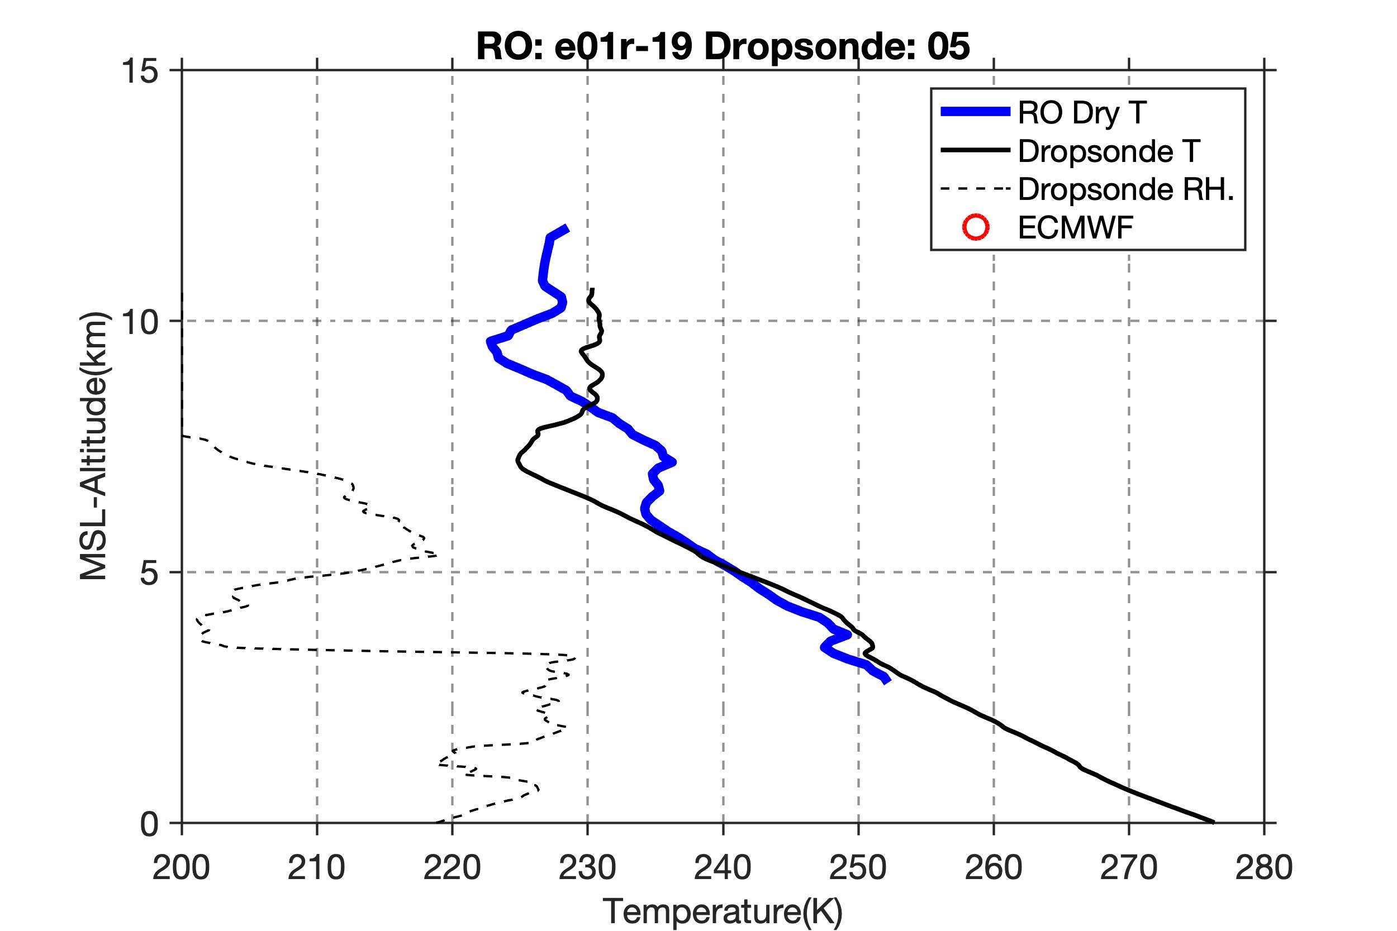
WRF DROPS Temperature@ 7 km
Temperature (K)
Systematic fluctuations in temperature over the range from 6-11 km altitude correspond to strong temperature gradient in hi-res WRF model run that assimilates dropsondes.

Slide 14
WRF DROPS Temperature@ 10.5 km
Temperature (K)
Systematic fluctuations in temperature over the range from 6-11 km altitude are opposite sign at 1.5 km where temperature gradient is reversed. Possible wave pattern.

Slide 15
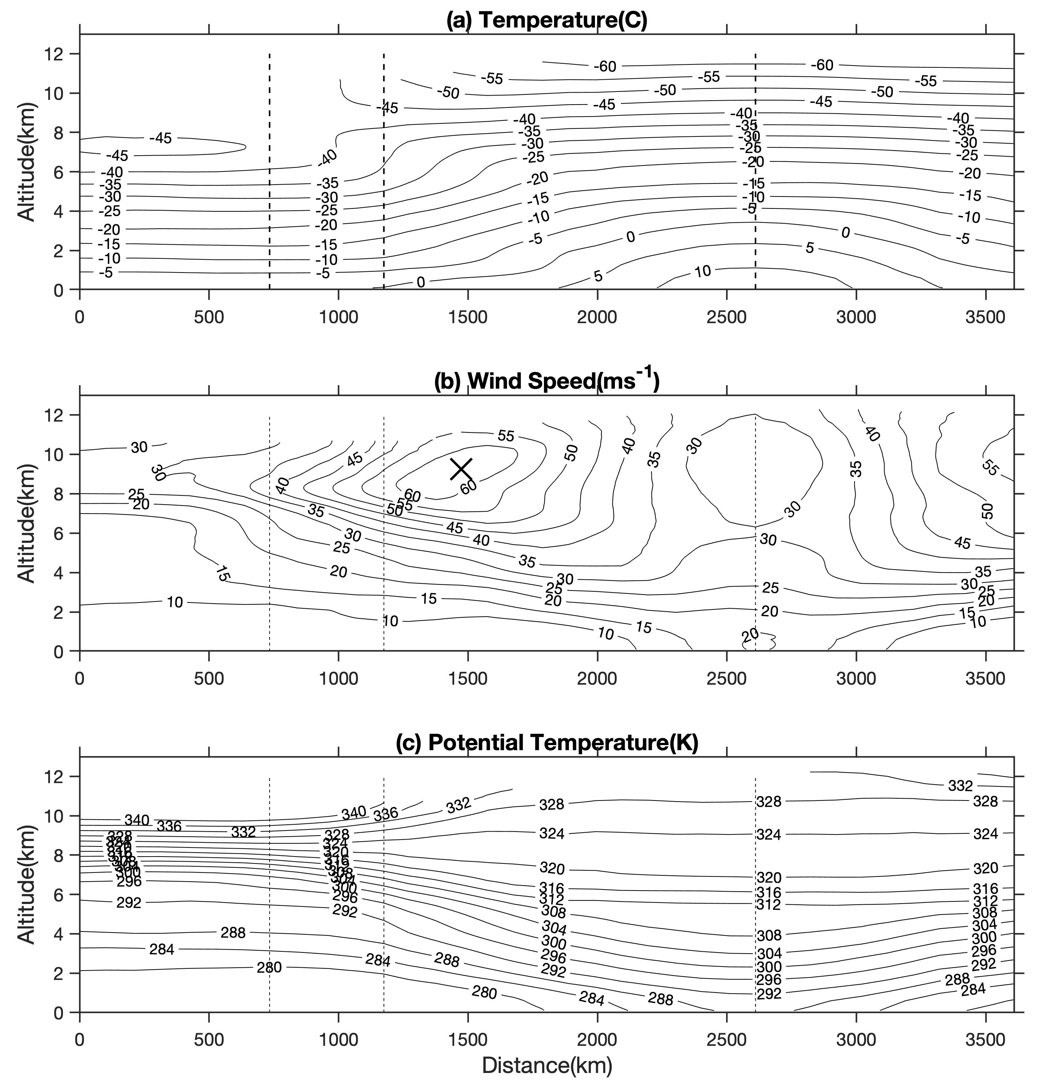
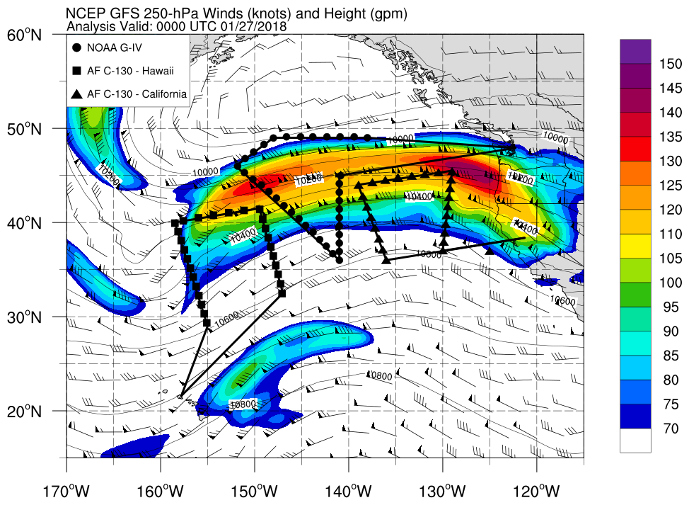
Gravity Wave Analysis
Unwrapped dropsonde measurements
A
B
C
D
E
We are examining whether gravity waves can be an explanation for some of the vertical variations in the ARO profiles.
Jet/front system is a potential gravity wave source.
A unique dropsonde data set is available to investigate the presence of waves.
NCEP GFS 250 hPa winds
Jet Core
B
A
C
E
Front System
D
With a good distribution of ARO profiles, we could potentially test our methods for retrieving gravity wave parameters and compare them to what is seen in the dropsonde cross-sections.

Slide 16
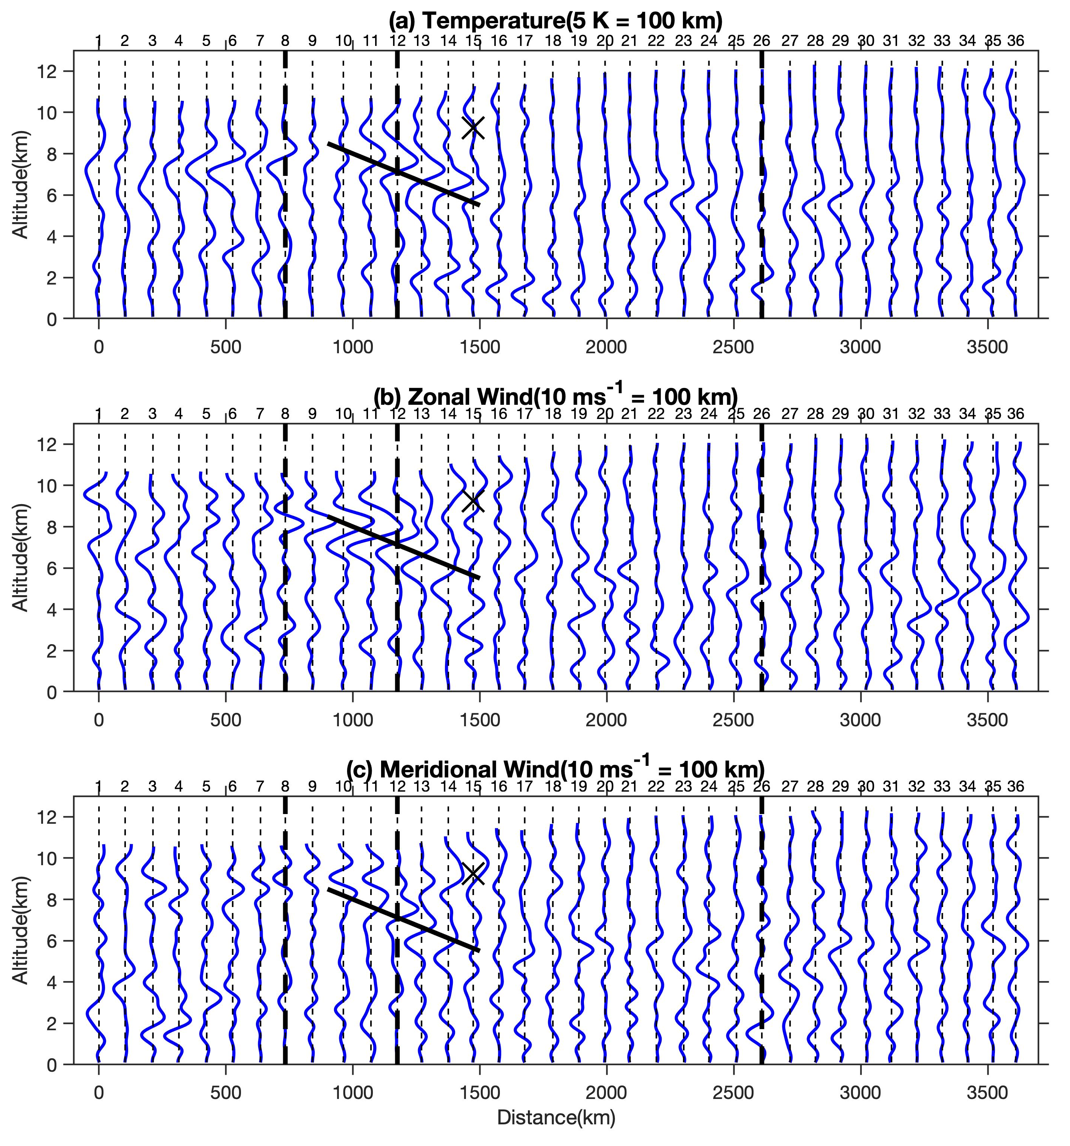
A possible wave structure is present in dropsonde temperature, zonal and meridional wind perturbations. The background temperature variations (λz>5 km) and turbulence/noise (λz<1 km) have been removed.
B
A
C
E
A
B
C
D
E
D
fjioe

Slide 17
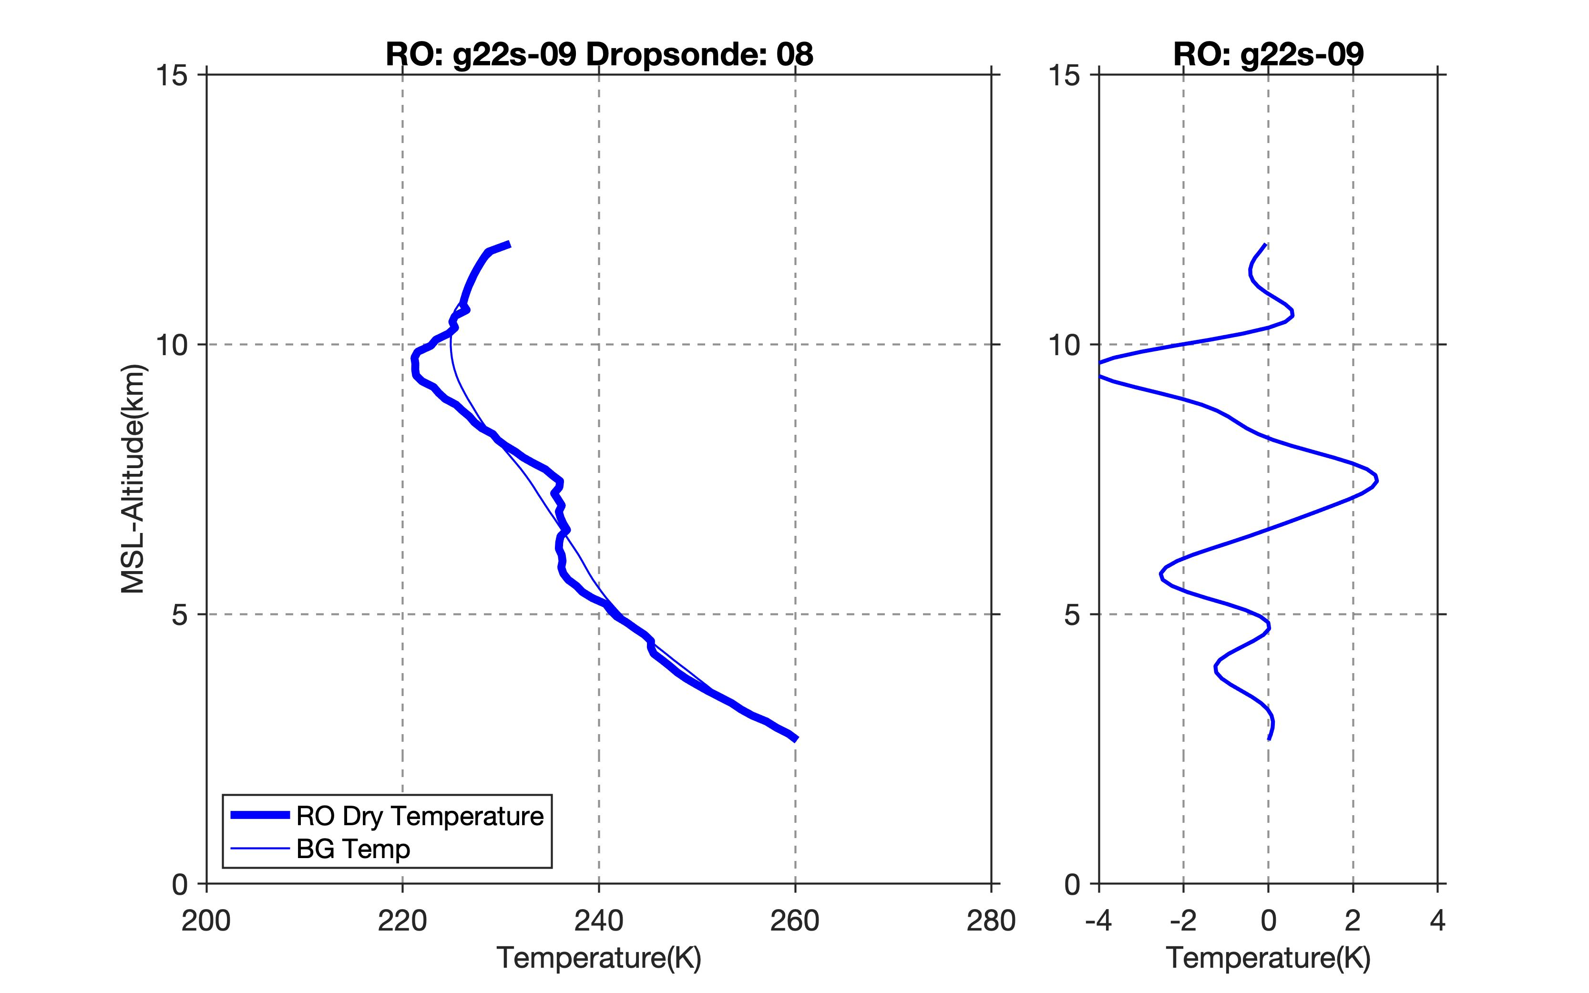
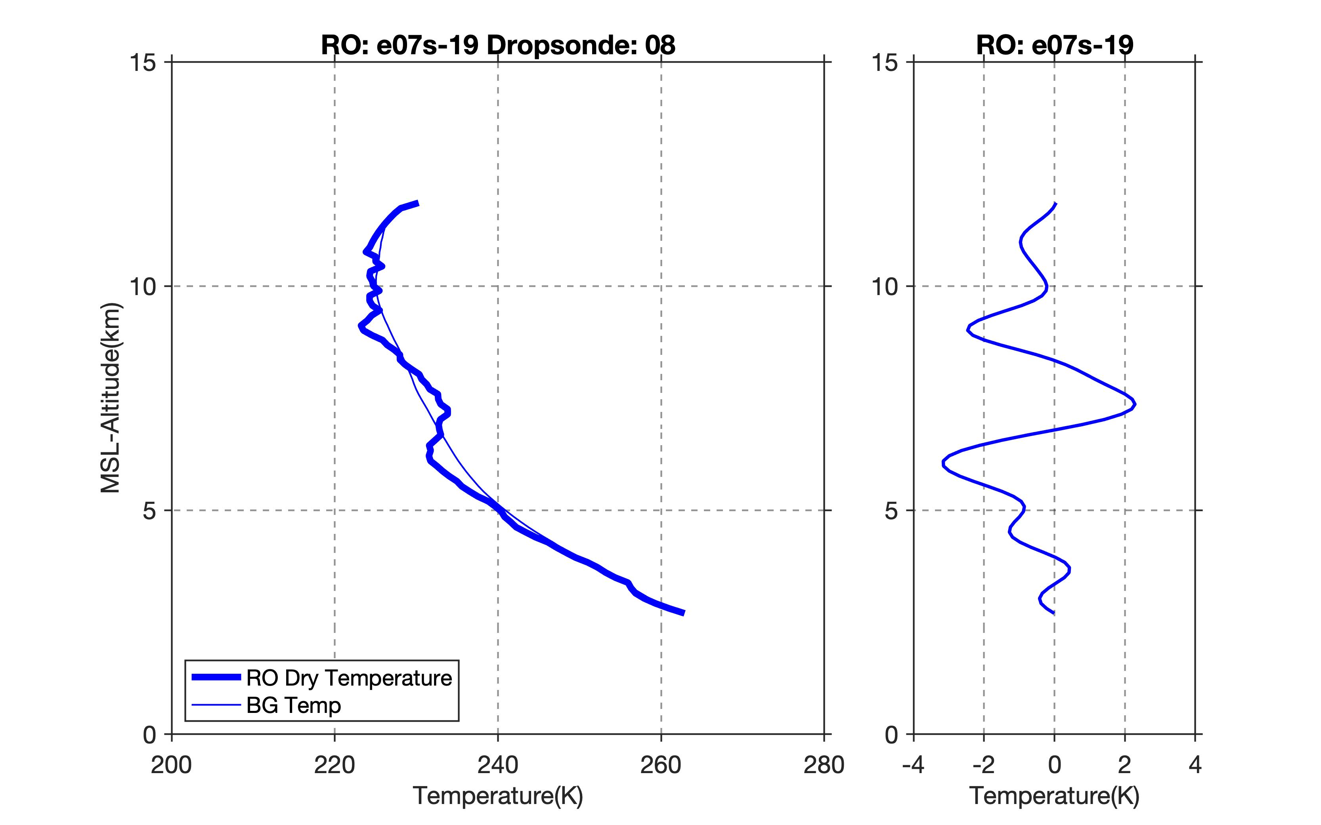
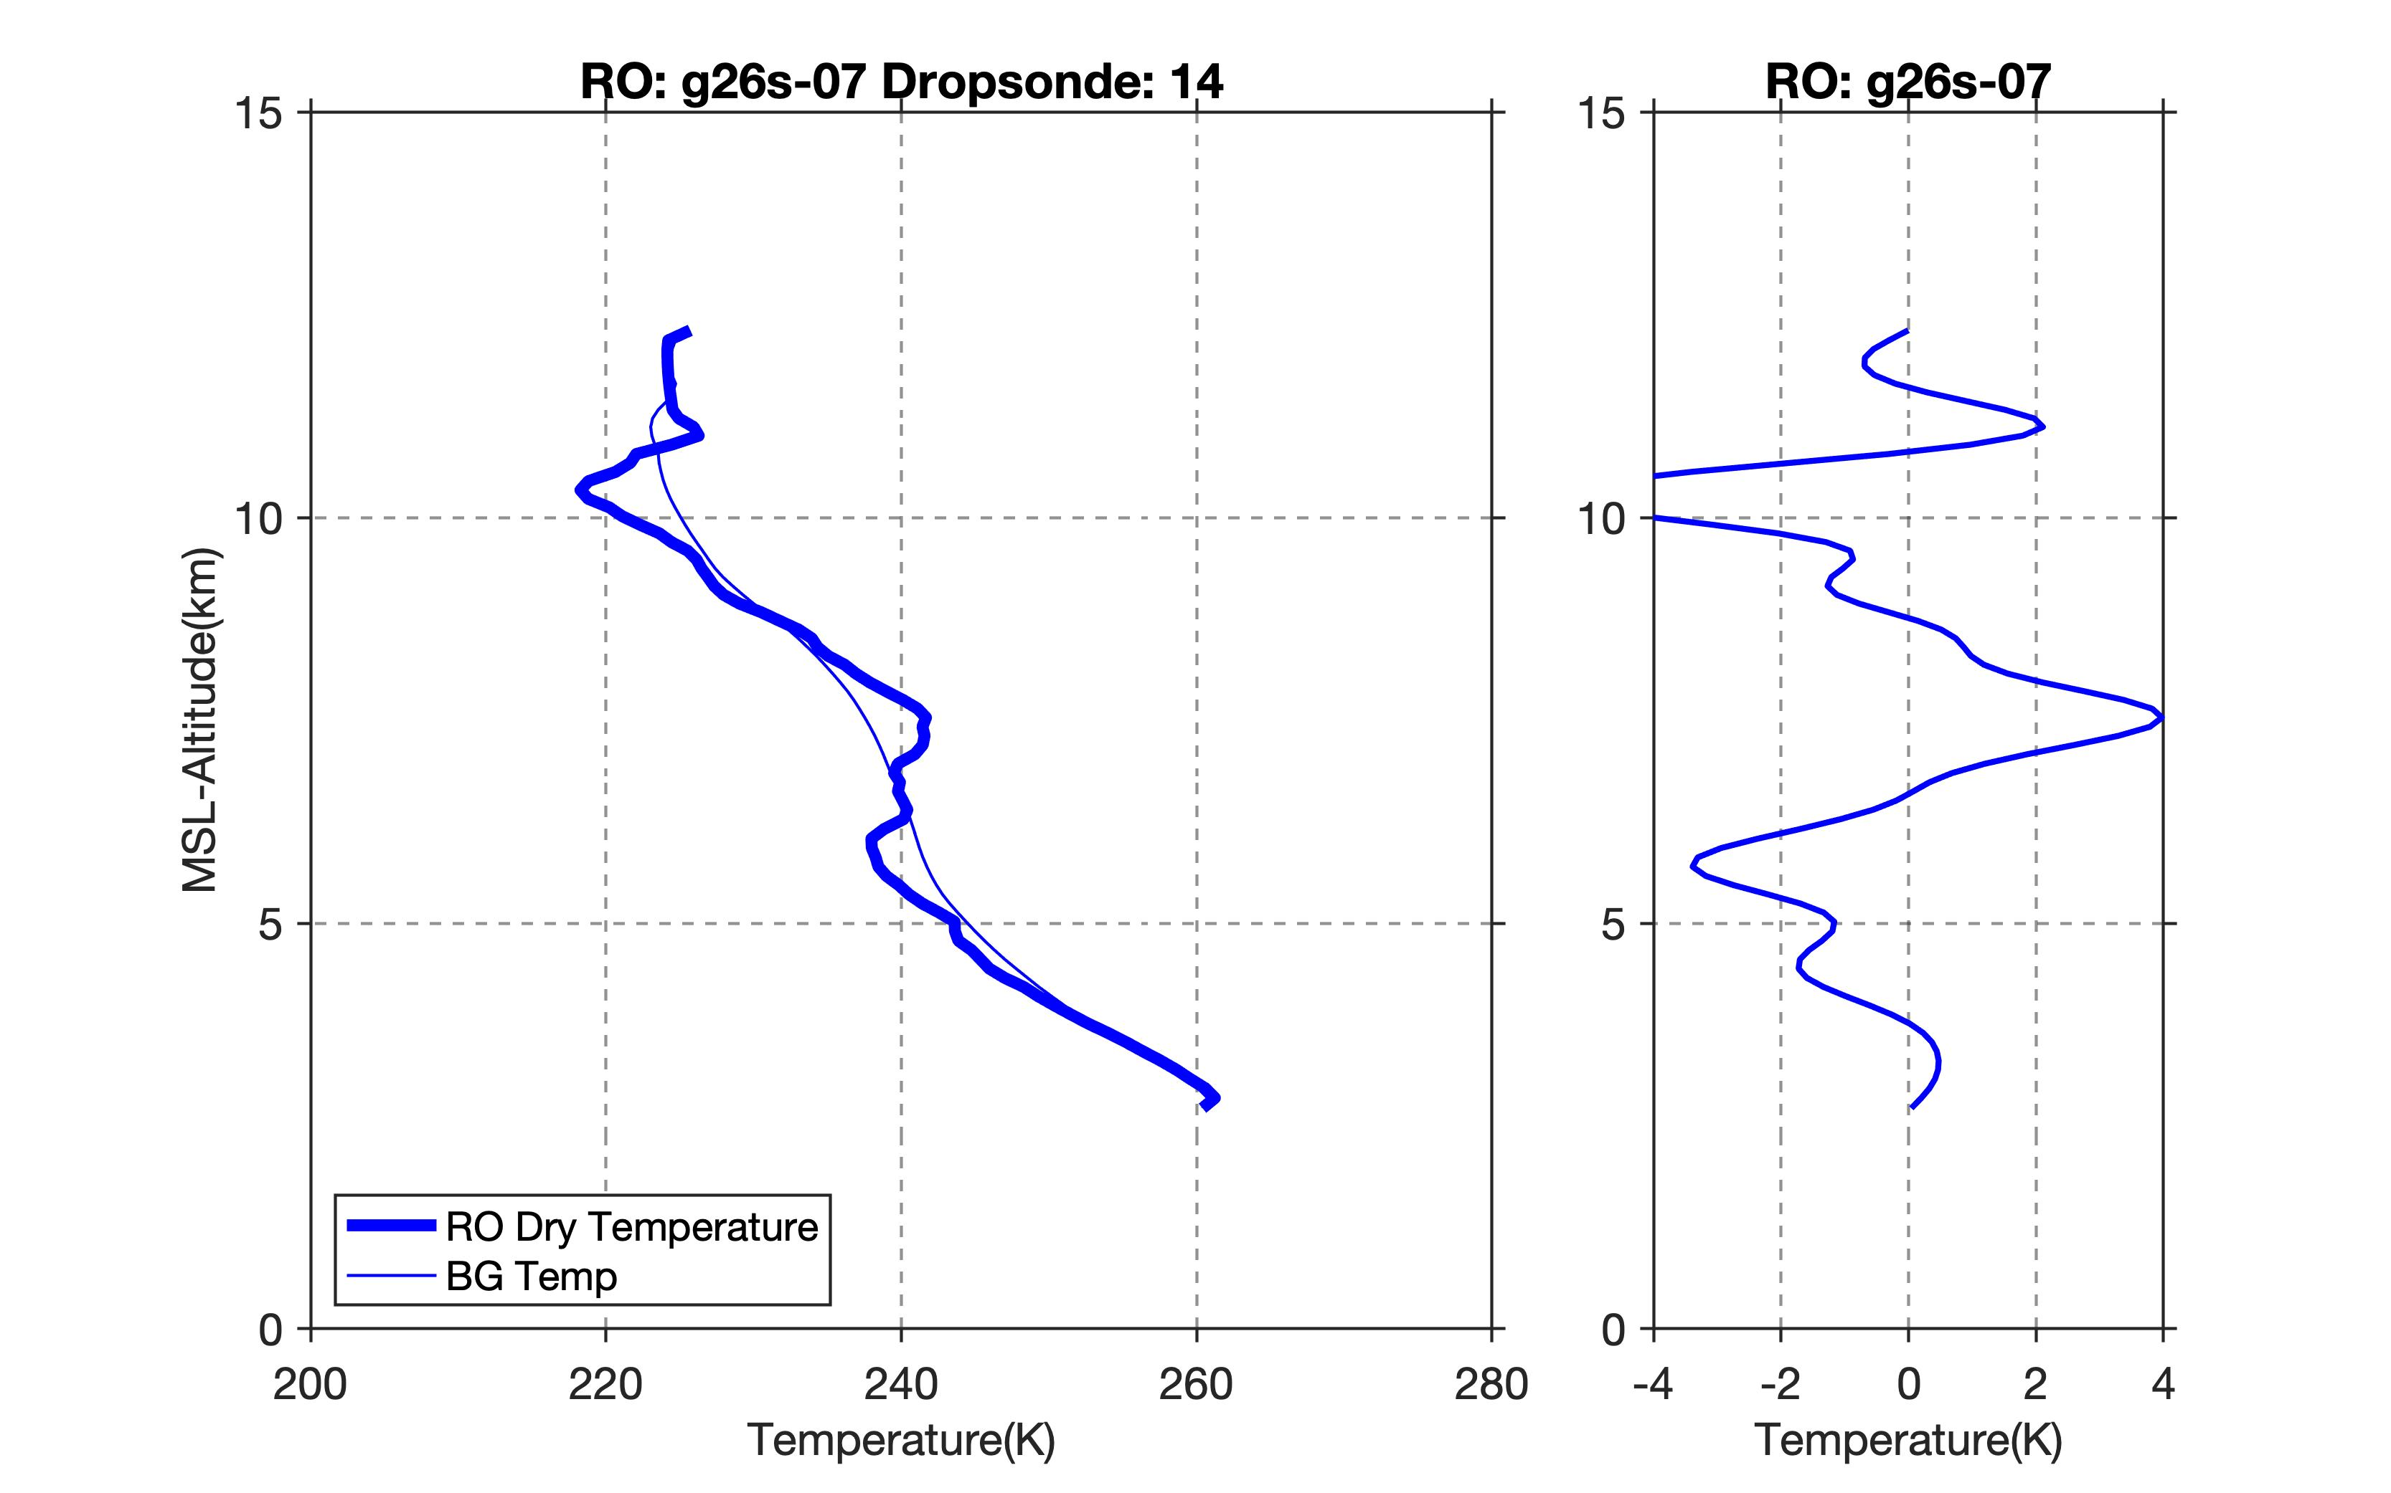
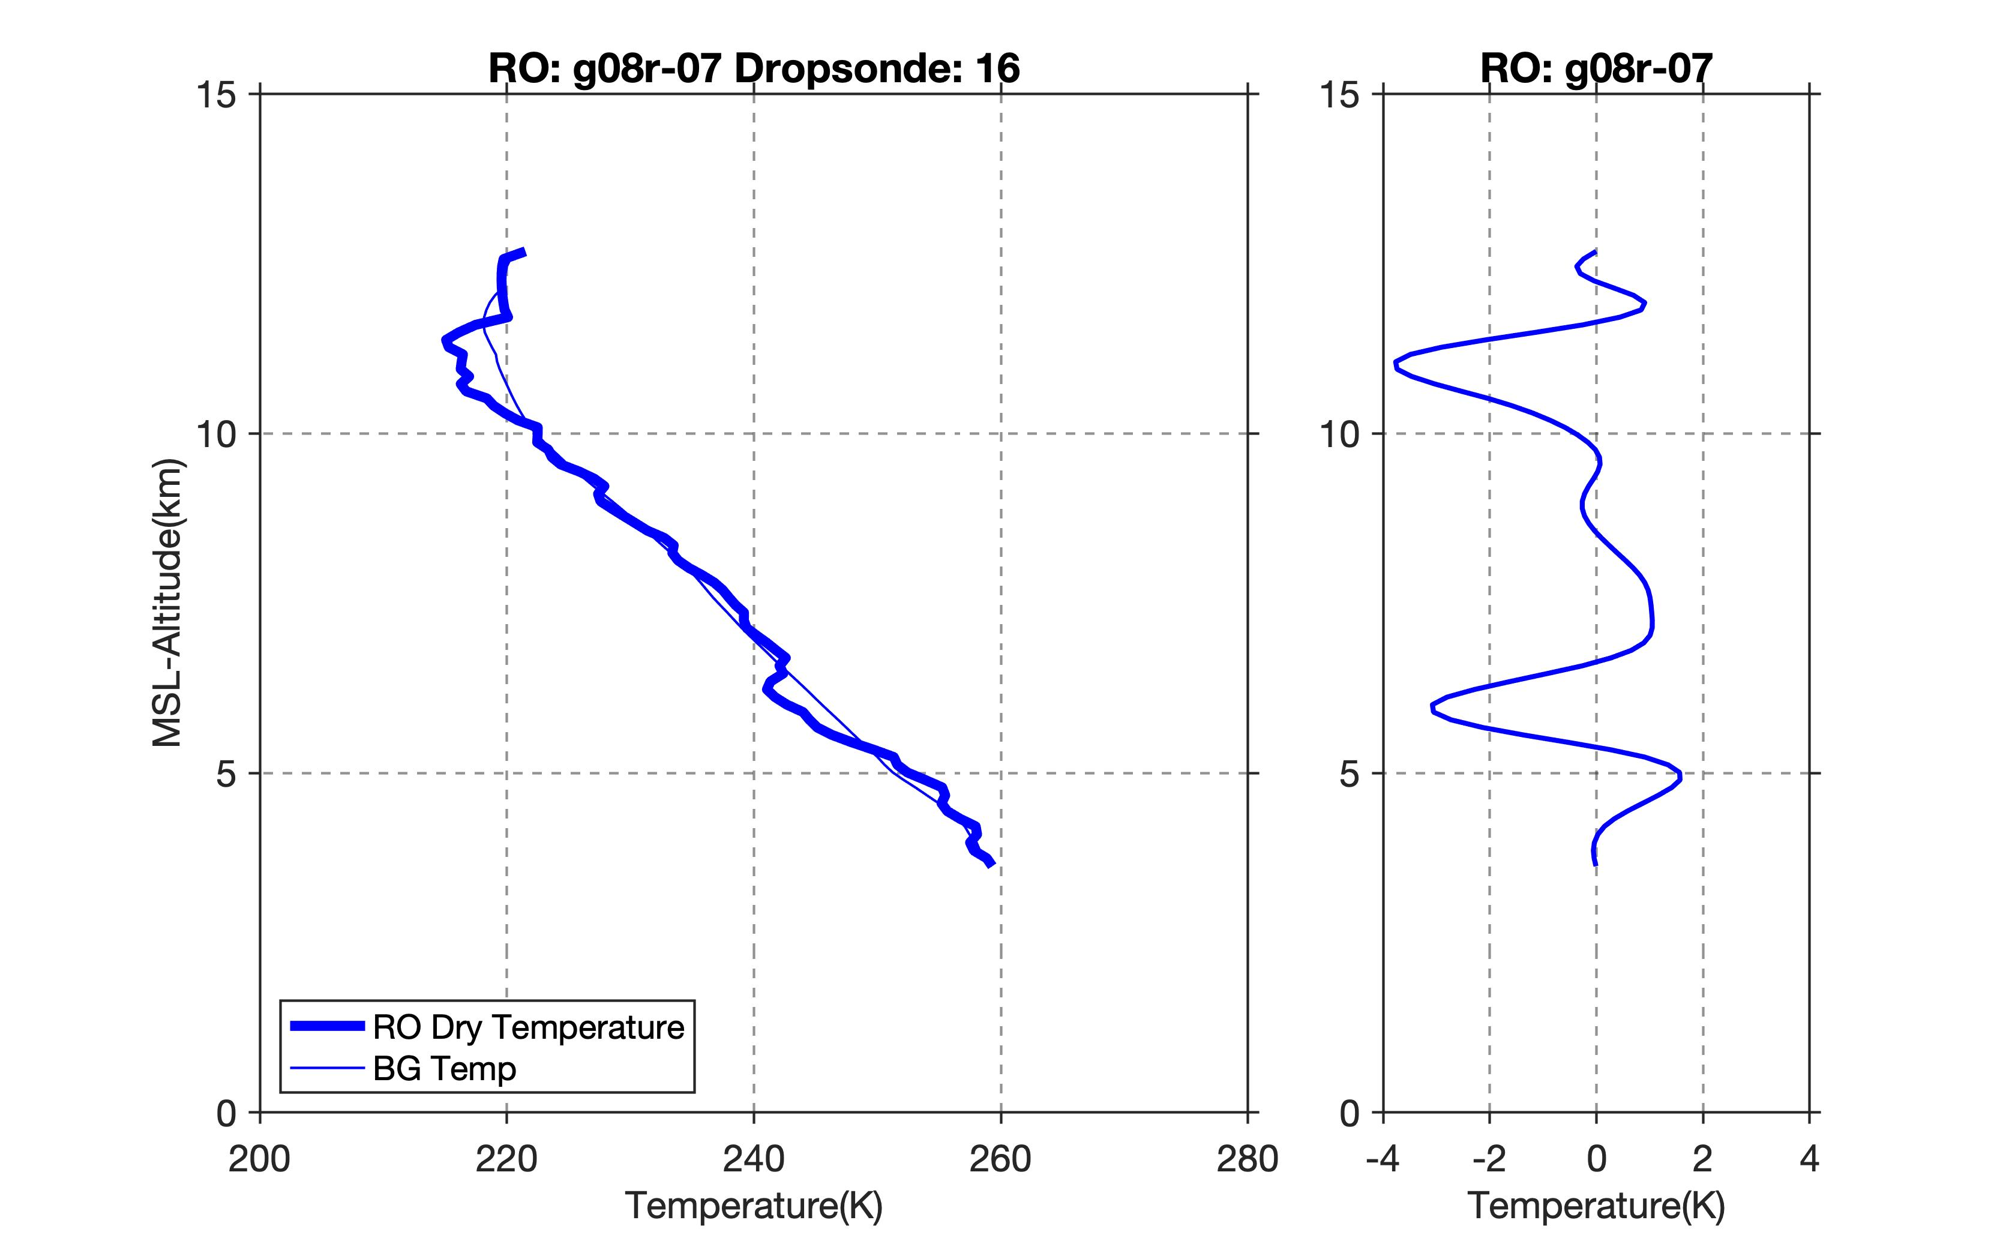
Preliminary results: possible analogous wave structure is present in the ARO profiles in the same location near the jet.

Slide 18
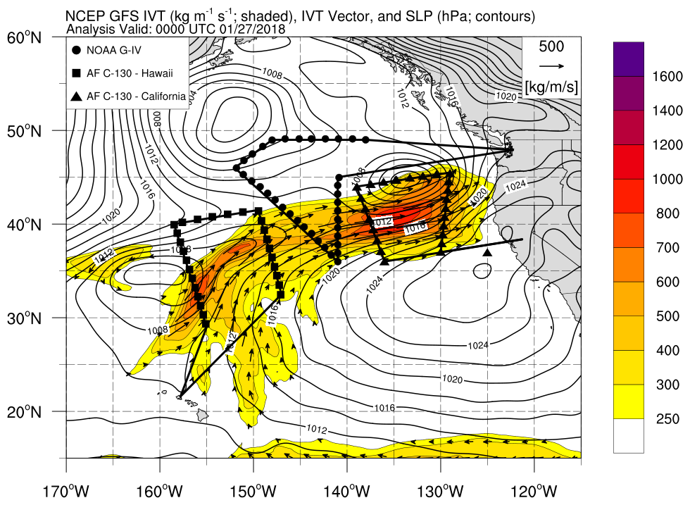
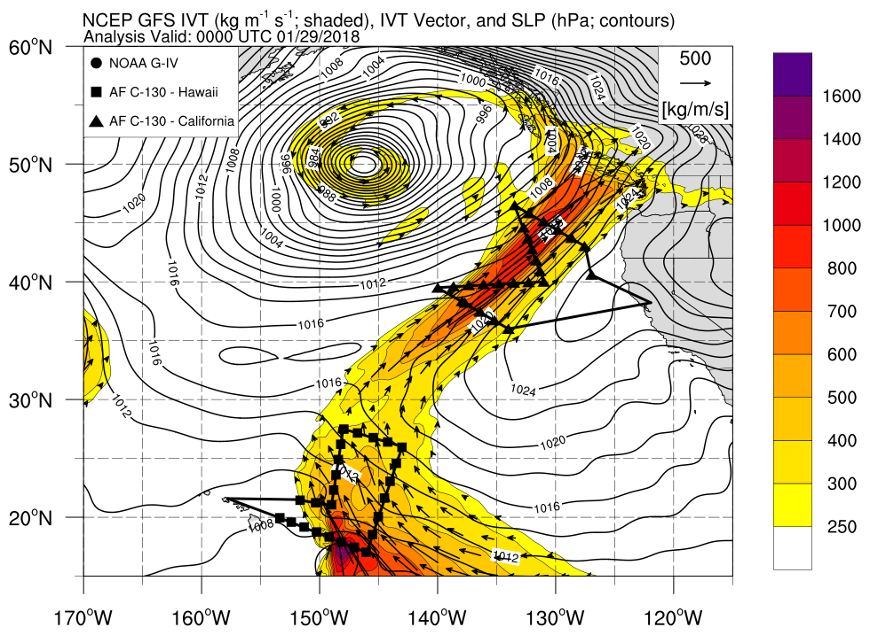
Using ARO data for WRF modeling verification
ARO observations are available on 27 Jan 00Z to verify the analysis after dropsonde data assimilation
Preliminary dropsonde data denial experiments comparing 4DEnVar and 3DEnVar (Zheng et al., 2019, in prep.)

Slide 19
Current GSI/West-WRF DA system
Downscaled GEFS+CMCE (40 members)
Deterministic forecast (e.g.
6h or 1-10d)
West-WRF 6-h
Deterministic forecast
Observations
(e.g., prepbufr/bufr)
GSI Hybrid DA System
GSI Analysis
West-WRF: version 3.9.1.1
GSI: v3.6; hybrid 4DEnVar for data assimilation
Ensembles are generated by downscaling GEFS ensemble (20 member) and CMCE ensemble (20 member).
Observations assimilated: Conventional data in NCEP prepbufr, satellite atmospheric motion vector winds, GPSRO, with and without dropsondes
ARO observations are used to compare model runs with and without dropsondes

Slide 20
Impacts of dropsondes (analysis drops – denial)

Slide 21
Impacts of dropsondes (analysis drops – denial)

Slide 22
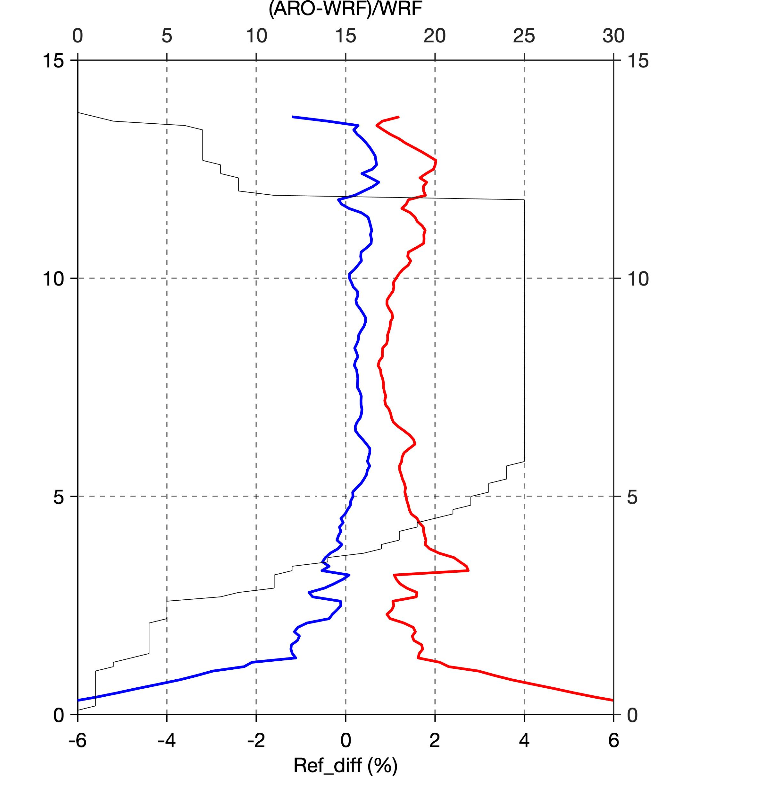

Results
Number of profiles
ARO obs are used to evaluate Drops vs no Drops
Compare % differences in refractivity
(ARO N – WRF N) / WRF N
Drop experiment has lower bias than denial experiment
RMS is mixed, sometimes higher, sometimes lower

Slide 23
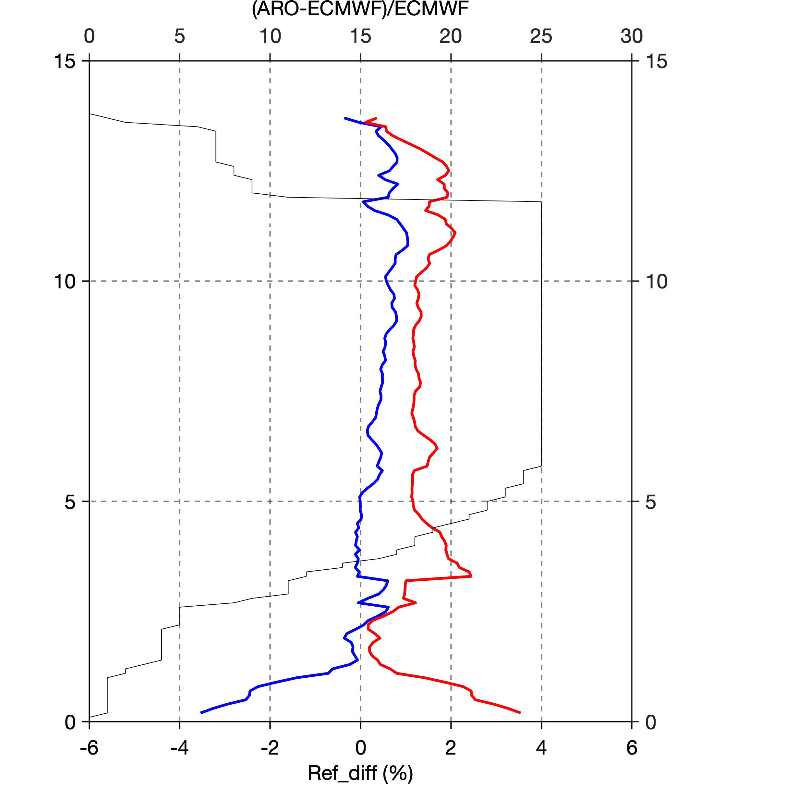
Results - ECMWF
Number of profiles
(ARO N – ECMWF N) / ECMWF N
Drop experiment has smaller bias (~lower T) than ECMWF experiment from 7-12 km
Drop experiment has larger bias (moister) than ECMWF experiment at ~3 km
Drop experiment has lower RMS than ECMWF experiment from 6-12 km.

Slide 24
Perspectives for ARO data assimilation
DA for ARO has been tested using the spaceborne GPS RO refractivity operator.
Next steps:
Investigate obs errors, model covariance, and tune them.
Implement ARO non-local excess phase operator for WRF V.4.0.1.
Expectation is that it spreads out analysis increment horizontally.

Slide 25
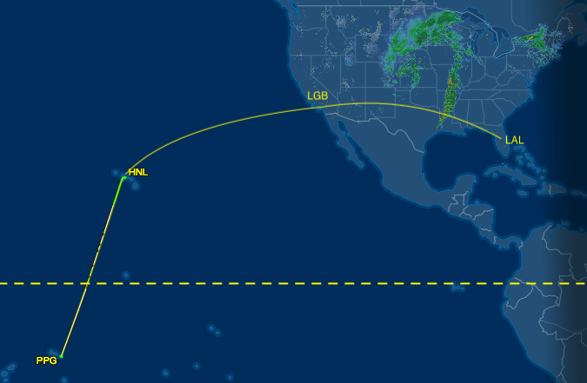
Tropical observations in AR Recon 2019
The AR Recon flights in 2019 will be useful for assessing how deep the profiles go in the tropical atmosphere.
NOAA G-IV GRAV-D Mission piggyback.
One ROC2 receiver onboard.
Running in automatic mode on mission flights ~20,000 ft.
Multiple ferry flights between FL, CA, HI and Samoa at Flight level ~35,000 ft.
Gravity for the Redefinition of the American Vertical Datum (GRAV-D)

Slide 26
Summary
The tests of the ROC2 instrument using a conventional closed-loop tracking receiver show good quality ARO profiles, with surprisingly good vertical extent.
Sampling is 16 GPS and 7 Galileo occultations over a 7.5 hr flight.
We have demonstrated the retrieval of the first Galileo ARO profiles, and shown they are consistent with GPS ARO.
Measurements from 2 independent receivers, and 2 constellations indicate very good repeatability.
Differences among ARO and dropsondes are explained with 3D temperature gradients in mid-to-upper troposphere.
Independent ARO observations have a smaller bias relative to the WRF in the dropsonde experiment than the denial, and smaller bias relative to ECMWF, indicating initial condition improvement from dropsondes.
The unique dataset with closely spaced dropsondes shows possible wave structures that appear to also be present in the ARO profiles.
The prospects are good for a highly successful deployment during Strateole-2.
Notes:
Not ideal flight track?
If the lowest altitud limit comparable to COSMIC?

