Slide 1
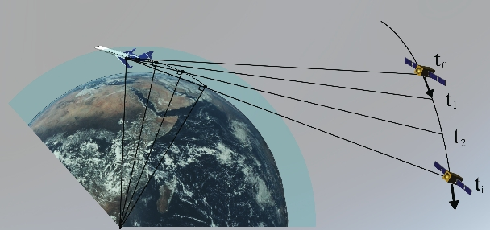
Airborne GPS Radio Occultation for Improving Forecasting of
Tropical Storms and Atmospheric Rivers
Jennifer S. Haase

Slide 2
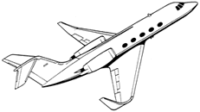
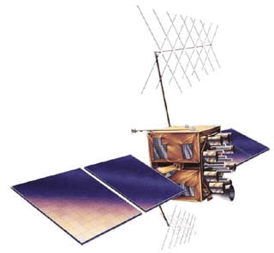
Airborne GPS radio occultation
Side-looking GPS receiver tracks setting and rising satellites
Nearly horizontal raypaths experience refractive delay
Atmospheric humidity profile is derived from refractive delay
α
Bending angle
Tangent point –
point closest to Earth surface
A profile of N is retrieved at each height
Notes:
What is GPS radio occultation? This technique uses side-looking GPS receivers on a moving platform, that record the signal from GPS satellites as the descend beyond the horizon.
These nearly horizontal raypaths through the atmosphere experience a refractive delay and bending of the raypath
The refractivity depends on the density of the atmosphere, so we can retrieve profiles of atmospheric properties from these delays.
T

Slide 3
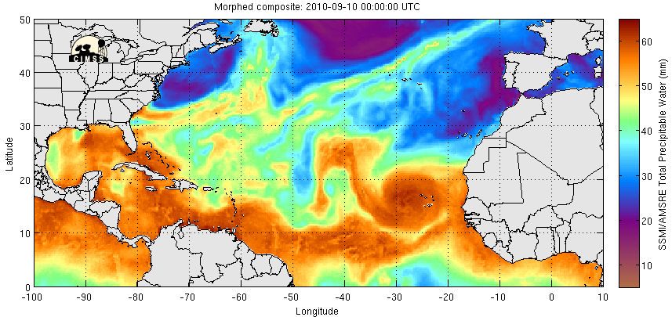
Focus on tropical waves
PRE-Depression Investigation of Cloud systems in the Tropics (PREDICT)
PGI39
PGI38
Gaston TS
PGI41
Igor
Cat 4-5
PGI44
Karl Cat 3
CIMSS MIMIC TPW product
While more than 80% of intense hurricanes in the Atlantic originate as African easterly waves (Landsea, 1993) most easterly waves do not develop into hurricanes. Which waves will develop? How can we improve hurricane intensity forecasting?
Notes:
The focus of the PREDICT campaign was on tropical waves, atmospheric pressure disturbances that are formed off the coast of Africa that travel across the Atlantic as easterly waves. They show up clearly in the microwave imagery of total precipitable water as these regions of high moisture within the tropical wave. Here the values of total precipitable water in the atmospheric column can get as high as 60 mm of equivalent liquid water

Slide 4
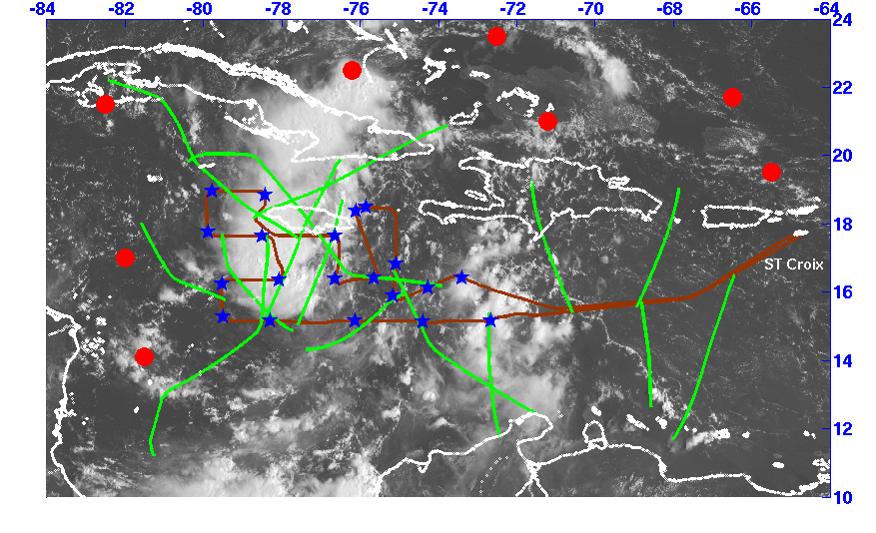
Airborne RO provides much denser sampling than COSMIC spaceborne RO
GOES-13 visible imagery 13.75Z (GHRC dataset, www.ghrc.nsstc,nasa.gov/hydro)
All possible rising and setting occultation tangent point paths for
RF18, Sept. 13, 2010. (green) compared to all COSMIC RO for entire day (red)

Slide 5
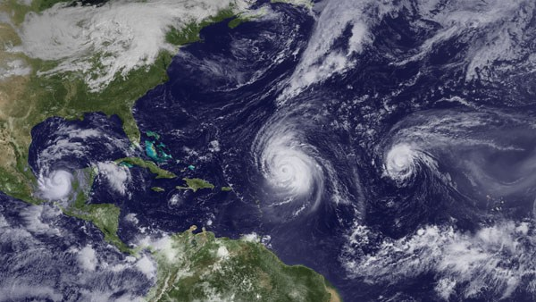
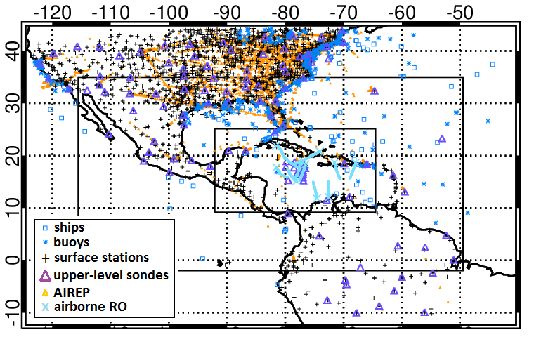
Numerical Experiments
Resolution: 27, 9, 3km Vortex following
Microphysics | Morrison
PBL | YSU
Cumulus (d01, d02) | Kain-Fritsch
Longwave | RRTM
Shortwave | Goddard
WRFV3.2, WRF 3DVAR with modified GPSRO operator for airborne receiver, based on the one for spaceborne (Chen et al. 2009)
Observations: NCEP GTS data, dropsonde and airborne radio occultation (ARO) observations from PREDICT
Background error covariance calculated from 60 pairs of 12 and 24-hr WRF forecast differences (NMC method).

Slide 6
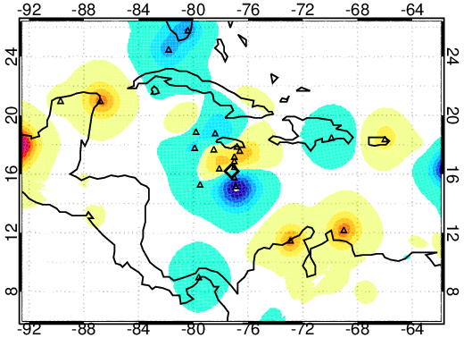
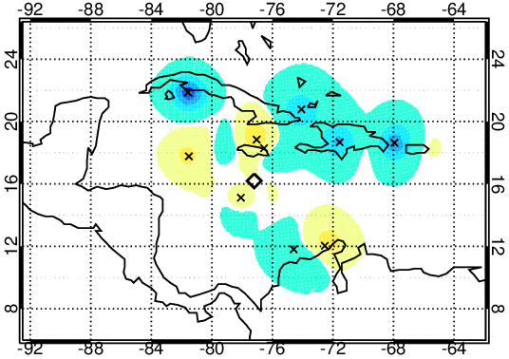
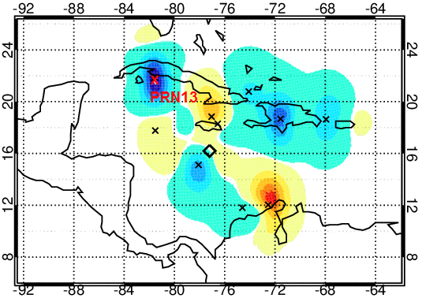
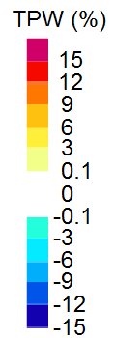
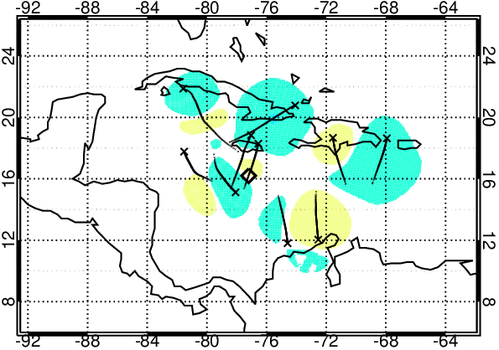
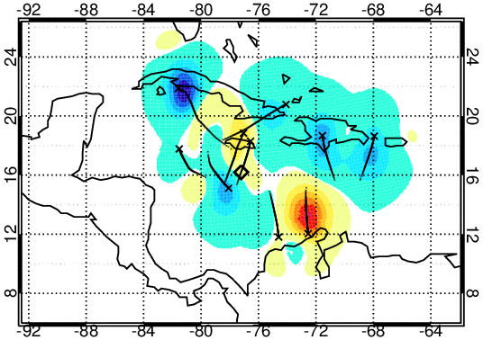
TPW Analysis Differences (12Z Sep 13)
CTRL – background
GDANc – CTRL
GDAEc – CTRL
GDANd – CTRL
GDAEd – CTRL

Slide 7
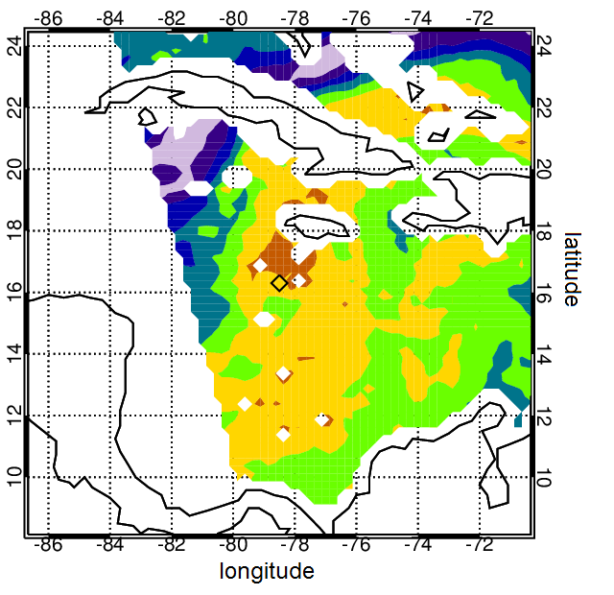
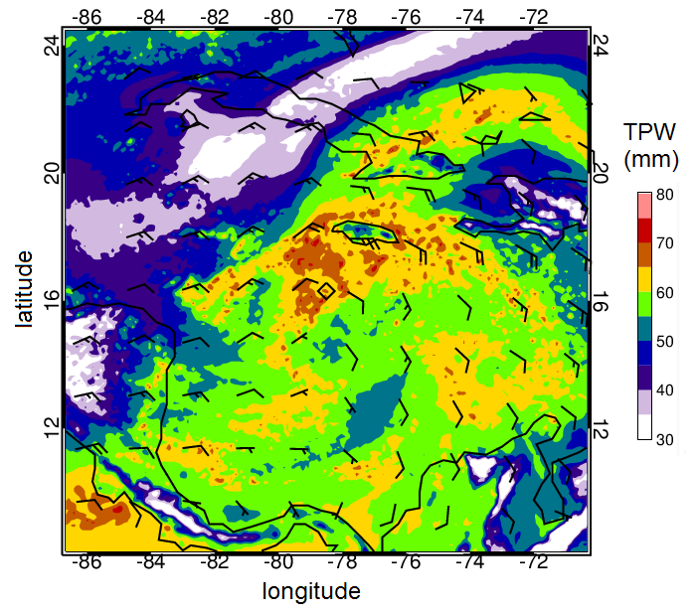
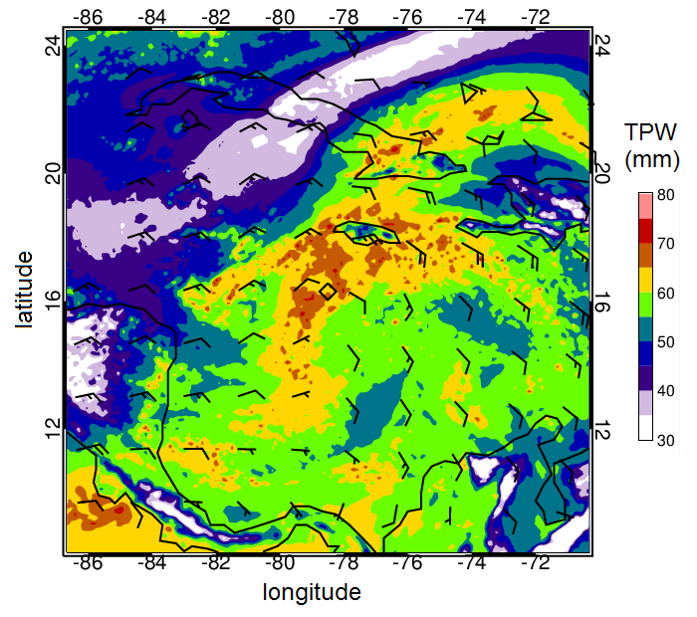
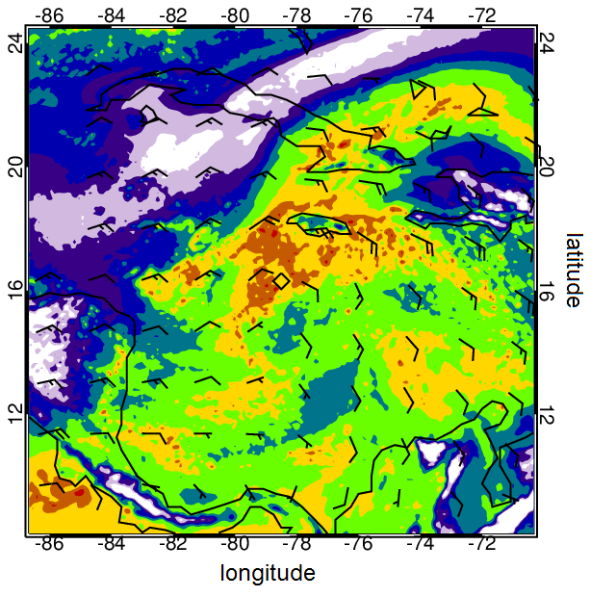
6-h TPW Forecasts (18Z 13 Sep.)
Satellite
CTRL
GDAEc
GDAEd

Slide 8
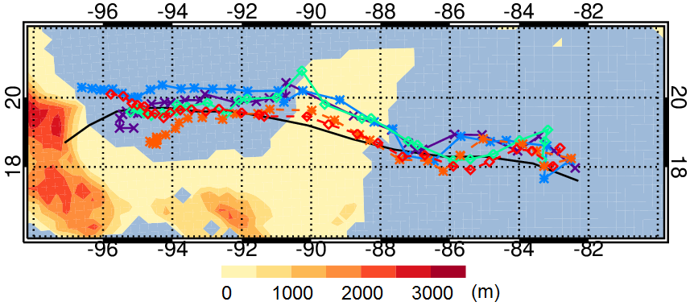
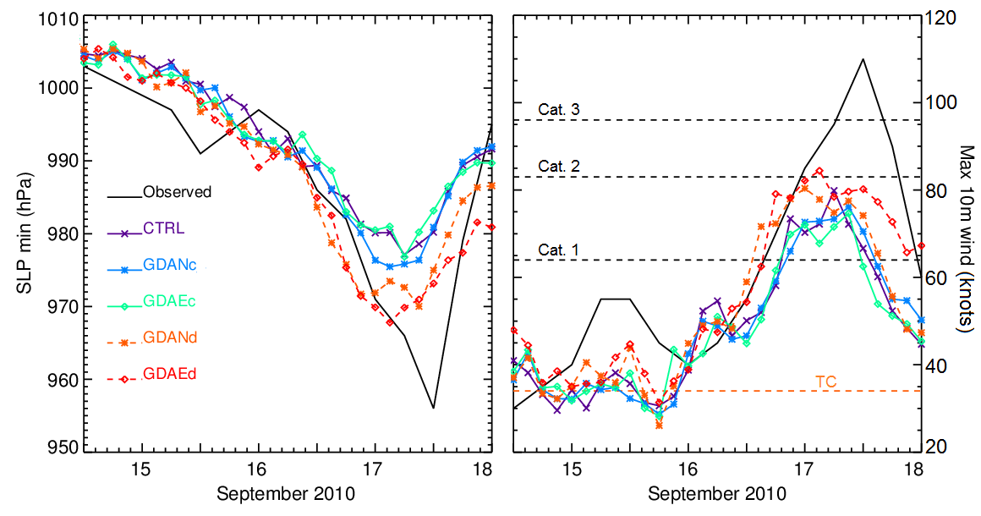
Forecasts
Tracks
1200 UTC 14 Sept. – 0000 UTC 18 Sept. 2010

Slide 9
Forecasts
Minimum sea level pressure (SLP) and 10-m wind speed
1200 UTC 14 Sept. – 0000 UTC 18 Sept. 2010

Slide 10
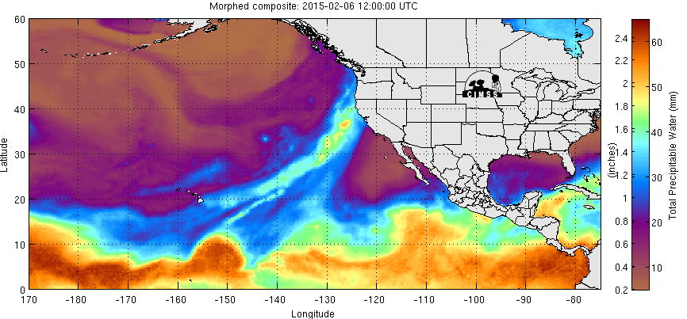
Precipitable water on day of atmospheric river landfall
Total precipitable water (mm) as measured by the SSM/I composite produced by the CIMSS (Cooperative Institute for Meteorological Satellite Studies) for 6 February 2015, a day when the atmospheric river being investigated made landfall on the Northern California coast.

Slide 11
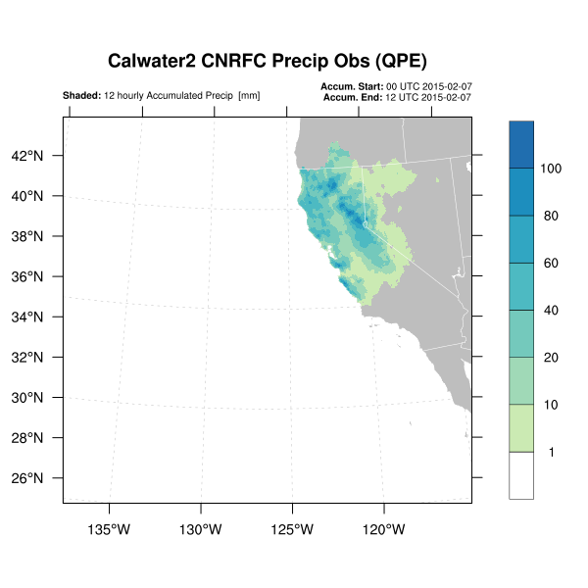
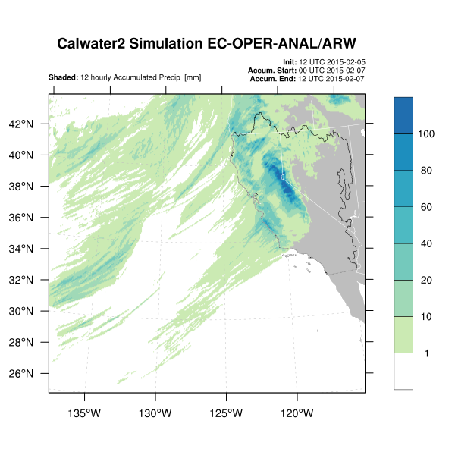
Precipitation Forecasts
High resolution WRF model simulation
Driven by European Center ECMWF operational weather model and analysis
Rainfall observations
(composite raingauge and radar)
12 hr accumulated precipitation from CNRFC
High resolution WRF run with ECMWF operational analysis boundary/initial conditions
Verify by drainage basin, region, and/or elevation

Slide 12
Total integrated water vapor
DMSP Satellite
precipitable water
High resolution WRF model simulation
Driven by European Center ECMWF operational weather model and analysis
SSM/I satellite cannot measure moisture in the presence of precipitation (white blank areas within AR)
Highest moisture within AR is further north in observations than in model

Slide 13
Precipitation timing
Model precipitation is too early and too high in coastal central California and the Sierra Nevada

Slide 14
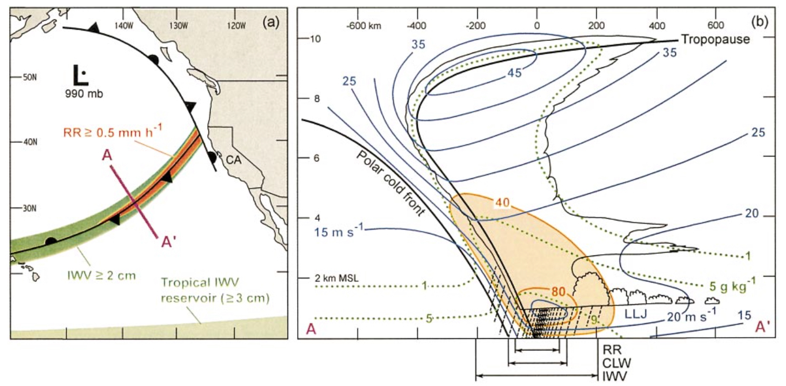
Calwater 2015 Atmospheric Rivers
Atmospheric rivers provide 20%-50% of California’s annual precipitation.
Orographic precipitation due to interaction with coastal ranges produces extended precipitation that contributes to snowpack but also can cause flooding.
Microphysics determines hydrometeor type and distribution w.r.t. topography
Objective is to investigate ability of polarimetric measurements to describe dropsize distribution
Notes:
Figure 1 Left: Schematic illustration of an atmospheric river over the northeastern Pacific Ocean (from Ralph et al., 2004). (Left) Map view of cold front with a moist low-level jet with high IWV. Right: Conceptual cross-section showing the front-parallel wind speed (blue; m/s) and moisture flux (orange; x105 kg/s), specific humidity (dotted green; g/kg), and schematic clouds and precipitation. Mean width scales of IWV, cloud liquid water, and rain rate are shown below the cross-section.

Slide 15
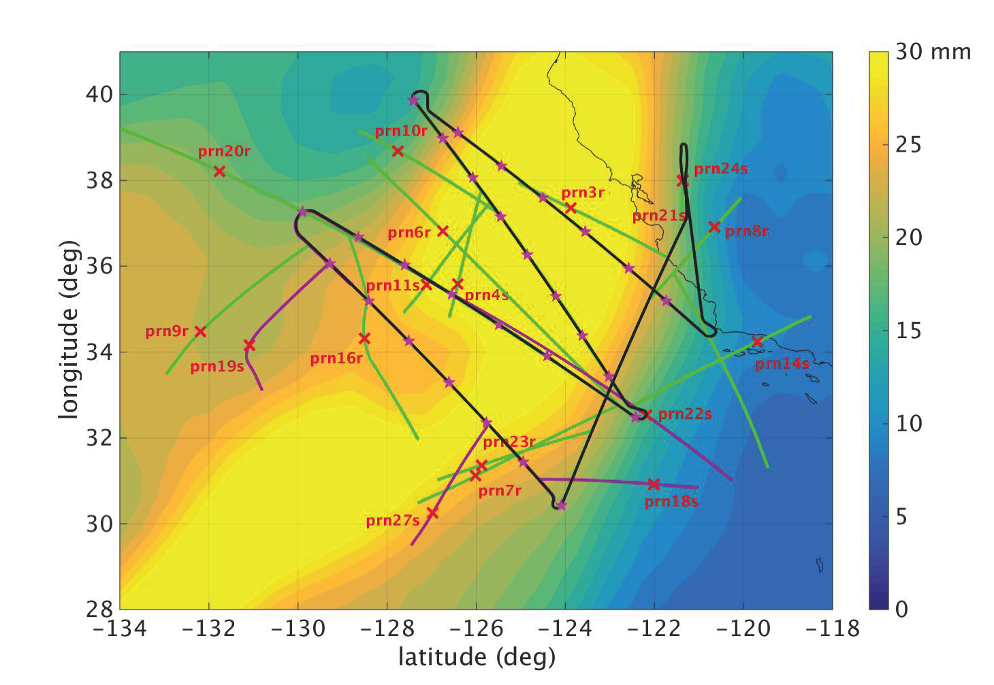
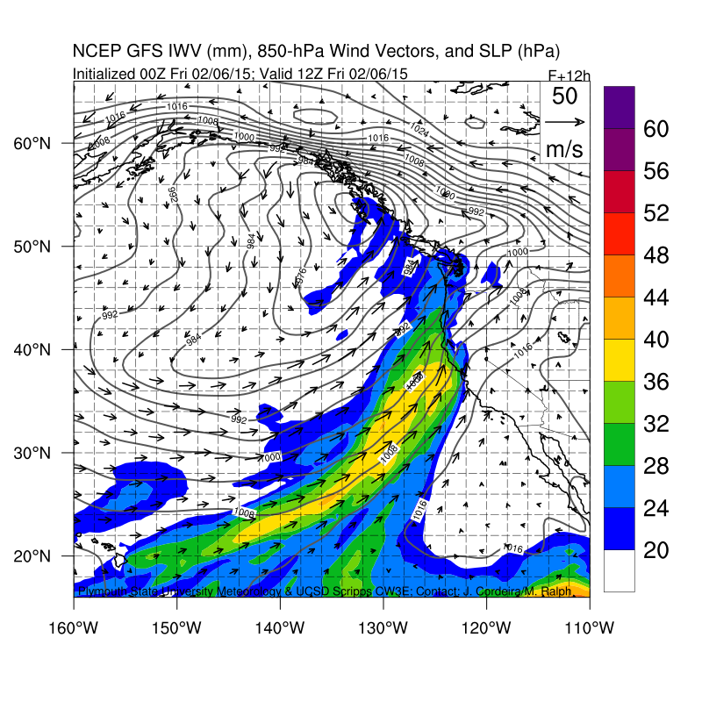
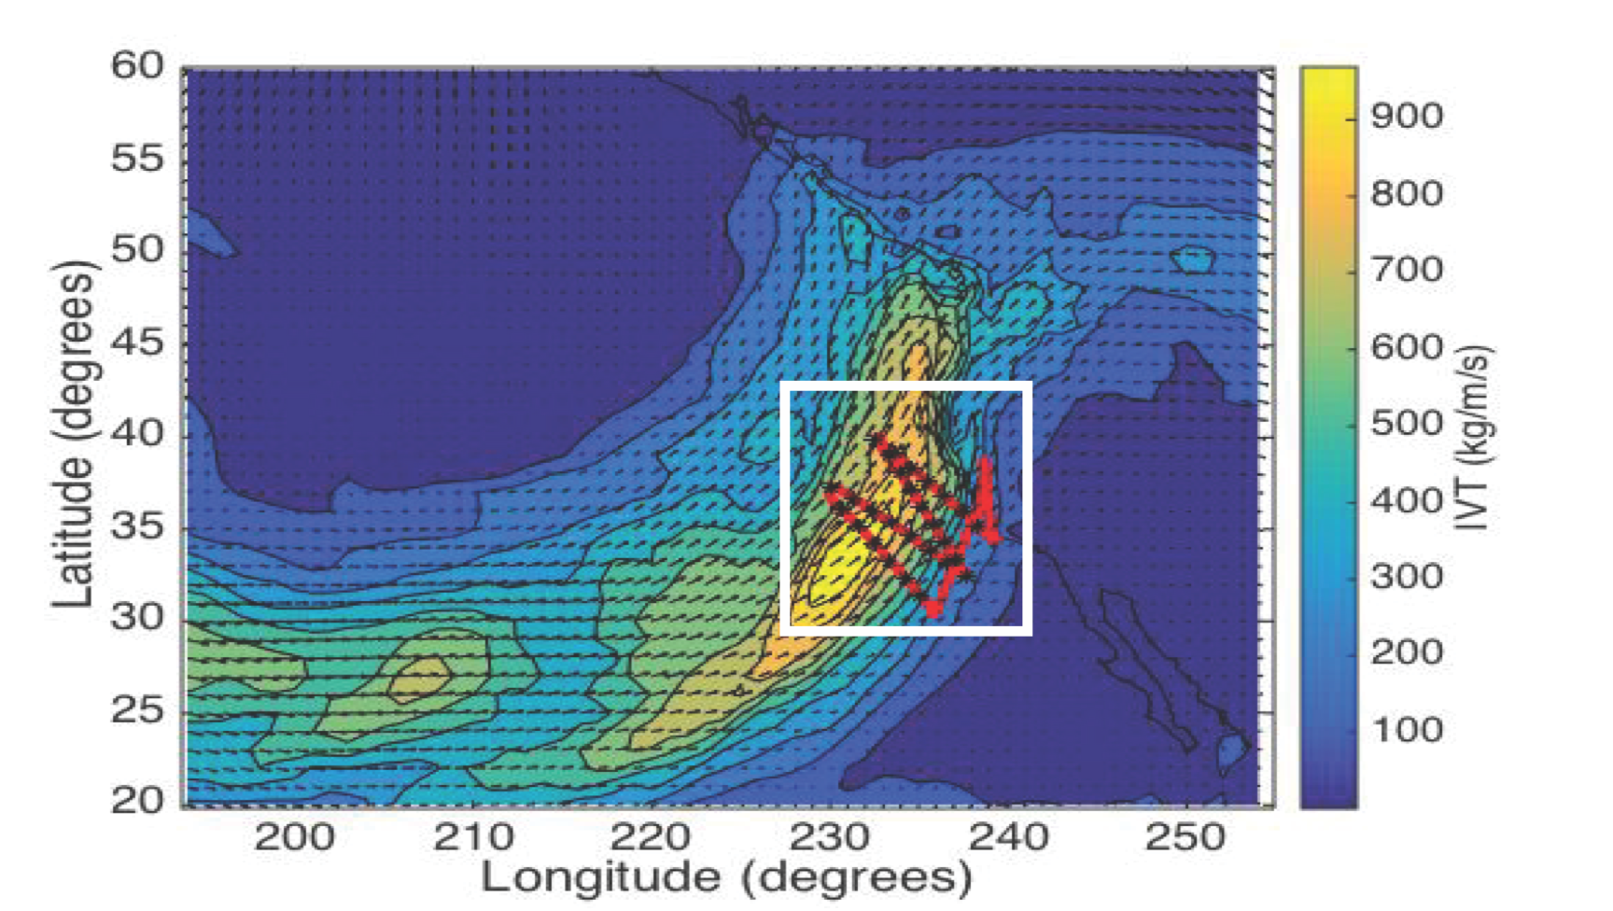
ARO observations
PW from ERA-Interim
1800 UTC 06 Feb 2015 analysis Integrated Vapor Transport (IVT)
NOAA GIV flight trajectory (brown line)
Dropsonde locations (pink stars)
Occultation tangent points drift along the green curves
500 hPa tangent point location (red x)

Slide 16
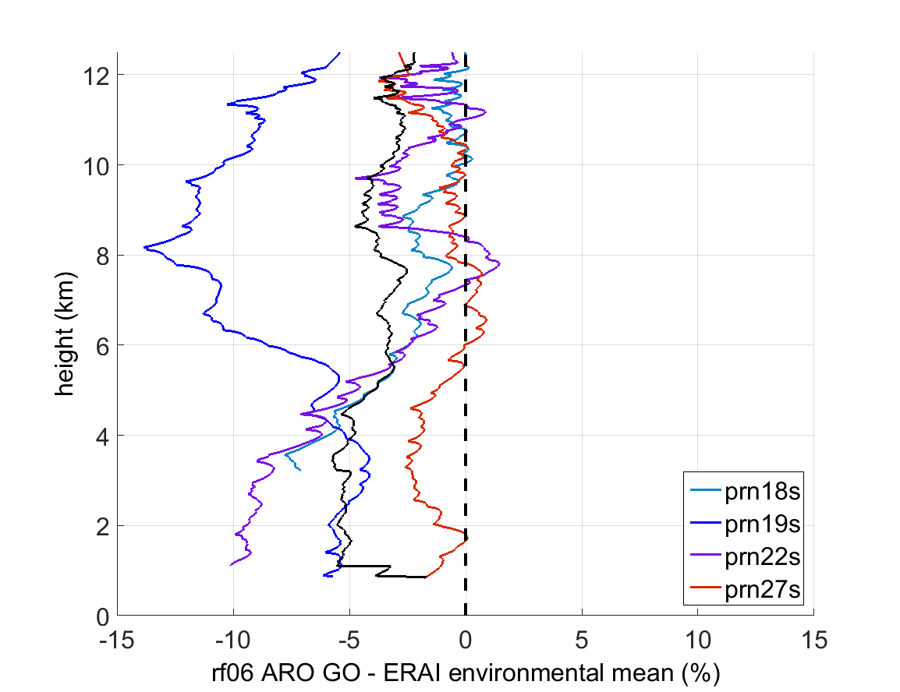
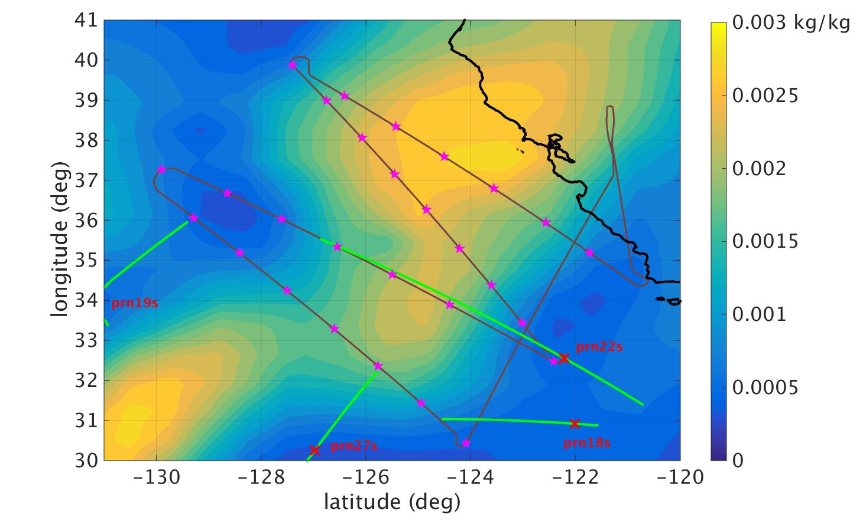
Preliminary GO retrievals

Slide 17
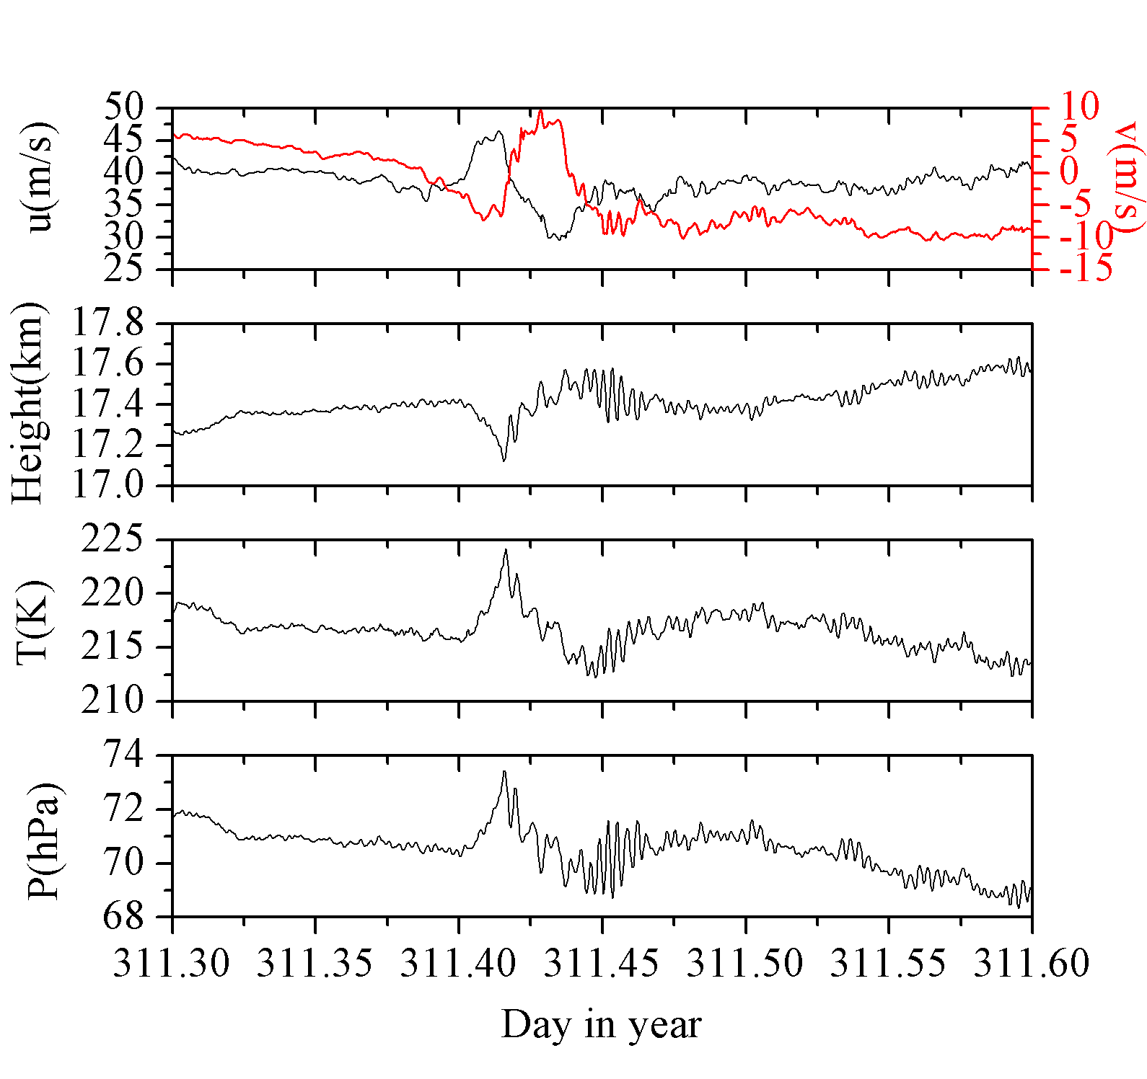
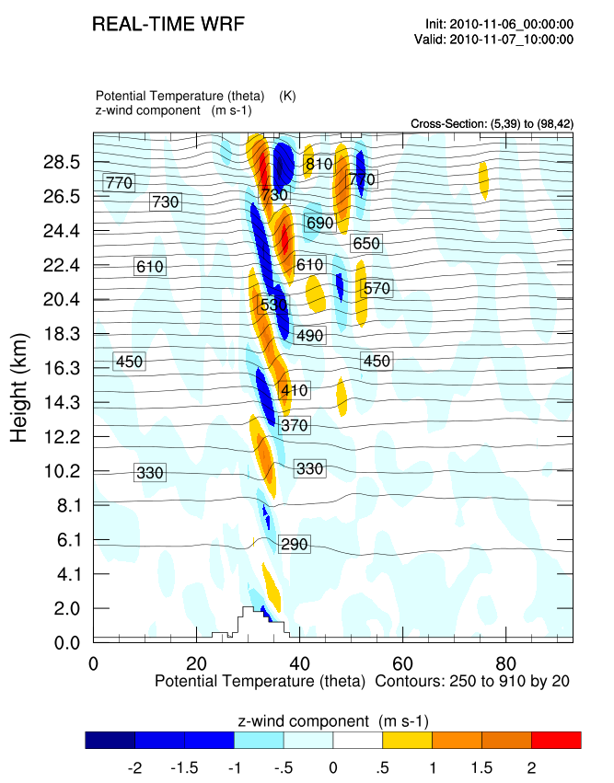
Upcoming Strateole-2 will quantify gravity waves in the equatorial atmosphere
40 equatorial balloon flights
Winter 2018, winter 2020-2021, and winter 2023-2024
Primary science objective is to determine horizontal scale and phase speed of fine vertical scale gravity waves and their contribution to momentum flux
Balloon velocity variations over the Antarctic peninsula
Equatorial test flights in 2010

Slide 18


Acknowledgements
SIO
  J. Sussman, B. Murphy, P. Muradyan
Purdue University
  James Garrison
  E. Wang, A. Johnson, U. Acikoz, B. Ventre
UC Davis
  Shu-Hua Chen
  Xue Meng Chen, Shu Ya Chen (NCAR, National Central University)
Texas A&M Corpus Christi
  Feiqin Xie, Loknath Adhikari
NCAR
  EOL, RAF facilities
  Chris Davis
NOAA, NOAA AOC
  Chris Fairall, Ryan Spackman, Jack Parrish

