Slide 1
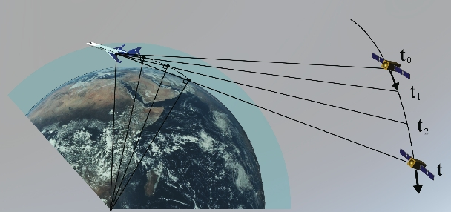
Improvements in
Airborne GPS Radio Occultation using Phase Matching Inversion for Tropical Storms and Atmospheric Rivers
Jennifer S. Haase

Slide 2


Acknowledgements
SIO
  J. Sussman, B. Murphy, P. Muradyan
Purdue University
  James Garrison
  E. Wang, A. Johnson, U. Acikoz, B. Ventre
UC Davis
  Shu-Hua Chen
  Xue Meng Chen, Shu Ya Chen (NCAR, National Central University)
Texas A&M Corpus Christi
  Feiqin Xie, Loknath Adhikari
NCAR
  EOL, RAF facilities
  Chris Davis
NOAA, NOAA AOC
  Chris Fairall, Ryan Spackman, Jack Parrish

Slide 3

Overview
Hurricane Karl development case
Geometric optics and phase matching
Calwater2015 atmospheric rivers case

Slide 4
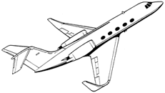
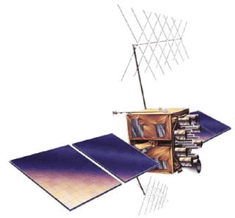
Airborne GPS radio occultation
Side-looking GPS receiver tracks setting and rising satellites
Nearly horizontal raypaths experience refractive delay
Atmospheric humidity profile is derived from refractive delay
α
Bending angle
Tangent point –
point closest to Earth surface
Notes:
What is GPS radio occultation? This technique uses side-looking GPS receivers on a moving platform, that record the signal from GPS satellites as the descend beyond the horizon.
These nearly horizontal raypaths through the atmosphere experience a refractive delay and bending of the raypath
The refractivity depends on the density of the atmosphere, so we can retrieve profiles of atmospheric properties from these delays.
T

Slide 5
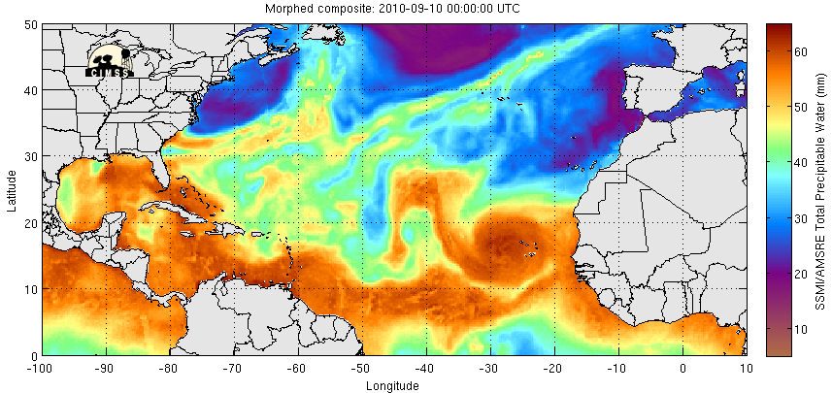
Focus on tropical waves
PRE-Depression Investigation of Cloud systems in the Tropics (PREDICT)
PGI39
PGI38
Gaston TS
PGI41
Igor
Cat 4-5
PGI44
Karl Cat 3
CIMSS MIMIC TPW product
While more than 80% of intense hurricanes in the Atlantic originate as African easterly waves (Landsea, 1993) most easterly waves do not develop into hurricanes. Which waves will develop? How can we improve hurricane intensity forecasting?
Notes:
The focus of the PREDICT campaign was on tropical waves, atmospheric pressure disturbances that are formed off the coast of Africa that travel across the Atlantic as easterly waves. They show up clearly in the microwave imagery of total precipitable water as these regions of high moisture within the tropical wave. Here the values of total precipitable water in the atmospheric column can get as high as 60 mm of equivalent liquid water

Slide 6
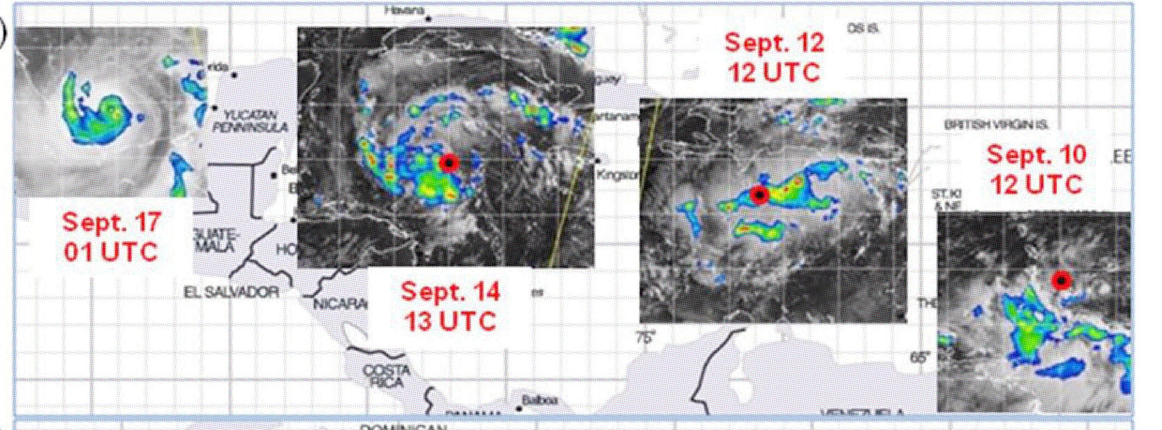
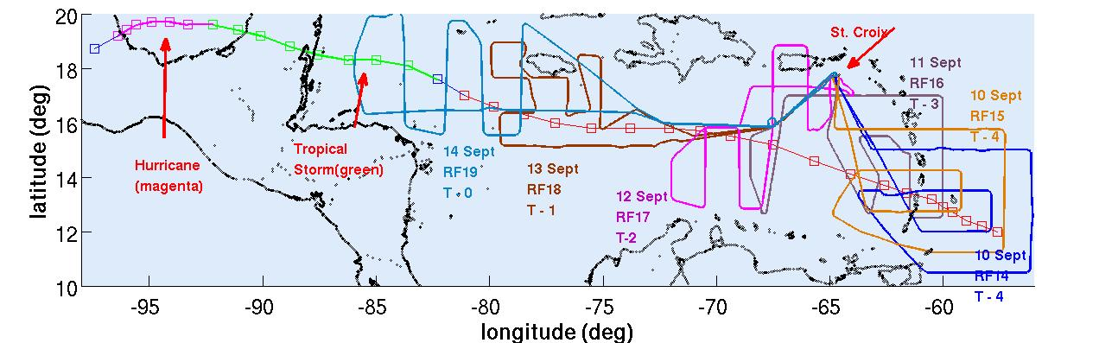
Development of Karl
Davis and Ahijevych, JAS, 69, 2011
Hurricane ←Tropical Storm ←Depression ←---------------------------------Disturbance
Sept 16 18Z Sept 14 18Z Sept 14 12Z Sept 9
Six PREDICT research missions, RF14 – 19 flown to sample pre-Karl system, releasing 14-16 dropsondes each

Slide 7
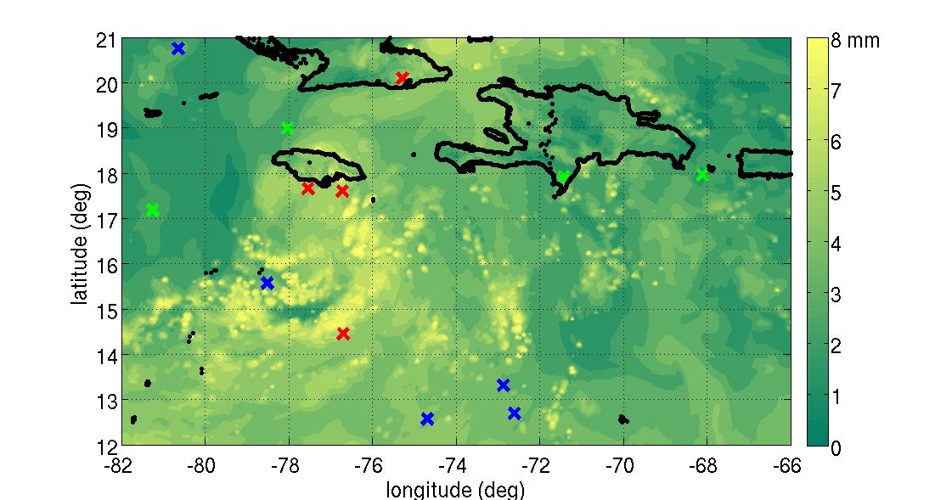
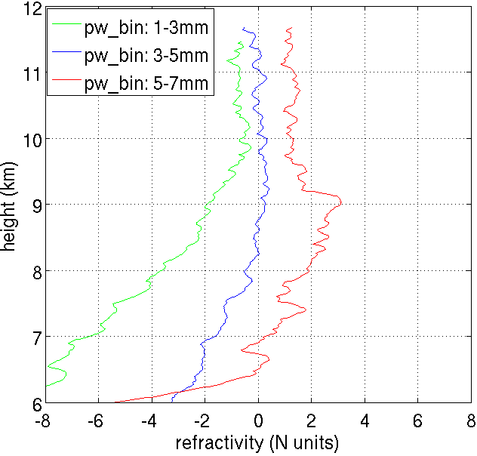
Spatial distribution of moisture from ARO
relative to environmental background mean
WRF PW above 500 hPa
13 Sept 12:00 UT
ARO picks up large scale moisture variations
ARO profiles that sample in upper level high PW region of storm have higher average refractivity
However the true benefit comes from assimilating the information at the location of each observation

Slide 8
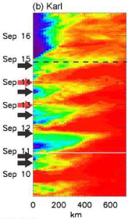
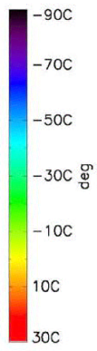
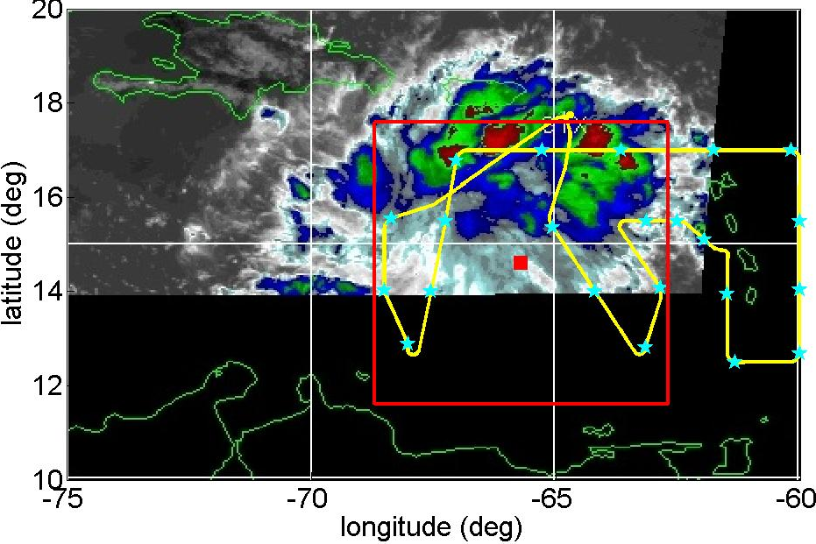

Pre – Karl diurnal convective cycle from IR
The pre-Karl system exhibited a diurnal convective pattern in IR cloud top temperature until genesis on 14 September
Pulse of deep convection on 11 September
RF19 T-0
RF18 T-1
RF17 T-2
17:32 UT
RF16 T-3
RF15 T-4
RF14 T-4
11 Sept, RF16, T - 3
Davis and Ahijevych, JAS, 69,2011

Slide 9
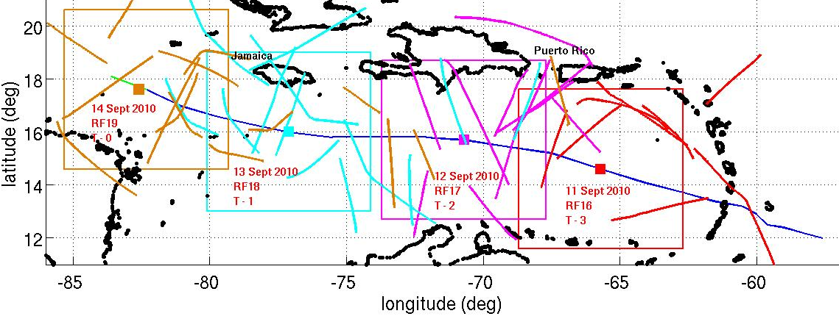
Evolution of the mean profile
To investigate temporal moisture evolution, a 6 x 6 meso-α box was defined surrounding the storm location for each day 11-14 Sept, T-3 to T-0
ARO open loop profiles were averaged within the region for each flight.

Slide 10
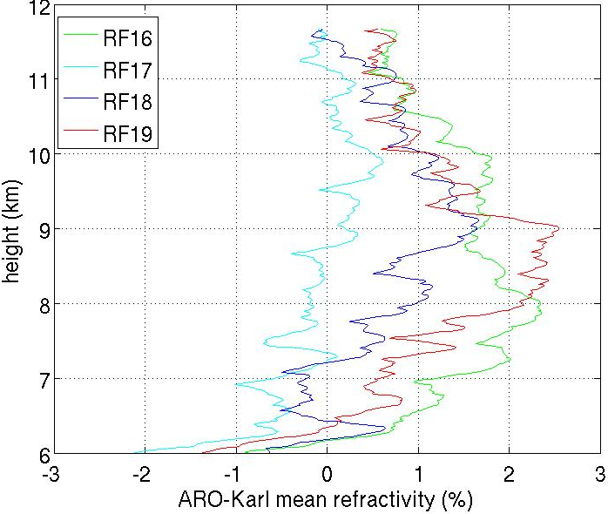
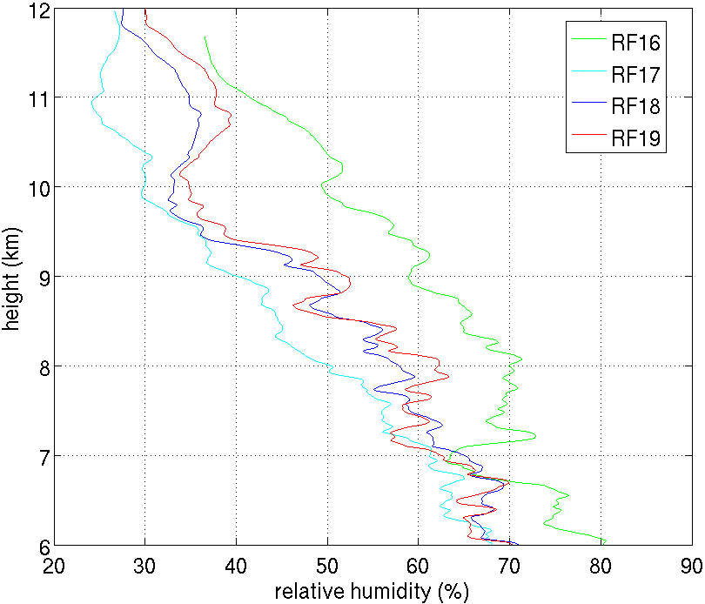
Moisture variability of ARO during development
11 Sep
12 Sep
13 Sep
14 Sep
T - 2
T - 0
T - 1
T - 3
ARO was consistent with general moistening over T-2 to T-0 similar to dropsonde observations in the same region.
Both refractivity and moisture on 11 Sept, T-3 were high compared to the other flights.
This was the day of the pulse of convection seen in the IR in Davis and Ahijevych 2011

Slide 11
Airborne retrieval improvements
Conventional receiver tracking descends to 7 km
Open-loop software receiver retrieves data to the surface
Climatological model increases SNR and accuracy of excess phase profile
Phase Matching reduces bias in bending angle below 6 km
Fourier Spectral Inversion (FSI) produces comparable results to Phase Matching
Refractivity retrievals from the Abel Inversion are improved

Slide 12
GO underestimates bending
Geometric optics bending angle is underestimated
Therefore refractivity is underestimated
Ad hoc modification of bending angle to monotonically decreasing function underestimates bending and refractivity still further

Slide 13
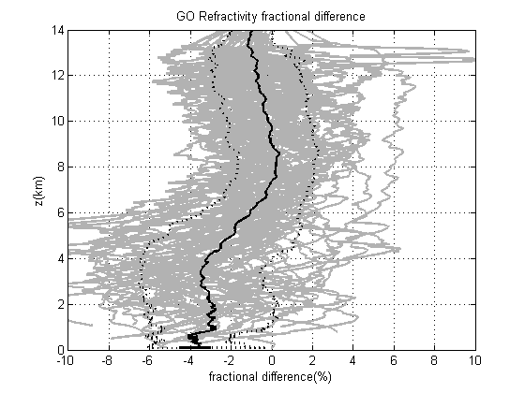
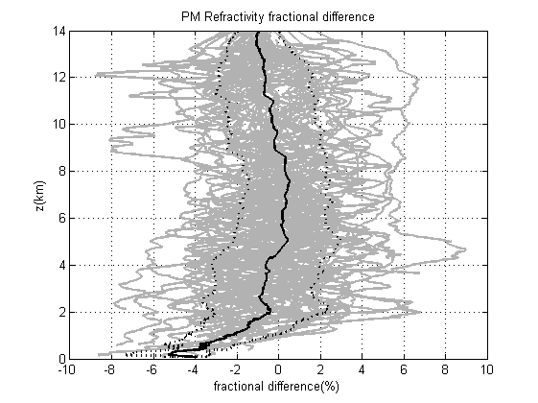
Bias is reduced by phase matching
Fractional refractivity difference with respect to ERA-Interim model
For all Karl flights.

Slide 14
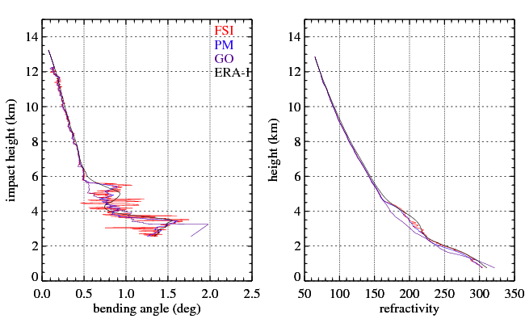
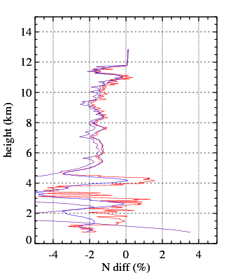
FSI gives similar results as PM
FSI confirms bias of geometric optics
Suggests that sharp layers are resolvable that differ significantly from ERA-I

Slide 15
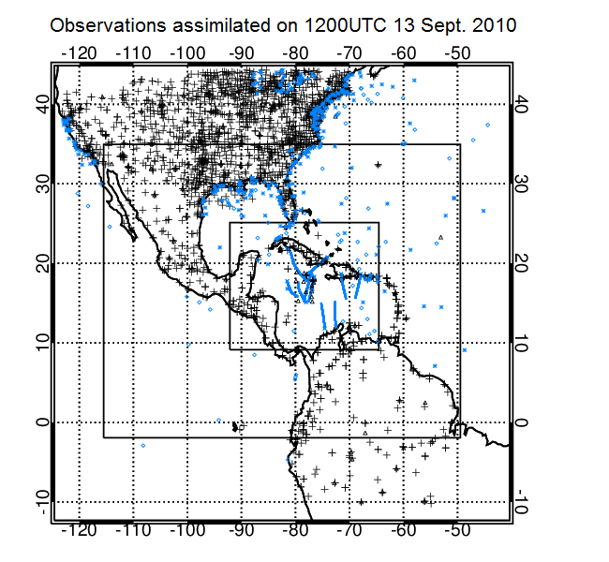
Data assimilation on day prior to reaching tropical storm
WRF 3DVAR Data Assimilation (DA) is used to perform data assimilation of conventional GTS and airborne RO data
  1. Control: No data are assimilated.
  2. GTS + dropsondes observations are assimilated
  3. GTS +:dropsondes + ARO are assimilated
ARO observation errors were estimated to be 2% and not used below 2 km.
A non-local operator for integrated excess phase along the GPS ray path (Chen et al., 2009) was modified from the space-borne geometry to the airborne geometry which considers drift.
We added the option of assimilating data at higher vertical resolution (originally observations were thinned to the number of model levels), by taking advantage of the greater horizontal drift of tangent points for an airborne receiver.
X.M. Chen Poster F0045
Notes:
Three-way nested simulation domains (27 km, 9 km, and 3km grids) and locations of all assimilated observations during the data cycling period. Colors: 1200 UTC September 10th in violet to 1200 UTC September 13th in red. The large black cross indicates the position of the Tropical Low at 1800 UTC September 13th as reported by the National Hurricane Center (Stewart 2011).
WRF Model configuration:
• Purdue microphysics scheme (Chen and Sun, 2002)
• YonSei University (YSU) planetary boundary layer scheme (Hong et al., 1996)
• Kain-Fritsch (KF) cumulus parameterization (Kain 2004),
• Rapid Radiative Transfer Model longwave radiation parameterization (Mlawer et al. 1997)
• Goddard shortwave radiation parameterization (Chou and Suarez 1999; Chou et al. 2001).
• A time step of 120 seconds is used for domain 1.
• Initial and boundary conditions are the NCEP FNL (Final) Operational Global Analysis
The Three-Dimensional Variational (3DVAR) Data Assimilation (DA) system of the Weather Research and Forecasting (WRF) model is used to perform data assimilation of dropsonde and airborne RO data every 3 hours over the time period shown for three experiments:
1. NONE: No data are assimilated during data cycling.
2. DRPS: Dropsonde observations are assimilated every three hours
3. DRPS+GPS: Airborne GPS refractivity data are added to the DRPS experiment, providing additional information on the refractivity of the air column, mainly above 5km.
* The vertical profiles are thinned to one observation per model level to avoid over-weighting and correlation of observational errors.
* Background error covariance was calculated with the NMC method (Parrish and Derber, 1992) using 12 and 24-hours model forecast differences from the WRF model for September 2010.
* ARO observation errors were estimated to be 2% and constant over height from 0 to 14 km based on the comparison completed at left.
* A non-local operator for integrated excess phase along the GPS ray path (Chen et al., 2009) has been modified from the space-borne geometry to account for the truncation of the observations at the aircraft flight level and to account for the horizontal drift of the tangent points.
* Three external iterations are performed at each data assimilation cycle to assure balance before propagating forward.

Slide 16
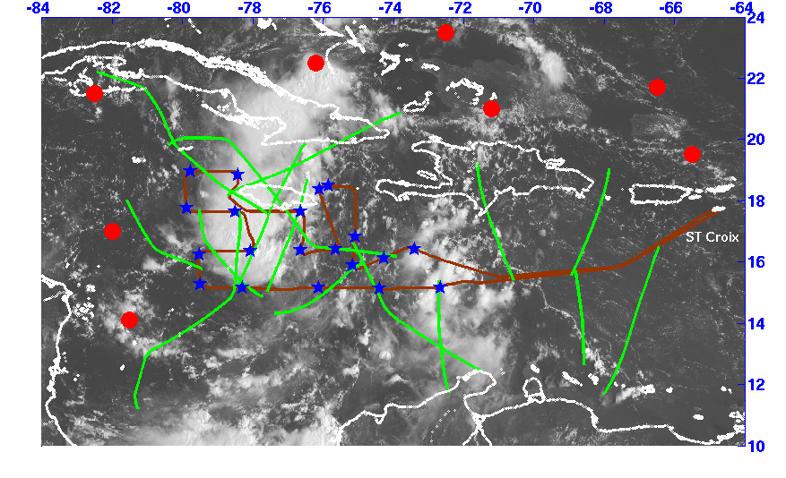
Airborne RO provides much denser sampling than COSMIC spaceborne RO
GOES-13 visible imagery 13.75Z (GHRC dataset, www.ghrc.nsstc,nasa.gov/hydro)
All possible rising and setting occultation tangent point paths for
RF18, Sept. 13, 2010. (green) compared to all COSMIC RO for entire day (red)

Slide 17
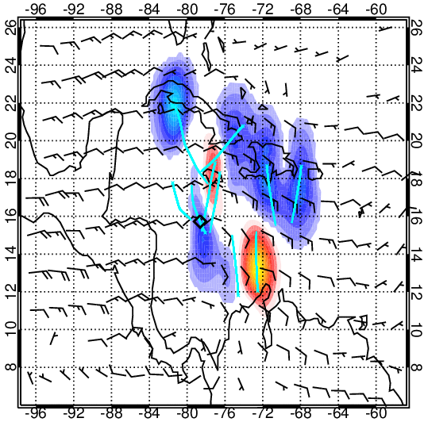
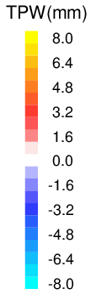
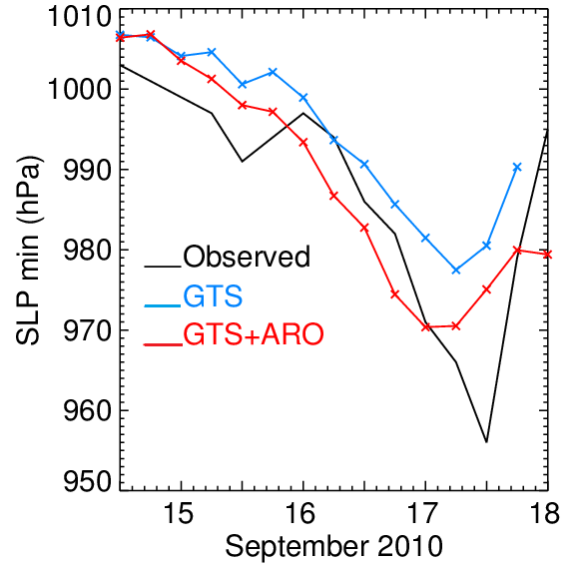
(GTS+ARO) – (GTS) TPW difference and mean flow (900-400 hPa)
at end of assimilation at
1200 UTC 13 Sept. 2010
Improved intensity

Slide 18
Areas not sampled by dropsondes were key regions where moisture was increased

Slide 19
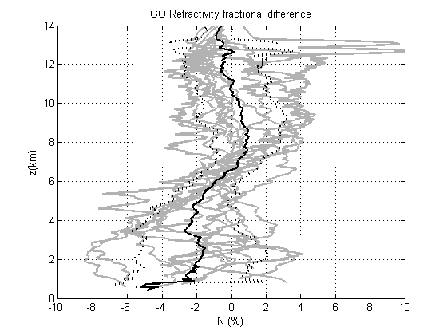
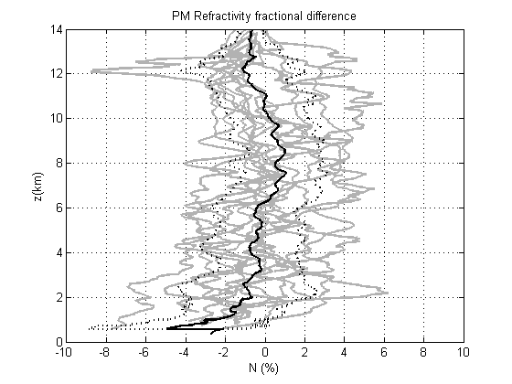
PM retrievals were key to improving quality of the data for assimilation
Reduced observation errors, that were set to 2% above 2km in the data assimilation
Low SNR data not used below 2 km
Areas not sampled by dropsondes were key regions where moisture was increased

Slide 20
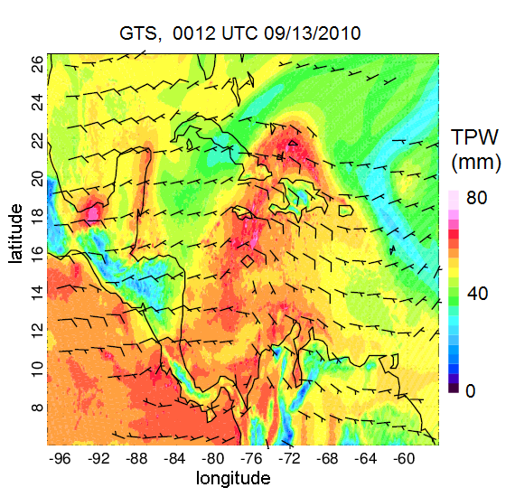
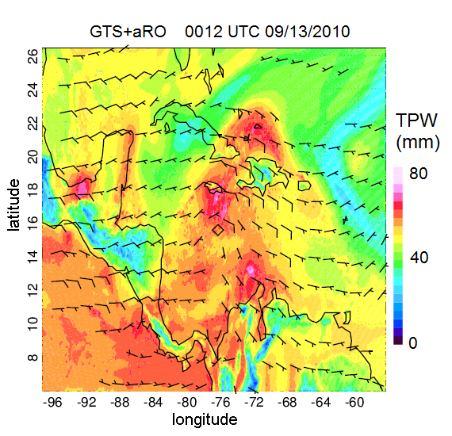
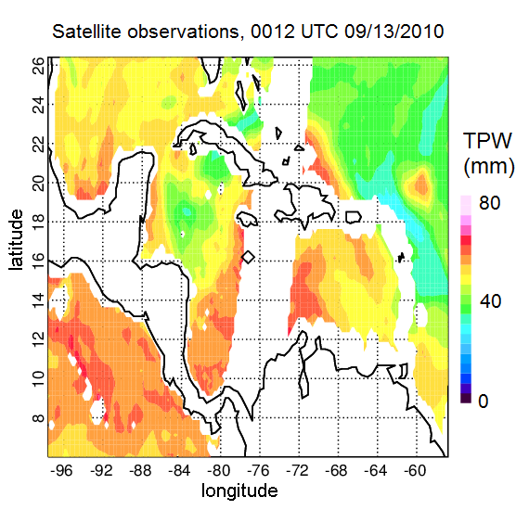
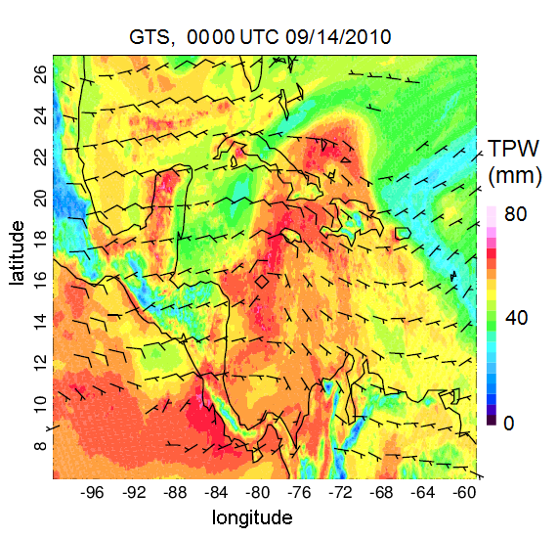
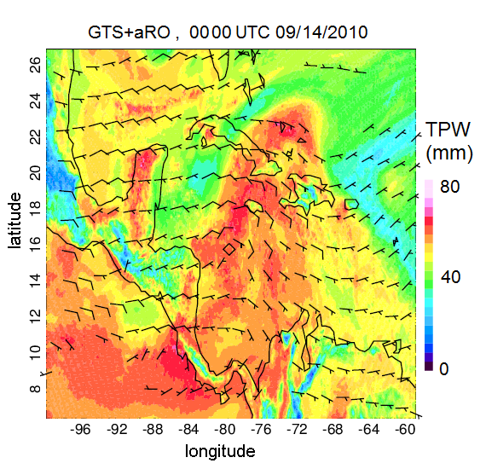
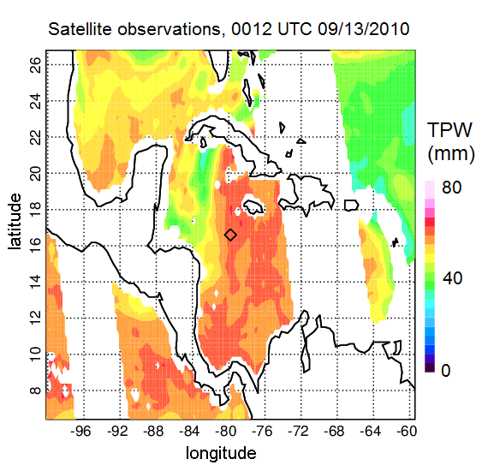
Verification by satellite PW obs
Moisture and windspeed increased in inflow region
Observed PW from
SSMI, TMI, AMSR-E
GTS only
GTS + ARO
13 Sep 12Z
(end of data assimilation)
0000Z UTC 09/14/2010
14 Sep 00Z forecast

Slide 21
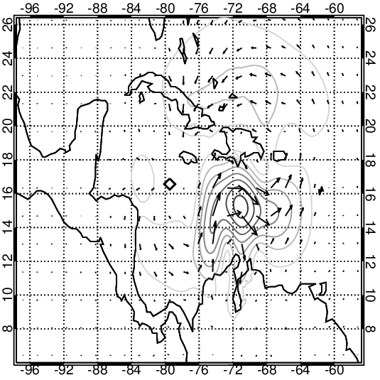

Indirect impact on winds
(GTS+ARO) – (GTS) 850-hPa wind difference
1200 UTC 13 Sept. 2010
After data assimilation, at 13 Sep 12Z, the initial surface convergence was greater in the GTS+ARO experiment.
Refractivity operator also includes pressure, resulting in impact on winds.
850 hPa wind difference between the two data assimilation simulations (GTS+ARO – GTS) shows increased southerly flow, decreased easterly flow.
Decrease of easterly flow
Increase of southerly flow -> increase storm cyclonic circulation

Slide 22
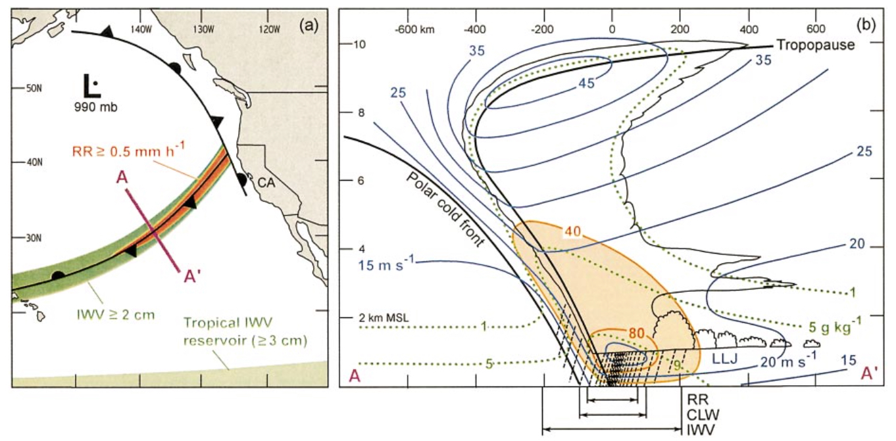
Calwater 2015 Atmospheric Rivers
Atmospheric rivers provide 20%-50% of California’s annual precipitation.
Orographic precipitation due to interaction with coastal ranges produces extended precipitation that contributes to snowpack but also can cause flooding.
Microphysics determines hydrometeor type and distribution w.r.t. topography
Objective is to investigate ability of polarimetric measurements to describe dropsize distribution
Notes:
Figure 1 Left: Schematic illustration of an atmospheric river over the northeastern Pacific Ocean (from Ralph et al., 2004). (Left) Map view of cold front with a moist low-level jet with high IWV. Right: Conceptual cross-section showing the front-parallel wind speed (blue; m/s) and moisture flux (orange; x105 kg/s), specific humidity (dotted green; g/kg), and schematic clouds and precipitation. Mean width scales of IWV, cloud liquid water, and rain rate are shown below the cross-section.

Slide 23
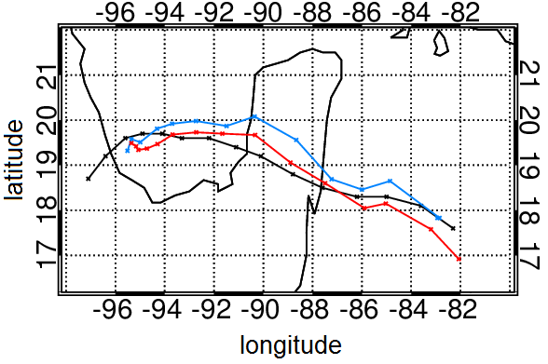
Track was also improved with ARO assimilation.

Slide 24
Data types collected
14 flights conventional receiver GPS and GLONASS observations
10 flights GISMOS GRS 10 MHz data for OL tracking top and side recordings for standard occultation
2 flights GISMOS GRS 10 MHz data with side recordings from H- and V- polarized antennas

Slide 25
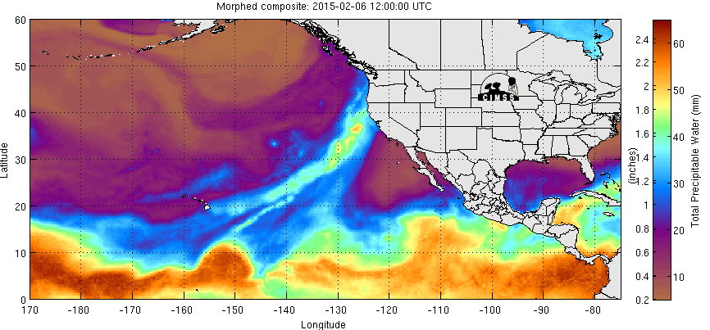
Precipitable water on day of atmospheric river landfall
Total precipitable water (mm) as measured by the SSM/I composite produced by the CIMSS (Cooperative Institute for Meteorological Satellite Studies) for 6 February 2015, a day when the atmospheric river being investigated made landfall on the Northern California coast.

Slide 26
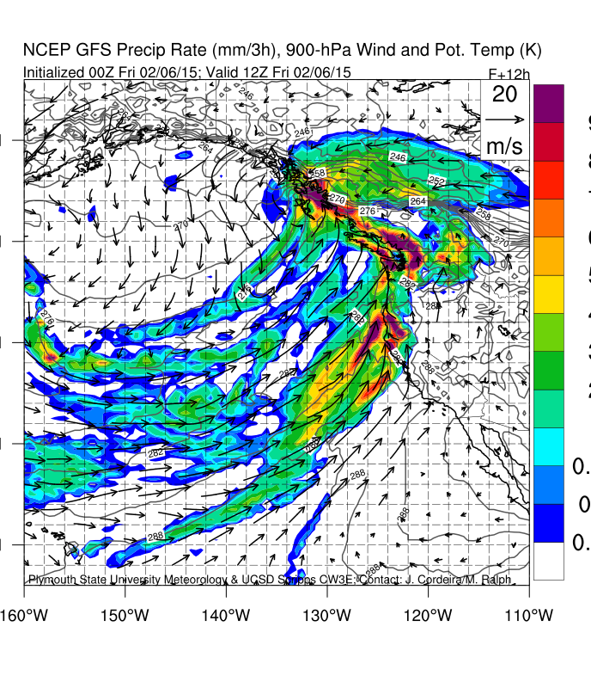
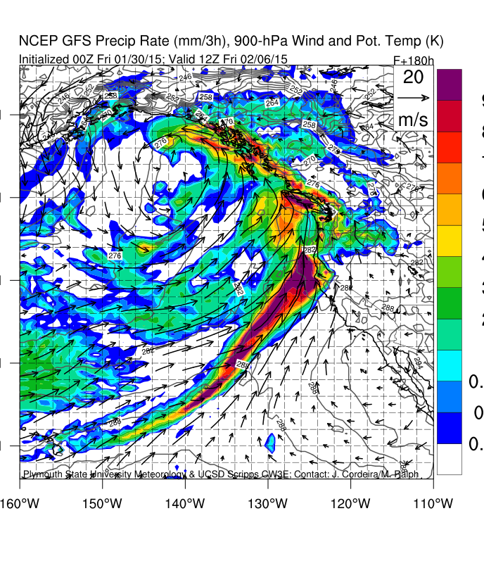
Forecast precipitation overestimated
http://vortex.plymouth.edu/~j_cordeira/ARPortal/Current/products.html
Precipitation valid 12Z 6 February 2015
30 January 2015 – 180 hr Forecast
Precipitation overestimated

Slide 27
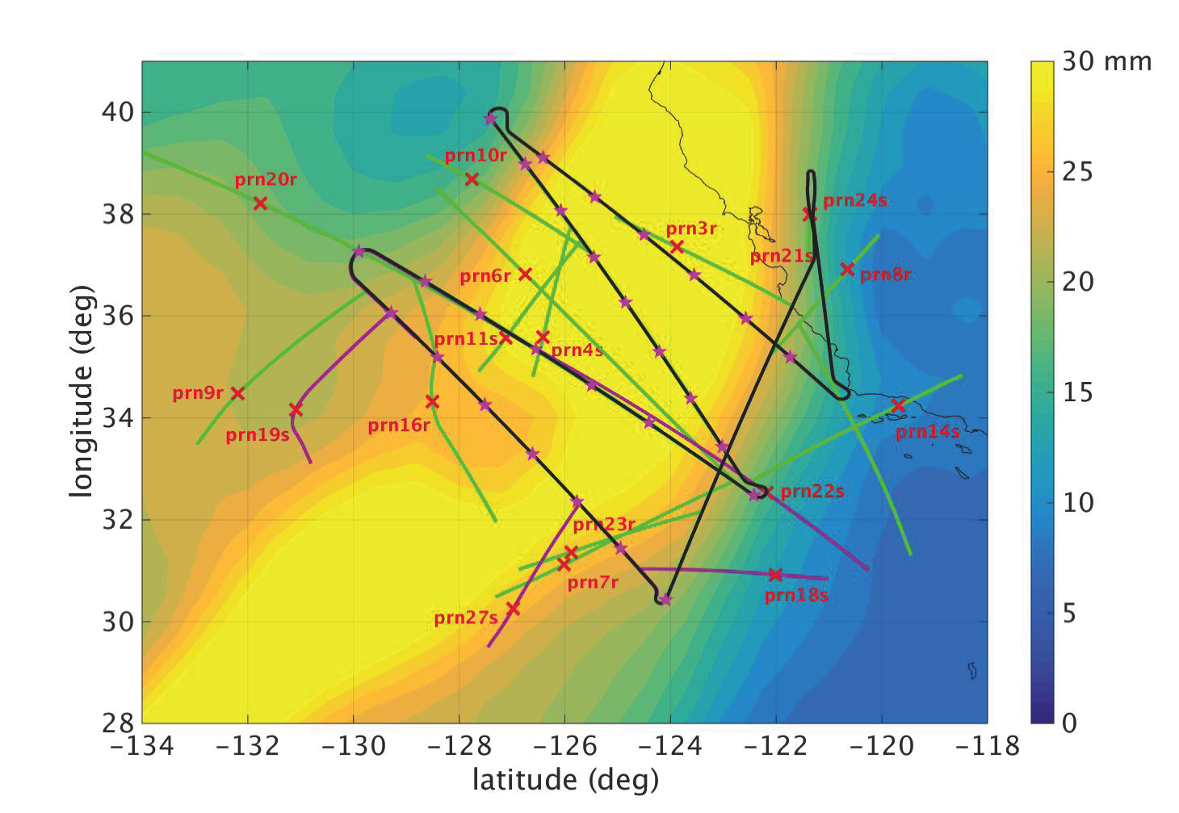
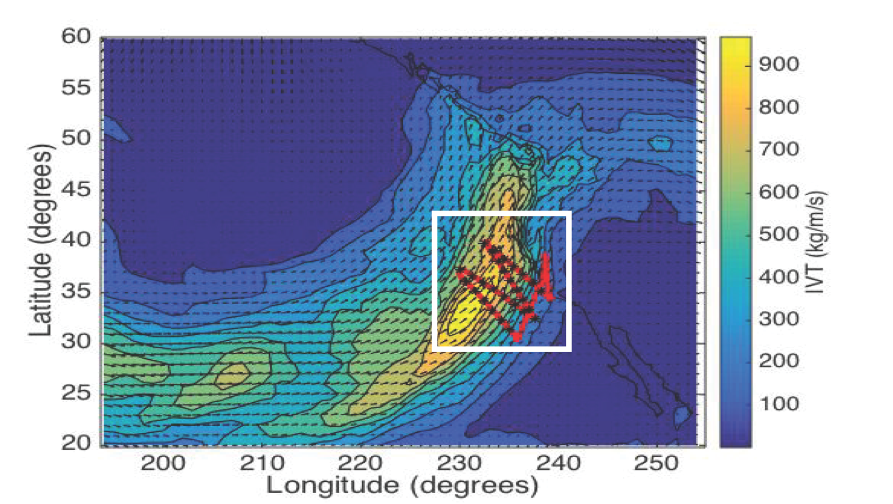
ARO observations
PW from ERA-Interim
1800 UTC 06 Feb 2015 analysis Integrated Vapor Transport (IVT)
NOAA GIV flight trajectory (brown line)
Dropsonde locations (pink stars)
Occultation tangent points drift along the green curves
500 hPa tangent point location (red x)

Slide 28
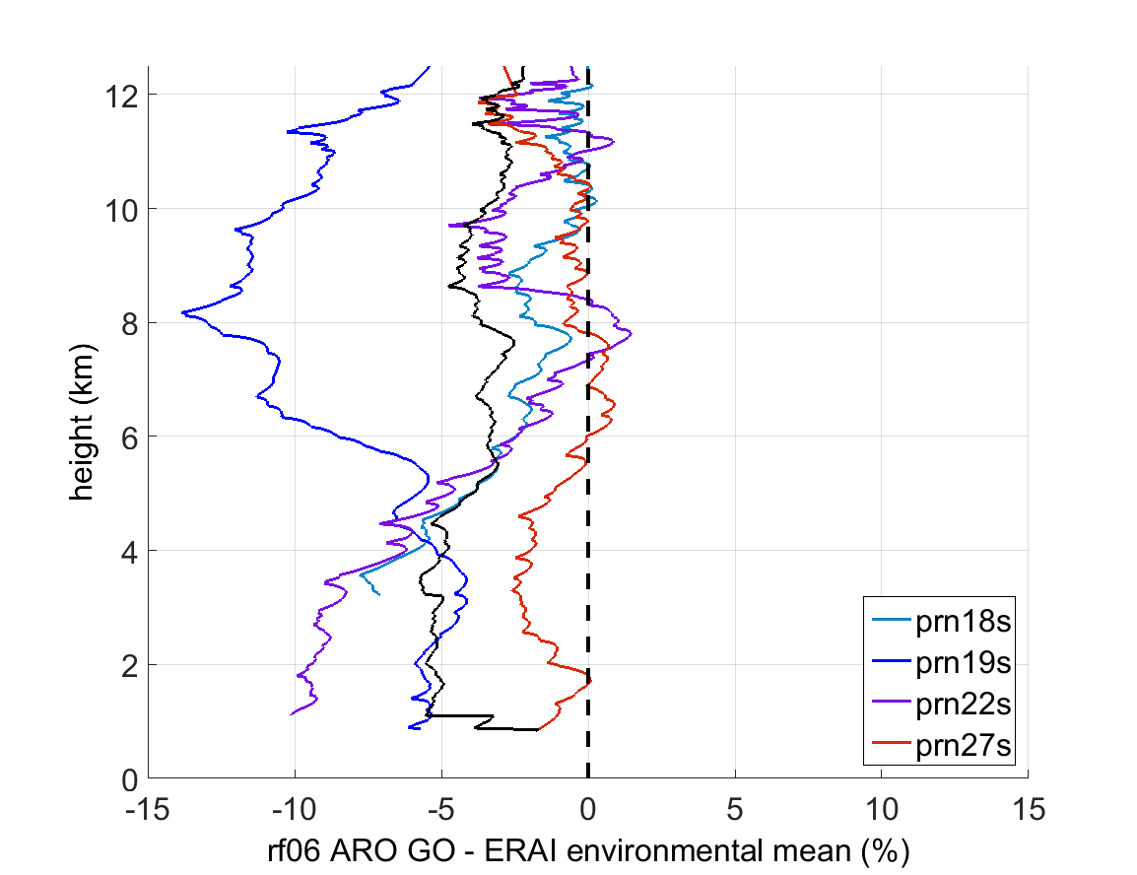
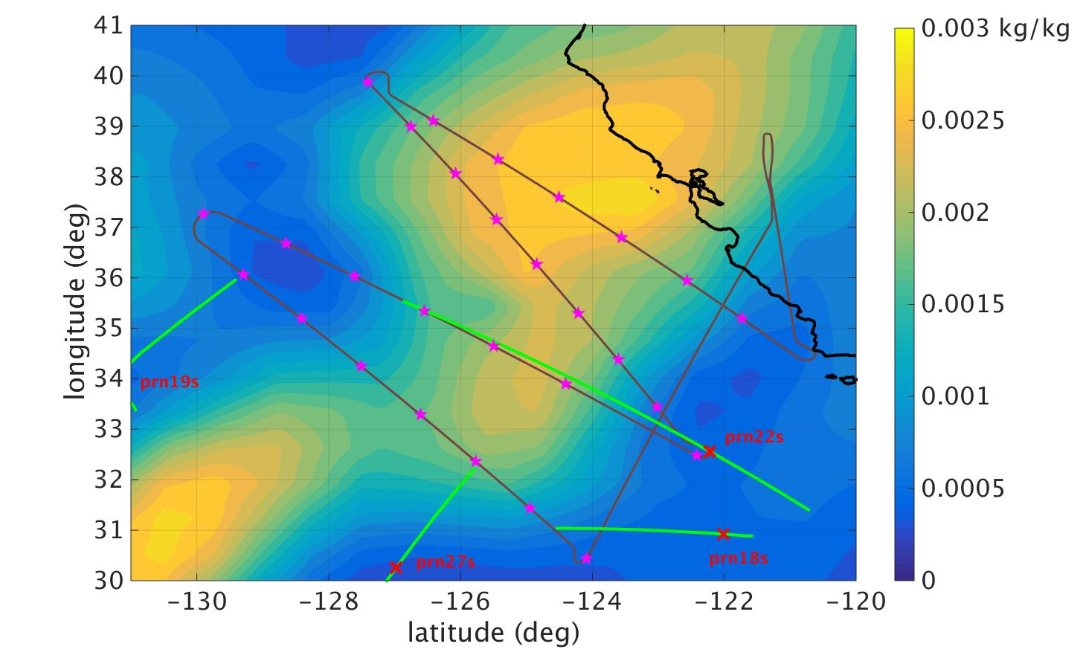
Preliminary GO retrievals

Slide 29
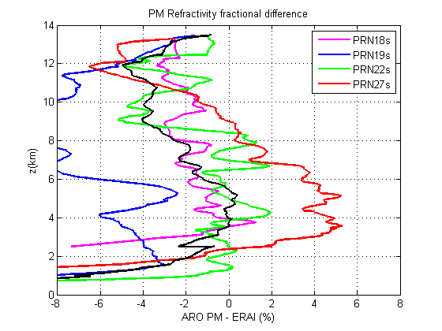
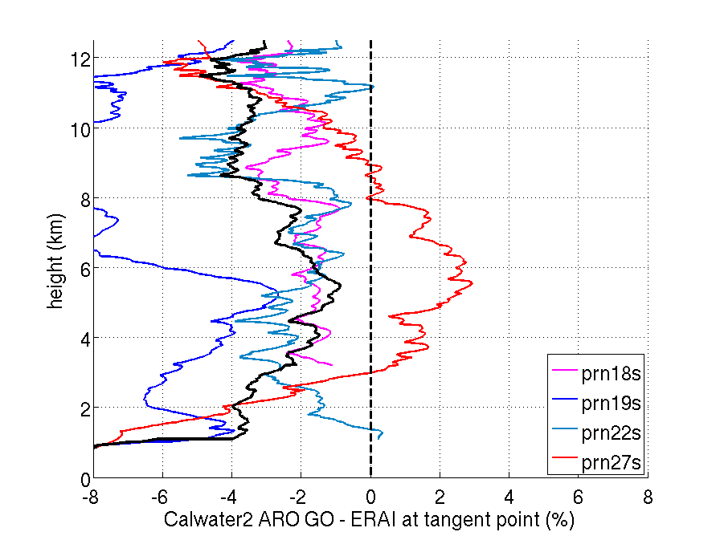
Phase matching reduces bias
Geometric optics retrieval
Phase matching retrieval

Slide 30
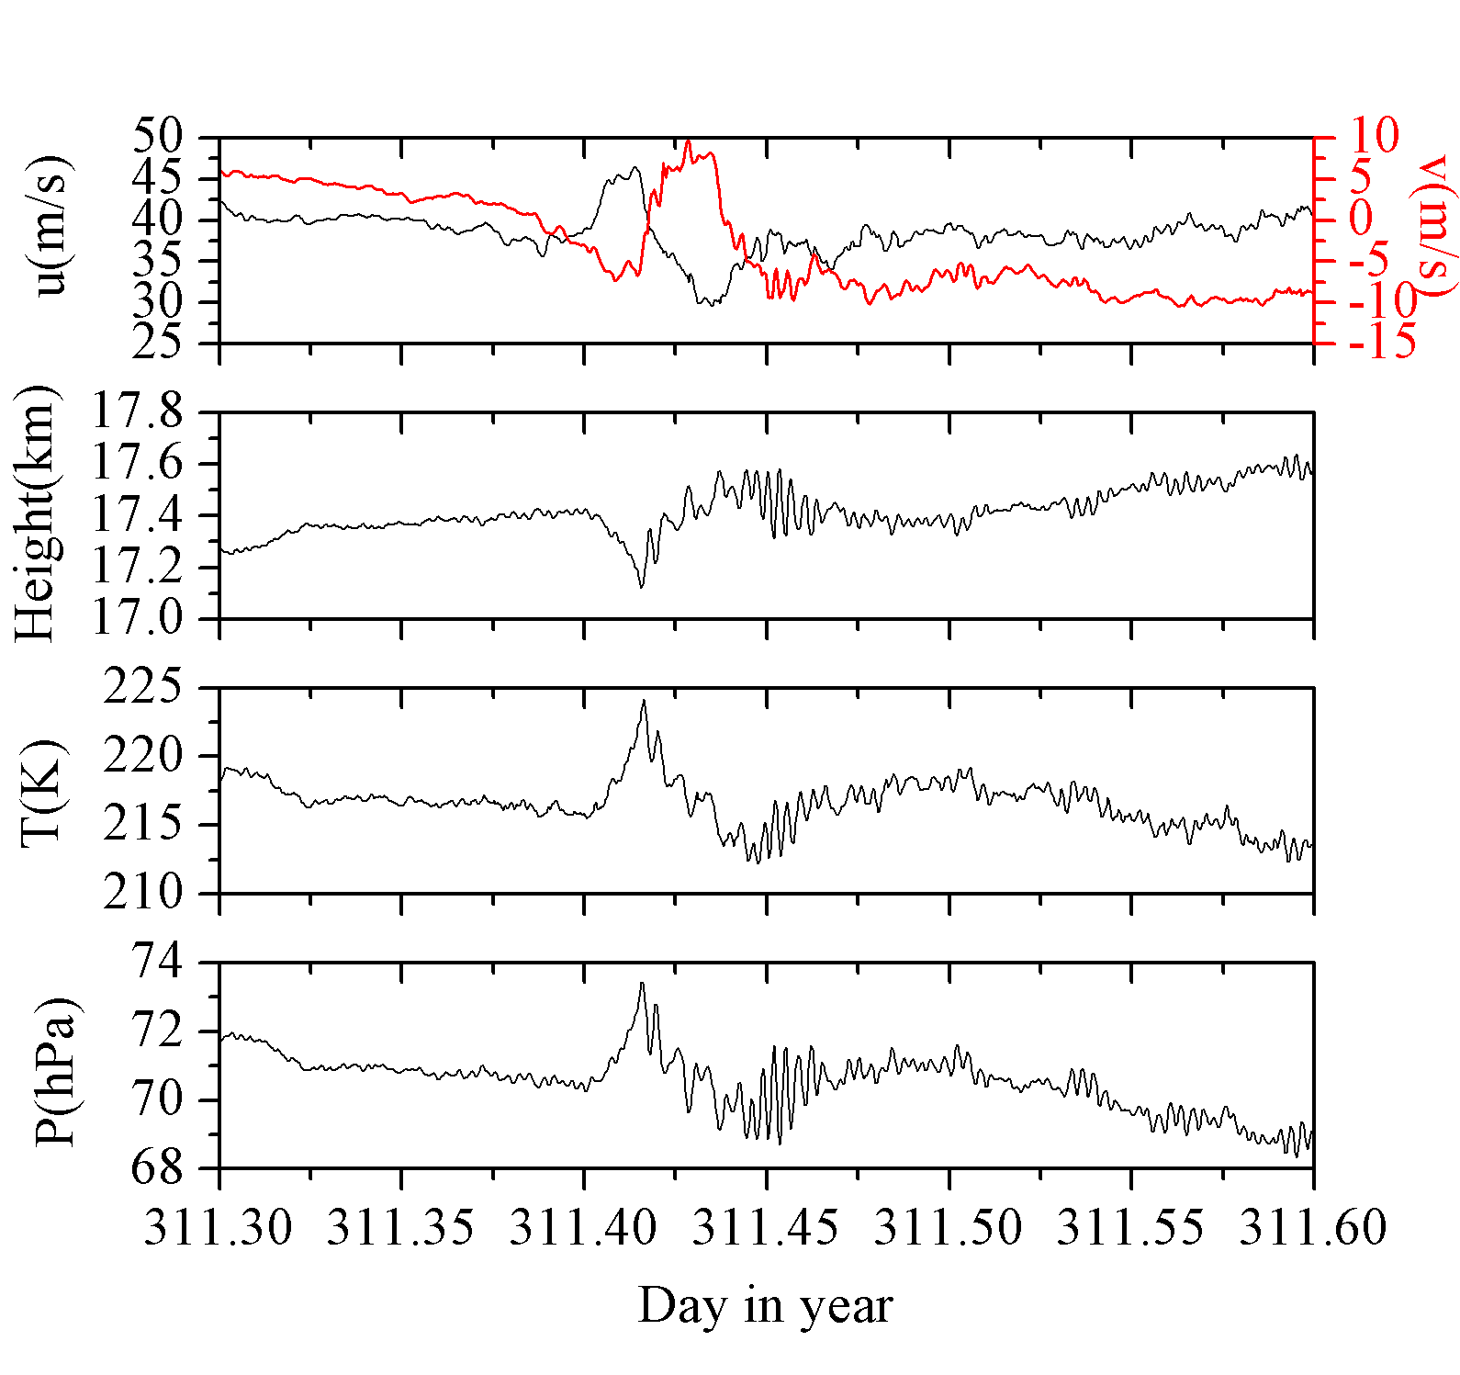
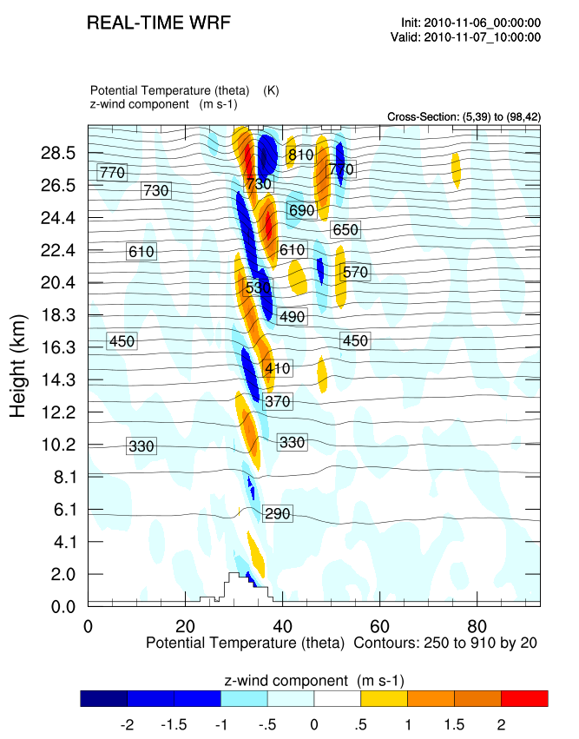
Upcoming Strateole-2 will quantify gravity waves in the equatorial atmosphere
40 equatorial balloon flights
Winter 2018, winter 2020-2021, and winter 2023-2024
Primary science objective is to determine horizontal scale and phase speed of fine vertical scale gravity waves and their contribution to momentum flux
Balloon velocity variations over the Antarctic peninsula
Equatorial test flights in 2010

Slide 31
Conclusions
Both Phase Matching and Fourier Spectral Inversion provide retrievals with much lower biases (~2% less) below 6 km.
ARO profiles show large scale moisture variations in the tropical storm region
Data assimilation using a non-local observation operator shows forecast improvement for the GTS + ARO assimilation test.
Airborne radio occultation data assimilation with dense sampling near the storm center has impact on pressure and wind fields, as well as directly sensed water vapor.
Please see X.M. Chen Poster F0045

Slide 33
GO captured the highest areas of moisture but not those to the southeast

Slide 34
PM retrievals were key to improving quality of the data for assimilation
Reduced observation errors, that were set to 2% above 2km in the data assimilation
Low SNR data not used below 2 km

Slide 35
PM by removing bias, increased moisture especially below 6km
affecting retrievals to the southeast

Slide 36
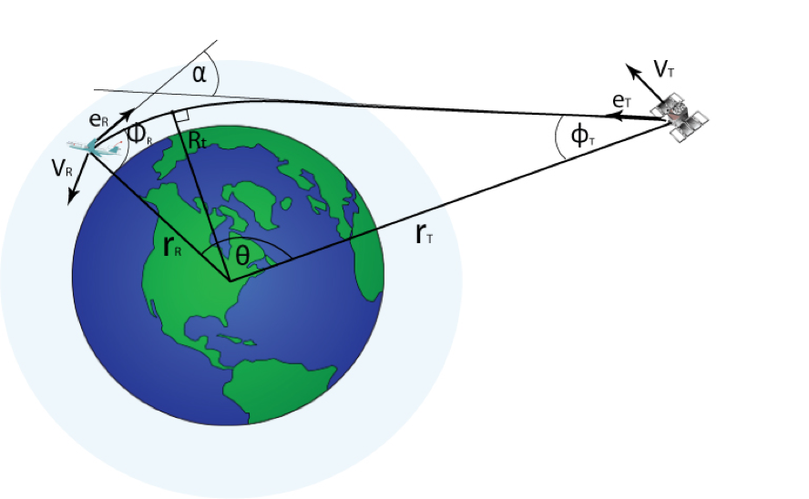
GPS radio occultation theory
GPS signals are refracted in the atmosphere
Measure the difference between the observed distance and the straight line
Refraction causes a Doppler shift in the carrier frequency
The bending angle is an integral of the refractive index
Partial bending angle describes the refraction below the aircraft height
Refractive index depends on P,T, and e

Slide 37
Refractivity
Bending angle
negative elevation
positive elevation
partial bending
Excess Phase
Excess Doppler
Challenging measurements: maximum doppler 2.5 m/s
velocity noise 0.005 m/s

Slide 38
Indirect impact on winds
(GTS+ARO) – (GTS) 850-hPa wind difference
1200 UTC 13 Sept. 2010
After data assimilation, at 13 Sep 12Z, the initial surface convergence was greater in the GTS+ARO experiment.
Refractivity operator also includes pressure, resulting in impact on winds.
850 hPa wind difference between the two data assimilation simulations (GTS+ARO – GTS) shows increased southerly flow, decreased easterly flow.
Decrease of easterly flow
Increase of southerly flow -> increase storm cyclonic circulation

Slide 39
Verification by satellite PW obs
Moisture and windspeed increased in inflow region
Observed PW from
SSMI, TMI, AMSR-E
GTS only
GTS + ARO
13 Sep 12Z
(end of data assimilation)
0000Z UTC 09/14/2010
14 Sep 00Z forecast

Slide 40
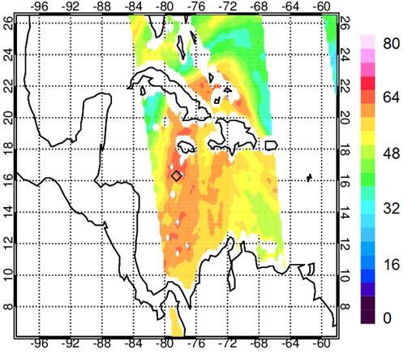
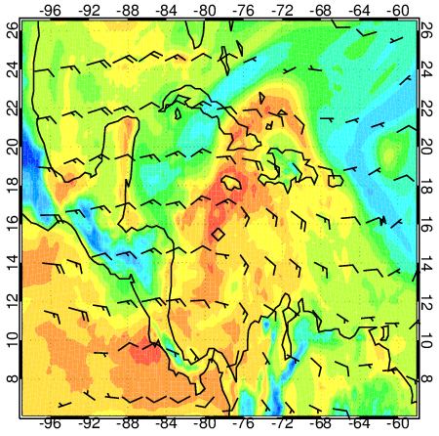
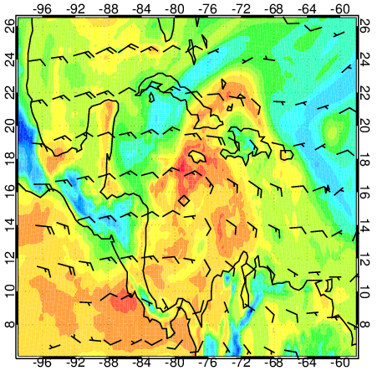

Total Precipitable Water (TPW in mm) and mean flow (900-400 hPa)
1800 UTC 13 Sept. 2010
Satellite composite
(SSMI, TMI, AMSR-E, WindSat)
GTS
GTS+ARO

Slide 42
Pre – Karl diurnal convective cycle from IR
The pre-Karl system exhibited a diurnal convective pattern in IR cloud top temperature until genesis on 14 September
Pulse of deep convection on 11 September
RF19 T-0
RF18 T-1
RF17 T-2
17:32 UT
RF16 T-3
RF15 T-4
RF14 T-4
11 Sept, RF16, T - 3
Davis and Ahijevych, JAS, 69,2011

Slide 43
Evolution of the mean profile
To investigate temporal moisture evolution, a 6 x 6 meso-α box was defined surrounding the storm location for each day 11-14 Sept, T-3 to T-0
ARO open loop profiles were averaged within the region for each flight.

Slide 44
Moisture variability of ARO during development
11 Sep
12 Sep
13 Sep
14 Sep
T - 2
T - 0
T - 1
T - 3
ARO was consistent with general moistening over T-2 to T-0 similar to dropsonde observations in the same region.
Both refractivity and moisture on 11 Sept, T-3 were high compared to the other flights.
This was the day of the pulse of convection seen in the IR in Davis and Ahijevych 2011

Slide 45
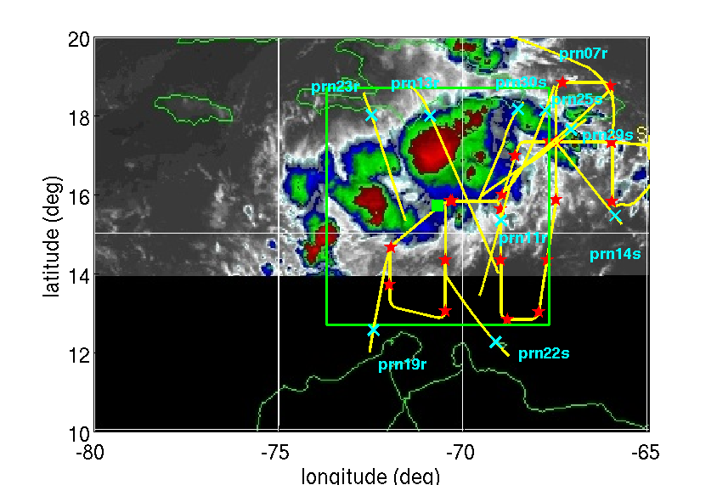

Complementary to dropsondes
The GV dropsondes did not sample northwest of the storm track on 12 September because of flight safety restrictions over deep convection.
Side-looking ARO samples this deep convection, complementary to dropsondes, through clouds and heavy precipitation.

Slide 46
Instantaneous phase
Jensen et al., 2003, FSI
Add a correction to propagate phase to circular orbit where dR/dtheta = 0
Positive elevation angle
Adhikari et al., 2016, airborne FSI
n_{A} refractive index at aircraft height
Wang et al., 2016, airborne Phase Matching

Slide 47
Instantaneous phase
Jensen et al., 2003, FSI
Add a correction to propagate phase to circular orbit where dR/dtheta = 0
Positive elevation angle
Adhikari et al., 2016, airborne FSI
n_{A} refractive index at aircraft height
Wang et al., 2016, airborne Phase Matching

Slide 48



Refractivity Variability from Dropsondes
Tropical Storm Karl
Refractivity
Wet term variation from mean
Dry term variation from mean
mid-latitude atmospheric river

